Slide 1
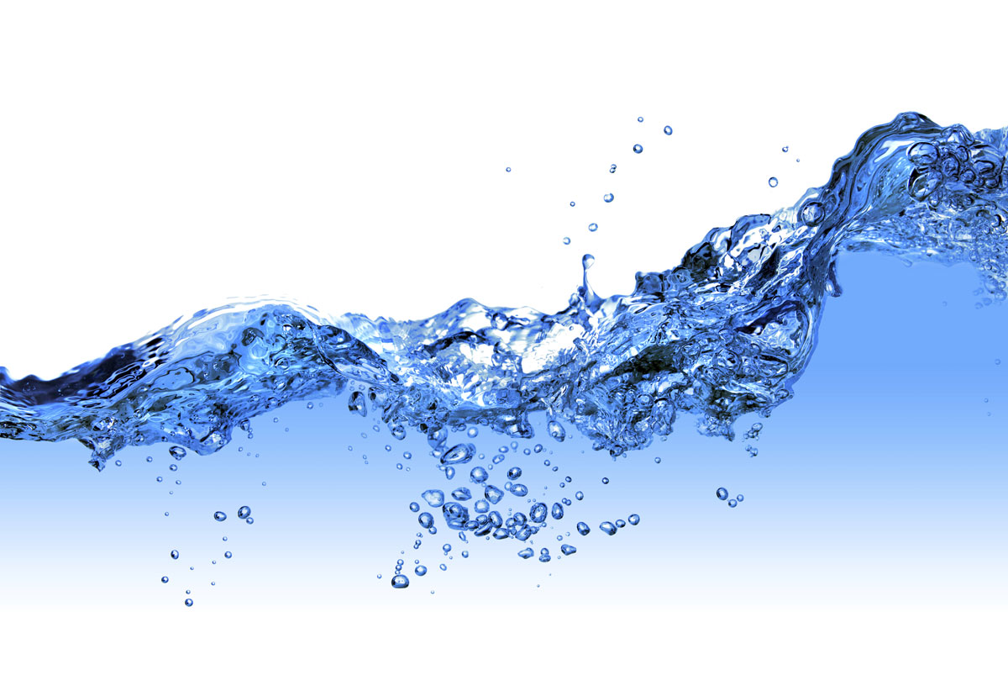
Safe and Productive Use of Wastewater
Manzoor Qadir and Richard Thomas
FAO/UNEP/UNU-INWEH/UNW-DPC Capacity Development Project Inception Workshop, 14-15 November 2011

Slide 2
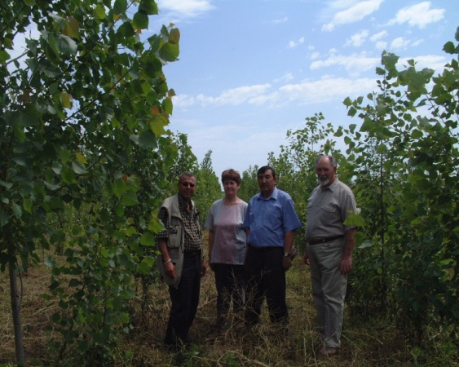
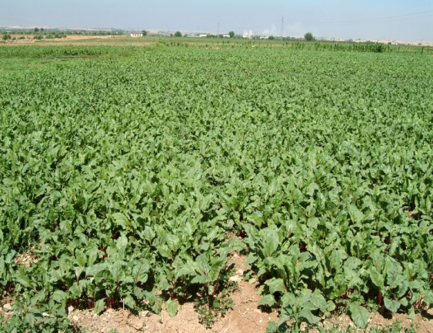
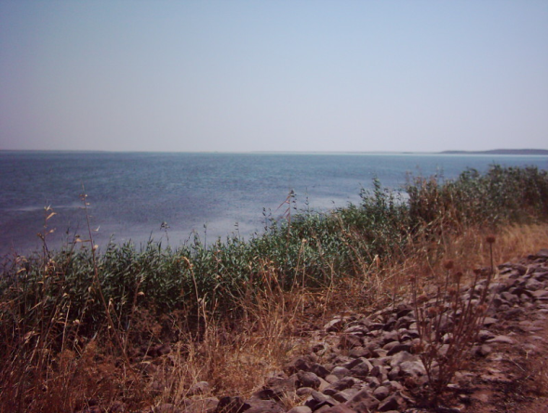
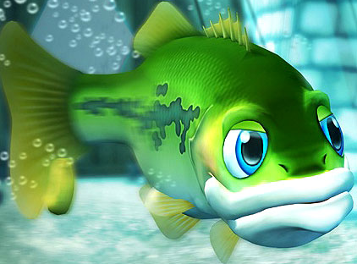
Wastewater Use in AAAA
Agriculture
Agroforestry
Aquaculture
Aquifer recharge

Slide 3
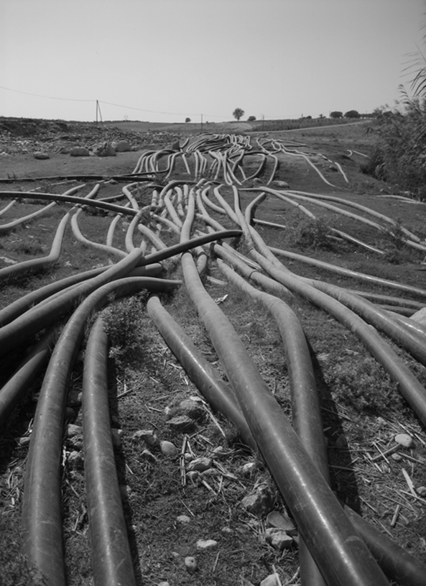
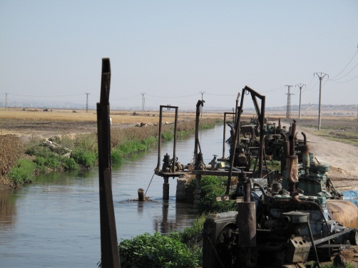
Key Issues and Challenges
  Most developing countries and countries in transition have yet to reach full-capacity wastewater treatment
  Policies and regulatory measures that encourage wastewater treatment and reuse of treated wastewater are lacking
  Wastewater is available to the farmers in untreated, inadequately treated, or diluted forms

Slide 4
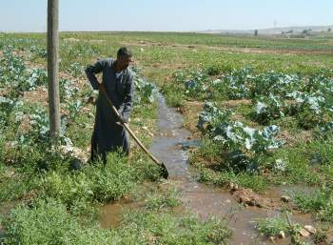
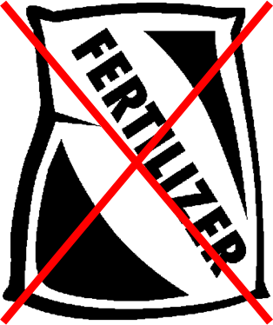
Incentives for the Farmers
  Reliable availability of a water resource amid water scarcity
  Savings on fertilizer use (wastewater contains nutrients)
  Less pumping cost if alternate water source is groundwater
  Additional benefits: high-value crops; increased cropping intensities

Slide 5
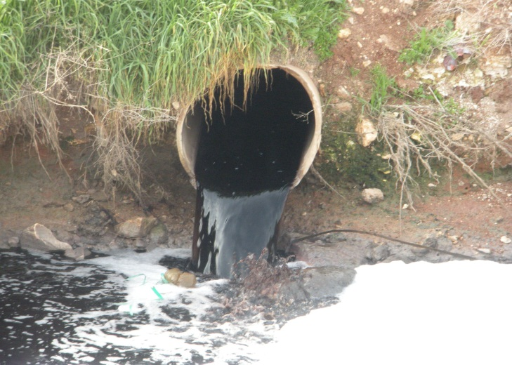
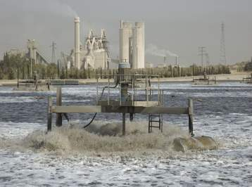
Categories of Wastewater Use
  Direct use of untreated wastewater occurs from a sewage outlet when it is directly disposed of on a land for irrigation
  Direct use of treated wastewater occurs when wastewater has undergone treatment before it is used for irrigation or recycling purposes

Slide 6
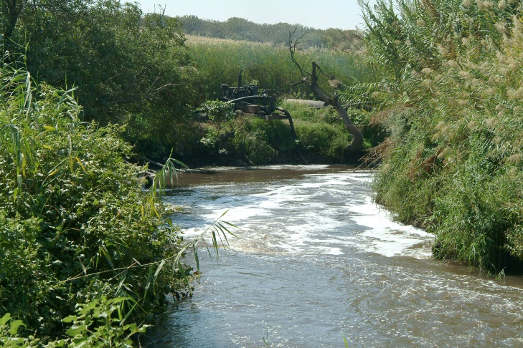
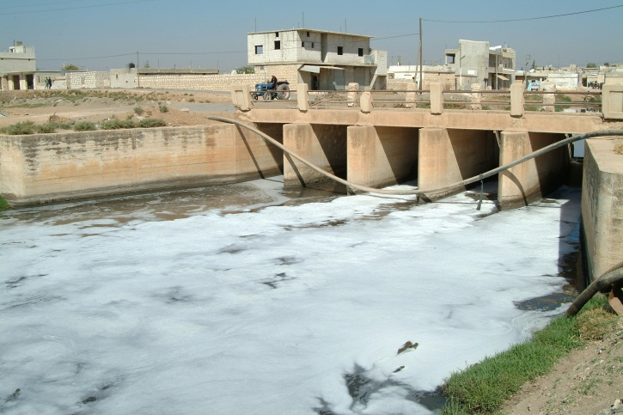
Categories of Wastewater Use
  Indirect use of untreated wastewater occurs when water from a river receiving untreated wastewater is abstracted by farmers downstream for agriculture.
    This happens when cities do not have comprehensive sewage collection network and wastewater is discharged into rivers.

Slide 7
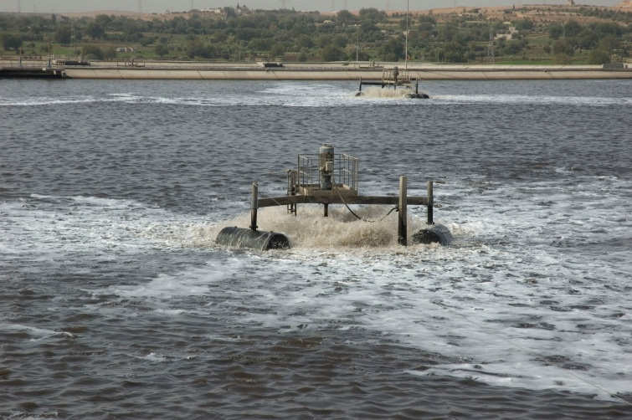
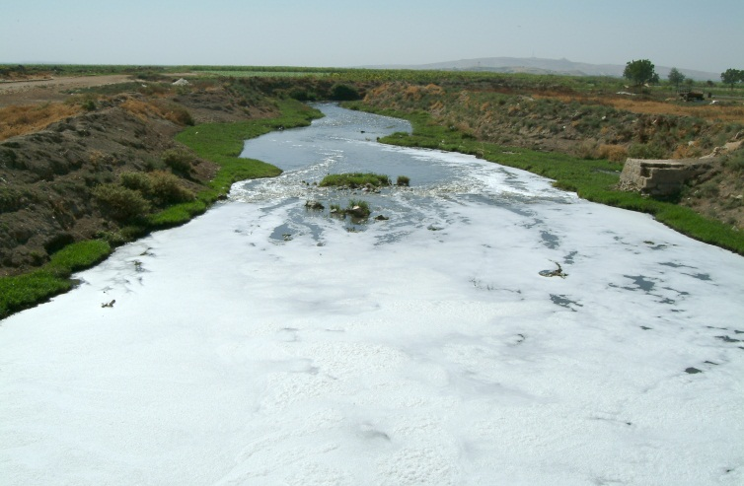
Categories of Wastewater Use
  Indirect use of inadequately treated wastewater occurs when water from a river receiving such wastewater is abstracted by farmers downstream for agriculture.
    This happens when cities have sewage collection network, but wastewater treatment is inadequate.

Slide 8

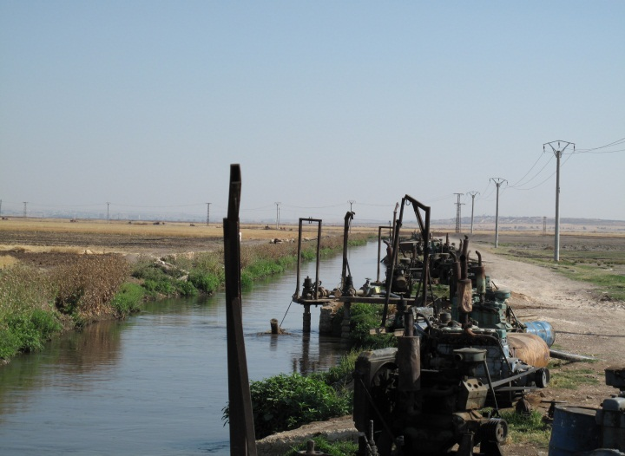
Categories of Wastewater Use
  Planned use of wastewater refers to the conscious and controlled use of wastewater either in raw (direct) or diluted (indirect) forms.
  Unplanned use of wastewater refers to unregulated use of wastewater either in raw (direct) or diluted (indirect) forms; common in developing countries

Slide 9
Wastewater Program at UNU-INWEH
  Recent initiative
    Partnership with ICARDA – Wastewater and greywater reuse in dry areas, environmental impact assessment of wastewater reuse
    Partnership with ACWUA – Wastewater and greywater reuse in the Arab region
    Partnership with FAO/UNEP/UNW-DPC – Capacity Development Project on safe use of wastewater in agriculture
    Potential partnership with IWMI – Regional wastewater assessment; wastewater and greywater reuse in Africa and Asia

Slide 10
Some Examples . . . . . . .

Slide 11
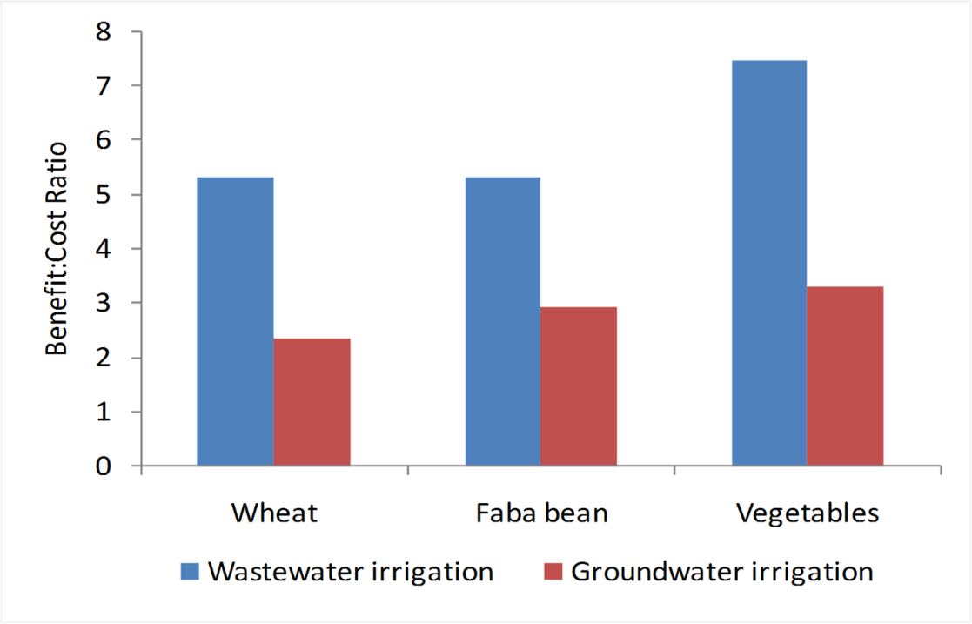
Economics of Wastewater Use
  Based on crop cultivation, fertilizer use, farm labor, and irrigation costs
  Some costs such as environmental and health costs were not included
  Benefit:cost ratio was almost double from wastewater-irrigated area

Slide 12
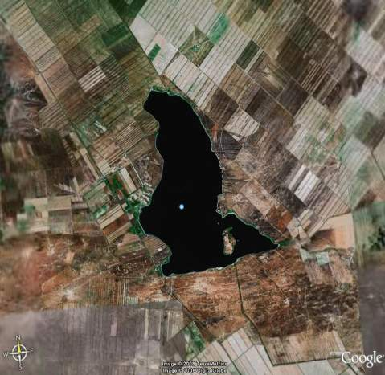
Use of Wastewater for Agroforestry
  Almaty, Kazakhstan
    Treated wastewater stored in Sorbulak lake
    Four agroforestry species
      Silver-leaf poplar (Populus alba L.)
      Ash (Fraxinus excelsior L.)
      White mulberry (Morus alba L.)
      Dog rose (Rosa canina L.)

Slide 13
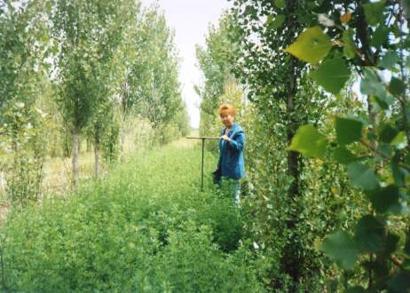
Use of Wastewater for Agroforestry
  5-year irrigation with wastewater didn’t increase metal ion concentration in soil above the respective permissible levels
  Increase in nutrient availability status of the soil because of nutrients added with wastewater irrigation

Slide 14
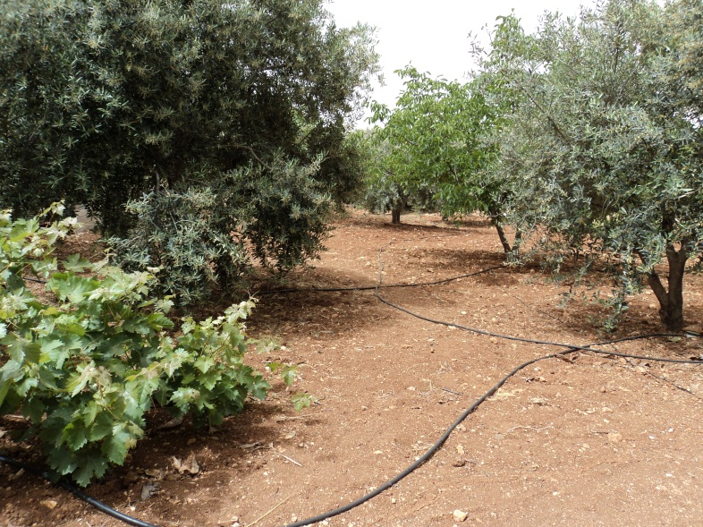
Use of Greywater for Olive Irrigation
  Amman, Jordan
    Part of domestic effluent consisting of kitchen and bathroom wastewater (50-80% of residential wastewater)
    Separated from domestic wastewater, treated, and reused
    Greywater use for home farming to irrigate high-value olives contribute to income generation at household level in dry areas

Slide 15


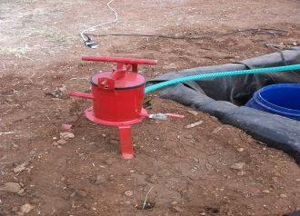
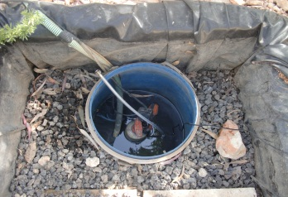
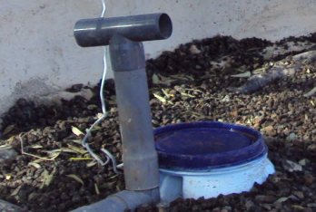

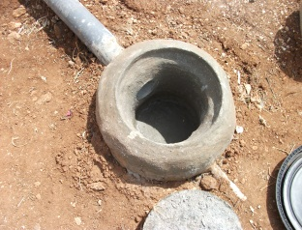
Greywater Treatment System
Green removal panel
Manhole- steel cover
Screen Filter
To the irrigation system
Stone
Vales

Slide 16
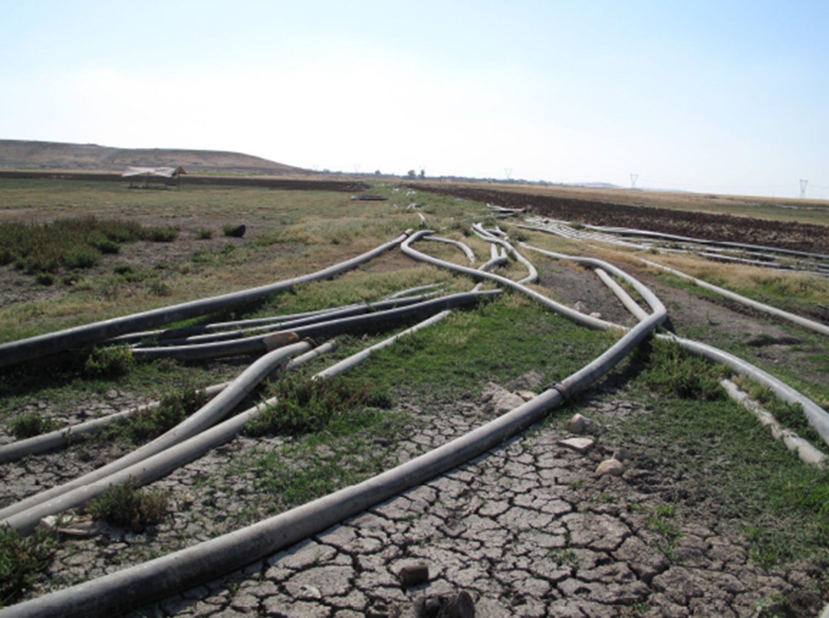
Environmental Impact Assessment of Irrigation with Untreated or Inadequately Treated Wastewater

Slide 17
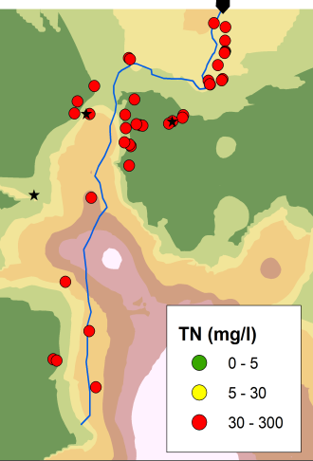
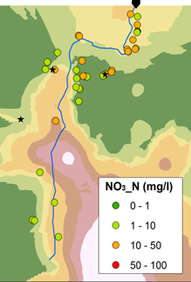
Nitrogen in Groundwater

Slide 18
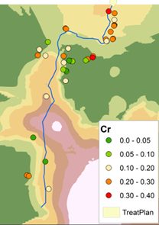
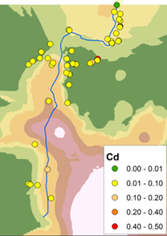
Heavy Metals in Groundwater

Slide 19
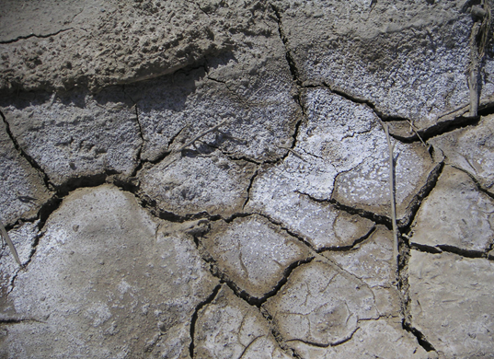
Climate Change – Wastewater Irrigation Nexus
High-intensity rainfall events leading to surface runoff and transport of salts and contaminants from soils irrigated with untreated or inadequately treated wastewater to nearby good soils irrigated with freshwater or rain-fed

Slide 20
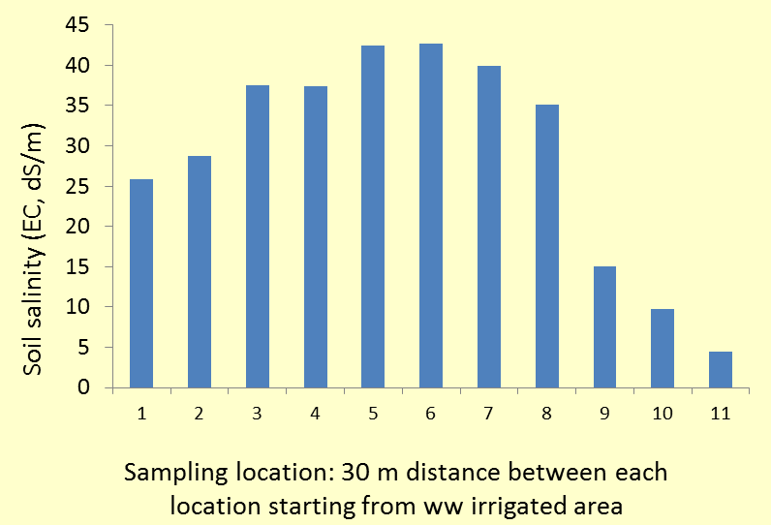
Salinity Build-up in Adjacent Areas

Slide 21
Conclusions
  Urban wastewater and greywater in water scarce countries is a valuable resource that needs:
    Implementation of treatment and regulated reuse of wastewater
    Monitoring systems and implementation of WHO guidelines
    Skilled human resources and institutional capacity
    Pertinent and flexible policy frameworks
  Regulated reuse of treated wastewater offers great promise for environment and health protection as well as livelihoods resilience

