Slide 1
The WHO-FAO-UNEP Guidelines: Risk Assessment and Mitigation Where Wastewater Treatment Fails
Pay Drechsel and Manzoor Qadir
International Water Management Institute (IWMI)

Slide 2
IWMI is one of 15 international research centers supported by the network of 60 governments, banks, private foundations etc. collectively known as the Consultative Group on International Agricultural Research (CGIAR).
IWMI is a non-profit organization with a staff of over 300 and offices in more than 10 countries across Asia and Africa.
IWMI's Mission is to improve the management of land and water resources for food, livelihoods and the environment.

Slide 3
Wastewater research within IWMI
One IWMI research division is on Water Quality, Health & Environment, where we work closely with WHO and FAO on the safe use of wastewater and excreta in agriculture.
IWMI is specialized on low-income regions where conventional treatment has low coverage and impact.
Areas of research:
Assessing health risks (Quantitative microbial risk assessment, QMRA)
Exploring risk mitigation options (participatory research)
Assessing costs and cost effectiveness of interventions
Assessing options to increase the adoption of interventions
Mapping global wastewater use

Slide 4
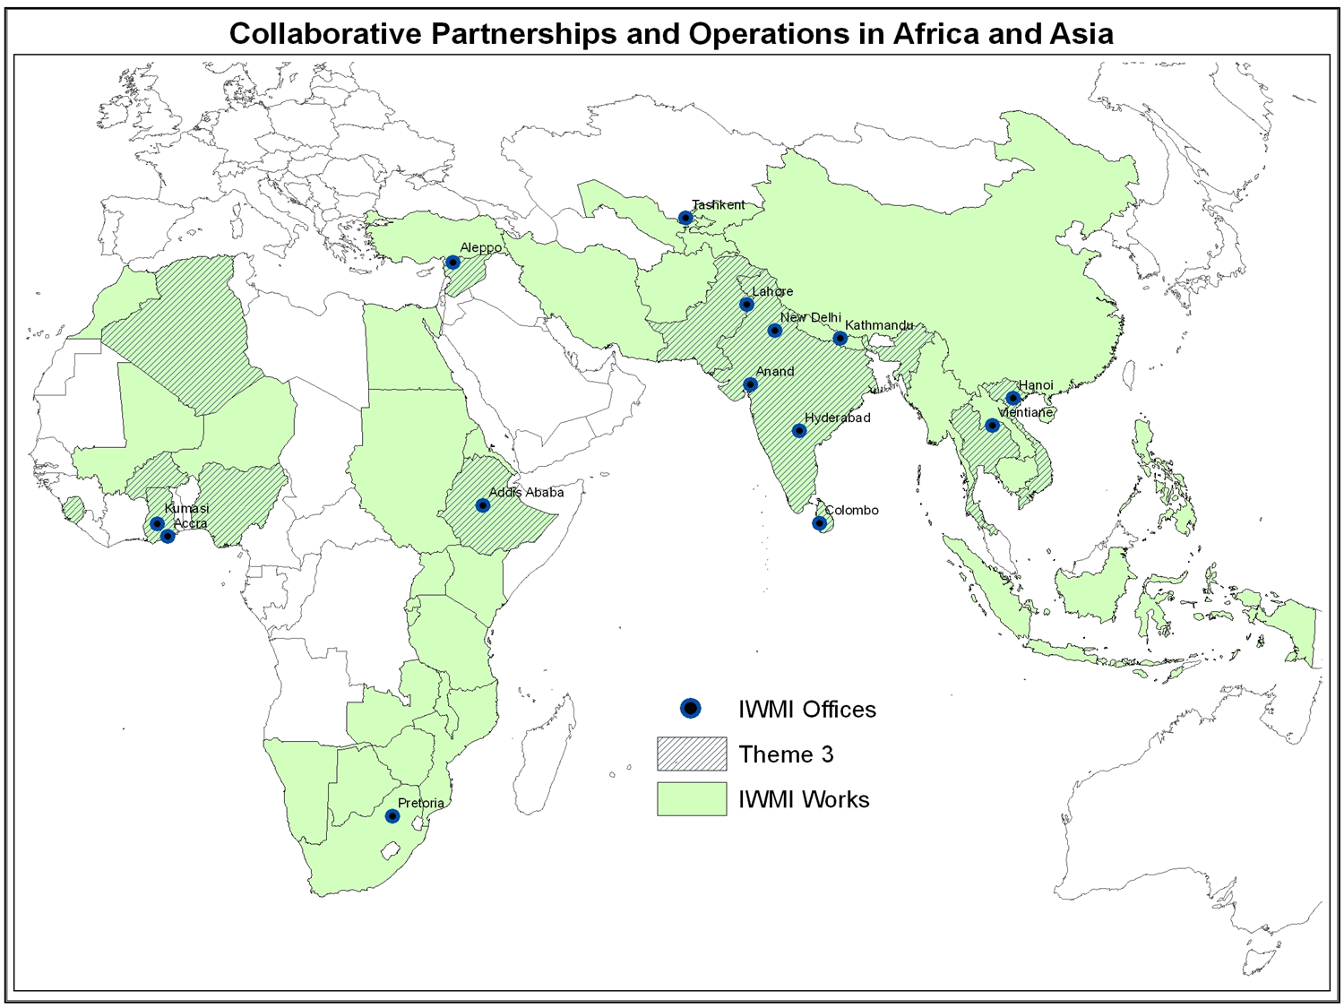
Ouagadougou
IWMI Offices 2010
Water Quality, Heath & Environment
Other IWMI projects

Slide 5
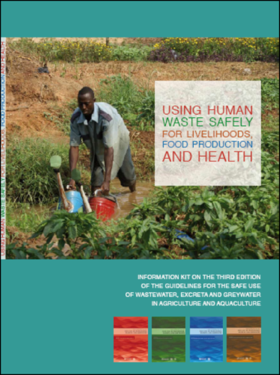
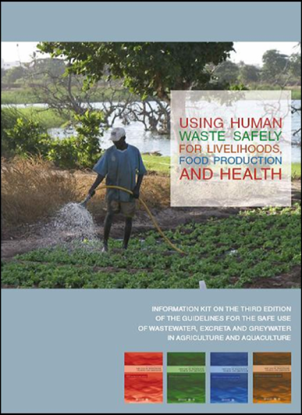
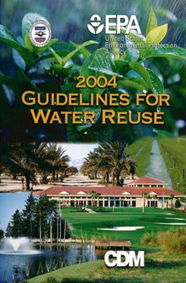
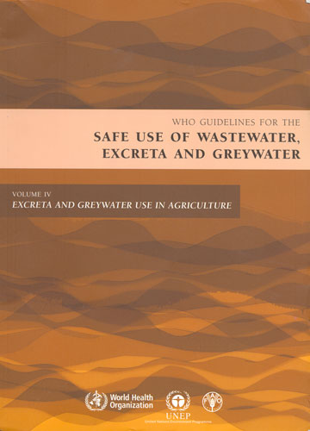
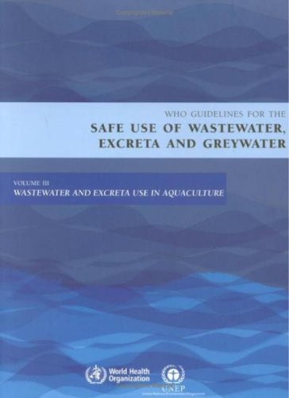
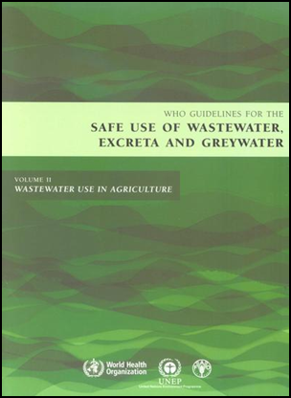
Advising WHO, USAID, World Bank
2012 edition in work

Slide 6
Safety concept
Wastewater treatment is the key barrier for risk reduction (WHO 1989) …
Wastewater generation
Consumer
Wastewater treatment
Safe produce
…
… but is not available or has little coverage in many regions

Slide 7
1989 WHO Guidelines
WHO-FAO-UNEP (2006)
Irrigation water quality thresholds
Health-based targets
Wastewater generation
Farm worker
Traders
Kitchen staff
Consumer
Wastewater generation
Farm worker
Traders
Kitchen staff
Consumer
Wastewater treatment
Safe Irrigation Practices
Hygienic Handling Practices
Safe food washing and preparation
Wastewater treatment
Awareness creation to create demand for safe produce
Multi-barrier approach for health risk reduction
Notes:
Hazard analysis and critical control points Single barrier as risk management tool → multi barriers

Slide 8
Risk mitigation measures IWMI works on:
Farm based
Market based
Kitchen based
Policy based (WHO and USAID Guidelines, National policy work)

Slide 9
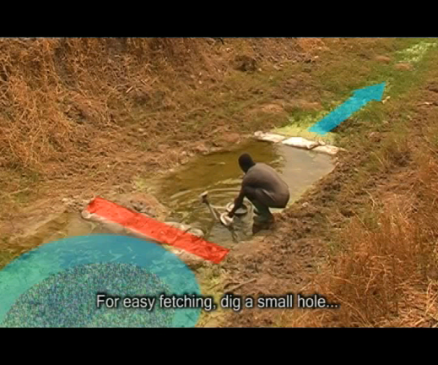
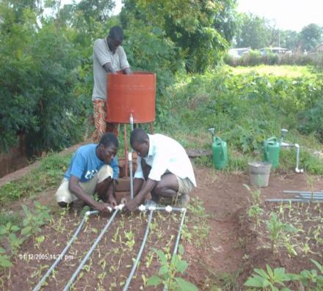
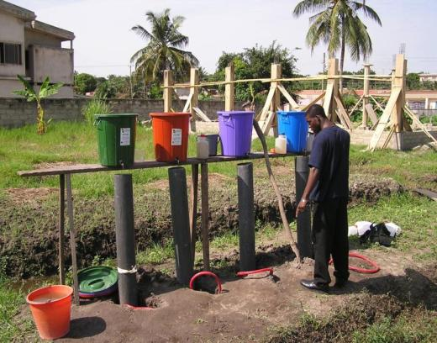
Drip and furrow irrigation
Sedimentation ponds
Cessation of irrigation
Filter
Limited soil splash
Improved water fetching
Increased retention time
On-farm treatment ponds
FARM

Slide 10
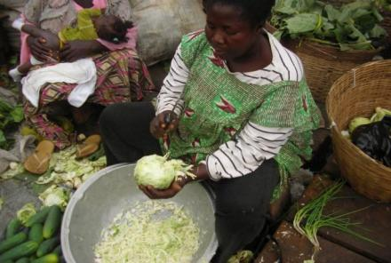
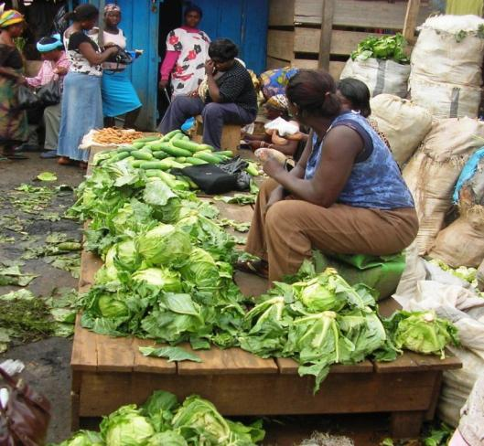
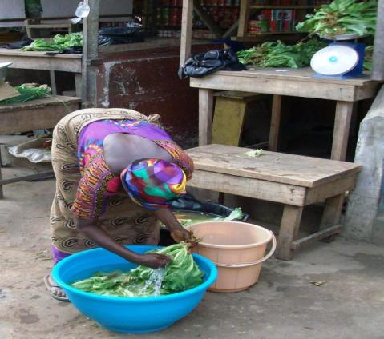
Supporting die-off
Display w/o recontamination
Safe washing & refreshing
Safe cutting practices, etc.
MARKET

Slide 11
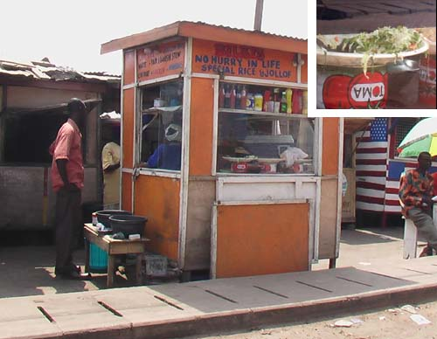
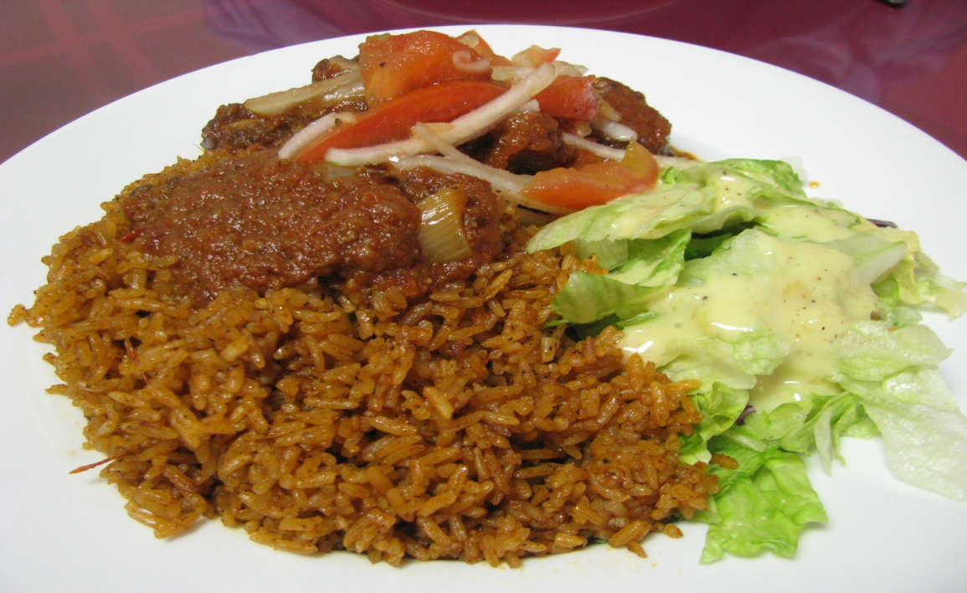
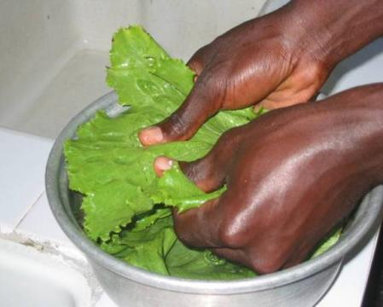
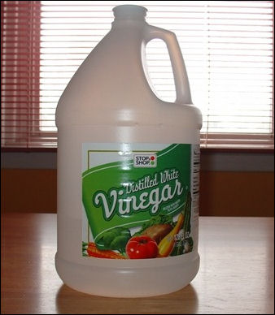
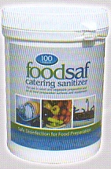
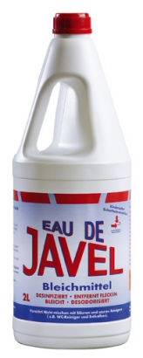
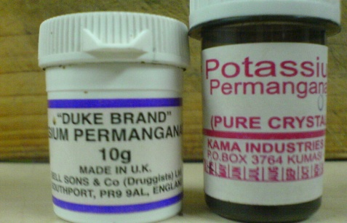
Kitchen
Effective & safe vegetable washing

Slide 12
All results ARE translated into various extension and training materials

Slide 13
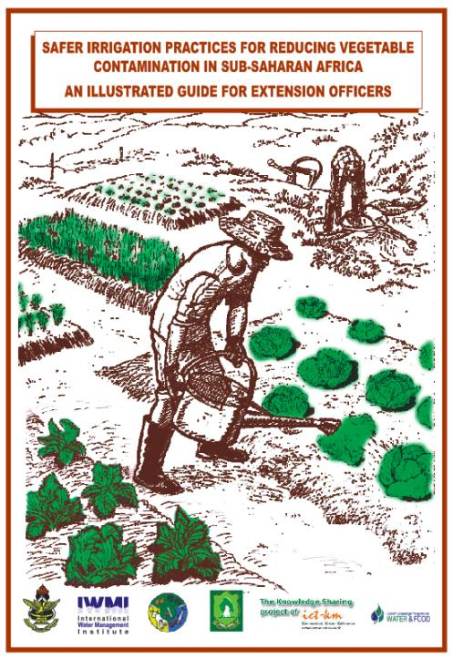
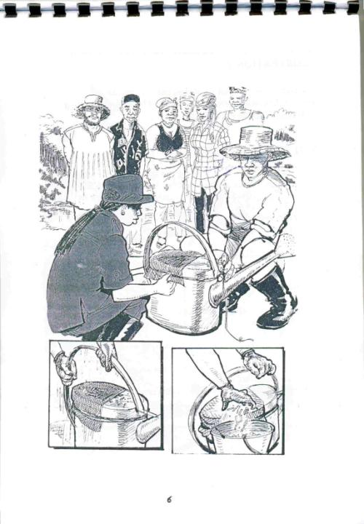
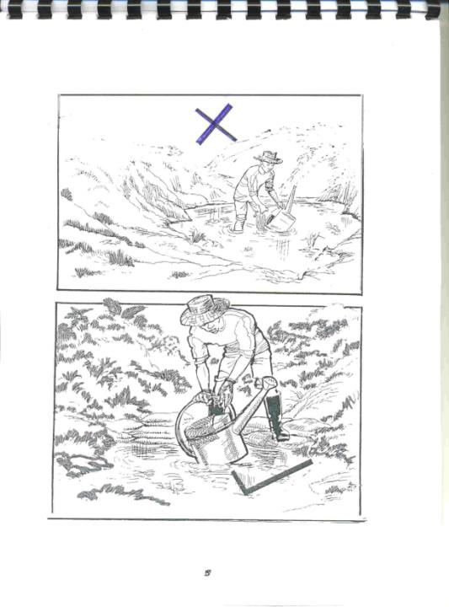
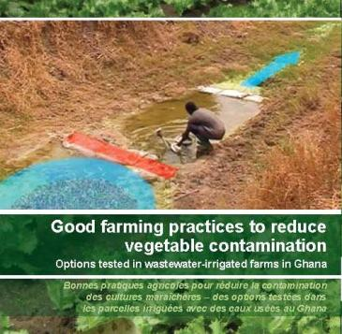
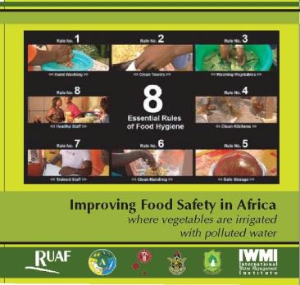
Multi-media Extension Material
Free online at video.google.com
Supporting FAO Farmer Field School modules

Slide 14
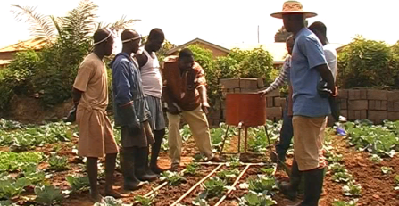
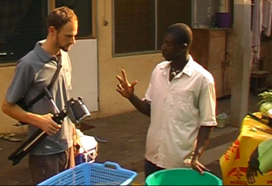
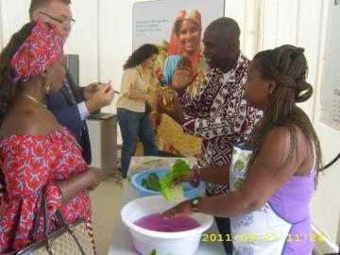
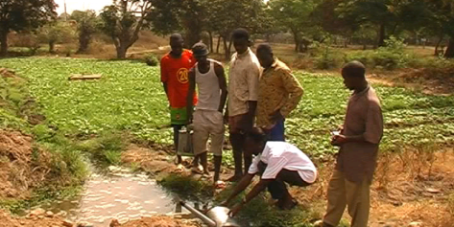
Training of trainers, farmers, fast food sellers

Slide 15
Conclusions: Health risks can be managed
Risk management is possible at low cost also where wastewater treatment is only emerging (>90% of disease burden down).
Combination of treatment & non-treatment options would be ideal, but also on-farm and/or off-farm interventions alone can be very effective.
Impact & cost-effectiveness of these interventions depend on their adoption rate: this requires education, incentives & social marketing (similar to hand wash campaigns).

Slide 16
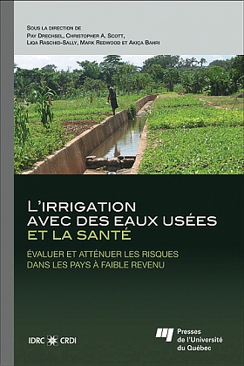
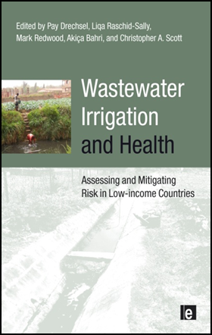
Free online references for further reading
www.iwmi.org www.idrc.ca

Slide 17
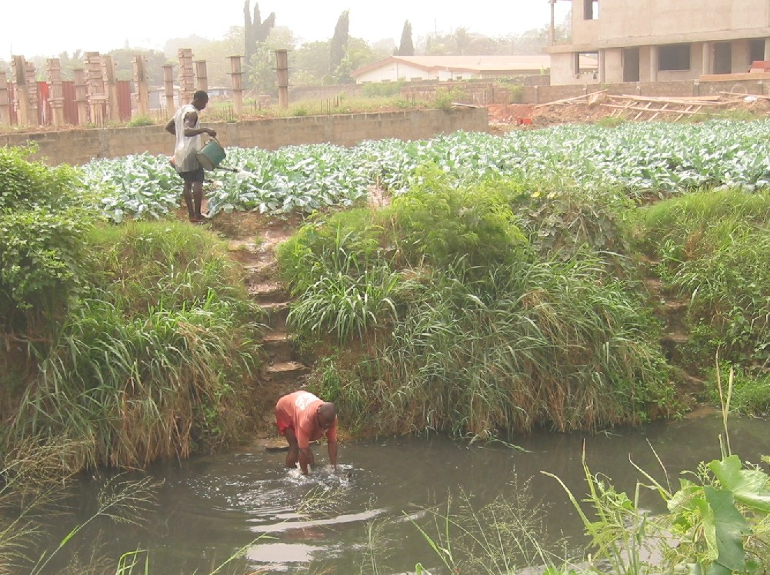
Thank you

