Slide 1
DWA Working Group
BIZ 11.4 „Water Reuse“
Objectives and activities
Bonn, 15.11.2011

Slide 3
DWA working group “Water Reuse”
The German Association for Wastewater, Water and Waste (DWA) constituted the working group AG BIZ 11.4 “Water Reuse” on
May 19th 2005
Focus on water reclamation
→ treatment of wastewater to make it reusable
→ Safe reuse of reclaimed water
Considered reuse applications:
Agricultural irrigation
Use as service water in urban areas
  Not considered:
  Industrial water recycling, groundwater reclamation and “alternative sanitation concepts”
Notes:
There is an obvious lack of knowledge and competence about the topic of water reuse in Germany. Against this background, the working group “Water Reuse” was constituted within the German Association for Wastewater, Water and Waste (DWA) on the 19th of may 2005.
The focus of this working group is the (safe) reuse of “properly treated” municipal wastewater.
The main reuse application to be considered is use in agriculture for irrigation.
Other applications to be considered are use as service water in buildings (for example for toilet flushing)
or in urban areas (for example for road cleaning and grass strip irrigation).
The working group decided not to examine:
Water recycling and reuse in industry as it is already an established and well-developed practice. Recycled water in the manufacturing industry amounts to roughly 24,000 Mm³/yr, a number which exceeds the total amount of municipal wastewater by a factor of 2.4 (quantities for the year 1998). Lastly, there is another working group within the DWA which concentrates on industrial waste water treatment.
Water reclamation for groundwater enrichment and drinking water production as well as water reuse which occurs by catching surface water (mostly river water) for drinking water production are also not an objective of the working group.
The working group also decided not to examine alternative sanitation concepts based on the separation of different water streams (black-, yellow-, brown-, and grey water).
Given these limitations, the main area of interest for the working group is the reuse of the effluent of municipal wastewater treatment plants. The most important water reuse application is agricultural irrigation, due to the high water demand of this sector, especially in other countries, and also due to the partially lower treatment requirements (nutrient removal may not be necessary as the nutrients can be left in the effluent and used as fertilizer).

Slide 4
DWA working group “Water Reuse”
Objectives of the working group “Water Reuse”:
Increase acceptance and make the topic “water reuse” well-known among the public
Enhance experiences of water engineers with the topic “water reuse”
Collect and elaborate experiences and make it usable (even for non-specialists)

Slide 5
Publication “DWA-Topics”
Title: “Treatment Steps For Water Reuse”
Assessment of process steps for the treatment of wastewater for reuse
Subsumption of water reuse in international context
Assessment matrix of the process steps for the treatment of wastewater for reuse
Original version in German
Translations in English, French,
Spanish, Arabic, Chinese and
Persian

Slide 6
DWA seminar „Practical aspects of water reuse“
One-day training for graduates:
- “introduction to water reuse“
- optionally with recognition of achievements at the university
Two-day DWA seminar:
- “Practical aspects of water reuse“
- for engineers, decision-makers and German alumni
5-day DWA event for international water experts
- “Practical aspects of Water reuse“
- for international water experts from industry, administration and consulting, decision-makers and alumni
- with excursions and certification

Slide 7
Topics of the DWA seminar
Rules and regulations
Introduction
Energy and climate
Ecology and agriculture
Hygiene
Treatment steps for water reuse
Planning and implemen-tation
Economic aspects
Operation
Acceptance

Slide 8
Members of the DWA Working Group
Prof. Dr.-Ing. Peter Cornel (chairperson)
Technische Universität Darmstadt, p.cornel@iwar.tu-darmstadt.de
Edgar Firmenich
Berlinwasser Management Consult, Edgar.Firmenich@berlinwasser.net
Tim Fuhrmann
Emscher Gesellschaft für Wassertechnik mbH, fuhrmann@ewlw.de
Dr.-Ing. Stefan Gramel
KfW Entwicklungsbank, stefan.gramel@kfw.de
Prof. Dr.-Ing. Wolfgang Günthert
Universität der Bundeswehr München, wolfgang.guenthert@unibw.de
Peter Kampe
peter.kampe@gmx.de
Volker Karl
KfW Entwicklungsbank, volker.karl@kfw.de

Slide 9
Members of the DWA Working Group
Roland Knitschky
DWA, knitschky@dwa.de
Katharina Müller
Technische Universität Darmstadt, k.mueller@iwar.tu-darmstadt.de
Prof. Dr.-Ing. Hermann Orth
Ruhr-Universität Bochum, hermann.orth@rub.de
PD Dr. agr. Frank Riesbeck
Humboldt-Universität zu Berlin, Frank.Riesbeck.1@agrar.hu-berlin.de
Dr.-Ing. habil. Holger Scheer
Emscher Gesellschaft für Wassertechnik mbH, Essen, scheer@ewlw.de
Florian Schmidtlein
Aqua consult Ingenieur GmbH, Hannover, schmidtlein@aqua-consult.de
Klaus Weistroffer
Klaus.Weistroffer@t-online.de

Slide 10
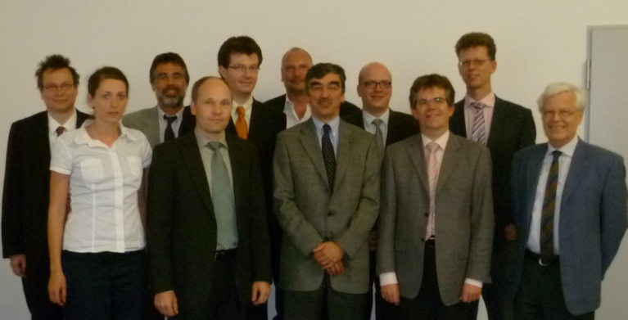
Members of the DWA Working Group
Thank you!

