Slide 1
Capacity Development in the Water Sector in Africa A Region for Priority Action for the UN Water Decade Programme on Capacity Development (UNW-DPC)
Dr. Jens Liebe
12th WaterNet Symposium
26 October 2011
Maputo, Mozambique
1

Slide 2
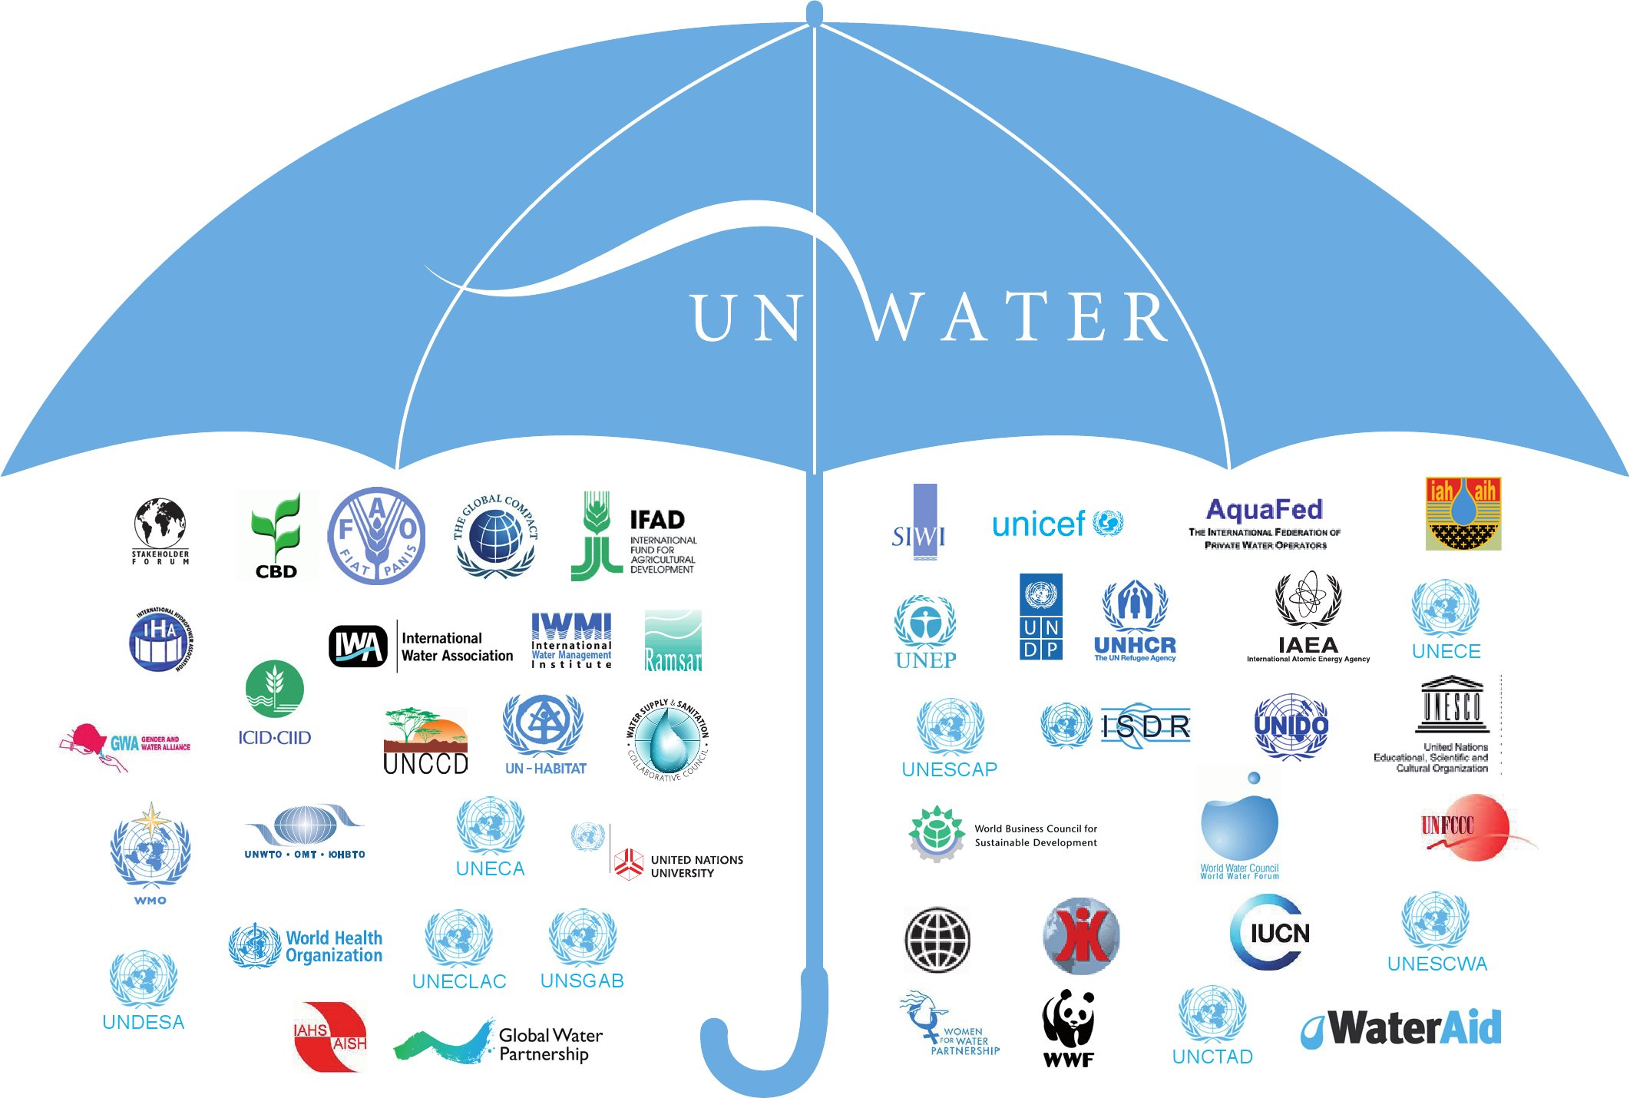
WWAP
UNW-DPC
UNW-DPAC
UN-Water Members
UN-Water Partners

Slide 3

UNW-DPC’s Mission
“to enhance the coherence, credibility and integrated effectiveness
of UN-Water
by strengthening its capacity development programmes, particularly in developing countries and economies in transition.”

Slide 4
UNW-DPC: integral part of the UNU system
UNW-DPC supports the UNU in contributing to resolve the pressing global problems of human survival, development and welfare.
Through
collaborative research,
capacity development, and
advisory services

Slide 5
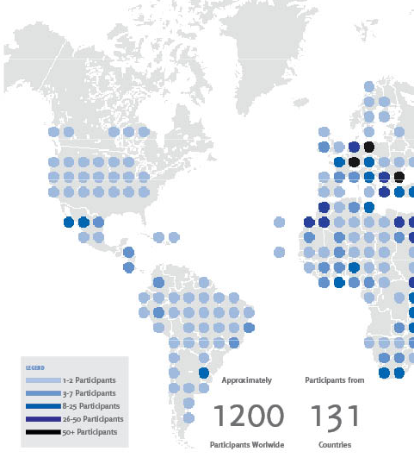
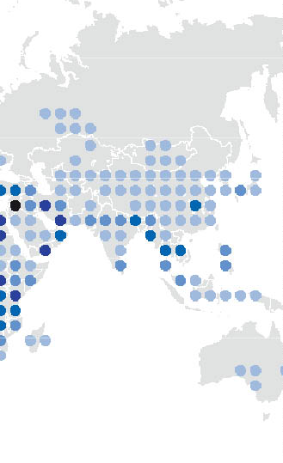
UNW-DPC Capacity Development Effort

Slide 6
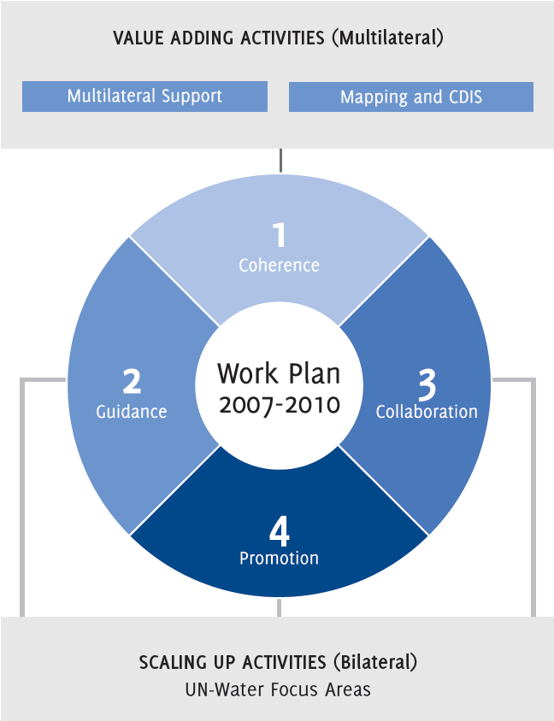
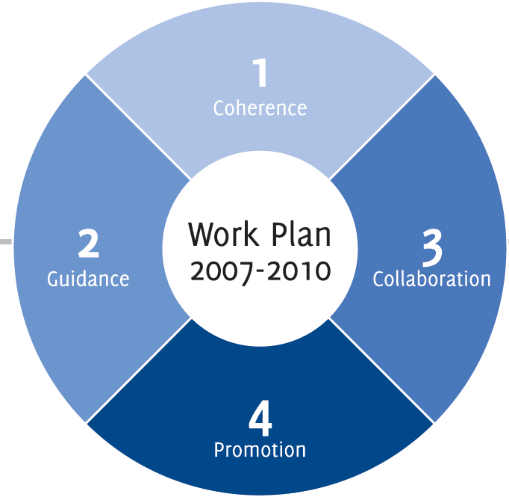
UNW-DPC work plan structure

Slide 7
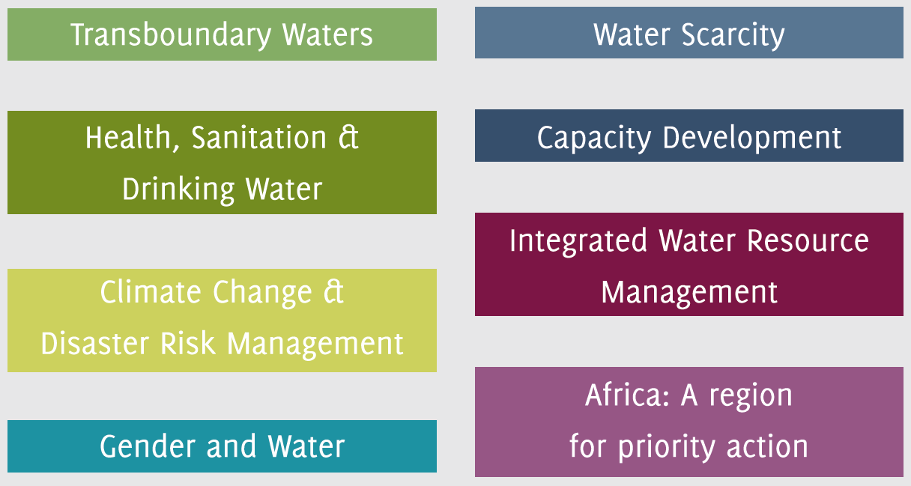
UNW-DPC Areas of Activity
all areas of priority to UN-Water:

Slide 8
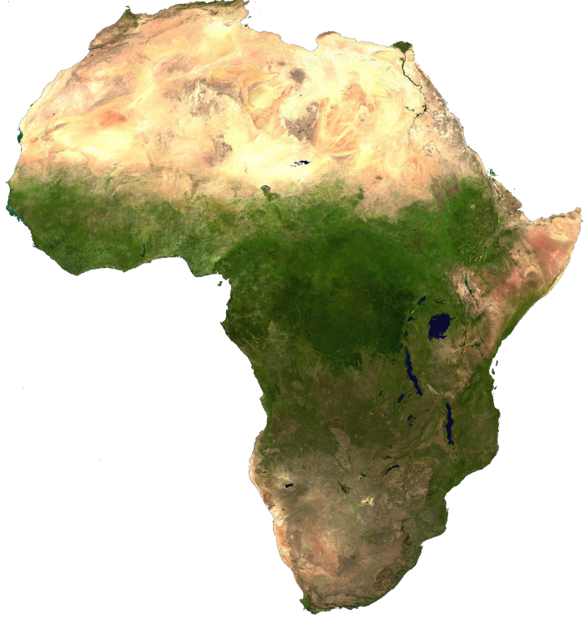
Africa: a region for priority action
Acknowledgment of great challenges for Africa, e.g., in the sectors of
Health
Sanitation
Freshwater sustainability
Drinking water quality, and
Water efficiency in agriculture.

Slide 9
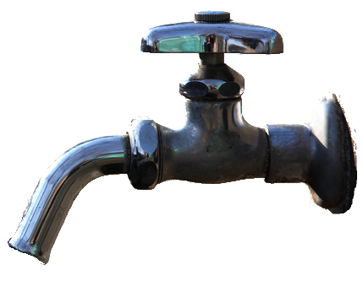
Africa: a region for priority action
MILLENNIUM DEVELOPMENT GOALS
Goal 7: Ensure environmental sustainability
Target 10: Halve, by 2015, the population without sustainable access to safe drinking water and basic sanitation
Photo: © mrhayata

Slide 10
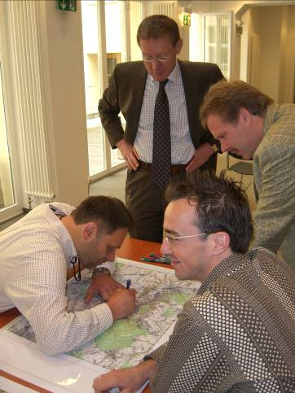
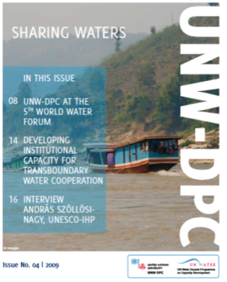
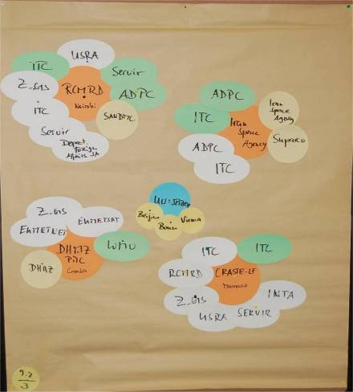
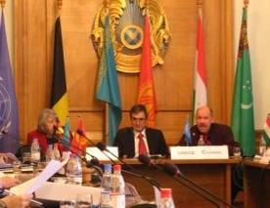
UNW-DPC Strategy: long-term Capacity Development Concept
Workshops,
Meetings,
Publications
Needs Assessment, White
papers
Stakeholder Analysis, Activity Mapping
Data- AIS
Services
Strategic support, Policy advice
UNW-DPC follows a long term capacity development concept to support UN-Water
From single to ‘embedded’ activities using multilateral thematic, conceptual and collaborative workshops

Slide 11
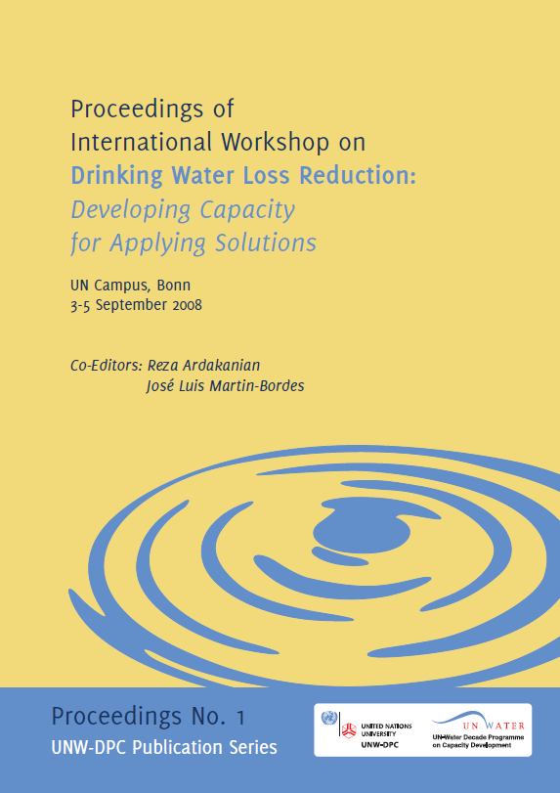
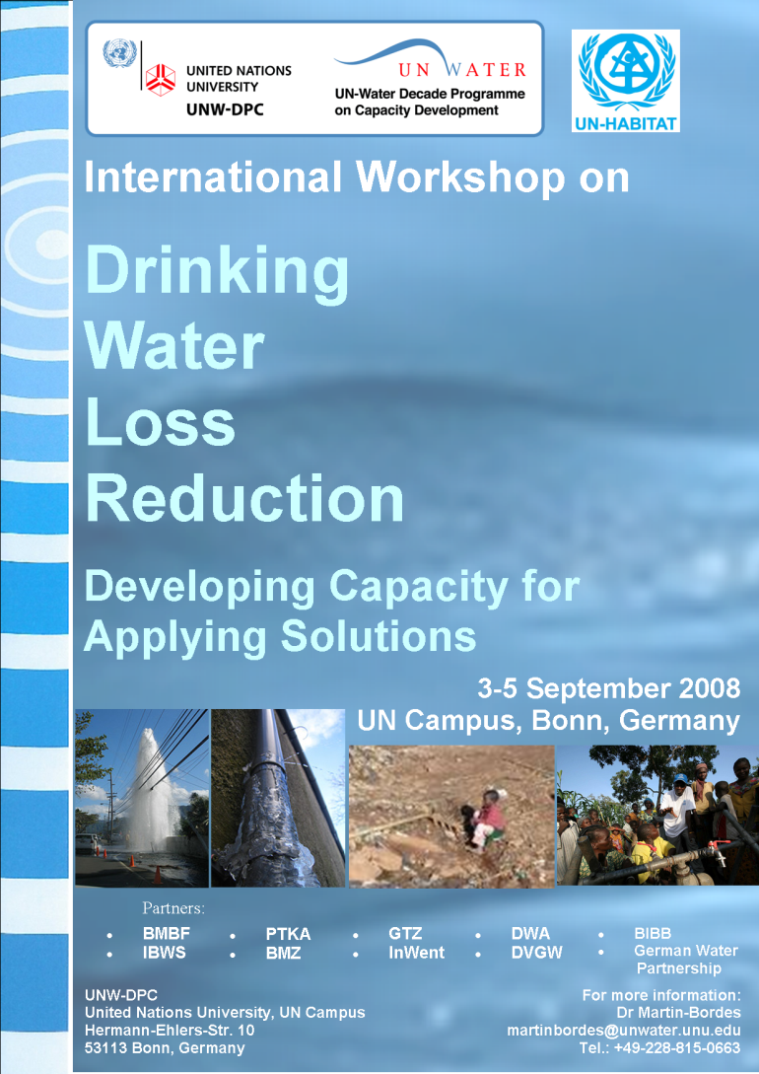
Example: UNW-DPC support sequence on Drinking Water Loss Reduction
1. International workshop
Raise awareness
Determine level of stakeholder interest
Identify stakeholders’ experience, assess key issues and action-oriented tasks
Publish report as baseline for regional meetings

Slide 12
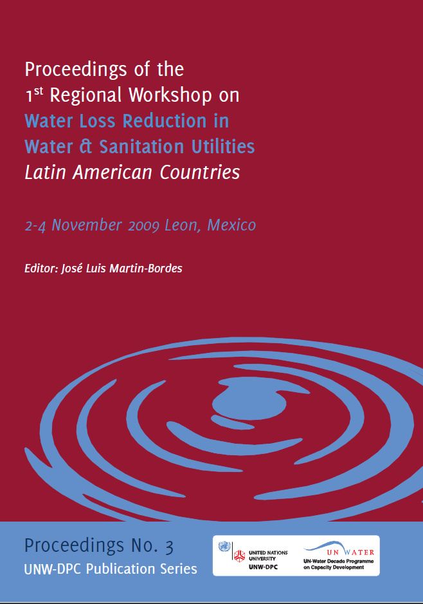
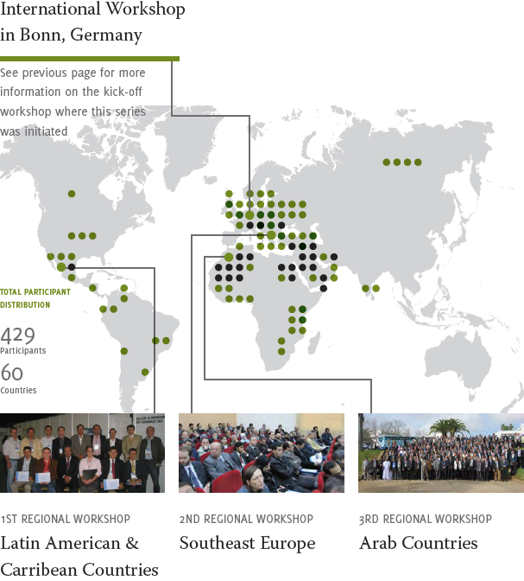
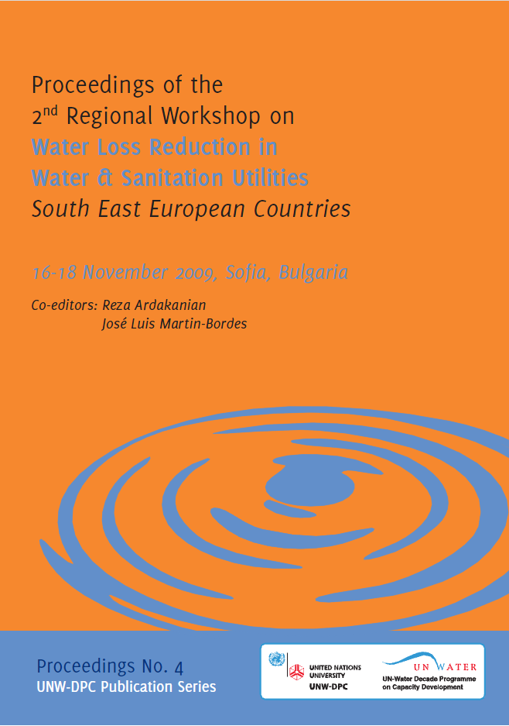
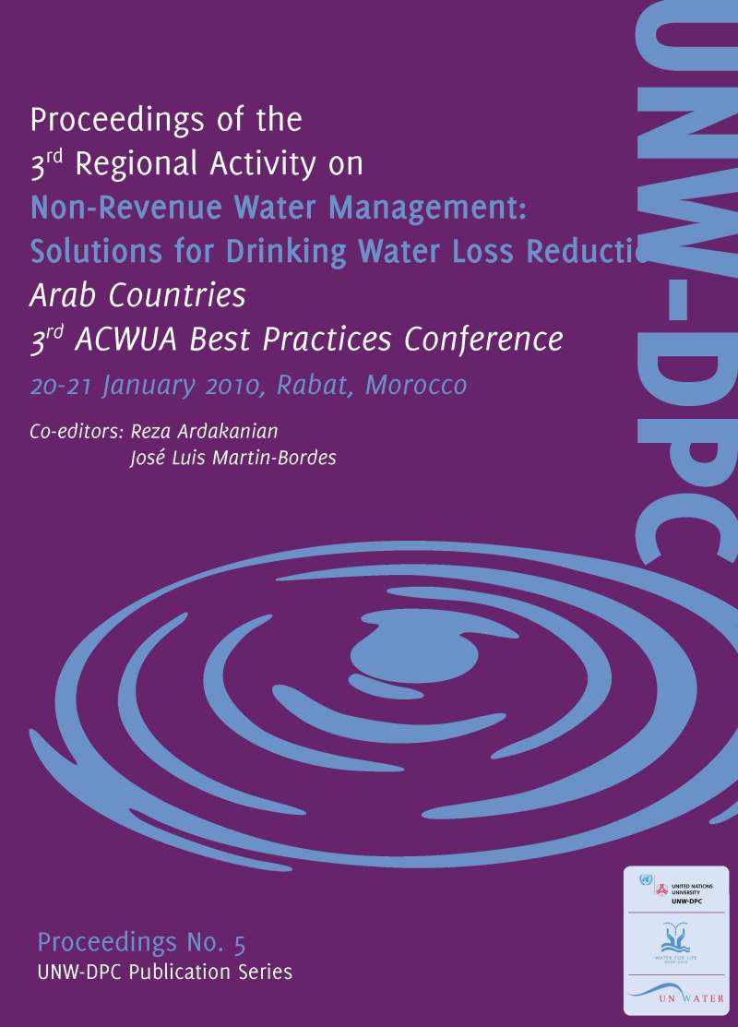
2. Series of Regional Drinking Water Loss Reduction Workshops, together with UN-Habitat and local partners

Slide 13
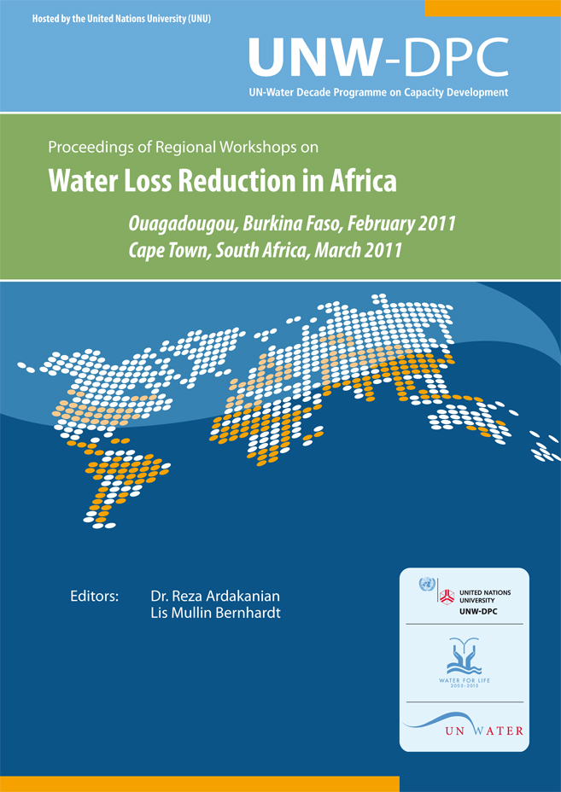
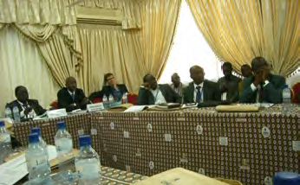
3. Further awareness raising
In cooperation with:
GIZ
VAG
KIT, and
University of Applied Sciences Northwestern Switzerland
Ouagadougou
Burkina Faso
23 Feb 2011

Slide 14

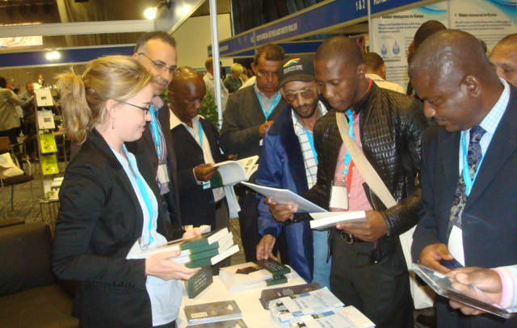
3. Further awareness raising
World Water Day 2011
Seminar on "Capacity Building for Non Revenue Water Loss Reduction: an Africa Perspective"
In cooperation with UN-HABITAT and the African Development Bank.

Slide 15
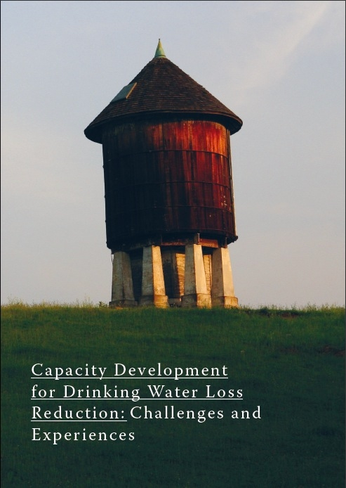
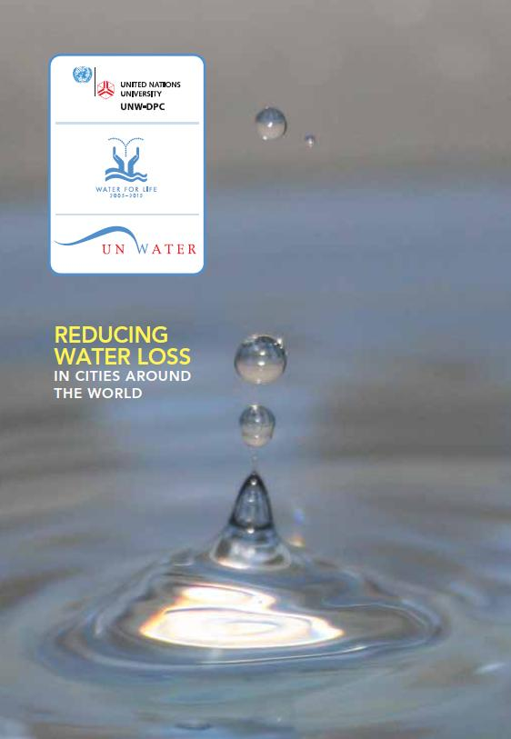
Book and Video launch
Launched at the World Water Day 2011 in Cape Town

Slide 16
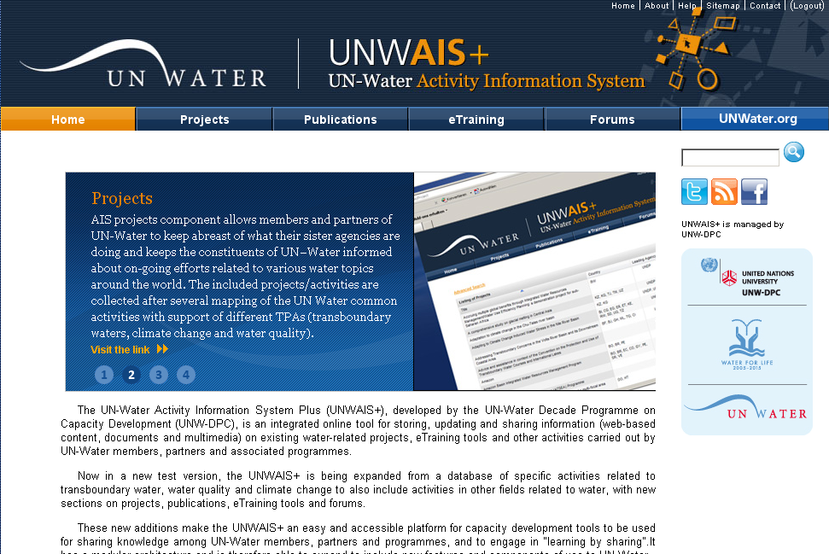
4. Long-term visibility on UNWAIS+

Slide 17
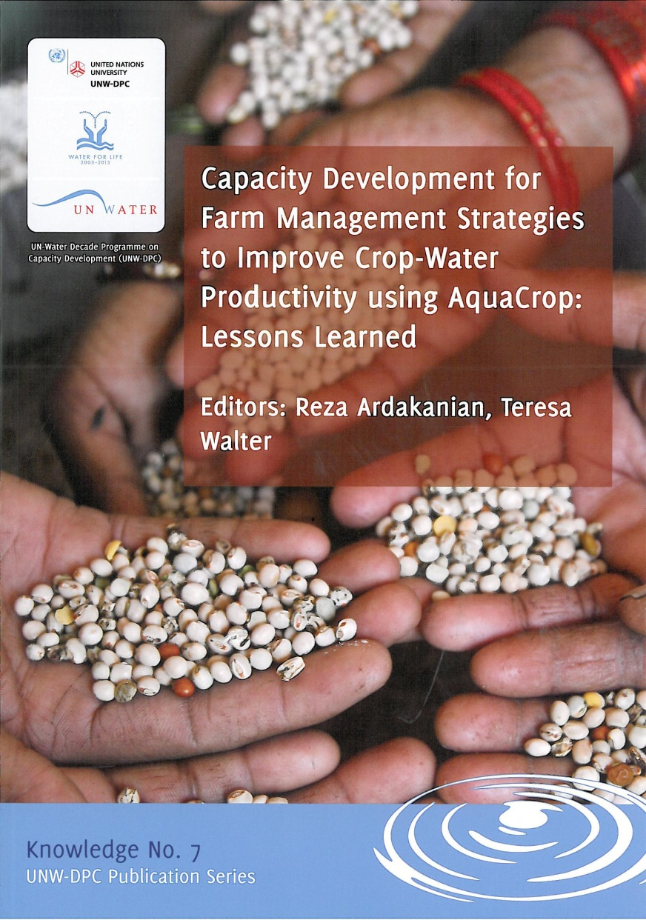
CD for Farm Management Strategies using AquaCrop
Training Workshops, Africa
Burkina Faso
Egypt
South Africa
Training Workshops, Asia
Iran
China
Wrap-up at International workshop in Indonesia, showcasing best case studies of practical applications to policy makers

Slide 18
Africa: a region for priority action
All of its regionally-focused series of workshops have had one foot in Africa, including
training for journalists (in Cairo, Egypt)
training in the use of the AquaCrop software for agricultural efficiency in the use of water (in Ouagadougou, Burkina Faso and Bloemfontein, South Africa),
training for policymakers in the MENA region,
a regional drinking water loss reduction workshop for water managers (in Rabat, Morocco), and collaboration in the first workshop for the scientific G-WADI network in Dakar, Senegal.
In addition, UNW-DPC has carried out UN-Water-wide activities in the form of a capacity development seminar in Kampala, Uganda (March 2010) on the occasion of the 15th African Water Association Congress.

Slide 19

Upcoming events related to Africa
Event calendar
International workshop on Safe Wastewater Use in Agriculture by WHO/FAO/UNEP/UNW-DPC, November 15, 2011 in Bonn, Germany
Organizing Information Systems Session on the November 20, 2011 in Cairo, Egypt (AWF2011)
tbc: International conference, UNU-INRA, December 5-7, 2011 in Accra, Ghana
tbc: Regional Workshop on Safe Wastewater Use in Agriculture, February 2012, in Africa
tbc: AfWA, February 20-23, 2012, in Marrakech, Morocco

Slide 20
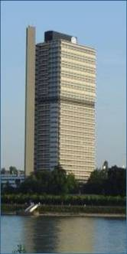

Thank you!
UN-Water Decade Programme on Capacity Development (UNW-DPC)
UNITED NATIONS UNIVERSITY
UN Campus
Hermann-Ehlers-Str. 10
D-53113 Bonn, Germany
Phone: + 49 (0) 228 815-0652
Fax: + 49 (0) 228 815-0655
E-Mail: info@unwater.unu.edu
www.unwater.unu.edu

