Slide 1
12th WaterNet/WARFSA/GWP Symposium
Special session
Research and capacity development on water resources management by the UNITED NATIONS UNIVERSITY: focus on Africa
Strengthening professional capacity of key fisheries organizations in sub-Saharan Africa: the role of UNU-FTP
Thor Asgeirsson
Tumi Tomasson
United Nations University -Fisheries Training Programme

Slide 2
World fisheries
Million tons
FAO stats
Notes:
Wold catch has stagnated around 80 million tons
Only growth is the aquaculture production which will drive the increase for the years to come

Slide 3
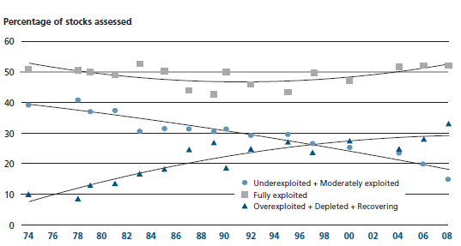
Stocks utilization
Of researched stocks
Notes:
The stagnation is supported by the fact that about 80% of researched fish stocks are either fully or overexploited
Importance of fisheries management
Increased demand for sustainable fisheries – what ever that means (ecological, social, and economical)

Slide 4
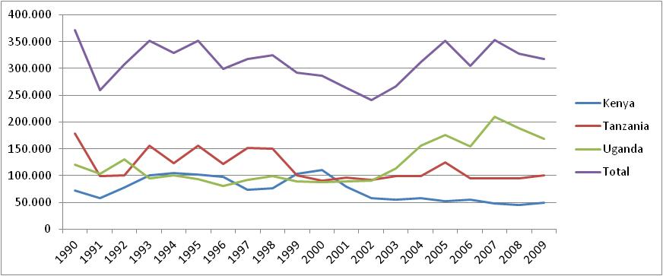
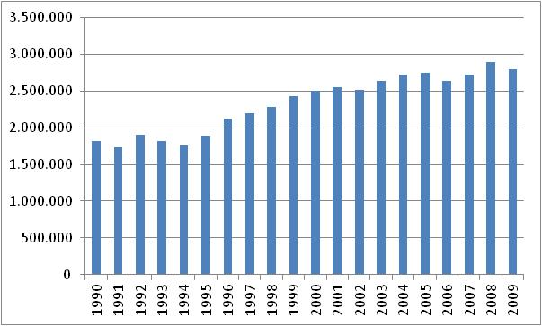
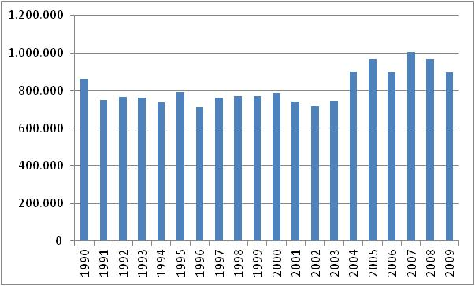
Catch in east and west Africa
Catch (inland – L.V.) of Kenya, Uganda, Tanzania
Catch of major west African countries
Catch (inland) of some east African countries
Notes:
Catch is Africa show similar trends as the world catch although information about the catch may not be that reliable and also the condition of the stock.
Catch in W Africa seems to be levelling off from 2002 but the inland fisheries in east Africa seems to have risen to another level in 2004
Catch levels in L.Victoria by the riparian countries have developed differently depending on the country. Kenya and Tanzania have reduced their catch at the same time Uganda has increased their share.

Slide 5
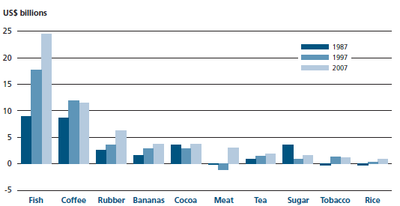
Net export of agriculture commodities from developing countries
Notes:
The importance of fisheries to African countries is great. African countries are since the expansion of their EEZ to 200 nm, gaining control over their fishing grounds with increasing monitoring and surveillances and better fisheries management.
The economic importance of fisheries can be seen in the export numbers developing countries. The exports growth since 1987 has been more in fisheries than in any other agricultural commodity.
Net export value of fish today is more than combined export value of coffee and rubber.

Slide 6
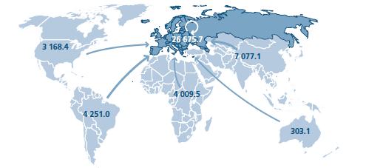
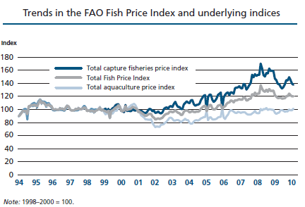
Africa exporter of fish
Net exported in value (million US$) over 2 billion
Value:
export>import
Increasing demand
Higher prices
Quantity:
export<import
Notes:
The export of fish from Africa into Europe is over 4 billion USD and net export of about 2 billion USD.
At the same time Africa imports more quantity of fish than it exports indicating an import of low value species.
This shows the importance of fish to Africa both in economical terms and also in relation to food security and nutrition.
With limited resources Africa is now turning towards aquaculture with leading nations Egypt and Nigeria with Uganda rising fast and other countries ready for take off.
Prices of fish has been increasing over the years and although average total price of fish has been declining lately the price for aquaculture fish seems to hold.

Slide 7
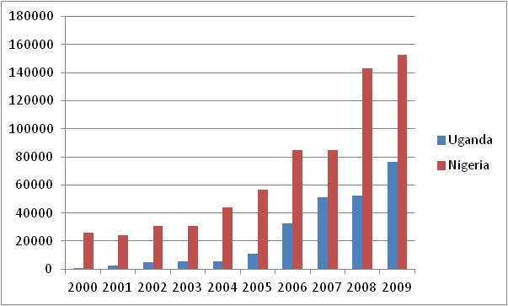
Aquaculture
4-fold increase in sub-Saharan Africa
2-fold increase in Asia
No increase in Europe
Notes:
Aquaculture in sub-Saharan African is growing and has for the past 10 years increase four-fold in sub-Saharan Africa compared to doubling in Asia and no increase in Europe
This is again specially evident in Nigeria and Uganda

Slide 8
Sustainable fisheries
“whatever that means!!”
Ecological, sociological, and economical sustainability
Better information about fisheries
  Catch statistics
  Production numbers/capacity
  Monitoring and Surveillance
Information for fisheries management
Master/strategic plan for fisheries
Stronger fisheries institutes (improved capacity)
Notes:
Kanski eiga stikkorðn frá síðust glæru betur við hér.
Leggja áherslu á að með þessari aukinni kröfu um sjálfbærni þá kemur meiri krafa um kerfi, menntun starfsmanna, eftilit og rannsóknir

Slide 9
UNU and UNU-FTP
Recognition of economical and ecological aspects of fisheries
  UNCLOS in 1982
  Expansion of EEZ to 200 nm
  Convention on biological diversity (Rio 1992)
  FAO code of conduct for resp. fisheries (1995)
Recognition of growing problems in fisheries
Recognition of potential of fisheries for developing countries
Recognition of needs to improve institutional capacity
UNU-FTP was established in 1998 in Iceland
Notes:
Point out the increased recognition of importance of fisheries for food security and economics from different conventions prior to the establishment of UNU-FTP

Slide 10
UNU-FTP activities and working environment
Formal cooperation of:
  Marine Research Institute (host)
  MATIS food research institute
  University of Iceland
  University of Akureyri
  Fishing industry
6 months in-service training
Development of short courses and conferences
Scholarship programme

Slide 11
The 6 months fisheries training programme
Institutional Capacity Building Programme
In-service (6 months) applied training
Post-graduate (non-degree)
Key fisheries institutes/organizations
Need based – priority areas
Research environment
Cooperation in selection of candidates
Notes:
Highlight that this is
Need based
Inter-disciplinary training
Development of professionals that take responsibility for what they do
Development at both professional and personal level

Slide 12
UN: 2005-2014 Education for Sustainable Development
UNESCO learning philosophy: the four pillars of learning
UNU-FTP concepts in that environment
Learning to know
Lectures
International communication
Project
Visits
Cultural adaptation
Learning to do
Learning to live together
Tailor-made studies
Sharing housing
cooperation
Presentations
Professional responsibility
Learning to be

Slide 13
UNU-FTP
Structure of the 6 month training programme in Iceland
Orientation (1 week)
Introductory course (5 weeks)
Fellows should gain a holistic view of fisheries and be able to put their
own fisheries into an international and/or regional perspective
Fisheries Policy and Planning
(6 weeks)
Resource economics
Project planning
Policy formulation
Management systems
Resource (stock) Assessment
(6 weeks)
Fish biology
Biological indicators
Sampling strategy
Survey design
Environmental aspects of fisheries
Assessment models
Data poor situations
Precautionary approach
Catch rules
Quality Management of Fish Handling and Processing
(6 weeks)
Fish processing
HACCP
Storage /shelf life
Quality indicators
Sanitation
Traceability
Packaging
Product development
Fishing Technology
(6 weeks)
Fishing methods
Fish behaviour
Gear design
Gear material
Gear selectivity
Gear research
Vessel structure
Sustainable Aquaculture
(6 weeks)
Aquaculture systems
Aquaculture research
Site selection
Species selection
EIA
Planning and monitoring
Operational aspects
Management of Fisheries Companies
(6 weeks)
Operational planning
Strategic planning
Business planning
Human resources
Raw materials
Economic analysis
Accounting
Fleet management
Project proposal
Research project – Final report and presentation (14 weeks)
Must address important issues in fellow’s home country

Slide 14
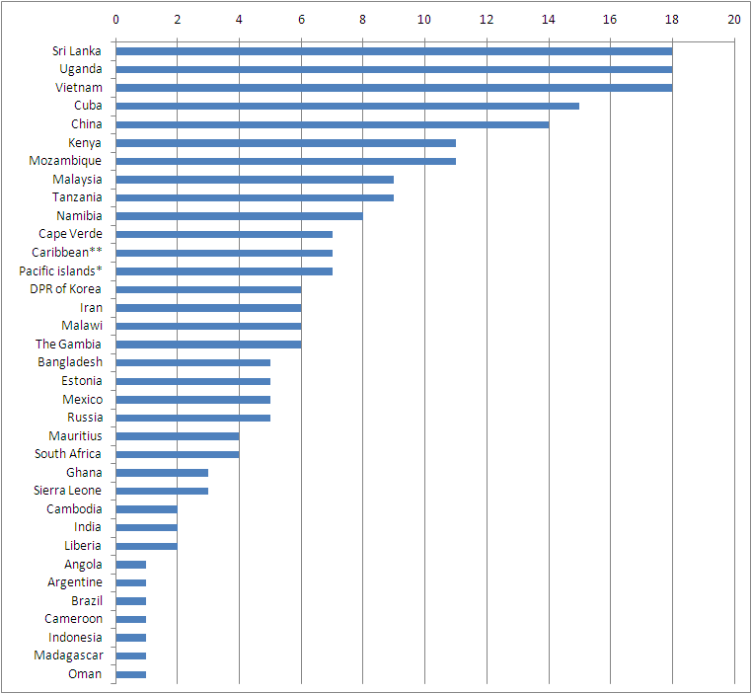
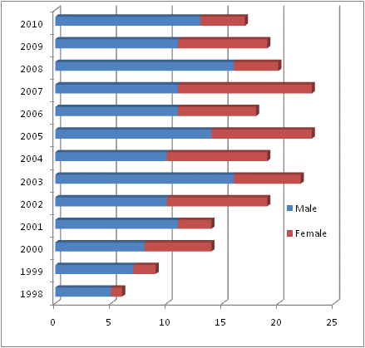
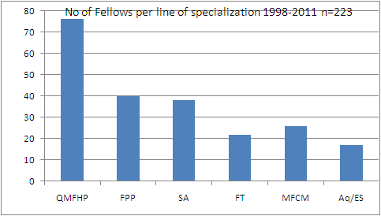
Number of fellows 1998-2011
Gender ratio
223 Fellows
42 countries
* Fiji, Tonga, Nauru, Vanuatu, Samoa
** Belize, Barbados, Jamaica, Guyana

Slide 15
Short course development
Technical and financial support
In partner countries (cooperation)
3-10 days (highly focused)
Counterparts (educational institute, FD)
Training of trainers (delivered by local experts)
Local ownership
Involvement of former UNU fellows

Slide 16
Scholarship programme
For post-graduate studies in Iceland
Former fellows
Full MSc degree support and partial (27 months) PhD degree support
2-3 per year (based on performance)
Currently 6 PhD and 2 MSc

Slide 17
UNU-FTP in sub-Sahara countries
Sub-Saharan Countries | Men | Women | Total | (2011) | MSc | PhD
The Gambia | 5 | 1 | 6
Cape Verde | 3 | 4 | 7
Sierra Leone | 2 | 1 | 3 | 2
Liberia | 2 | 0 | 2 | 2
Ghana | 0 | 3 | 3 | 2
Cameroon | 1 | 0 | 1 | 1
Angola | 0 | 1 | 1
Namibia | 5 | 3 | 8 | 2
South Africa | 2 | 2 | 4 | 2
Mozambique | 7 | 4 | 11 | 3
Tanzania | 4 | 5 | 9 |  | 1
Kenya | 9 | 2 | 11 |  | 1
Uganda | 14 | 4 | 18 | 2 | 1 | 2
Malawi | 6 | 0 | 6
Mauritius | 4 | 0 | 4 |  | 2
Madagascar | 1 | 0 | 1
Total | 65 | 30 | 95 | 16(6) | 5/9 | 2/10
Notes:
Initially the focus was on SADC countries
Now the focus is on west Africa

Slide 18
Specializations of African fellows

Slide 19
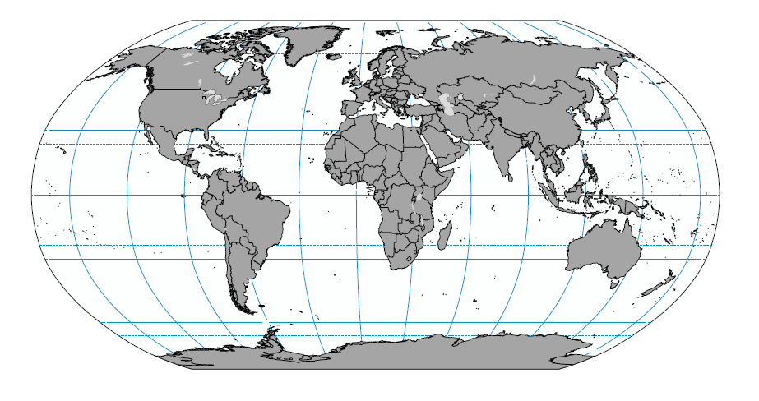
UNU-FTP Countries
Uganda
*2009/2010/2011 Sustainable Aquaculture for Extension Officers
*2011 Quality Management and Fish Processing for Fish Inspectors
Tanzania
*2006 Maintenance and Operation of a Database on Artisanal Fisheries
*2009 Fisheries Data Collection and Analysis
Namibia
*2006 Workshop on Fisheries and Aquaculture in Southern Africa: development and Management
*2008 Profitability Assessment in Fisheries and Aquaculture Enterprises
*2011 Fish Handling and Quality Management for Deck Officers and Processors
Mozambique
*2008 Profitability Assessment in Fisheries and Aquaculture Enterprises
*2011 Management of Small Aquaculture Enterprises
Kenya
*2008 Fish Inspection and Quality Control: Basic/Advanced
*2009 Fisheries Data Collection and Analysis
indicate the countries fellows have come from.
Indicate where short courses and conferences sponsored by UNU-FTP have been held
Location of the UNU-FTP

Slide 20
Institutional partners (short course)
Mozambique:
  National Institute for Aquaculture Development
  Eduardo Mondlane University
  Polithecnica University
Uganda:
  Makerere University
  Fisheries Training Institute
Namibia:
  NAMFI
  University of Namibia
Kenya:
  Moi University
Ministries and Departments of Fisheries

Slide 21
UNU-FTP and sub-Sahara cooperation
Over 100 trained fisheries professionals, which many cooperate cross-cultural and cross boundaries
Over 100 research projects on topics of great relevance to sub-Saharan countries
Leaders in fisheries
12 training courses since 2006 (directly affecting about 400 professionals)
Cooperation and networking of key fisheries institutes and universities

Slide 22
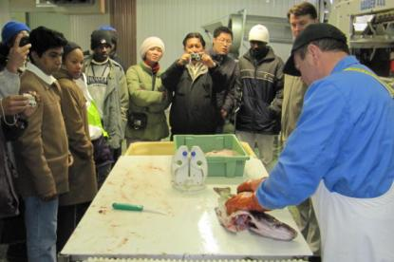
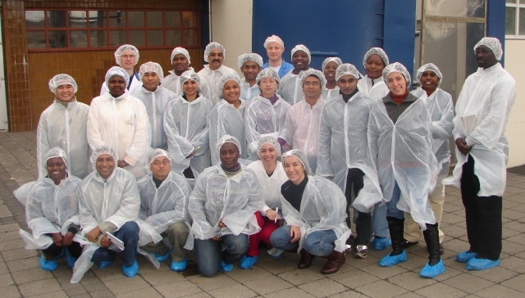
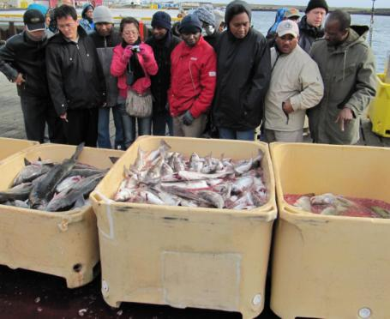
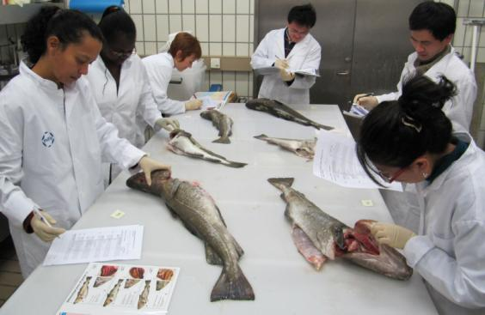
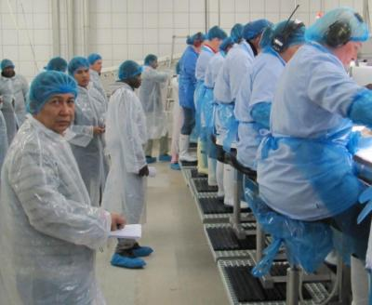
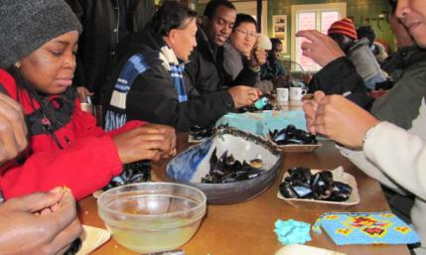
Thank you

