Slide 1
The new UNU Institute for Integrated Management of Material Fluxes and of Resources (UNU-FLORES) in Dresden (Germany) and Maputo: core areas of focus and twinning concept
Dr. Reza Ardakanian
UNU focal point on the establishment of UNU-FLORES
Director UN-Water Decade Programme on Capacity Development (UNW-DPC)

Slide 2
Presenting United Nations University
Founded in 1973 (began operations 1975) by
UN General Assembly as autonomous organ of the United Nations
Global University engaged in
  postgraduate training and teaching
  research
  dissemination of knowledge
in furtherance of the
purposes and principals of the UN

Slide 3
Basic Structure
Headquarters in Tokyo (financed by Japan), Rectorate in Tokyo, Bonn and Kuala Lumpur
13 Institutes for Research and Training
in 12 different countries, financed by host countries
Associated Institutes
Liaison offices to UN in New York and to
UNESCO in Paris

Slide 4
New Strategy: Twin institutes
Campus 1
Developed country
Fully financed by host country 1
Campus 2
Developing country
Partially financed by host country 2
Joint projects
Funding agencies

Slide 5
UNU-FLORES: why?
Non-renewable resources are depleted
Renewable resources are deteriorating in quality
Overuse and incomplete recycling
Diffuse distribution
Complex flux patterns
Coupling of agriculture, land use, water and waste on an international level
Need to consider Global change (climate, socio-economy, demography)

Slide 6
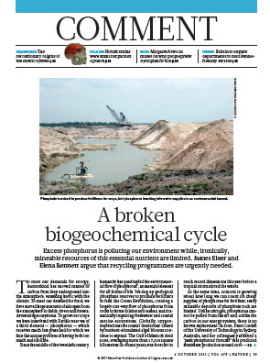
The challenge:
Phoshorus as an example
Nature 2011
Great uncertainty about available resources and fluxes
Loss to inland and coastal waters via water, soil (erosion), waste
Resources management requires inter- and trans-disciplinary strategies integrating soil, water and waste

Slide 7
State of the art: concept
Systems and flux analysis
Develop tools to evaluate options
Global change
(climate, demography, socio-economy, land use)
Develop scenarios
Water management
Soil and
land use management
Waste management and contaminated sites
Identify drawbacks
Analyse processes
Develop options
Implementation concepts
Capacity development

Slide 8
Purpose and activities as
specified in statutes
Research, teaching and capacity development in the areas:
Systems and flux analysis
Cycle and resource management on water, soil and land use and waste
Water inventory and fluxes
Global change assessment
Resources quantity and quality
Urban water/urban footprint
Green economy

Slide 9
In short: What is unique about
UNU-FLORES?
Integrative approach, considering interrelated resources together
Focus on Fluxes: overcome static models
Global perspective
Being part of UNU-family
Could become the first UNU institute with two campuses established (almost) concomitantly

Slide 10
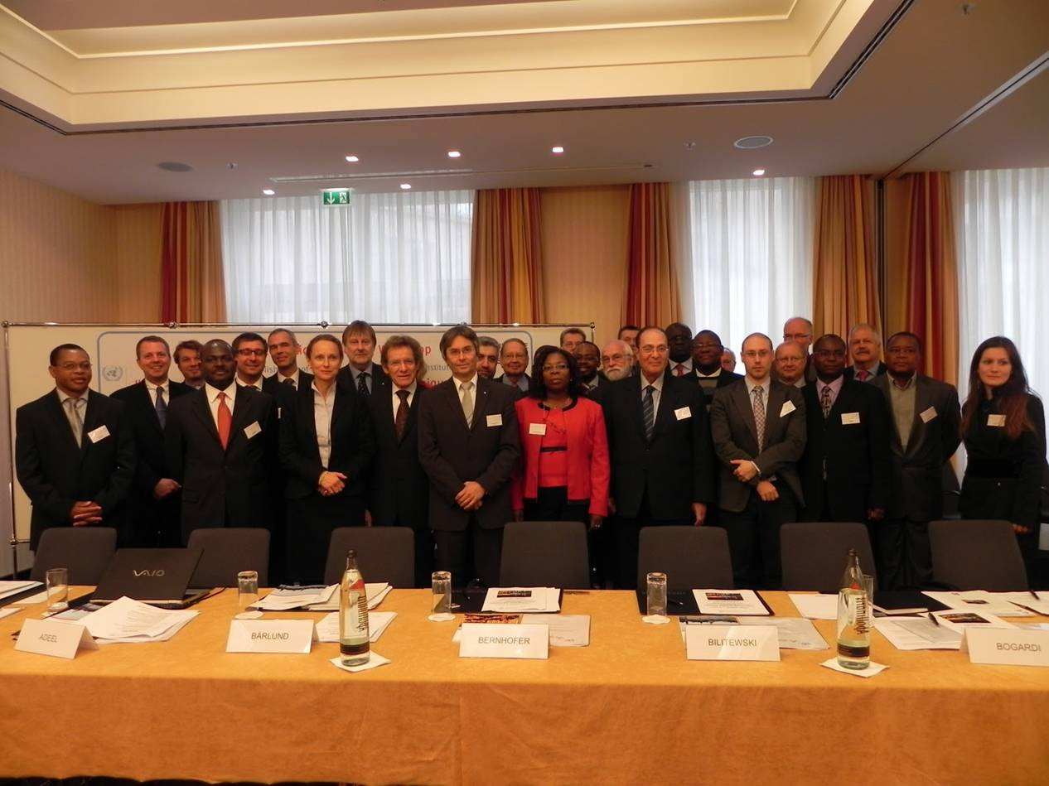
Establishing UNU-FLORS:
state of the art
1st international Scoping Workshop in Dresden, Germany, November 2010
  Participants: UNU institutes, UEM, MCT, UFS, UNAM, NEPAD, U. of Nairobi, Arab Water Council, TUD,...
  Research topics worked out
  Entry points for teaching programmes identified
  Opportunities and challenges of a Twin in Mozambique

Slide 11
State of the art: institutional development of Dresden twin
MoU signed between donors (BMBF, SMWK), UNU, TUD
Statutes approved by UNU-Council
Funding agreement about to be signed
Premises in Dresden currently under negotiation
Next milestones:
Finalize Funding agreement, premises
Recruiting funding director
FoC UNU-TUD
Expectation: Campus Dresden will start 2012

Slide 12
Why Dresden?
TU Dresden has a pronounced profile in soil, water, waste:
Faculty of Forest, Geo and Hydro Sciences
Partners:
Helmholtz Centre for Environment Research (UFZ)
  Modelling, systems analysis, eco-toxicology, IWRM
Leibnitz Institute of Ecological and Regional Development (IÖR)
  City planning, risk management, socio-economic feedback
Centre for International Postgraduate Studies on Environmental Management, CIPSEM (UNEP)

Slide 13
UNU-FLORES: Twinning strategy
Campus 1
Dresden
Fully financed by German Ministries
Campus 2
Maputo
Partially supported by Mozambique
Joint projects
Funding agencies

Slide 14
UNU-FLORES: Twinning strategy
Why Maputo?
Government (MCT) and UEM indicated support
Mozambique and the region facing serious challenges related to water, soil and waste management under conditions of global change
Establishing a Twin in Mozambique would comply with research agenda outlined in Consolidated Plan for Action for Science & Technology in Africa (CPA) and by NEPAD
UNU roadmap Africa
=>Establishment of resources-focussed twin institute could have strong regional impact / capacity strengthening through UNU collaboration and presence in Africa

Slide 15
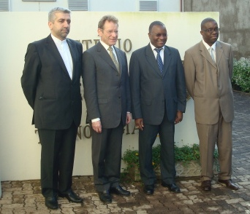
State of the art: institutional development of Maputo twin
UNU mission to Maputo, May 2011
Government confirmed
committment
UEM as local partner:
several study programmes
provide starting points for
joint programmes
Three committees established
MoU currently under development
Feasibility study to be finished in 2012

Slide 16
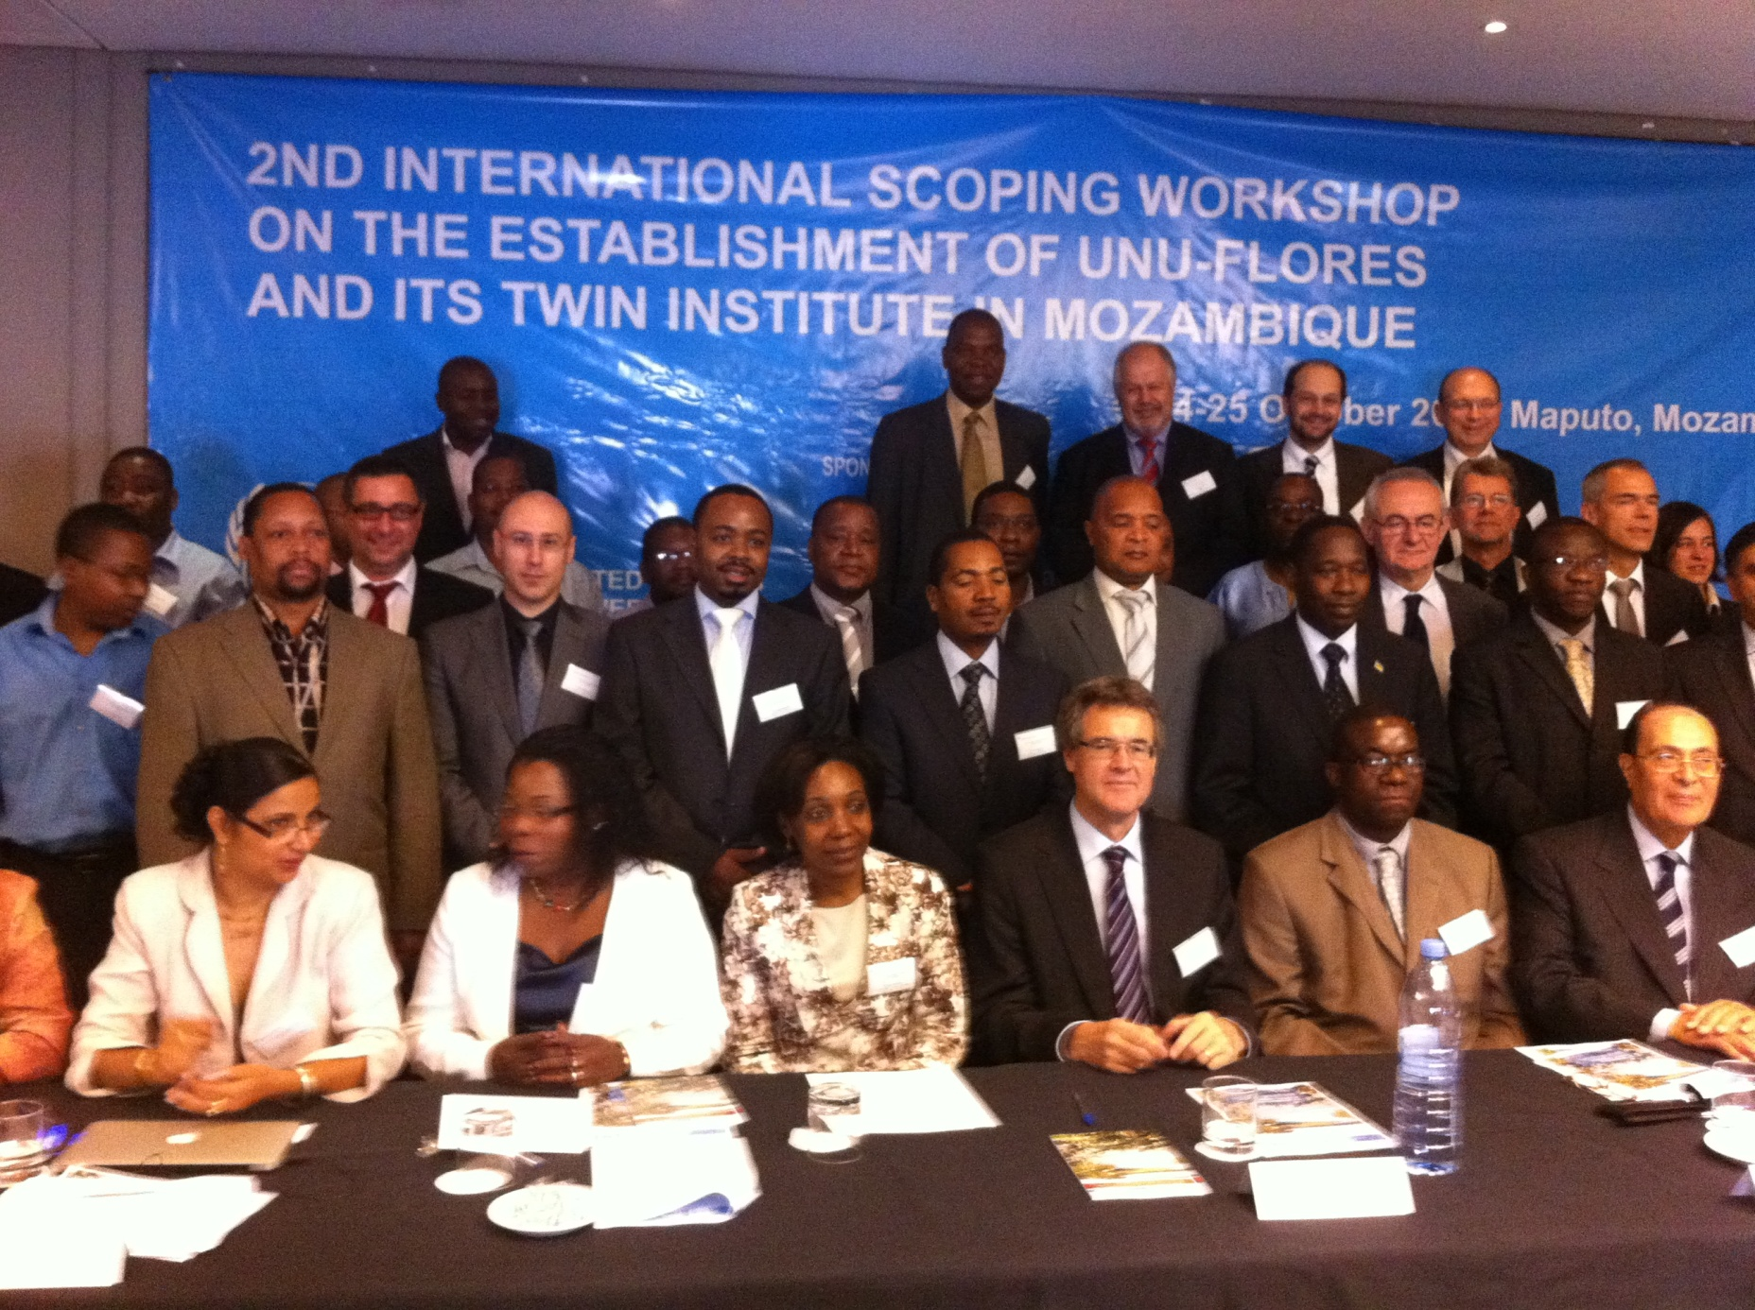
2nd International Scoping Workshop
Maputo, 24-25 October 2011
Participants: UNU institutes, UEM, MCT, UFS, NEPAD, CapNet, Arab Water Council, TUD, Intl. Experts

Slide 17
Major research areas identified at 2nd International Scoping Workshop
Systems and flux analysis
Water economics and governance
Almost identical to proposed structure of UNU-FLORES
Integrated Water Resources management
Soil and
land use management
Waste management and Sanitation
Capacity development

Slide 18
UNU-FLORES: teaching programmes
Build on existing programmes at TUD:
MSc course Hydro Science and Engineering
  Soil and land-use, waste, could be upgraded by TUD
Additional (UNU-FLORES-specific) modules proposed:
  Matter Flux analysis
  Water cooperation/governance
  Water efficiency
  Risk management
  Engineering Education
Graduate school (PhD)
Links to TUD affiliated institutions serves for synergies

Slide 19
UNU-FLORES: teaching programmes Maputo twin
Results of scoping Workshop in Maputo:
Identification of areas to be covered in MSc and PhD programmes
  Close relation to research
  Add value, not re-invent the wheel
Elaboration on structural aspects to be considered
Approach: build on existing curricula, close interaction between both twins and with TUD, UEM

Slide 20
UNU-FLORES aims at
• establishing strong partnerships in Southern Africa
Inking effectively with related programmes in research and teaching
Fulfilling a role as regional hub for integrated resources management (water, soil, waste)
Objective: two-year long process (2011-2012) incl. feasibility study, scoping workshop Maputo, business plan, analysis of legal/institutional pre-requisites
Goal: Twin institute to be operational by 2013

Slide 21
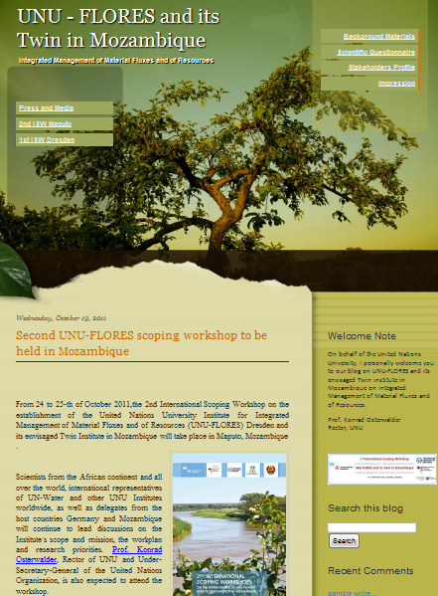
UNU-FLORES website / blog
http://unu-flores-mozambique.blogspot.com/
Up-to-date information
Background documents
Downloads
Possibility to post comments
Thank you

Slide 22
UNITED NATIONS UNIVERSITY
United Nations University Centre
5–53–70 Jingumae,
Shibuya-ku, Tokyo 150-8925
Japan
www.unu.edu

Slide 23
UNU-FLORES: a response to the challenges
Develop understanding and analysis methods of complex systems
Overcome static balance and flux models
Analyse interactions in water-matter-systems
Develop knowledge-based strategies for flux management and monitoring concepts under conditions of global change
Develop scientific tools for integrated resources management
Feedback with society and socio-economics
Education
Capacity development

Slide 24
Major research areas identified at 2nd International Scoping Workshop
Integrated Water Resources Management
Waste management and sanitation
(including drinking water)
Soil and land management
Systems and Flux analysis
Water economics and governance

Slide 25
Topics in IWRM
• Efficient use of water in agriculture
• interaction surface and groundwater and recycling
• Water produvity and food security
• Share water for sector use
• Stakeholders participation
• virtual waterproof
• material flow
• Water harvesting

Slide 26
Topics in waste management and sanitation
• waste water reuse (what are the shortfalls)
• Processing of waste water
• cheap and safe sanitation technologies
• Safe water cleaning

Slide 27
Topics in soil and land management
• Land grabbing
• Crops for energy (bioenergy)
• Soil contamination
• Soil errosion and degradation
• Land ownership

Slide 28
Systems and Flux analysis (industry water processing, cleaning water)
• nutrient recycling
• Carbon inventory
• Impacts of mining
• Analysis of water uses and pollution

Slide 29
Water economics and governance
monitoring,
assessment,
governance,
economics,
education and training,
extension,
policies,
gender

Slide 30
Partners
- UN(U) partners
- National within regional program SADC
- NEPAD/AU

