Slide 1
Where is the Capacity to Meet the
East African Water Crisis?
Unlocking the potential of Communities and Institutions
Dr. Zafar Adeel
Director, UNU-INWEH
Chair, UN-Water
12th WaterNet/WARFSA/GWP SYMPOSIUM
26 October 2011, Maputo, Mozambique

Slide 2
Overview
  The East African Context
  Capacity Challenges in East Africa
  Governance Structures in East Africa
  Institutional capacity building
  Community capacity building
  Some concluding thoughts

Slide 3
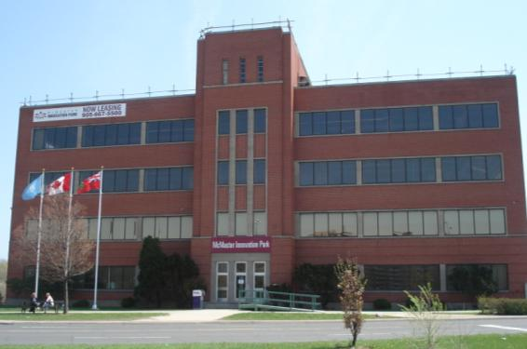
What is UNU-INWEH?
Created: 1996 ● 25 Staff ● ca. $6M annual budget
The water “academy” of UNU, supported by Canada (through CIDA) and hosted by McMaster University
Serving as the UN Think Tank for Water
A capacity-development and
water-science agency,
helping to address the
Millennium Development Goals
for water

Slide 4
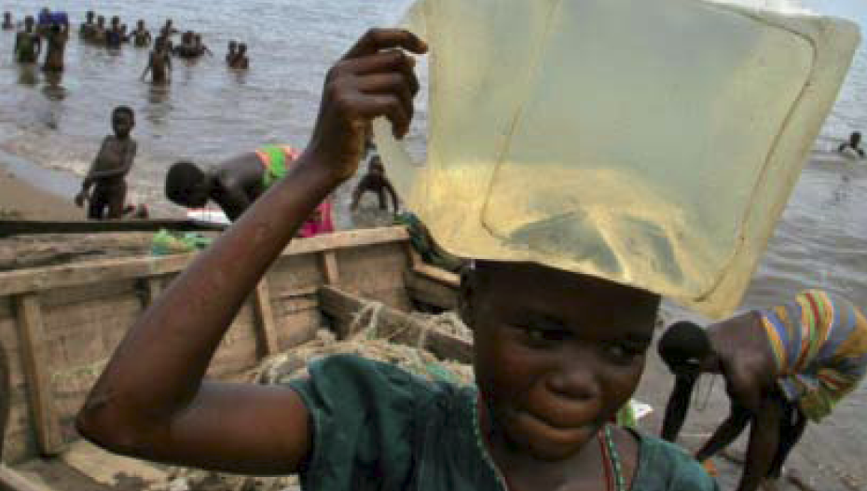
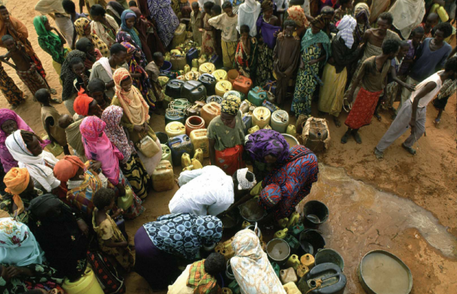
Over-Arching Priorities
Emphasizing human wellbeing
Facilitating adaptation to climate change
Ensuring gender equity
Ensuring Success
World-Class Leadership
Strong Engagement with Partners
Effective Knowledge Dissemination
Results Based Management

Slide 5
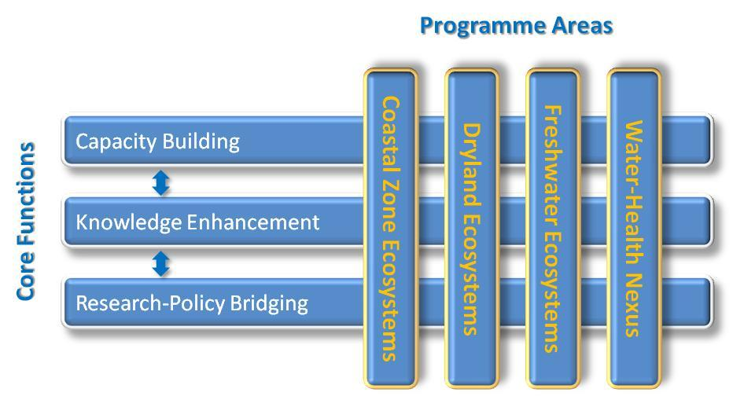
Programme Matrix

Slide 6
The East African Context
1

Slide 7
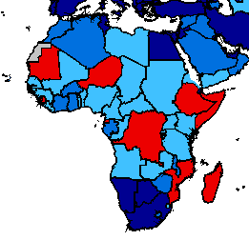
Proportion of the population using an improved drinking water source, 2010
Source: WHO/UNICEF Joint Monitoring Programme for Water and Sanitation (JMP)
Notes:
(These next few slides paint a picture of where the need is and the scope of the problem. You can run through them very quickly.)
(Note: This slide is percentage of people without access – not necessarily on or off track)
Talking Points:
This slide tells us where the over-800 million people who still lack safe water supply are.
The region with the most gaps, which also contains many of the countries which are off-track to achieve the water MDG, is Africa.
However, there are large unserved populations in Asia as well.

Slide 8
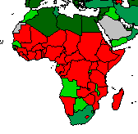
Proportion of the population using an improved sanitation facility, 2010
The world will miss the sanitation target by almost 1 billion people
Source: WHO/UNICEF Joint Monitoring Programme for Water and Sanitation (JMP)
Notes:
(Note: This slide is percentage of people without access – not necessarily on or off track)
Talking Points:
This slide tells us where the 2.6 billion people who still lack improved sanitation are.
The World will miss the sanitation MDG target by almost 1 billion people

Slide 9
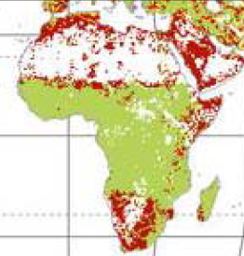

Relative Water Stress Index
Source: University of New Hampshire Water Systems Analysis Group, 2010

Slide 10
OECD
Average

Slide 11
Capacity Challenges in East Africa
2

Slide 12
Lack of Institutional Capacity
Insufficient research facilities
Insufficient policy analysis
Governance gaps – community, urban, national, regional
Result: Insufficient capacity to fully analyze and respond to local challenges
Some good examples
  EAC, Lake basin commission (LVBC, LVFO, LTA)
  Initiatives like LVEMP, TerrAfrica

Slide 13
Other Capacity Gaps
Lack of human resources capacity (coupled with “brain drain”)
Lack of technological capacity
Lack of capacity to provide services
Four pillar approach is a must
Limited community awareness and knowledge about water issues and how they relate to human health

Slide 14
Governance Structures in East Africa
3

Slide 15
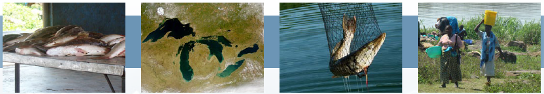
Lake Commissions
Lake Victoria Fisheries Commission (LVFC)
Lake Victoria Basin Commission (LVBC)
Lake Tanganyika Authority (LTA)

Slide 16


Lake Twinning
Sharing a comparative analysis of lake management, leading to a synoptic overview of related science
Developing a framework for collaboration on great lakes systems through enhanced science and policy linkages
Identifying approaches to effectively monitor and evaluate lake ecosystem health

Slide 17
Lake Twinning Framework
Climate change (adaptation/mitigation)
  Vulnerability mapping
  Management strategies
Governance structure
  How to deal with uncertainties
  Invasive species management
  Community engagement
Human wellbeing
  Linkage between healthy lakes
  and human well being
  Natural resources evaluation
Public-private partnerships
  Institutional analysis of how to foster these partnerships
  Sustainability of partnerships
Gender equity
  Role of women in management and education
Ecosystem approaches and management
  Groundwater aquifer management
  Invasive species
  Pollution control
  Water quality standards

Slide 18
UNU-INWEH’s Support for Governance
Knowledge Management system for LVBC
Link to GEF’s IW: Science platform: KIM-UNU
Capacity:
  Word-level search of thousands of publications
  Social networking and information sharing tools
  Geo-referencing capacity
  Information dissemination capacity

Slide 19
Institutional Capacity Building in East Africa
4

Slide 20

Water Virtual Learning Centre
A distance-learning IWRM programme
The core curriculum consists of 10 courses, 250 study hours
Flexible in terms of delivery mechanisms and procedures and accommodate:
  widely varying schedules and requirements
  technology access
  backgrounds of the participants
Delivered by regional partners and customized for each region

Slide 21
Water Virtual Learning Centre
Regional Partners
  East Africa – University of Nairobi, Kenya
  West Africa – University of Ghana, Ghana
  East Asia – Asian Institute of Technology, Thailand
  Pacific Islands – University of South Pacific, Fiji
  Middle East – Arabian Gulf University, Bahrain
  Central America – CATALAC, Panama
  Europe – University of Dundee, Scotland

Slide 22
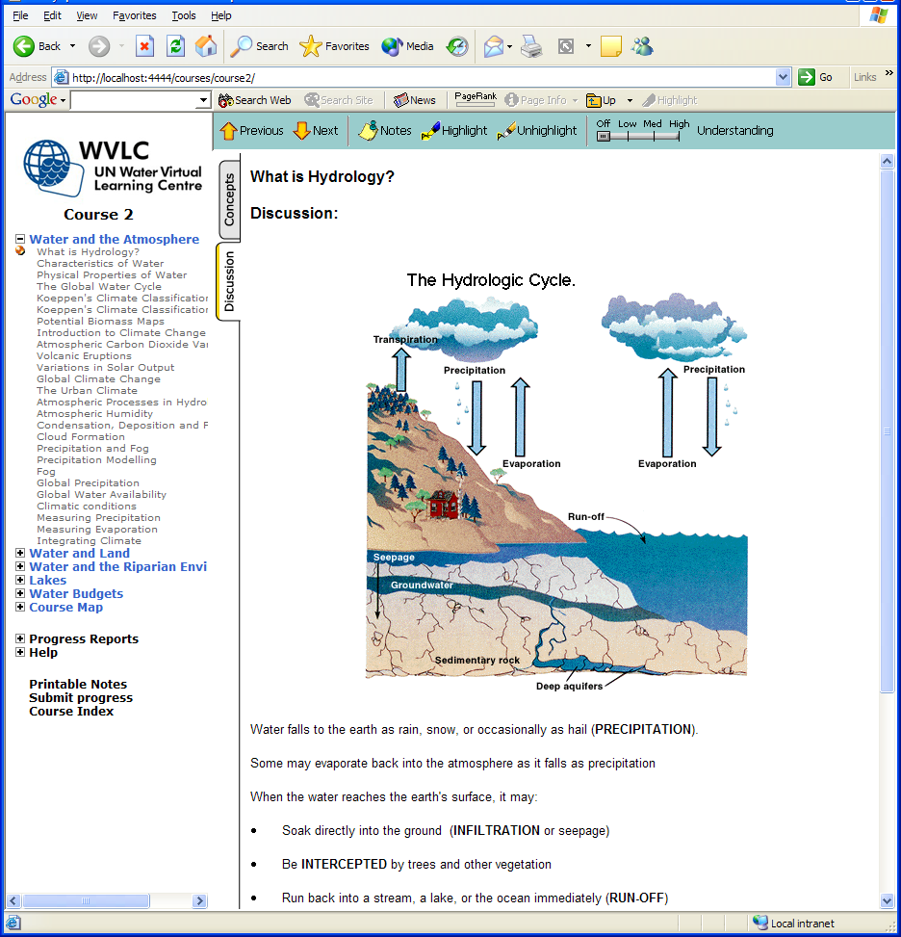

Slide 23
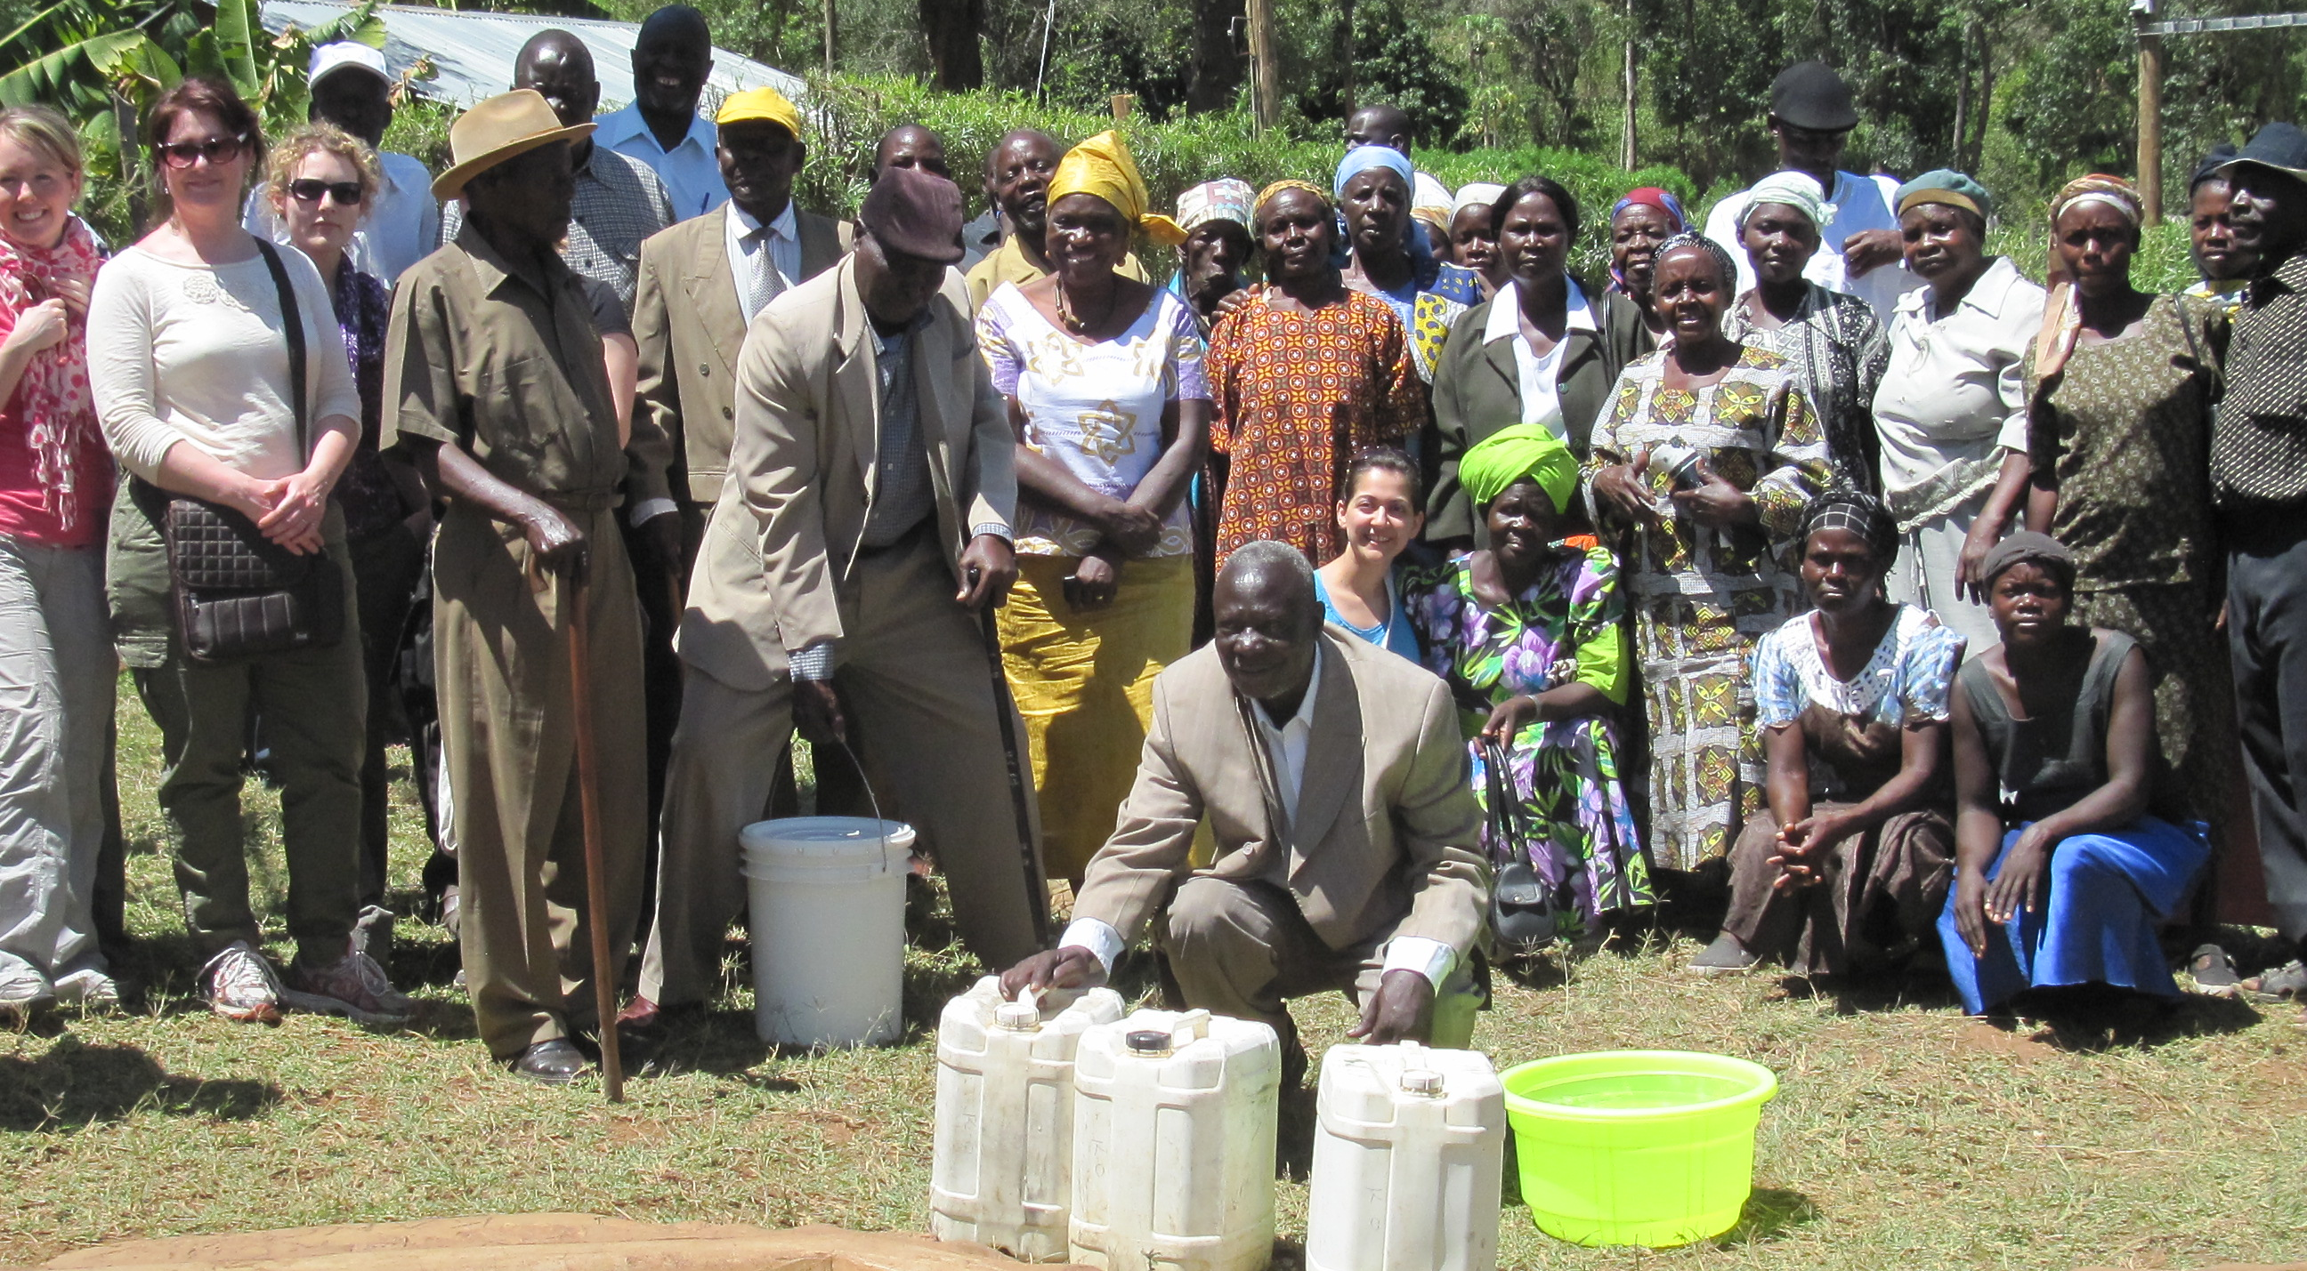
Community Capacity Building in East Africa
5

Slide 24
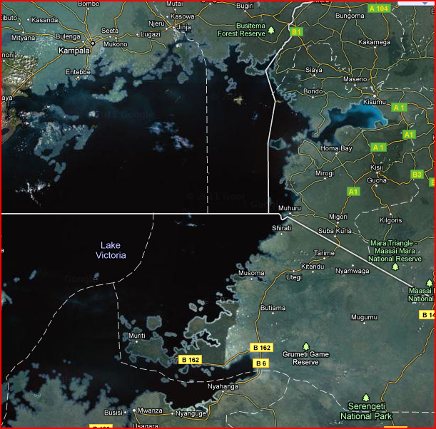
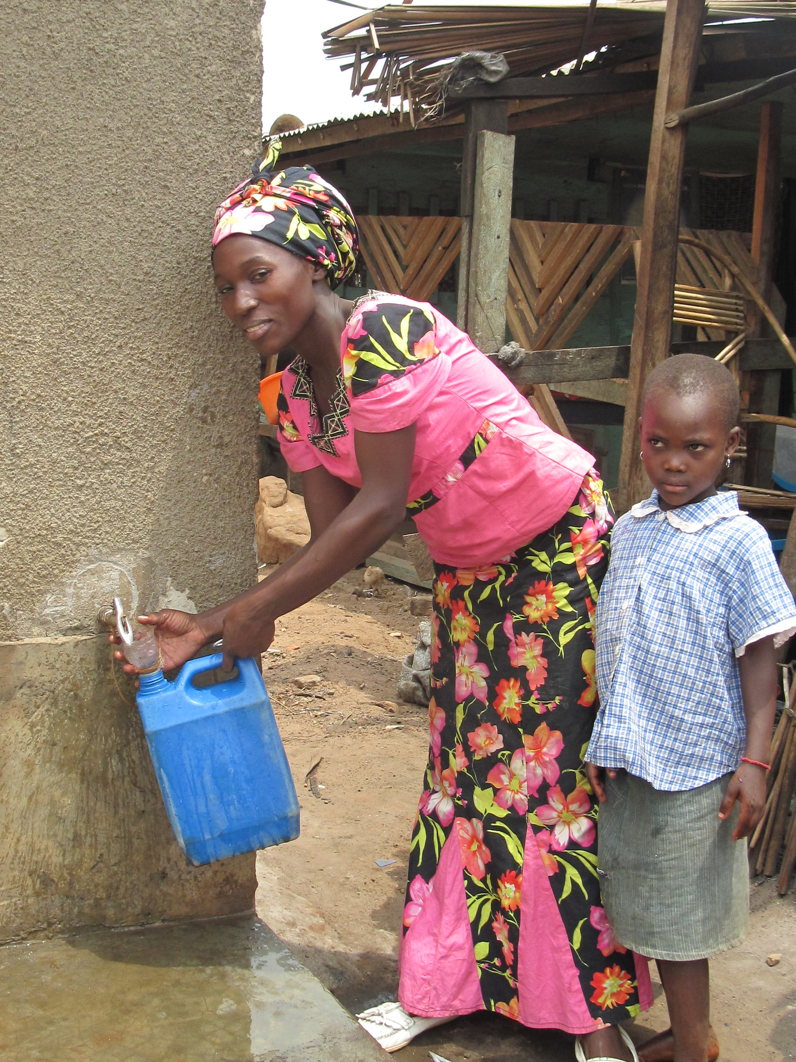
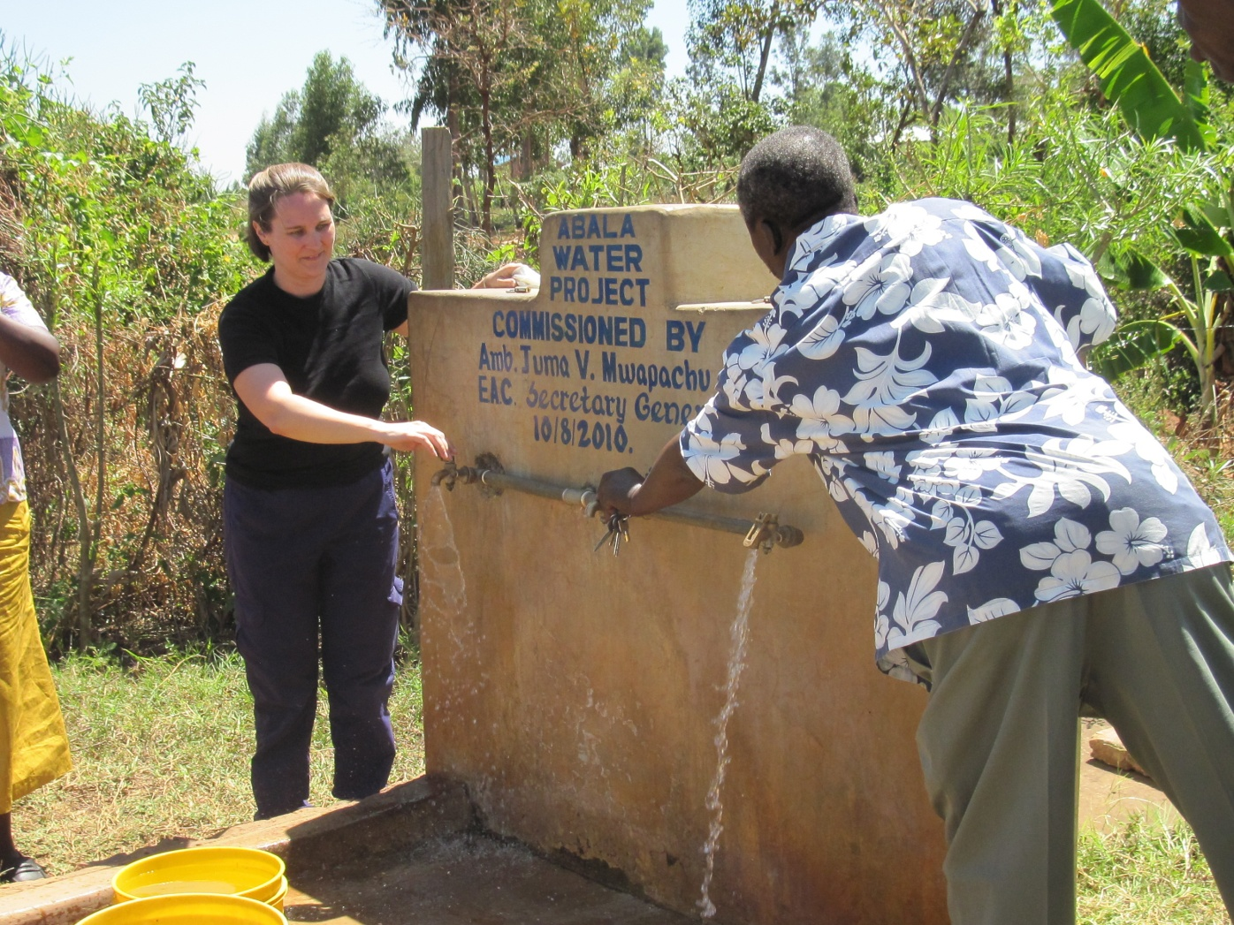
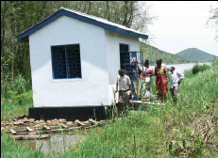
The
Communities
Remote, rural
Lake Victoria basin
Kiyindi
West Kagan
Mbarika
Courtesy of Google Maps
Notes:
Uganda, Kenya, Tanzania

Slide 25
Findings
Beneficiary communities can manage their own initiatives
Essential for communities to be actively involved in planning, implementation and management
Ultimate goal must be total ownership of the project by the community
  Leads to sustainability
Within this framework, small investments are making large impacts on the livelihood and health of communities

Slide 26
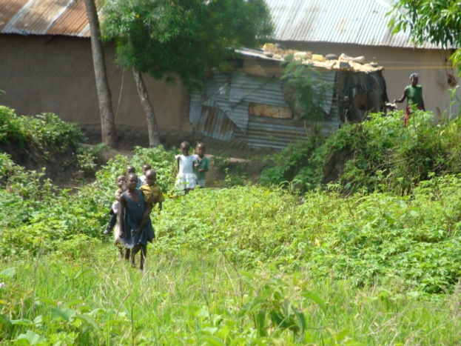
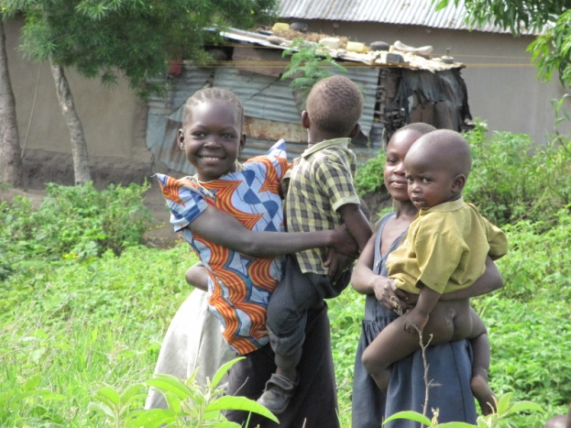
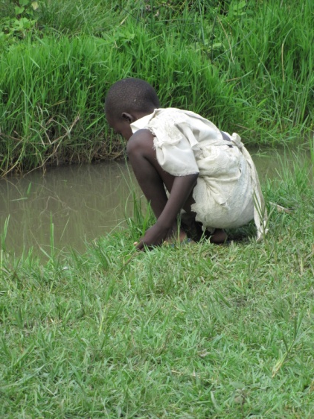
Focus: “KAPE” Project
“Knowledge, attitudes, practices and empowerment” related to water and sanitation
Working with the communities to affect change
Sustainable solutions
Evaluate the impacts of the intervention on the communities
Notes:
To bring together the experience of partner institutes in Canada, Africa and elsewhere to understand the knowledge, attitudes, practices and perceptions of local communities around water and health;
To use this information to develop an educational intervention that will help raise awareness of water-health links in local communities;
To evaluate those interventions so the learnings can be shared with other communities
To create sustainable development conditions for the people of East Africa by directly addressing water-health linkages in an integrated and effective manner.

Slide 27
Some Conclusions
6

Slide 28
Concluding thoughts
Greatest capacity challenge is institutional
  Must be addressed within the region – harnessing “local resources”
  Must be coupled with other capacity building efforts
Cross-sectoral integration has to remain a primary goal
  Link to “green economy” approaches
  Effectiveness of policies must be ensured
Community engagement is most important and most challenging
  Trust building through reliable information
  Empowerment through early engagement can lead to sustainable solutions

Slide 29
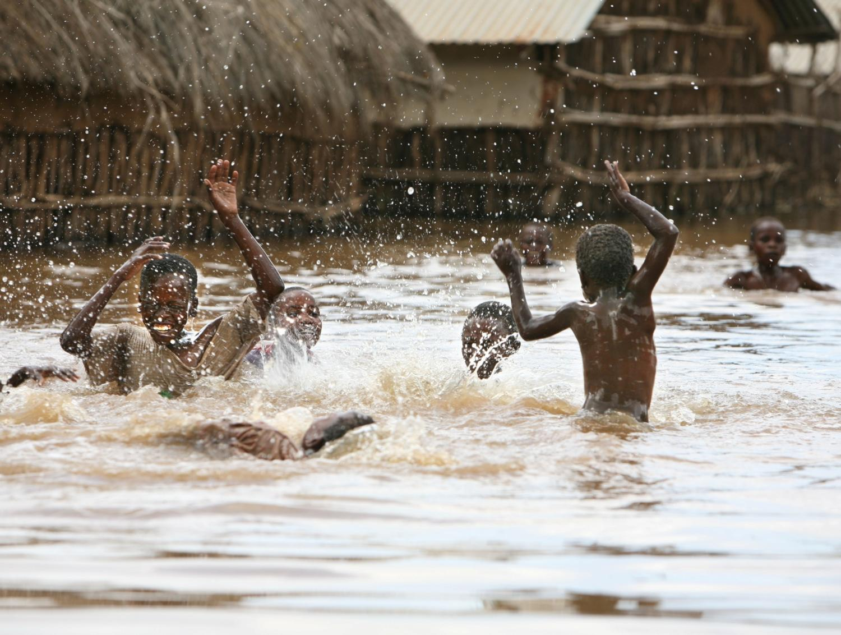

Thank you
United Nations University
Institute for Water, Environment & Health
The UN Think Tank on Water
contact@inweh.unu.edu
www.inweh.unu.edu

