Slide 1
Capacity Development in the Safe use of Wastewater in Agriculture
basic concepts of capacity development
presentation of the project agenda/roadmap
structure of the kick-off workshop
Dr. Jens Liebe
International Kick-off Workshop on Safe use of Wastewater in Agriculture
14 November 2011
UN-Campus Bonn, Germany
1

Slide 2
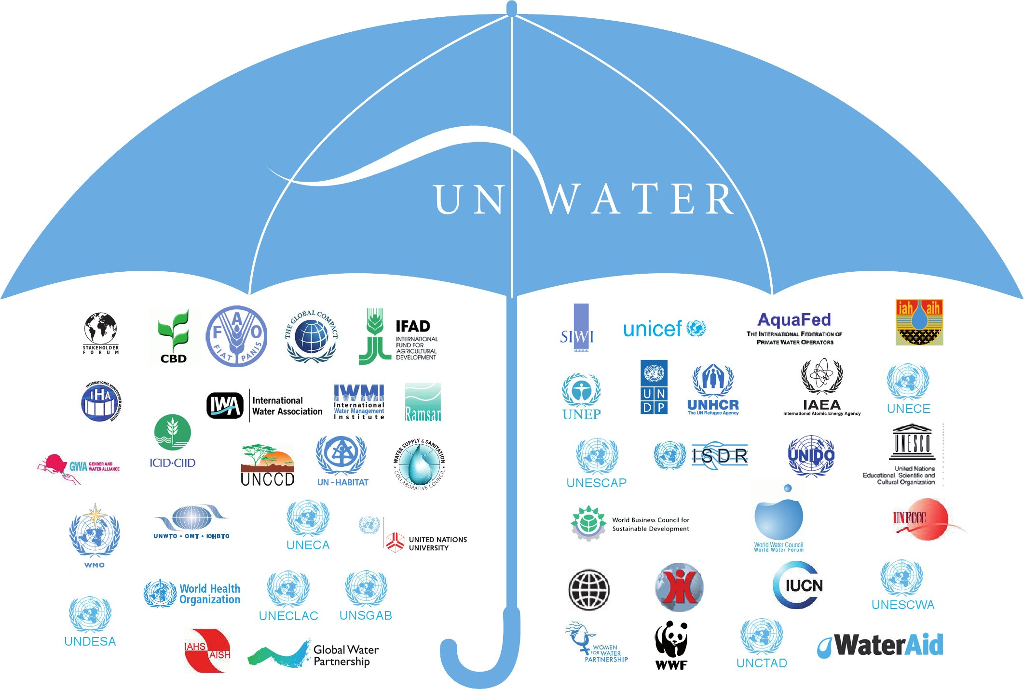
WWAP
UNW-DPC
UNW-DPAC
UN-Water Members
UN-Water Partners

Slide 3

UNW-DPC’s Mission
“to enhance the coherence, credibility and integrated effectiveness
of UN-Water
by strengthening its capacity development programmes, particularly in developing countries and economies in transition.”

Slide 4
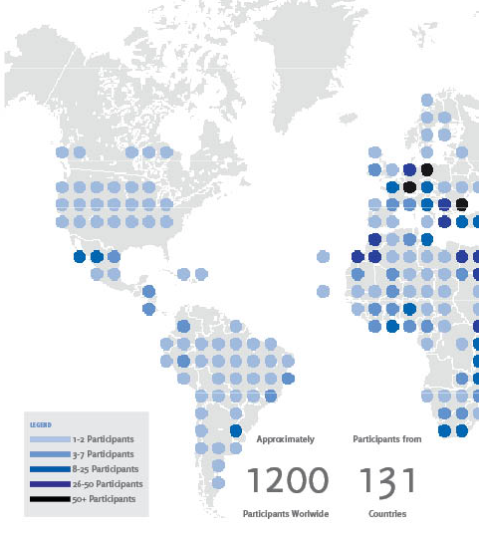
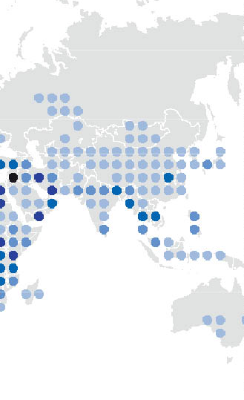
UNW-DPC Capacity Development Effort

Slide 5
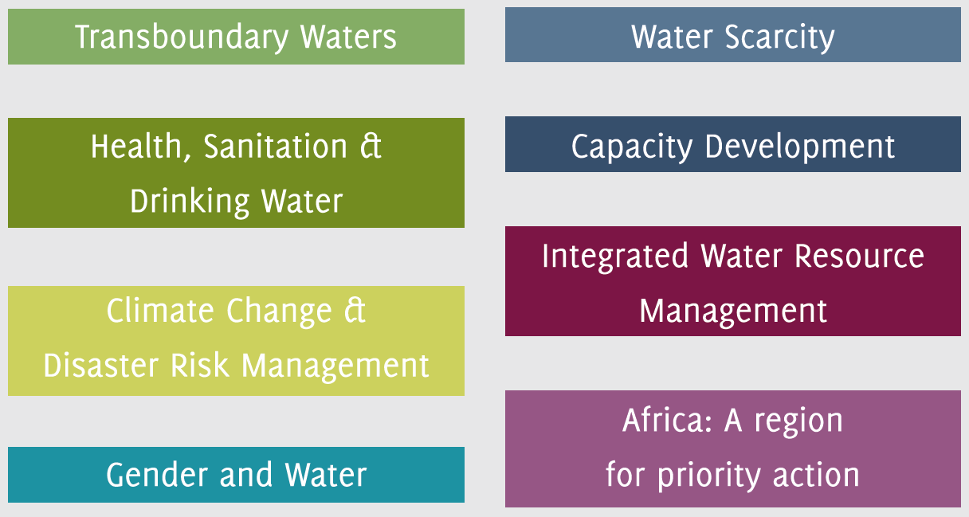
UNW-DPC Areas of Activity
all areas of priority to UN-Water:

Slide 6
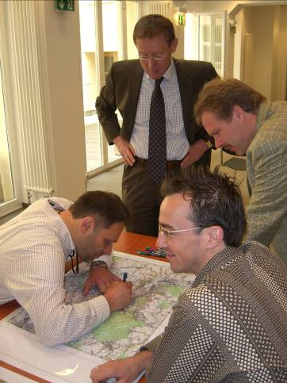
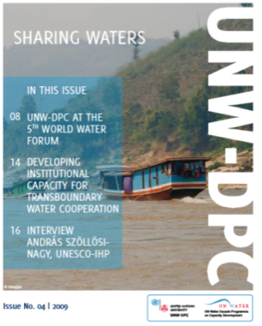
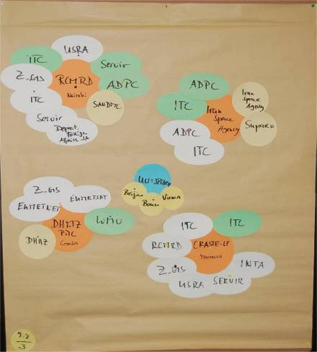
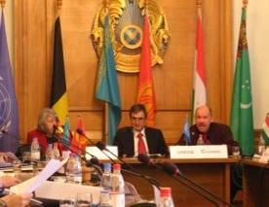
UNW-DPC Strategy: long-term Capacity Development Concept
Workshops,
Meetings,
Publications
Needs Assessment, White
papers
Stakeholder Analysis, Activity Mapping
Data- AIS
Services
Strategic support, Policy advice
UNW-DPC follows a long term capacity development concept to support UN-Water
From single to ‘embedded’ activities using multilateral thematic, conceptual and collaborative workshops

Slide 7
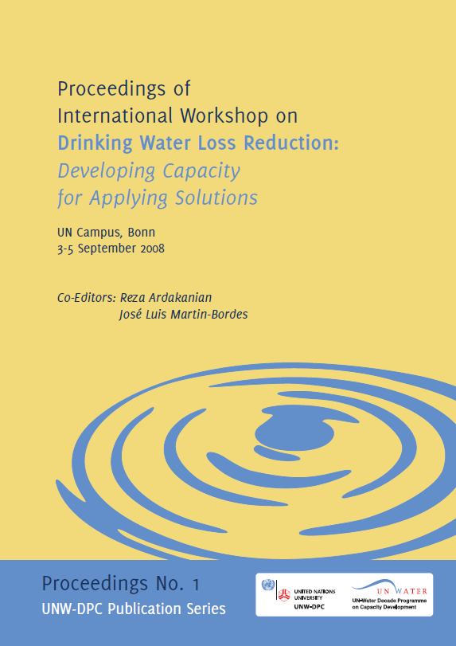
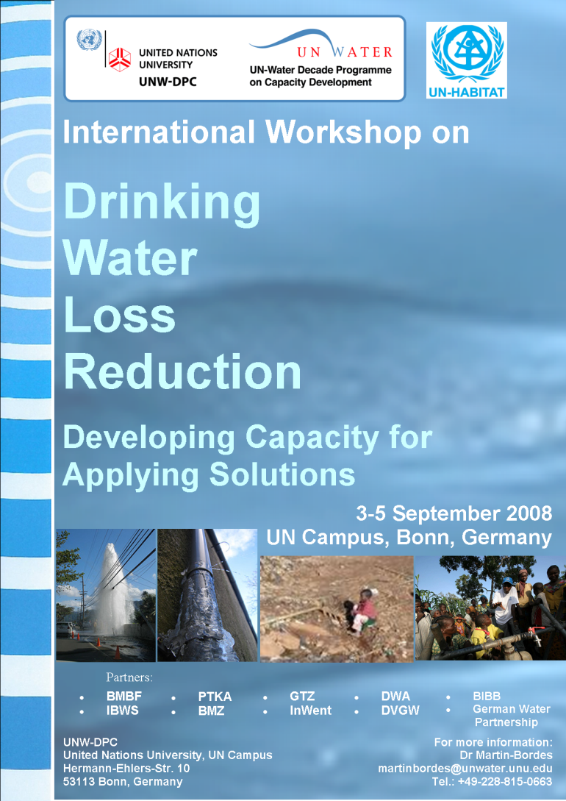
Example: UNW-DPC support sequence on Drinking Water Loss Reduction
1. International workshop
Raise awareness
Determine level of stakeholder interest
Identify stakeholders’ experience, assess key issues and action-oriented tasks
Publish report as baseline for regional meetings

Slide 8
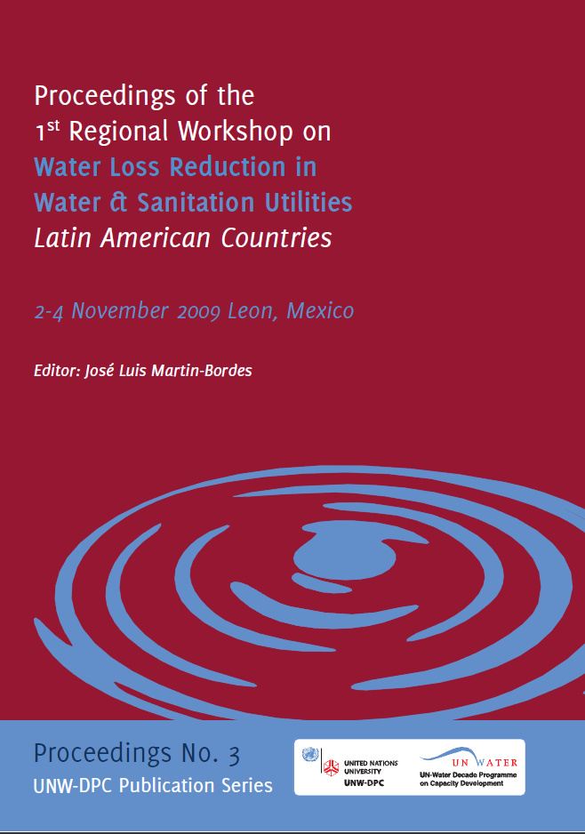
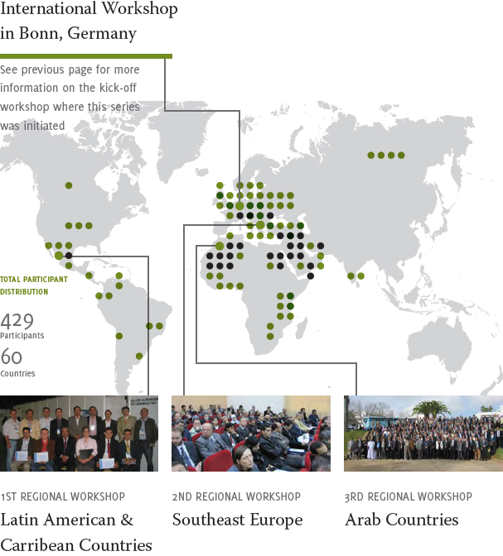

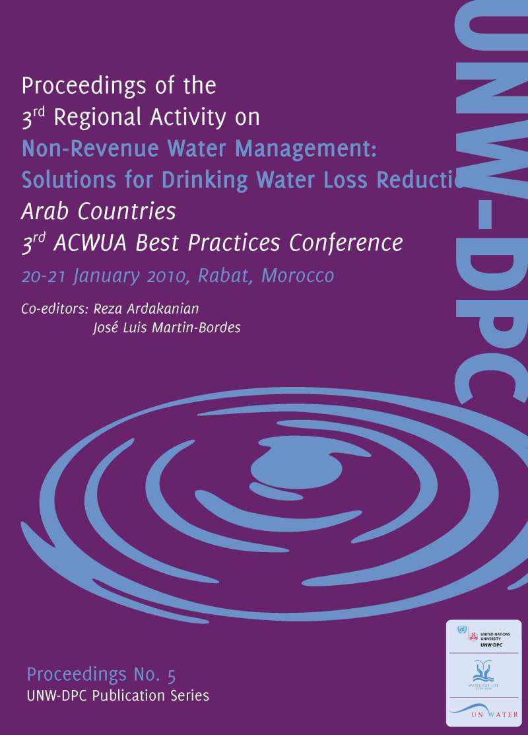
2. Series of Regional Drinking Water Loss Reduction Workshops, together with UN-Habitat and local partners

Slide 9
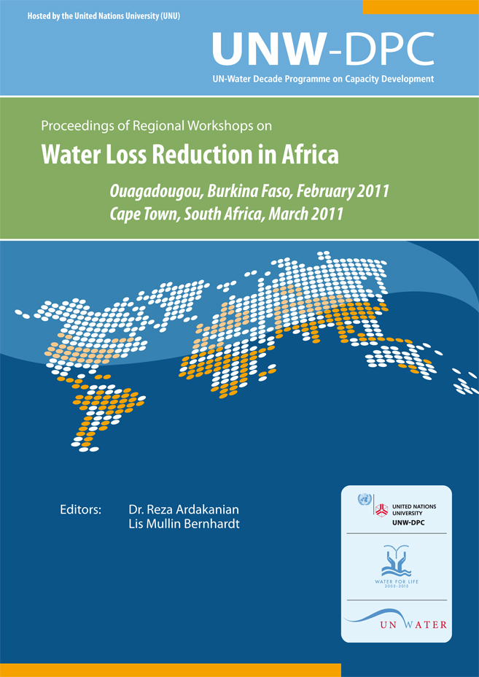
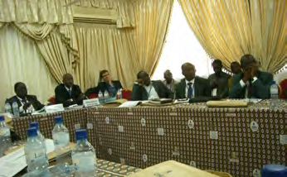

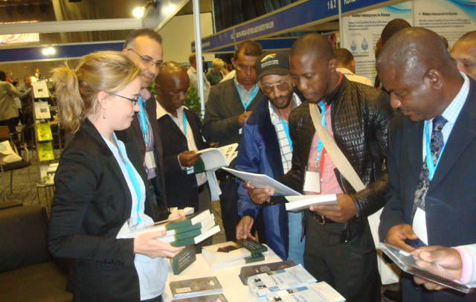
3. Further awareness raising
Workshop in Burkina Faso
Seminar
South Africa
Seminar on "Capacity Building for Non Revenue Water Loss Reduction: an Africa Perspective"

Slide 10
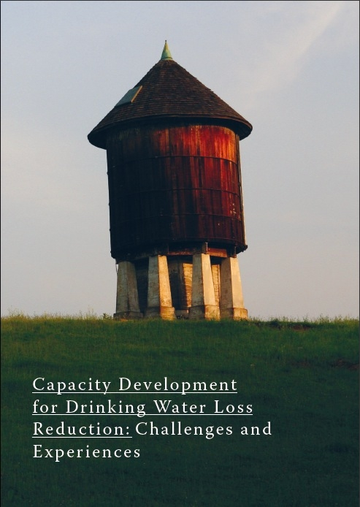
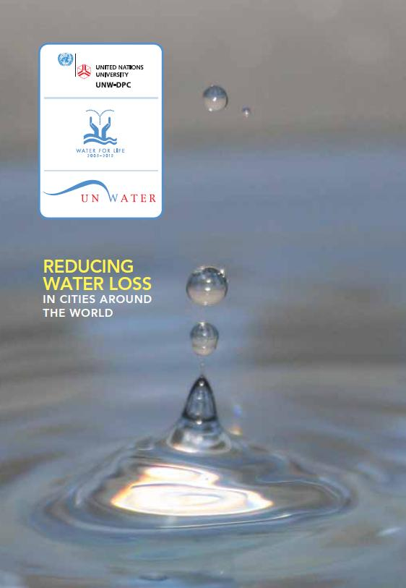
Book and Video launch
Launched at the World Water Day 2011 in Cape Town

Slide 11
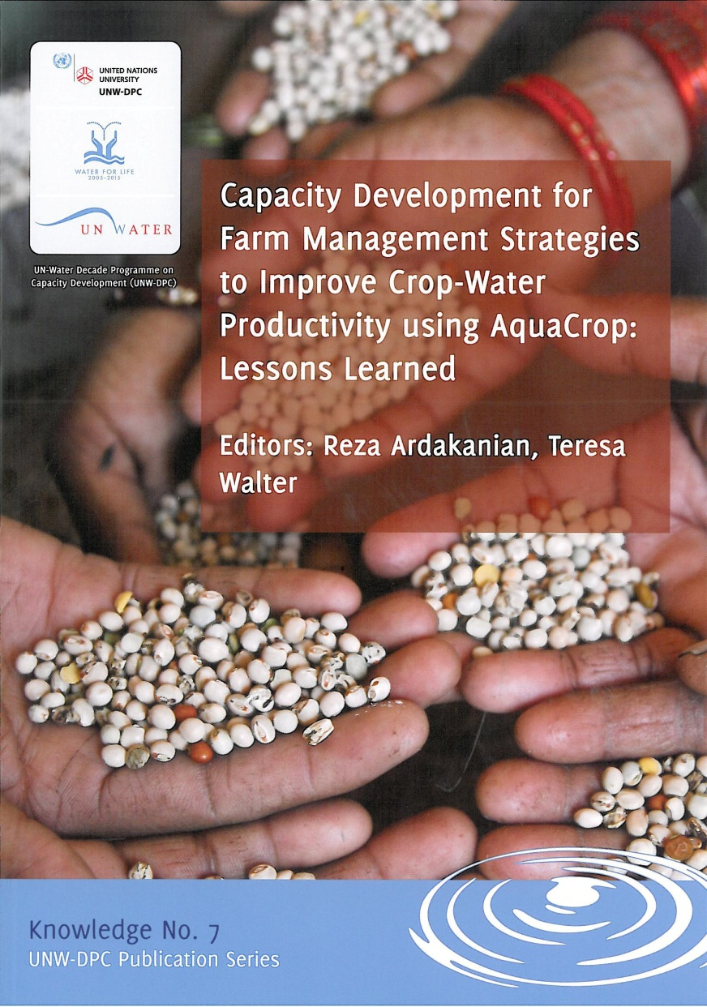
CD for Farm Management Strategies using AquaCrop
Training Workshops, Africa
Burkina Faso
Egypt
South Africa
Training Workshops, Asia
Iran
China
Wrap-up at International workshop in Indonesia, showcasing best case studies of practical applications to policy makers

Slide 12




Safe use of Wastewater in Agriculture
Stage I: capacity building at the
individual/organization level

Slide 13
Levels and dimensions of capacity with respect to safe wastewater use in agriculture
Trade and market environment
System level: Context in which organisations, individuals and groups involved in wastewater use for agriculture operate
Dimensions: Policies, strategies, laws and regulations related to safe wastewater use in agriculture.
Relationships, interdependencies and interactions among concerned stakeholders
Socio-economic and political environemnt
Organization level: Government Agencies and Institutions such as Ministries of Agriculture, Water, Environment, Health or Irrigation; Water control laboratories, Research Centers, Consumer groups
Dimensions: Resources (human, financial, information) procedures, structures, culture, decision-making, infrastructure, etc.
Individual Level: Public health, agricultural and environmental scientists, agriculture professionals, educators, researchers,engineers,policy makers and those responsible for developing
standards and regulations
Dimensions: Knowledge, skills, competences, work ethics, etc.
Governance
Education
(Source: UNDP 1998)

Slide 14
Stages of a Capacity Needs Assessment for individuals
Review the current national strategy to promote the safe use of wastewater in agriculture and the role of the organization in this strategy (policy making, research, education, extension, etc.)
Review and analyse the existing organization’s individuals competences (knowledge, skills) to play this role
Define the desired future situation in terms of individuals competences to effectively play this role
Identify training and education needs

Slide 15
Phases in Stage I: Capacity building at the individual/organization level
Phase I:
Individual Capacity Needs Assessment (CNA)
Questionnaires
National meetings
National Reports
Results
Phase II:
International workshop
Country needs
Gap Assessment
Clustering
Partners‘ materials
Phase III:
Regional workshops
Selected materials, methods and expertise
Dissemination techniques
Capacity building action plan at the individual/organization level
Phase IV:
Wrap-up workshop
New CNA at the intitution/system level
Implementation of Recommended Actions

Slide 16

Timeline
Results and milestones | Deadline
International Workshop | November 2011
Regional Workshops North Africa, Asia and Middle East, Latin America, Southern Africa | February to September 2012
International Wrap-up workshop | ~ March 2013

Slide 17
Structure of the kick-off workshop
Day 1
Introduction of organizing programmes, agenda, additional info
Launch of the UN-Water Activity Information System (UNW-AIS+)
Regional panel presentations of Capacity Needs Assessment (CNA) Results
Region 1: Asia: Iran, Jordan, Lebanon, Pakistan, and Syria
Region 2: Latin America: Bolivia, Colombia, Guatemala, and Peru
Region 3a: Northern Africa: Algeria, Egypt, Morocco, and Tunisia
Region 3b: Sub-Saharan Africa: Ghana, Senegal, and South Africa
Synopsis of regional presentations, discussion on regional and overarching issues

Slide 18
Structure of the kick-off workshop
Day 2
Recap of day 1 and introduction of additional materials
Presentations by Guest Organizations (DWA, IWMI)
Discussion on the way forward
Regional break out groups to discuss the information needs of countries engaging in safe use of wastewater in agriculture
Report of the speakers of the three regional breakout groups
Synopsis and closing
Bonn Dialogue on “The Water, Energy and Food Security Nexus: Solutions for the Green Economy”

Slide 19
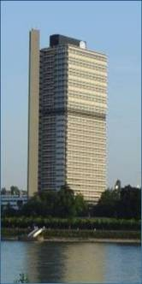

Thank you!
UN-Water Decade Programme on Capacity Development (UNW-DPC)
UNITED NATIONS UNIVERSITY
UN Campus
Hermann-Ehlers-Str. 10
D-53113 Bonn, Germany
Phone: + 49 (0) 228 815-0652
Fax: + 49 (0) 228 815-0655
E-Mail: info@unwater.unu.edu
www.unwater.unu.edu

