Slide 1









UN-Water Project on
Safe Use of Wastewater in Agriculture
Safe Use of Wastewater
In Agriculture
Wrap‐up and Concluding Session:
Expectations
1st Regional Workshop for Francophone Africa
18-19 February 2012
Palais de Congr‘es, Room „Fez“
Dr. Jens Liebe, UNW-DPC

Slide 2
Expectations of the Organizers
Action
Foster interdisciplinary approach (use or form a platform to promote the issue, …)
Contribute to awareness raising and public acceptance (resource, not waste; part of a solution to water shortage, food security; …)

Slide 3
Expectations of the Organizers
Revisit the challenges and possible solutions you described – anything you can implement?
Formulate goals which lead to actions/Future action plan (i.e. 3 most important interventions)
Promote formulation of guidelines, policies

Slide 4
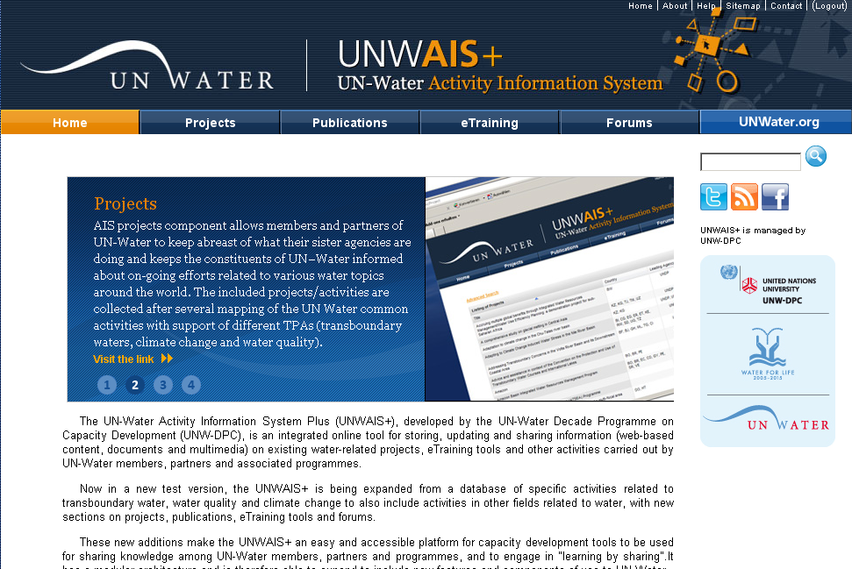

UN-Water Activity Information System
UNW-AIS
Discover, learn, and share!
http://www.ais.unwater.org/wastewater/

Slide 5
International Wrap-up Conference
Synopsis, inviting workshop participants with success stories
Complete institutional mapping and revised national report
Let us know of your activities (reportable post-workshop activities, achievements, challenges, needs assessment, etc.)

Slide 6
Your expectations and comments
How will you make use of what you have learned in this workshop?
What are your needs from UN-Water members and partners?

