Slide 1
WHO Guidelines
Safe Use of Wastewater Greywater and Excreta
Notes:
Not going to talk in detail about the many potential health impacts of ww use
Want to take the opportunity to clarify about the contents of the GLs and encourage you to use them….rich source of information
Some parts may be difficult to understand with translation … use group work afterwards

Slide 2
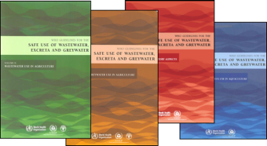

Slide 3
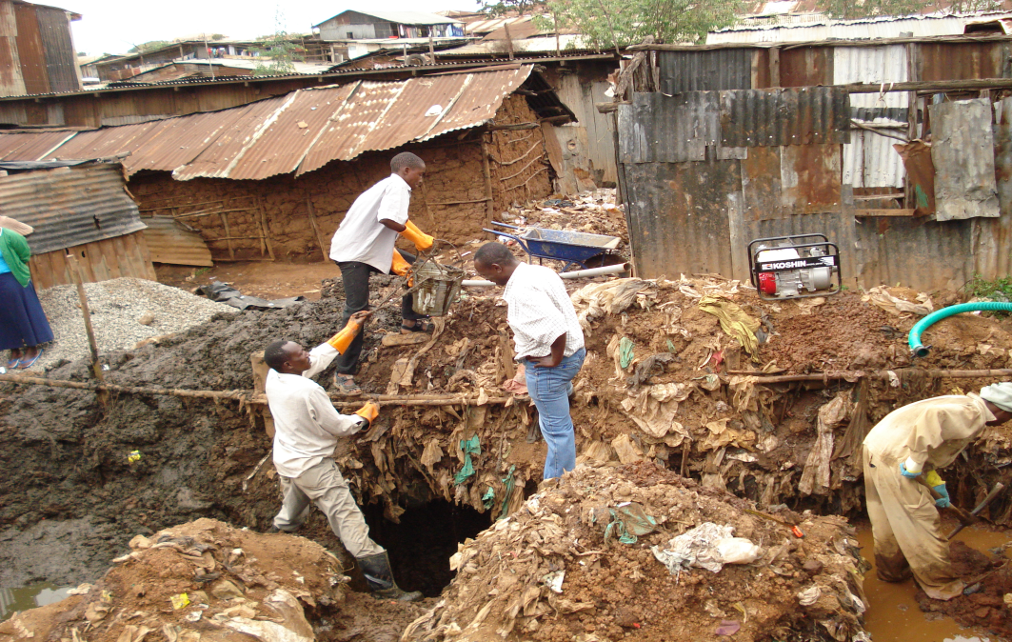
Wastewater Use at a Glance

Slide 4
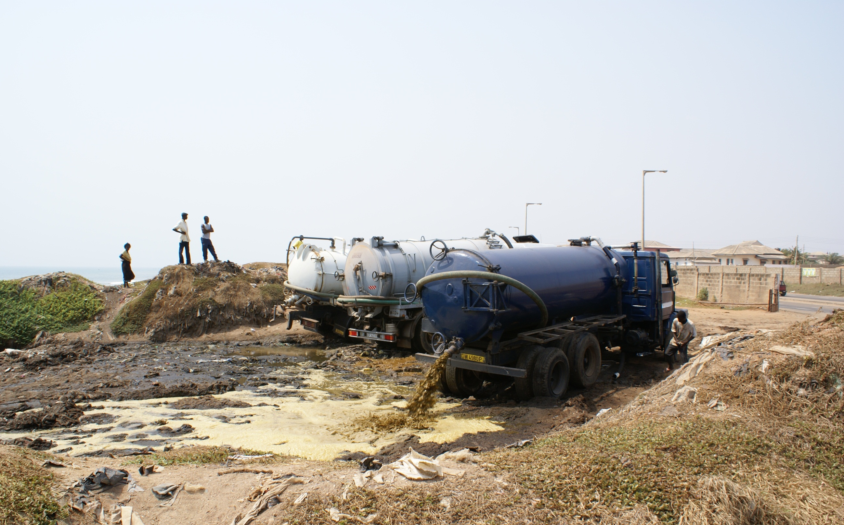
Wastewater Use at a Glance

Slide 5
Most wastewater is untreated
Up to 90 % of all wastewater in developing countries is discharged untreated directly into rivers, lakes or the oceans
Wastewater use is extensive worldwide and increasing
The extent is difficult to quantified due to the informal nature of the practice
Notes:
Reminder that…..used indirectly this where diease burden and most vulnerable people exposed are likley to be.

Slide 6
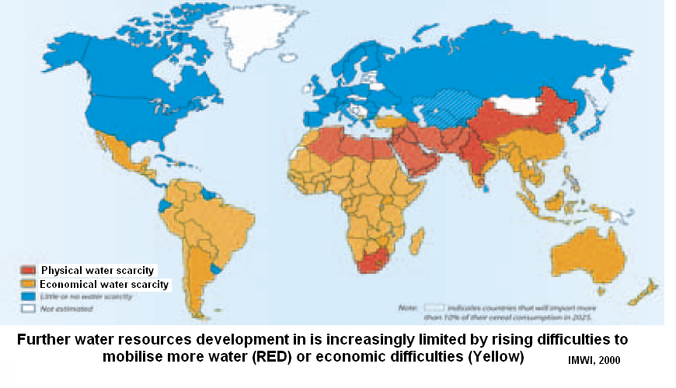
Demand to use wastewater will grow
Bluewater scarcity by 2025

Slide 7
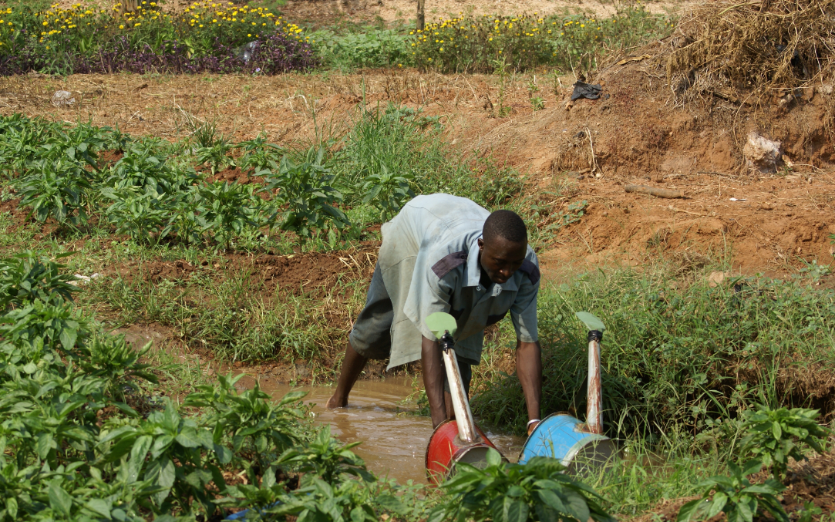
Health Risks and Benefits

Slide 8
Health risk and benefits
Direct Health Effects
Disease outbreaks (food, water and vector borne)
Persistent diseases (e.g. intestinal helminth infections, diarrhoeal diseases)
Non-communicable diseases (eg from industrial waste)
Workers
Community
Consumers
Indirect Health Effects
Adverse impacts on the safety of drinking water, food and recreational water.
Positive impacts on household food security and nutrition
Notes:
Dont have Burden of Disease estimates for WW use.

Slide 9
Major wastewater related diseases
Disease | Mortality (deaths/year) | Burden of Disease (DALYs/year) | Comments
Diarrhoea | 1 798 000 | 61 966 000 | 99.8% of deaths occur in developing countries; 90% of deaths occur in children
Typhoid | 600 000 | N/A | Estimated 16 million cases per year
Schistosomiasis | 15 000 | 1 702 000 | Found in 74 countries; 200 million people worldwide are estimated to be infected, 20 million with severe consequences
Ascariasis | 3 000 | 1 817 000 | Estimated 1.45 billion infections, of which 350 million suffer adverse health effects
Hookworm disease | 3 000 | 59 000 | Estimated 1.3 billion infections, of which 150 million suffer adverse health effects
Lymphatic filariasis | 0 | 5 777 000 | Mosquito vectors of filariasis breed in organically polluted water; does not cause death but leads to severe disability
Hepatitis A | N/A | N/A | Estimated 1.4 million cases per year worldwide; serological evidence of prior infection ranges from 15% to nearly 100%

Slide 10
Table 2.7 Vector-borne diseases of possible relevance to wastewater use in agriculture
Disease | Vector | Relative risk of wastewater use in agriculture | Comments
Dengue | Aedes aegypti | Low | Vectors breed in standing water (e.g. tires, cans, bottles, etc.). Present in South-east Asia but not China.
Filariasis | Culex quinquefasciatus | Medium | Vectors breed in organically polluted water. Endemic in many countries where wastewater use in agriculture is practised.
Japanese encephalitis | Culex spp. | Medium | Vectors breed in flooded rice fields. Endemic in many countries where wastewater use in agriculture is practised.
Malaria | Anopheles spp. | Low | Vectors breed in uncontaminated water; 90% of malaria cases occur in Africa. Anopheles breeding has been reported from serial waste stabilization ponds.

Slide 11
Table 3.5 Survival of various organisms
 | Organism | Survival times (days)
 |  | Water and sewage | Soil | Crops
Viruses | Enterovirusesª | <120, usually <50 | <100, usually <20 | <60, usually <15
Bacteria | Thermo. coliforms Salmonella spp. V. cholerae | <60, usually <30 <60, usually <30 ND | <70, usually <20 <70, usually <20 <20, usually <10 | <30, usually <15 <30, usually <15 <5, usually <2
Protozoan cysts | Cryptosporidium | <180, usually <70 | <150, usually <75 | <3, usually <2
Helminths | Ascaris eggs Tapeworm eggs | Years Many months | Years Many months | <60, usually <30 <60, usually <30

Slide 12
Chemical Risks
Use of waters with substantial industrial contamination is not recommended.
Limited evidence of direct health impacts – Effects are chronic rather than acute (over many years of multiple exposures) therefore it is difficult to attribute impacts to wastewater.
Heavy metal uptake in plants is highly dependent on soil conditions.
Indirect effects of wastewater contamination to drinking water due to poor irrigation practices leading to nitrate and toxic cyanobacteria poisoning.

Slide 13
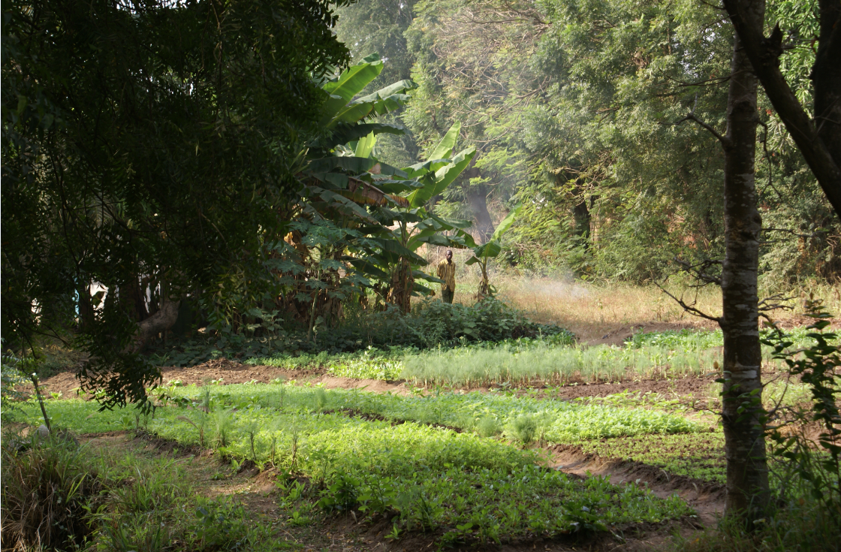
2006 WHO Guidelines
For the Safe Use of Wastewater, Excreta and Greywater

Slide 14
WHO Guidelines for Safe Use of Wastewater, Excreta and Greywater (3rd Edition)
    Objective: To Maximize the protection of human health and the beneficial use of human waste.

Slide 15
Some Lessons from the 1989 Guidelines
Strict standards borrowed from other countries often fail
Risk reduction is necessary (and possible) where wastes receive no or inadequate treatment
Guidelines are not just numbers;
good practice + microbial water quality standards
Low-cost treatment options are needed

Slide 16
1989 WHO Guidelines
2006 WHO Guidelines
Irrigation
water quality thresholds
Health-based targets
(DALYs)
Wastewater
generation
Farmers
Traders
Kitchens
Consumers
Wastewater
generation
Farmers
Traders
Kitchens
Consumers
Wastewater
treatment
Safe
Irrigation
Practices
Hygienic
Handling
Practices
Safe food
washing and
preparation
Awareness
creation
to create
demand for
safe produce
Wastewater
treatment
Technology barriers
Behaviour barriers
Facilitating behaviour change via education,
financial & non-financial incentives, and
regular inspections
Notes:
Hazard analysis and critical control points Single barrier as risk management tool → multi barriers
Behavior change - difficult
Hands up who has heard of DALYS?

Slide 17
1989 WHO Guidelines
2006 WHO Guidelines
Irrigation
water quality thresholds
Health-based targets
(DALYs)
Wastewater
generation
Farmers
Traders
Kitchens
Consumers
Wastewater
generation
Farmers
Traders
Kitchens
Consumers
Wastewater
treatment
Safe
Irrigation
Practices
Hygienic
Handling
Practices
Safe food
washing and
preparation
Awareness
creation
to create
demand for
safe produce
Wastewater
treatment
Wastewater treatment operators
Agriculture
Urban planning
Environment
Health
Facilitating behaviour change via education,
financial & non-financial incentives, and
regular inspections
INSTITUTIONS INVOLVED IN ENSURING SAFETY
Notes:
Hazard analysis and critical control points Single barrier as risk management tool → multi barriers
Behavior change - difficult
Hands up who has heard of DALYS?

Slide 18
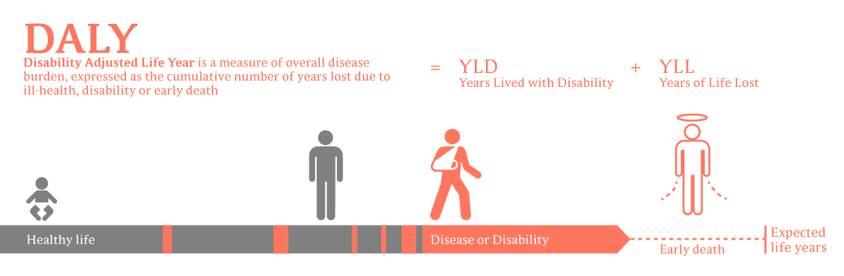
Has anyone heard of DALYs?

Slide 19
Why health based targets (DALYs)?
"The judgement of safety is a matter in which society has a role to play. The final judgement on whether the benefits of a target justifies the cost is for each country to decide"

Slide 20
Why health based targets (DALYs)?
2006 guidelines adopts 10 ⁻⁶ DALYs – equivalant to 1 excess case of cancer per 100,000 people exposed to wastewater

Slide 21
Why health based targets (DALYs)?
Countries may choose to start lower
at 10 ⁻⁴ or 10 ⁻⁵ DALYs where disease burden is high and other WASH intervention may be more effective

Slide 22
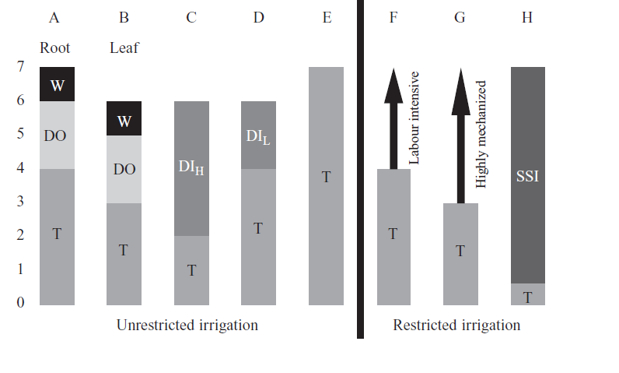
How can we reach that target?
Aiming for total of 6-7 log reductions by adding up multiple barriers
Wash
Die-off
Different levels
of treatment depending on use and post treatment barriers
Treatment

Slide 23
Are effluent guideline values included?
In summary:
≤1,000 e.coli/100ml
≤1 helminth egg per litre
Chemical limits for soils (health)
Chemical limits for WW (crop requirements)
≤1
≤1,000 e.coli/100ml
≤1,000
≤1,000
≤10,000
≤10,000
Treatment
≤100,000
≤100,000

Slide 24
Control measure | Pathogen reduction (log units) |  | Notes
A. Wastewater treatment
Treatment | up to 6−7 |  | Pathogen reduction depends on type and degree of treatment selected
B. On-farm options
Crop restriction (i.e., no food crops eaten uncooked) | 6−7 |  | Depends on (a) effectiveness of enforcement and (b) comparative profit margin of the alternative crop(s)
On-farm treatment:
(a) Three-tank system | 1−2 |  | Very effective for helminth egg sedimentation.
(b) Simple sedimentation | 0.5−1 |  | If ca. 18 hours; more effective for helminth eggs
(c) Simple filtration | 1−3 |  | Value depends on filtration system used
Safer wastewater application:
(a) Furrow irrigation |  | 1−2 | Crop density and yield may be reduced
(b) Low-cost drip irrigation |  | 2−4 | 2-log unit reduction for low-growing crops, and 4-log unit reduction for high-growing crops
(c) Reduction of splashing |  | 1−2 | Farmers trained to reduce splashing when watering
Pathogen die-off (cessation) |  | 0.5−2 per day | Die-off between last irrigation and harvest (value depends on climate, crop type, etc.)

Slide 25
Control measure | Pathogen reduction (log units) |  |  |  |  | Notes
C. Post-harvest options at local markets
Overnight storage in baskets |  |  | 0.5−1 | Selling produce after overnight storage in baskets (rather than overnight storage in sacks or selling fresh produce without overnight storage)
Produce preparation prior to sale |  |  | 1−2 | (a) Washing salad crops, vegetables and fruit with clean water
 |  |  | 2−3 | (b) Washing salad crops, vegetables and fruit with running tap water
 |  |  | 1−3 | (c) Removing the outer leaves on cabbages, lettuces, etc.
D. In-kitchen produce-preparation options
Produce disinfection/washing |  | 2−3 |  |  | Washing salad crops, vegetables and fruit with an appropriate disinfectant solution and rinsing with clean water.
Produce peeling |  | 2 |  |  | Fruits, root crops
Produce cooking |  | 5−6 |  |  | Option depends on local diet and preference for cooked food.

Slide 26
Implementation of the guideline

Slide 27
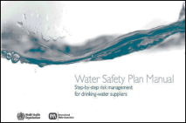
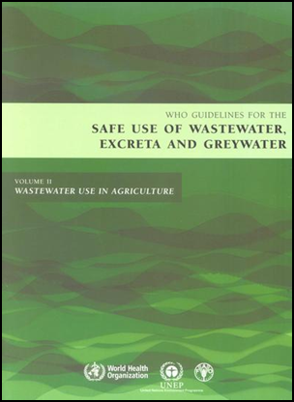
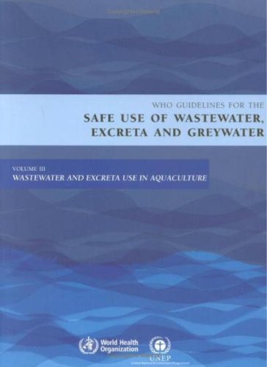
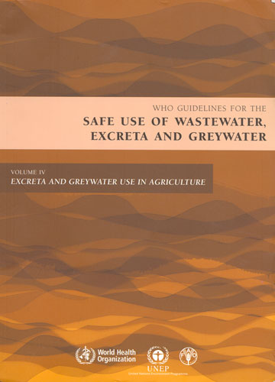
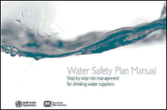
Various WHO Water Quality Guidelines
UNDER DEVELOPMENT 2012/13
Sanitation Safety Plan
Manual

Slide 28
Key Concepts
System assessment
Hazard identification
Risk assessment
Multiple barriers for risk management
Monitoring (operational and verification)
Incremental improvement

Slide 29
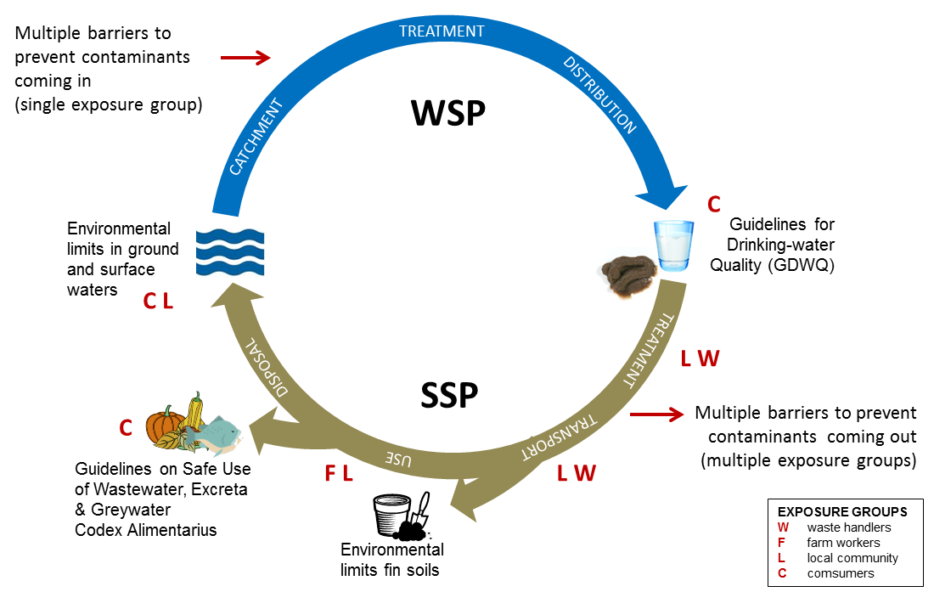
Water and Sanitation Safety Plans

Slide 30
Water and Sanitation Safety Plans
  Example barriers:
  Wastewater treatment
  Crop restriction
  The method of irrigation
  Washing
  Peeling
  Cooking
  Market hygiene
  Vaccines

Slide 31
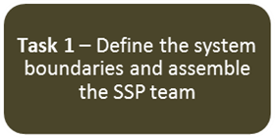
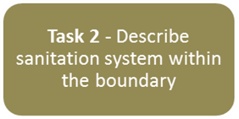
Risk Management (SSP) Tasks
Start by identifying priority high risk areas in the city

Slide 32
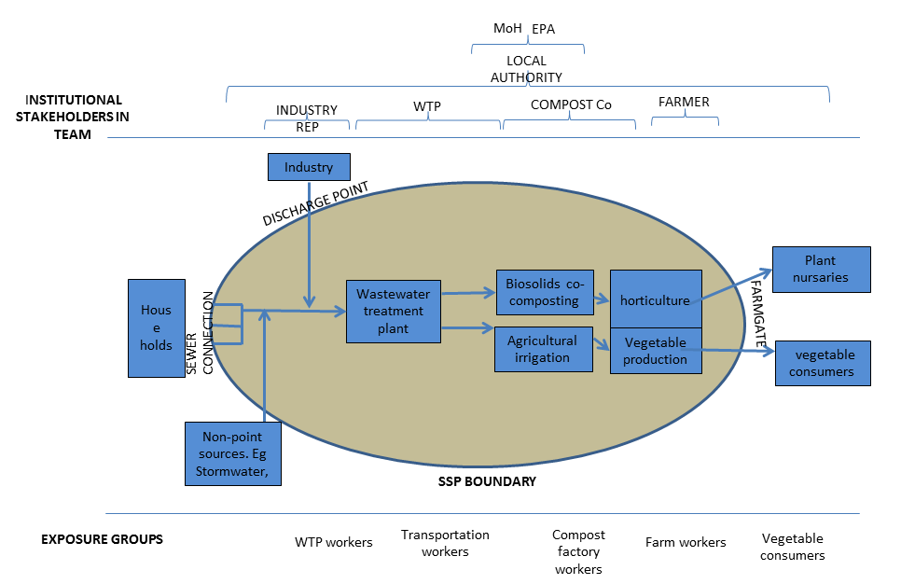

Slide 33
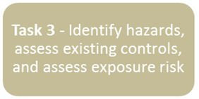
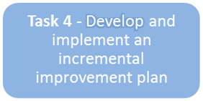
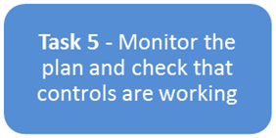
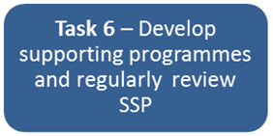
Risk Management (SSP) Tasks
Start by identifying priority high risk areas in the city
Continuous improvement

Slide 34
SSP Outline Tasks
1.1 Define the System Boundary and lead institution 1.2 Engage senior management support and secure financial and resource support 1.3 Assemble the SSP team
2.1 Map the system 2.2 Characterise waste / Characterise disease 2.3 Identify all potential exposure groups 2.4 Validate the system through field investigations 2.5 Gather relevant contextual information
3.1 Identify hazards/ hazardous events within the system for each exposure group 3.2 Identify exposure routes associated with each hazard 3.3 Assess and prioritize the risk associated with each hazard or hazardous event 3.4 Identify and assess existing control measures

Slide 35
SSP Outline Tasks
4.1 Review and rank options to control identified risks 4.2 Select control measures, and develop an improvement plan
5.1 Define operational monitoring of control measures against limits 5.2 Verify system performance against health indicators 5.3 External assessment of SSP performance 5.4 SSP Audit and Certification
6.1 Document and implement management procedures 6.2 Identify and implement supporting programmes 6.3 Regularly review and update the SSP

Slide 36
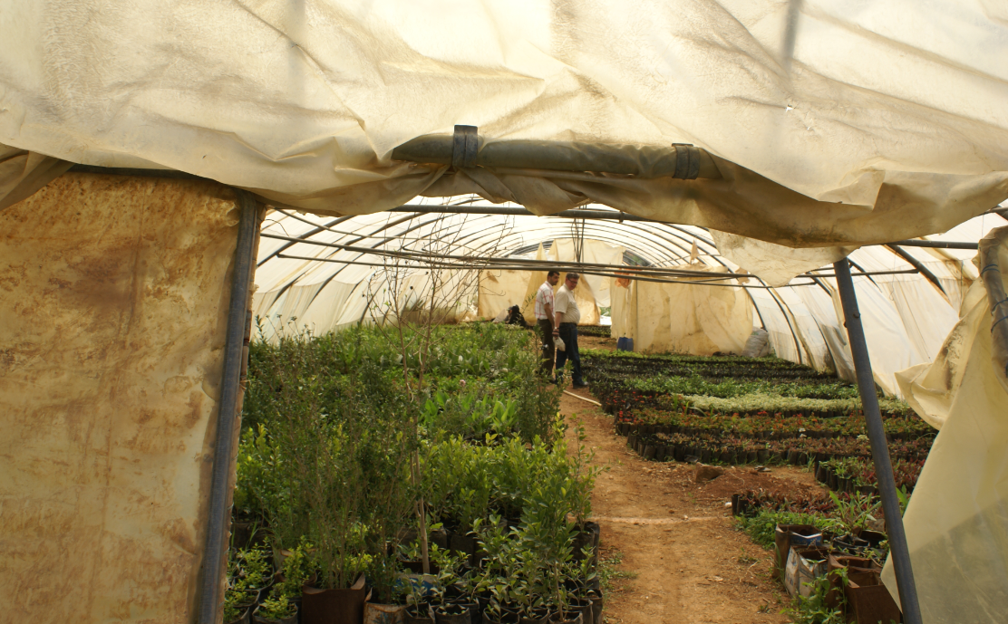
All publications can be found at:
www.who.int

