Slide 1


Maximizing Productivity from Wastewater: Irrigation, Soil, and Crop Management Strategies
Manzoor Qadir (UNU-INWEH)
Javier Mateo-Sagasta (FAO)
Fifth Regional Workshop ‘Safe and Productive Use of Wastewater in Agriculture’, March 2013, Bali, Indonesia

Slide 2
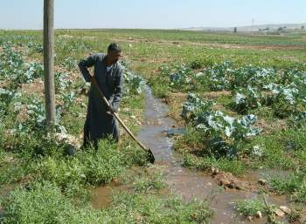

Wastewater: Opportunities for Crop Production
  Stable source of water with reliable availability of irrigation water amid water scarcity
  Savings on fertilizer use (wastewater contains nutrients), i.e. cheap source of nutrients with no or little amount of fertilizer needed

Slide 3
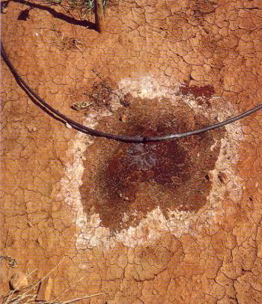
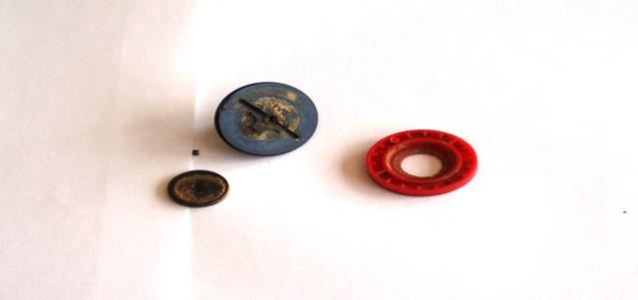
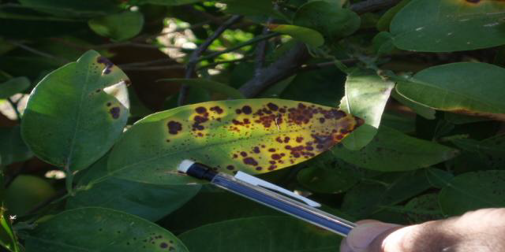
Wastewater: Risks for Crop Production
  Salinity/sodicity
  Specific ion toxicity
  Suspend solids
Salinity/sodicity
Clogged drippers
Boron toxicity

Slide 4
How can we maximize agricultural productivity and benefits from wastewater while minimizing risks?
Some on-farm strategies

Slide 5
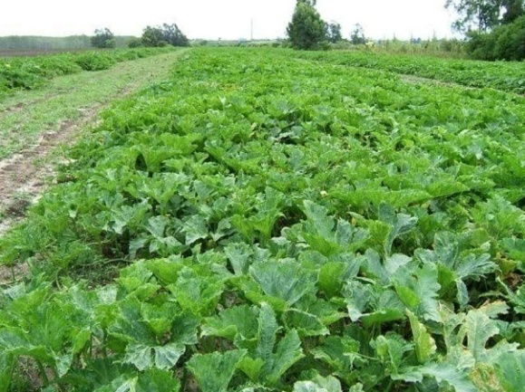
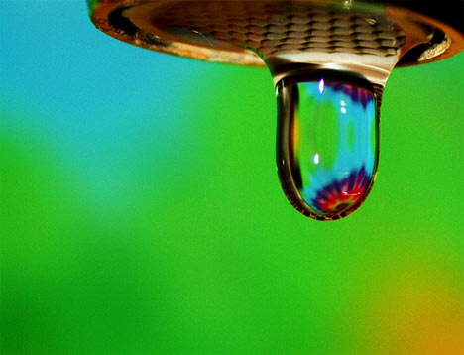

Crop selection
Irrigation management
Soil management
Irrigation, soil, and crop management strategies for wastewater use in agriculture
Qadir, Drechsel, Raschid-Sally (2008) Wastewater use in agriculture: Agronomic considerations. Encyclopedia of Water Science: 1296-1299
FAO (2003) Users manual for irrigation with treated wastewater. FAO Regional Office for the Near East, Cairo, Egypt.

Slide 6
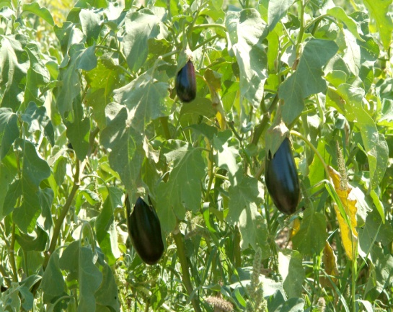
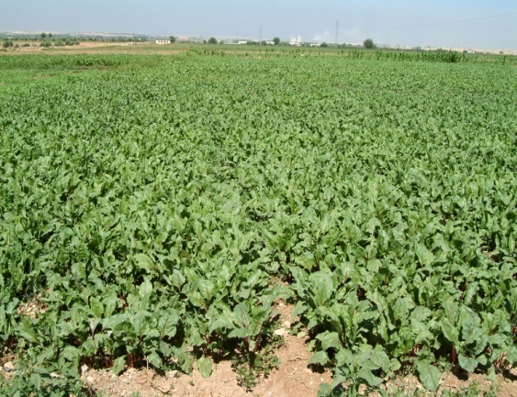
Crop Selection based on
  Market value/demand
  Crop irrigation requirement inline with water availability
  Crop diversification/restriction where untreated wastewater is used for irrigation
  Stress tolerance for salts, heavy metals, boron, etc.

Slide 7
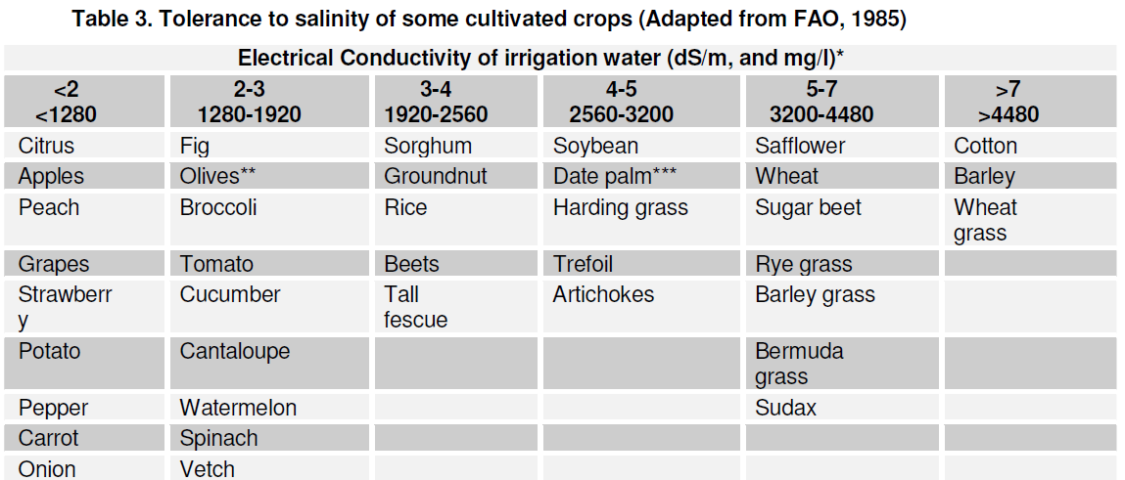
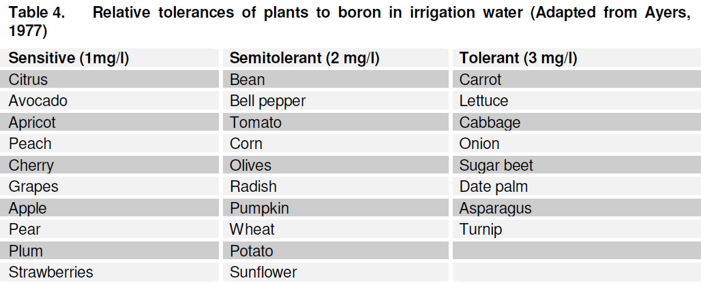

Crop Selection based on Stress Tolerance

Slide 8
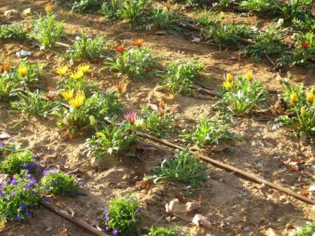
Irrigation Management
  Water quality: blending with freshwater or cyclic application with good-quality water
  Irrigation method:
  flood irrigation (low cost and low WUE), manual irrigation with watering cans, furrow irrigation, sprinkler irrigation, and drip irrigation (high cost and high WUE)

Slide 9
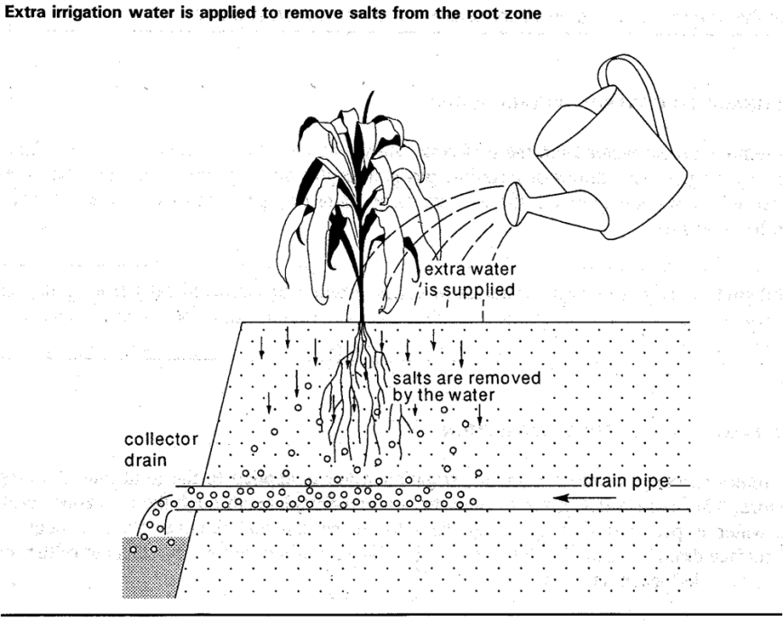
Irrigation Management
  Irrigation scheduling/frequency/rate
  Leaching and drainage
http://www.fao.org/docrep/016/i2800e/i2800e00.htm
ftp://ftp.fao.org/agl/aglw/fwm/Manual9.pdf

Slide 10
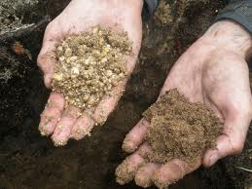
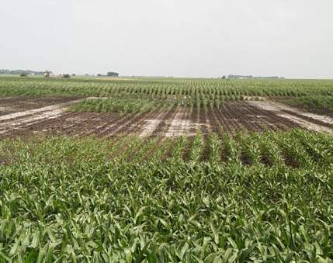
Soil Management based on
  Soil characteristics (sandy soils, clay soils…)
  Soil amendment needs (e.g. use of gypsum in case of highly sodic wastewater)
  Soil nutrient availability (fertilizer management)

Slide 11
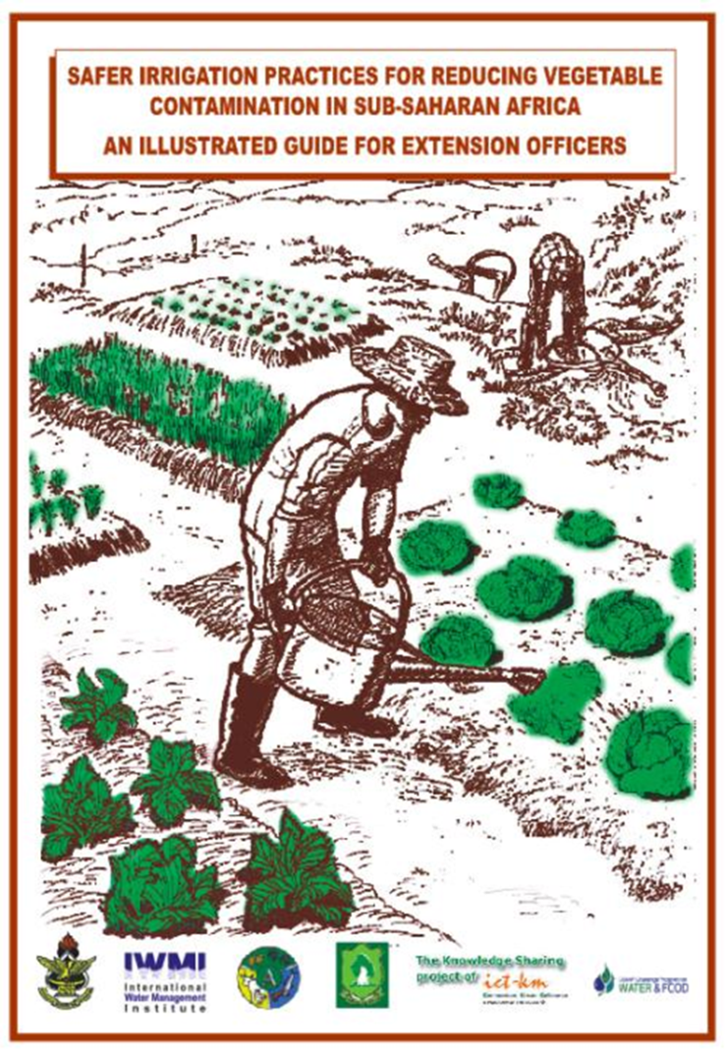
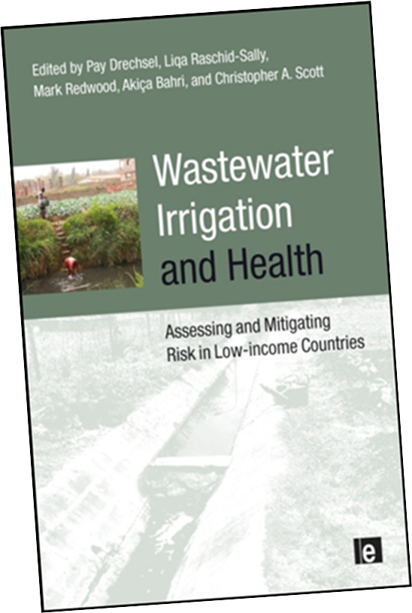
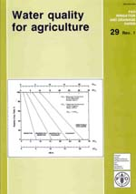
Some other selected publications
http://www.fao.org/docrep/016/i3041e/i3041e.pdf
http://www.iwmi.cgiar.org/Publications/Books/PDF/Farmers_Guide-Low_res-Final2.pdf
http://www.fao.org/docrep/008/y5009e/y5009e00.htm
http://www.fao.org/docrep/003/T0234E/T0234E00.htm

Slide 12
Conclusions
Recovery of water and nutrients from wastewater offers multiple opportunities for crop production.
These opportunities can translate into increased productivity and income for farmers if appropriate irrigation, crop, and soil management strategies are implemented.

