Slide 1






Institutional Arrangements and Collaboration for Safe Use of Wastewater in Agriculture in Southeast and Eastern Asia
Fifth Regional Workshop ‘Safe and Productive Use of Wastewater in Agriculture’, 5-7 March 2013, Bali, Indonesia

Slide 2
Presentation based on Questionnaire Response
  Cambodia
  China
  Lao PDR
  Malaysia
  Mongolia
  Philippines
  Thailand
  Timor-Leste
  Vietnam

Slide 3
Institutional Levels/Categories
National level across different ministries
District level across related institutions
Academic level across educational institutions
Farmers level across individual and associations
Policy level addressing the use of WHO/national guidelines
Regional level across countries in the region

Slide 4
National Level – Responsible Ministry
Great diversity at the national level ministries among countries for wastewater management
  Ministry of Agriculture
  Ministry of Environment
  Ministry of Infrastructure
  Ministry of Public Work and Transport
  Ministry of Energy, Green Technology, and Water
  Ministry of Construction and Infrastructure of Cities
Notes:
There is great diversity in terms of the leading ministry that has the overall responsibility of wastewater management at the national level. These ministries range from the Ministry of Agriculture to Ministry of Construction and Infrastructure of Cities.

Slide 5
National Level – Responsible Ministry
Thailand is a unique case – four ministries are involved at the national level with specific aspect of wastewater management
  Ministry of Industry (for industrial wastewater)
  Ministry of Interior (for community wastewater)
  Ministry of Natural Resources and Environment (for water quality control)
  Ministry of Public Health (for human excreta collection, transport, and treatment)
Notes:
Instead of a single ministry responsible for overall wastewater management in Thailand, there are four ministries at the national level with overall wastewater management responsibility. They are (1) Ministry of Industry (for industrial wastewater); (2) Ministry of Interior (for community wastewater); (3) Ministry of Natural Resources and Environment (for water quality control); and (4) Ministry of Public Health (for human excreta collection, transport, and treatment).

Slide 6
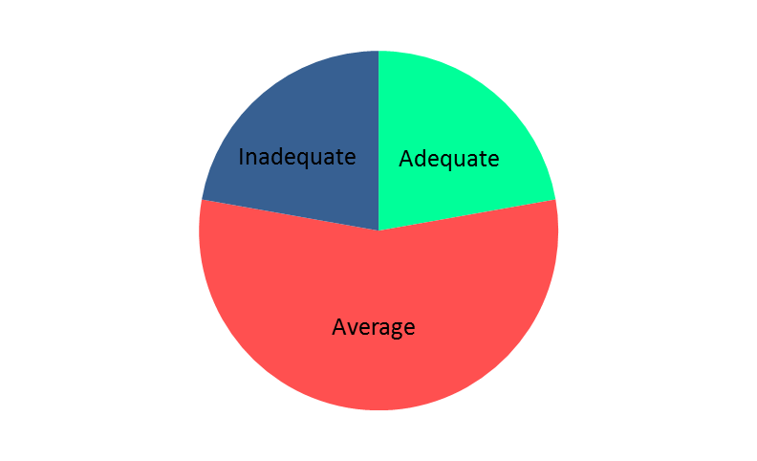
Inter-ministerial Collaboration
Categories included excellent, adequate, average, inadequate, and none

Slide 7
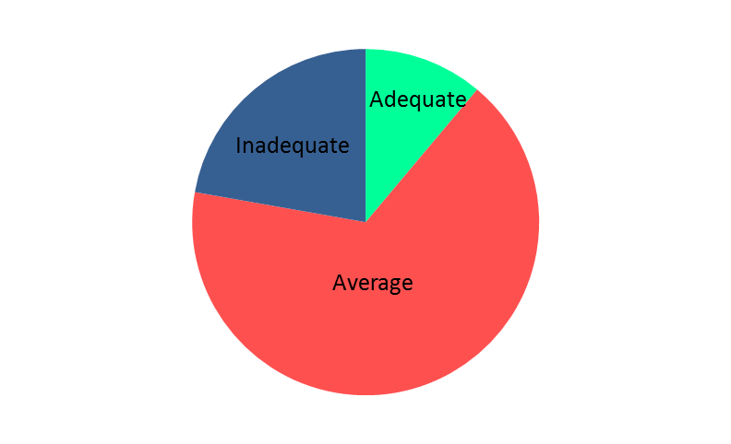
Government’s Commitment and Budget Allocation
Categories included excellent, adequate, average, inadequate, and none

Slide 8
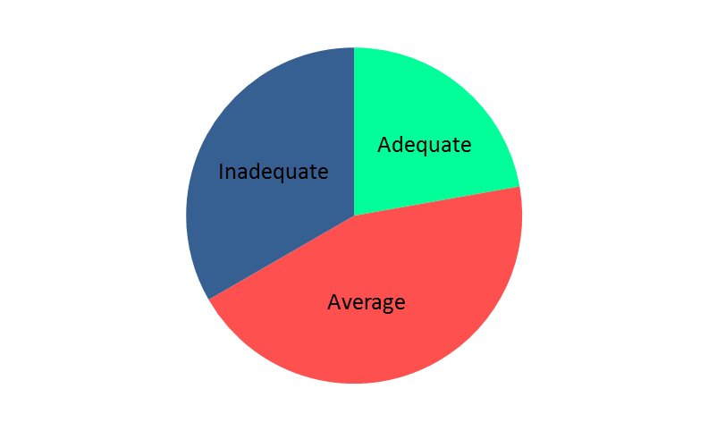
Institutional Collaboration at District Level
Categories included excellent, adequate, average, inadequate, and none

Slide 9
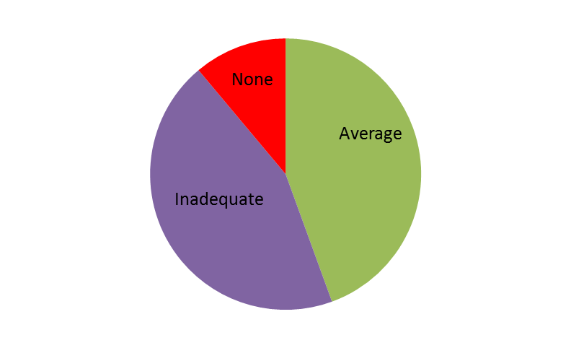
Institutional Commitment and Budget Allocation at District Level
Categories included excellent, adequate, average, inadequate, and none

Slide 10
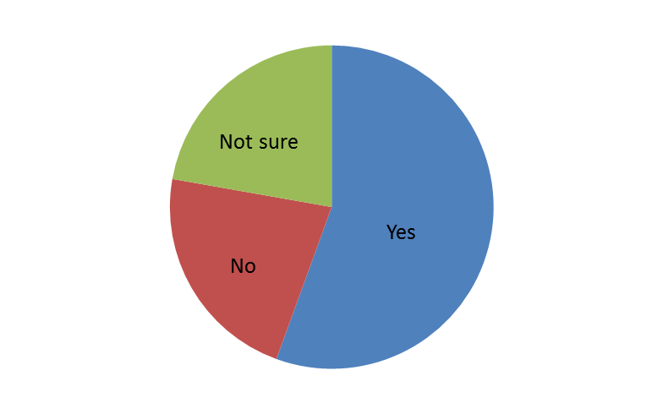
Academic Level: Wastewater in Schools’ Curricula
Topic of wastewater management in any form as a part of the curricula in schools

Slide 11
Academic Level: Wastewater in Universities’ Curricula
Topic of wastewater management as a part of the curricula in universities

Slide 12
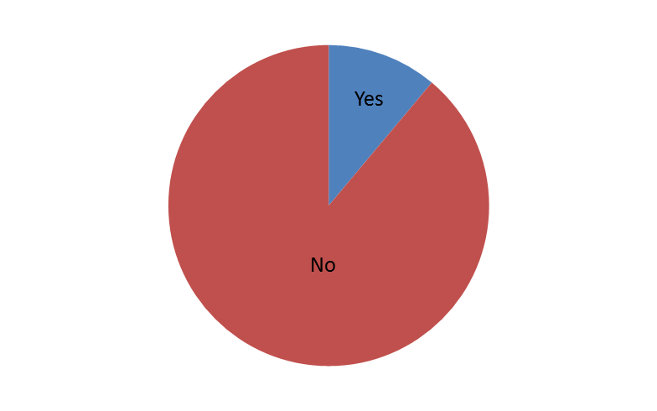
Farmers/Water Users Associations
Farmers/water users associations dealing with local institutions for wastewater delivery

Slide 13
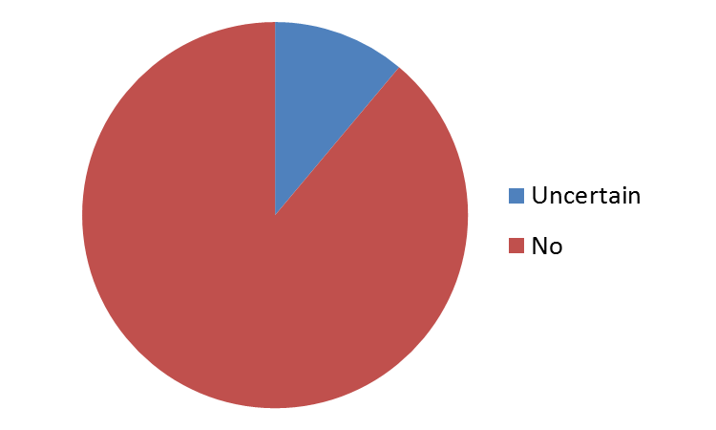
Farmers pay to Local Institutions for Wastewater

Slide 14
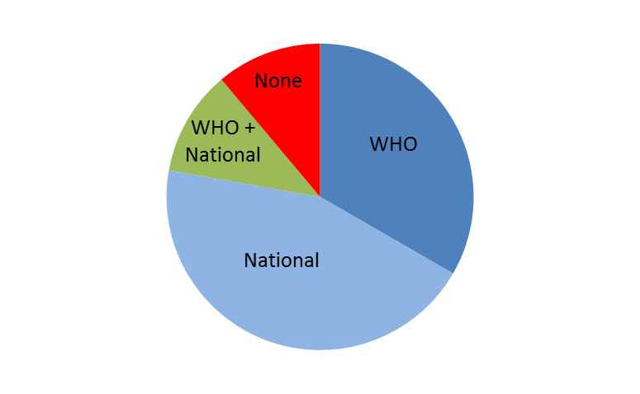
Policy Level: Guidelines for Wastewater Use
WHO Guidelines: Cambodia, Malaysia, and Thailand
WHO + National Guidelines: Vietnam
National Guidelines: China, Mongolia, Philippines, and Timor-Leste
None: Lao PDR
Categories included WHO guidelines, WHO + national guidelines, national guidelines, and none

Slide 15
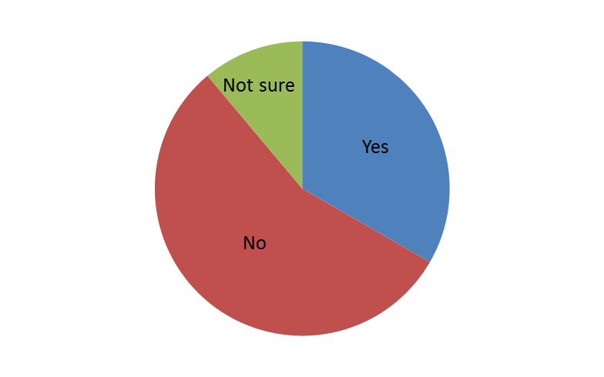
Regional Level: Collaboration across Countries
In case of yes, (1) collaboration through joint projects funded by international donor organizations and (2) participation in regional workshops

Slide 16
Discussion
What status do we have in regard to institutional arrangements at different levels for wastewater management?
What success stories do we have in terms of institutional collaboration addressing safe and productive use of wastewater?
How can we improve institutional collaboration addressing safe and productive use of wastewater?

