Slide 1
For use of poor quality water resources in agriculture Avinash C Tyagi Secretary General, ICID
NATIONAL STRATEGIES
5th Regional Workshop, Southeast and Eastern Asia
Safe and Productive use of Wastewater in Agriculture,
5-7 March, 2013, BALI, Indonesia
Under the Auspices of UN-Water
Partners: UNW-DPC, FAO, UNEP, WHO, ICID and IWMI

Slide 2
ICID Membership network spreads over 100 countries
covering about 96% of the world’s irrigated area

Slide 3





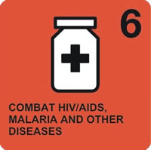


The Millennium Development Goals

Slide 4


Building the Future we want
June 2012, RIO de Janerio, Brazil

Slide 5
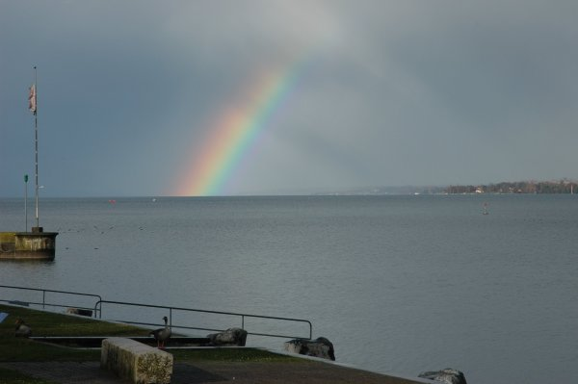
The Future We Want Green economy in the context of SD and poverty eradication
Apply green economy policies in advancing sustainable development and ending poverty
Recognize the importance of linking financing, technology, capacity-building and national needs for SD policies and green economy
…….
……….

Slide 6
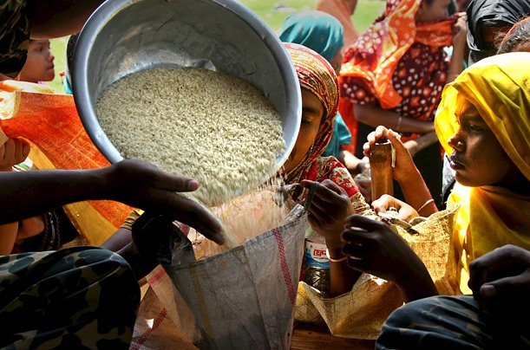
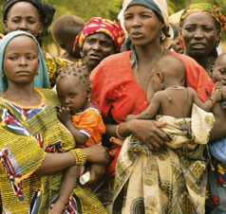
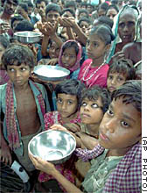
World agriculture faces an enormous challenge over the next
40 years to produce almost 50% more food up to 2030 and
double the food production by 2050
Key drivers
Increasing population and urbanization
Changing diets
Rapidly growing water demand from industrial/ energy and domestic sectors
Increasing area under bio-energy crops
Climate change impacts
Increasing fresh water scarcity

Slide 7
Global freshwater use: projections
Electricity
Domestic
Source: OECD Environmental Outlook baseline (2008)

Slide 8
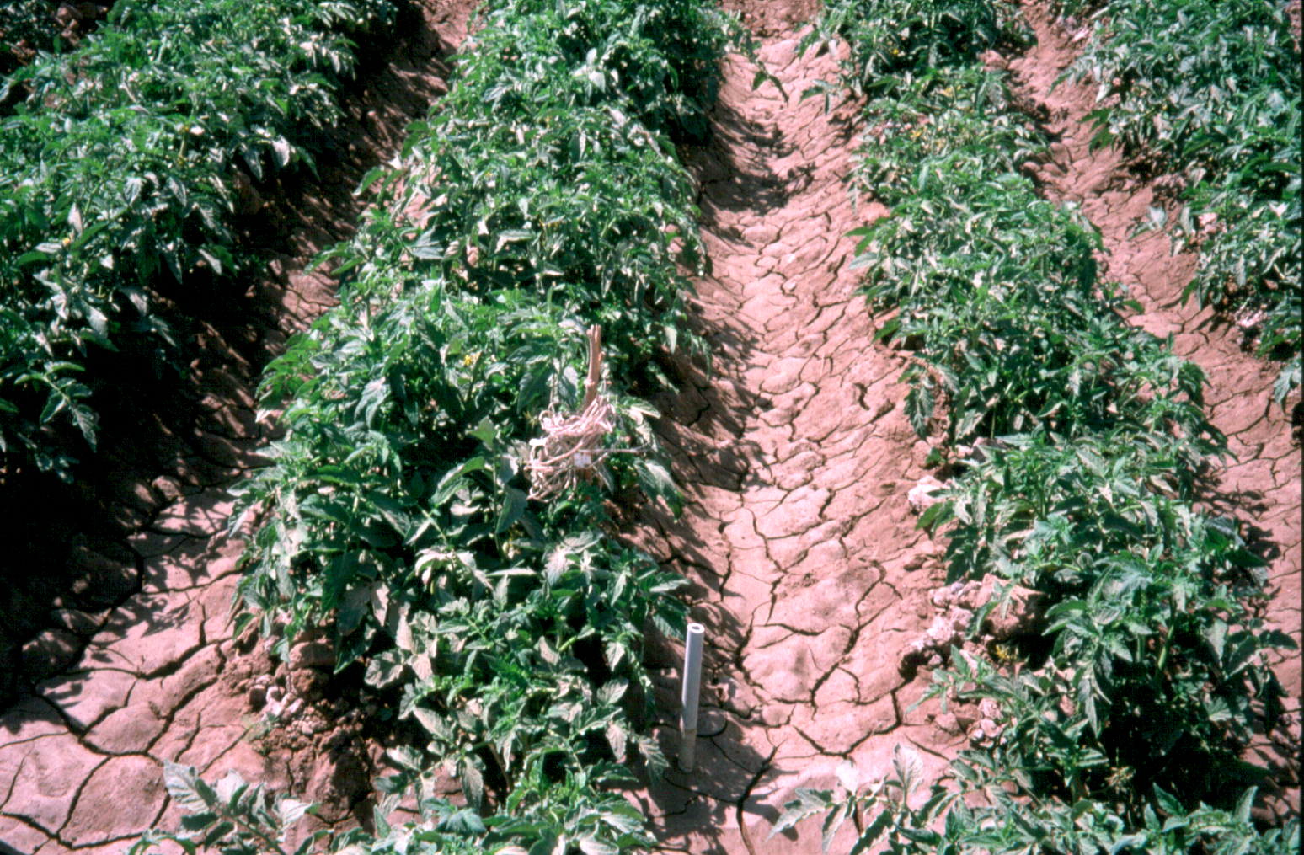
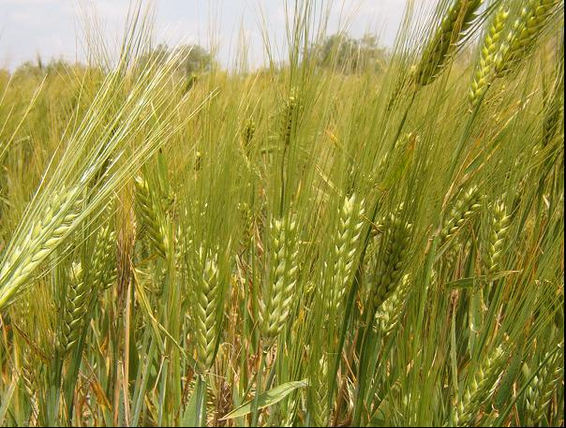
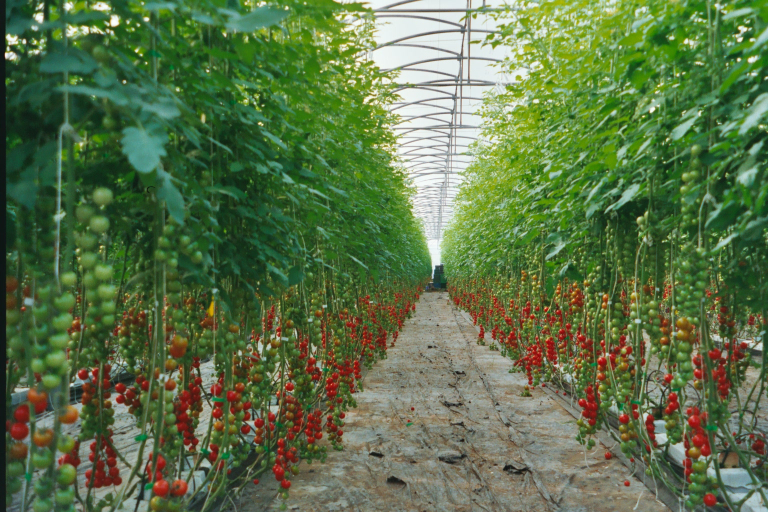
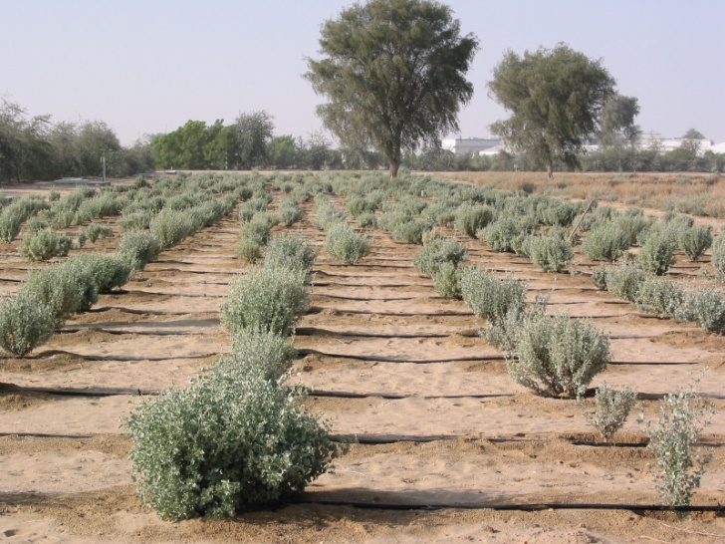
Tomatoes of high quality using Saline water for irrigation in Egypt.
Fresh tomatoes, Syria
barley genotypes, Dubai
Poor Quality Water
Saline water,
Brackish groundwater,
Wastewater
Cherie tomatoes, Malaga, Spain
Saline water can be used to produce food and fodder. Some varieties of tomato, Sugar beet, barley, Bermuda grass are salt tolerant.
pearl millet, Dubai
Halophyte shrub Atriplex, Dubai
Halophyte grasses, Dubai

Slide 9
Urban hydrologic cycle
RAIN
EVAPORATION
URBANISED LAND SURFACE
EVAPORATION
DETENTION
RETENTION
REGIONAL RETENTION
DETENTION
PIPE or
OPEN DRAIN
WATER SUPPLY
WATER QUALITY
CONTROL
SEWERAGE
TREATMENT
PLANT
OCEAN
WASTE WATER
SEWER
SOIL
RIVER SYSTEM
GROUND WATER

Slide 10
Urban wastewater generation
Households
Black water
(toilet)
Municipal wastewater
Urban wastewater
Institutions and establishments
Grey water (kitchen, bathroom)
Industries
Pre-treated
Untreated
Natural drainage channels
Urban runoff
Combined sewer
Storm water drainage
Separate sewer

Slide 11
Grey water
Grey water is all of the wastewater that drains out of washing machine, sinks and bathtub or shower; everything coming out of households except the toilet water.
Separating grey water from black water and tapping its reuse potential could be an ideal strategy for urban wastewater management
Grey water availability
Land area suitable for irrigation garden plants
Identification of right kind of plants etc.
Regulations: municipal bye-laws

Slide 12
Agriculture wastewater
Non-point Source Pollution: Sediment, Pesticide, Nutrient run-off
Point Source Pollution: Animal waste, piggery waste, silage liquor, daily farming waste, slaughtering waste, vegetable washing
AND
Including biological waste from hospitals
Industrial wastewater

Slide 13
Why bother about wastewater?
Wastewater (raw, diluted or treated) is a resource of increasing global importance, particularly in urban and peri-urban areas due to growing wastewater volumes
Without proper management, wastewater use poses serious risks to human health and the environment
With proper management, wastewater use can contribute significantly to sustaining livelihoods, food security and the quality of the environment
Wastewater already irrigates approximately 49 million acres of cropland, and
10 percent of the world's population would starve if they didn't have access to food grown that way

Slide 14
Why bother about wastewater?
In majority of the urban areas, the activities in the wastewater sector are focused mostly on wastewater disposal than recycle and reuse recycle
benefits of wastewater farming far outweigh the drawbacks
reuse of wastewater has not received much attention by the policy-decision makers perhaps because of the lack of viable models with necessary research and technology support,
strong policies and legal framework at the national and state levels and sufficient trained manpower in the urban local bodies are required.

Slide 15
Ecosystem Services
Unregulated discharge of wastewater undermines biological diversity, natural resilience and the capacity of the planet to provide fundamental ecosystem services, impacting both rural and urban populations and affecting sectors from health, industry, agriculture, fisheries and tourism
Notes:
Wastewater volumes are increasing: we need to do something now or our children will pay the financial, environmental and social costs.
The statistics are stark. Each day 2 million tons of solid matter and near 1.5-2 billion tons of wastewater are discharged. In developing countries, up to 90% of which is discharged untreated directly into rivers, lakes or the oceans resulting in considerable costs and threats to human and environmental health and our economies.
900 million people still do not have access to safe water and 2.6 billion (new WHO figures) do not have access to adequate sanitation.
Lack of safe drinking water pushes those that can afford it to drink bottled. It takes 3 litres of water to produce 1 litre of bottled water

Slide 16
Benefits of wastewater use?
Direct benefits
Recycles and thereby conserve water,
Recycles nutrients, thereby reducing the need for farmers to invest in chemical fertilizer, and
Provides a reliable water supply to farmers particularly in low-income dry areas;
Indirect benefits
Prevents of pollution of rivers, canals and other surface water that would otherwise be used for the disposal of the wastewater, and
Disposes municipal wastewater in a low cost and hygienic way.

Slide 17
National Water Policy
Objective: “…to meet all the needs of water: drinking agriculture, hydropower, ecological…..”
Recognize:
“ … the various available water sources are distributed in time and space which do not match the demand and sets out ways and means to harness all available sources….”.
“ … the need to recycle and reuse….”
But often fail to:
Include wastewater in their water budgets
Recognize the intricacies of urban hydrologic cycle
Set up institutions that cross-over the boundaries of waste water management in urban setting and irrigation management

Slide 18
Environment Management Policies
Objective: “…to meet ecological requirements related to water: drinking agriculture, hydropower, ecological…..”
Recognize:
“ … the quality of water resources as an essential element to meet the needs of environmental services ….”.
“ … the disposal and treatment of wastewater….”
But often fail to:
Regulate the wastewater disposal to water bodies

Slide 19
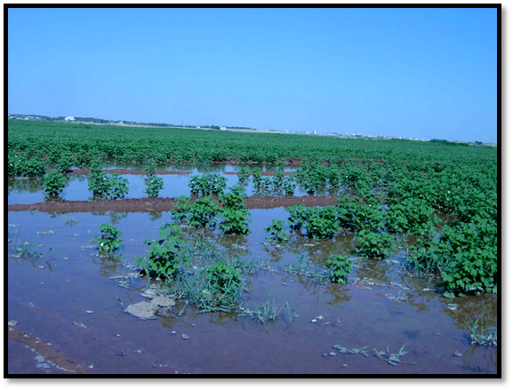
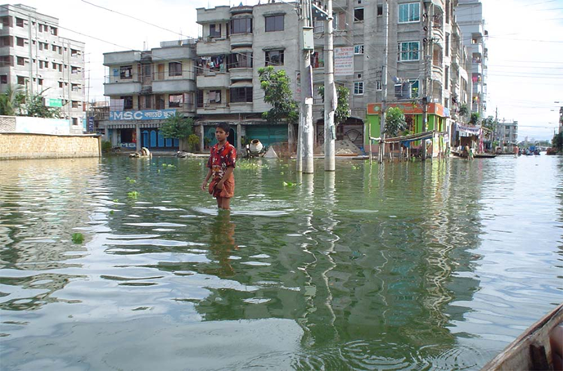
Inter-relations with floods
Peri-urban areas are generally the users of wastewater
These areas are habited by the most vulnerable sections of society and being adjunct to rivers, low lying are exposed to frequent flooding
As receptor of flood waters they have the potential to spread the contaminated wastewater used for irrigation to the downstream areas.

Slide 20
Disaster Management Plans
Objective: “…to reduce the adverse impacts of extreme events such as droughts and floods (for example)…..”
Recognize:
“ … the risk (floods or drought) assessment as a means to take preventive and prepare post disaster preparedness plans….”.
“ … ….”
But often fail to:
Assess health risks, particularly due to flooding of wastewater treatment plants and wastewater agriculture fields

Slide 21
National Health Policy
Objective: “…to achieve an acceptable standard of good health amongst the general population of the country…..”
Recognize:
“ …that the ambient environmental conditions are a significant determinant of the health risks to which a community is exposed; such as unsafe drinking water, unhygienic sanitation and air pollution significantly contribute to the burden of disease, particularly in urban settings”.
“ that the work conditions in several sectors of employment can be sub-standard effecting the health of the workers…”

Slide 22
Health exposure
Farm workers: Contact with wastewater
Consumers: Use of products, Vegetables and salads eaten uncooked, Sports fields and public parks
Since so much produce moves around the world, there is always the possibility of being exposed to produce irrigated with wastewater,
Nearby communities: Spread of polluted top soil; Entry of aerosols in atmosphere; flooding

Slide 23
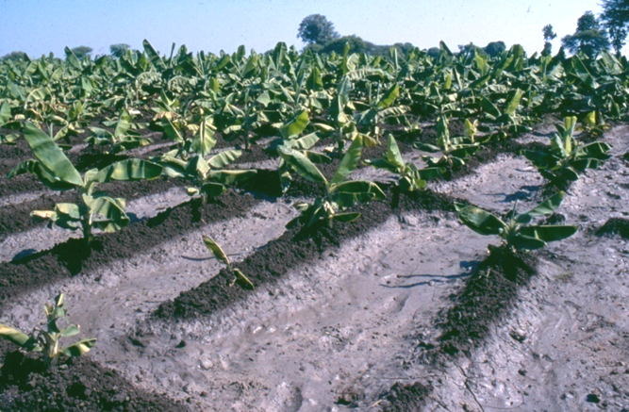
Strategies for managing health risks
Waste treatment
Crop restriction
Appropriate irrigation techniques
Human exposure control
Chemotherapy and vaccination
As the short-term benefits of wastewater irrigation could be offset by the long-term health and environmental impacts more research is needed

Slide 24
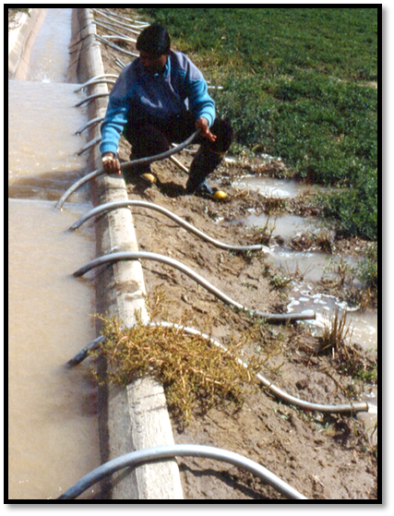
Is there need for a policy?
Is there a need for wastewater reuse?
What are the drivers of wastewater reuse?
Wastewater as a viable new resource?
What is the magnitude of the wastewater problem?
How is urban water collected?
Is there a separation of grey and black water collection systems?

Slide 25
Policy elements
What are the objectives? And how to achieve the objectives?
Will we use treated, partially treated, diluted or raw wastewater?
How do we manage health risks, nutrient and land management?
What are the economic considerations?
Is it socio-culturally acceptable? If not, how to make it acceptable?
How to get the institutions work together?
What regulatory mechanism has to be put in place?

Slide 26
Economics of wastewater
Source of water: provides water at little additional cost
Source of nutrients: saves fertilizers
Eco-services: saves costs of treatment to the acceptable standards and
Health risk management: Preventive health measures have a cost
Equity: many wastewater irrigators are not landless farmers, that rent small plots for income-generation
Opportunity cost
Stopping or over-regulating these practices could remove the only income many landless people have

Slide 27
Integration of policies
Health
Risk Management
Sustainable Urban Drainage Systems
Principales
SPATIAL PLANNING
IWRM
Plans
Wastewater Use
PLANS
URBAN
Water Management
Plans
Plans
LAND USE PLANNING
Integrated Flood Management
Coastal Zone Management
Total Water Cycle Management
Concepts

Slide 28
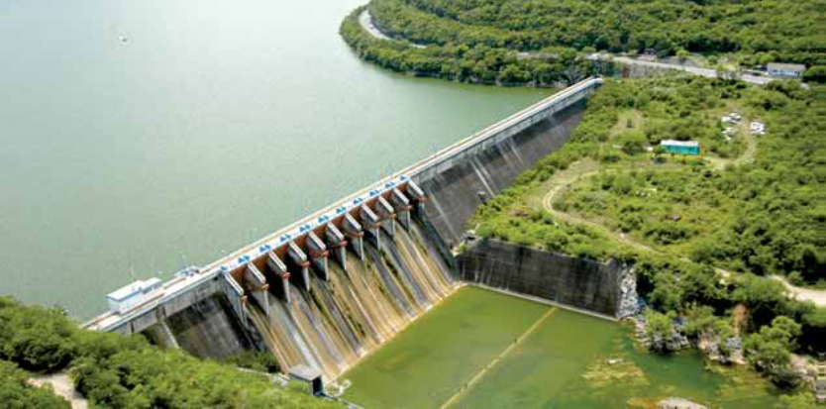
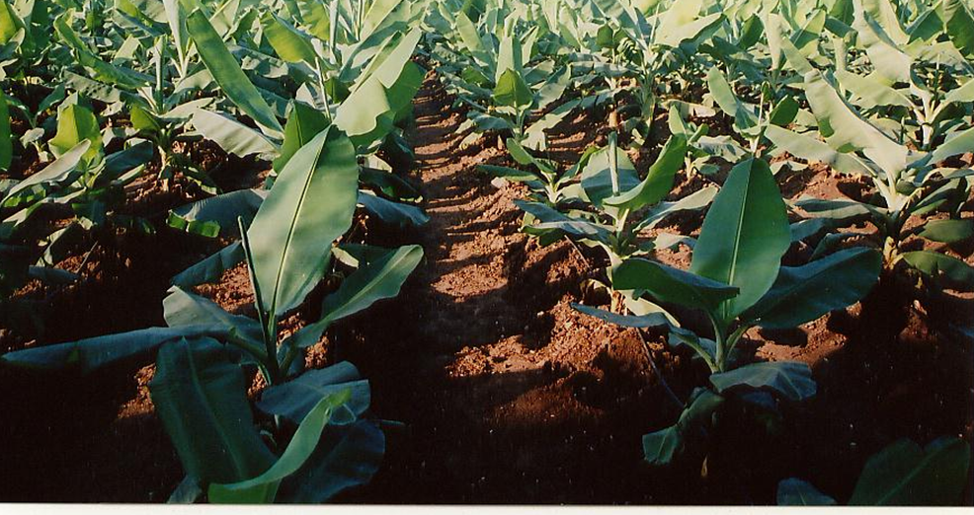
Policy Framework
Inter
national
National
Local
Policy
Legislation
Institutional framework
Regulation application

Slide 29
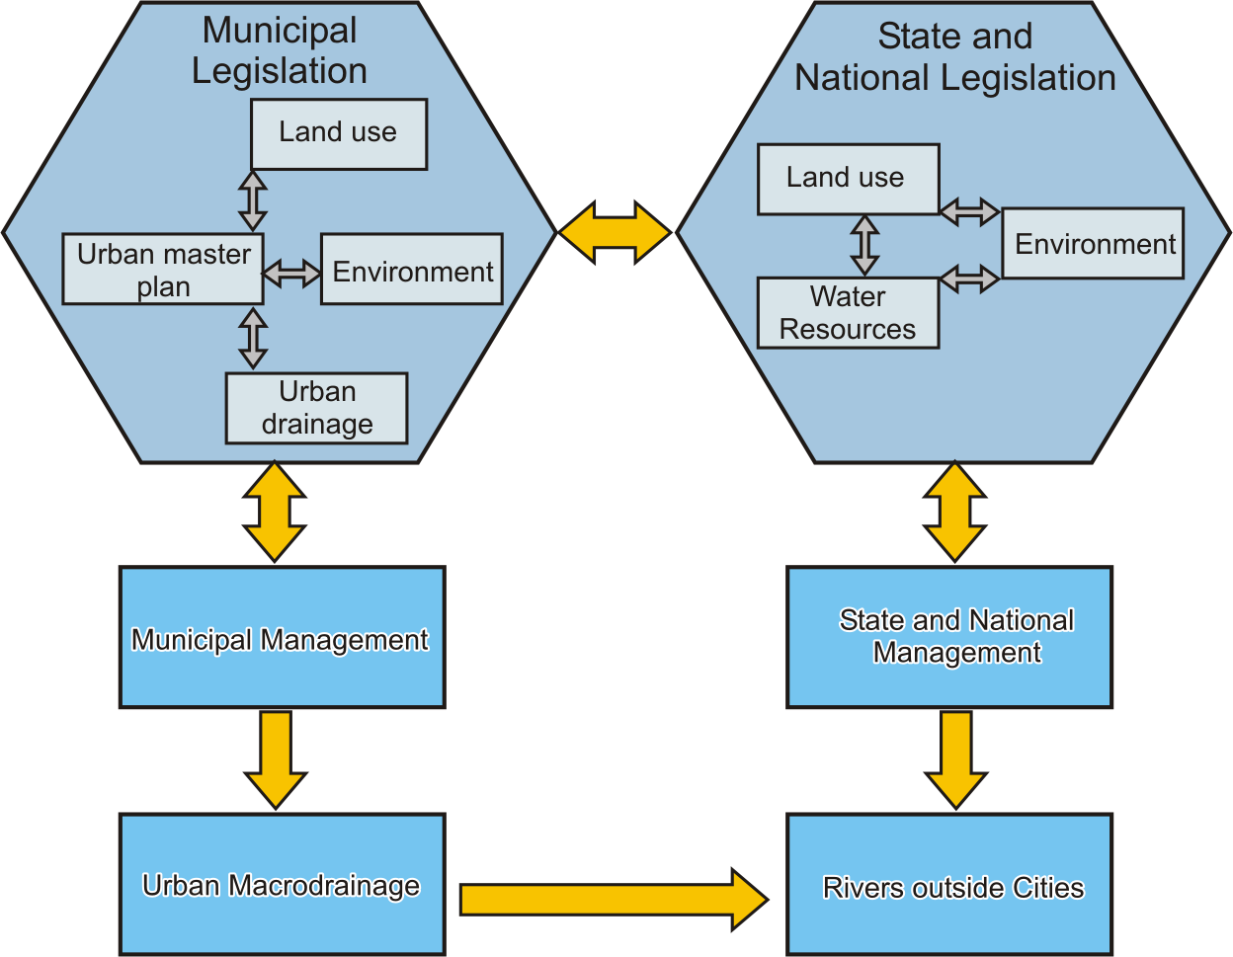
Legal and Institutional Framework

Slide 30
ICID: working groups
Working Group on Environment (WG-ENV)
Mandated to:
Provide guidance on the environmental aspects of drainage and irrigation systems
Management of sustainable environment
Maximising positive and minimizing negative aspects of irrigation and drainage
Working Group on use of poor quality water (including wastewater) in irrigation (WG-PQW)
Mandated to:
Promote safe management of poor quality water
Consider the required institutional and legislative aspects

Slide 31
Conclusions….
National policies and strategies are essential
National platform for wastewater use in agriculture
Legal Framework (control and regulations) based on realistic standards
Promoting research for better understanding of the problem and interdependencies
Application of holistic health guidelines
Monitoring and evaluation of wastewater generation and use

Slide 32
….Conclusions
Institutional manageability through inter-disciplinary institutions
Information, tools, techniques and technologies
Training and human resources development
Societal participation and awareness building

Slide 33
THANKS
For more visit
www.icid.org

