Slide 1









UN-Water Project on
Safe Use of Wastewater in Agriculture
Safe Use of Wastewater
In Agriculture
Africa ∙ Asia ∙ Latin America
Recap of the International Kick-off, previous Regional Workshops;
Scope of the 5th Regional Workshop
1st Regional Workshop for Francophone Africa
18-19 February 2012
Palais de Congr‘es, Room „Fez“
Dr. Jens Liebe, UNW-DPC

Slide 2
“Wastewater” is a resource
Wastewater use can …
…reduce pressure on freshwater resources
…improve food production, nutritional status
…save fertilizers and energy
How can member states be supported in promoting safe practices where wastewater is used in agriculture?

Slide 3
“Wastewater” use
In many countries
Wastewater use is a reality (whether there are regulations in place of not)
Wastewater use will become more important

Slide 4
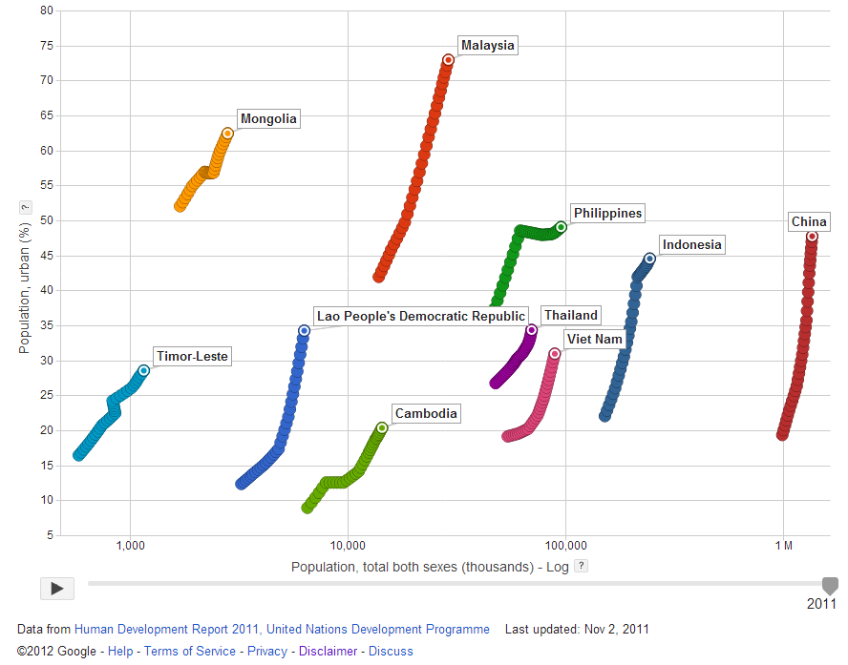
Population growth and urbanization
(1980-2011)

Slide 5
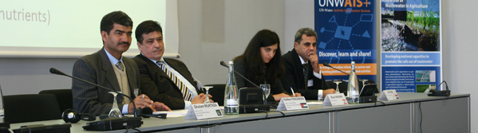
Goal
Qualified people in key organizations to formulate the right policies and
put into practice the safe use of wastewater in agriculture.
    Materials and methods
    Dissemination strategy
    Capacity building action plan
Systems
Organizations
Individuals

Slide 6
Wastewater - a multidisciplinary issue
Bringing people together
UN-Water members and partners
Country delegates from different disciplines
Participants from different countries
→ step towards safer practices

Slide 7






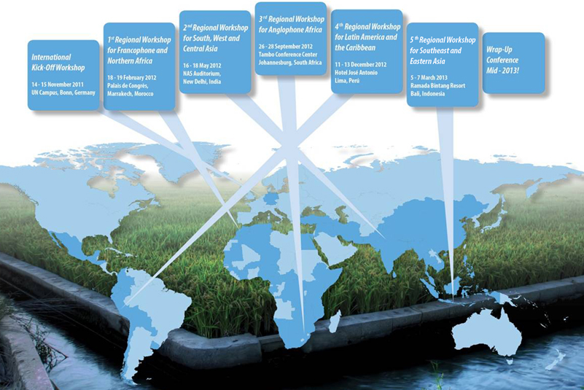
Safe Use of Wastewater in Agriculture
International Kickoff, 5 Regional Workshops:
Francophone & Northern Africa ·
South, West & Central Asia · Anglophone Africa · Latin America & the Caribbean · South-East and Eastern Asia, International Wrap-up

Slide 8
Phases of capacity building at the individual/organization level
Phase I:
Individual Capacity Needs Assessment (CNA)
National Reports
Phase II:
International workshop
November 2011
Gap Assessment
Phase III:
Regional workshops
February 2012 to March 2013
Capacity building action plan at the individual/organization level
Phase IV:
Wrap-up workshop
May 2013
Implementation of Recommended Actions
New CNA at the intitution/system level

Slide 9
Safe Use of Wastewater in Agriculture
Workshop title | No. of Countries | No. of Participants
International Kick-Off | 13 | 23
1st Regional Workshop for Francophone and Northern Africa | 17 | 27
2nd Regional Workshop for South, West and Central Asia | 11 | 21
3rd Regional Workshop for Anglophone Africa | 20 | 36
4th Regional Workshop for Latin America and the Caribbean | 13 | 29
5th Regional Workshop for Southeast and Eastern Asia | 10 | 29
Total | 73 (unique) | 165

Slide 10
UN-Water Project on
Safe Use of Wastewater in Agriculture
Safe Use of Wastewater
In Agriculture
Regional Workshops
1st Regional Workshop for Francophone Africa
Francophone & Northern Africa
South, West & Central Asia
Anglophone Africa
Latin America & the Caribbean
Southeast and Eastern Asia
18-19 February 2012
Palais de Congr‘es, Room „Fez“

Slide 11
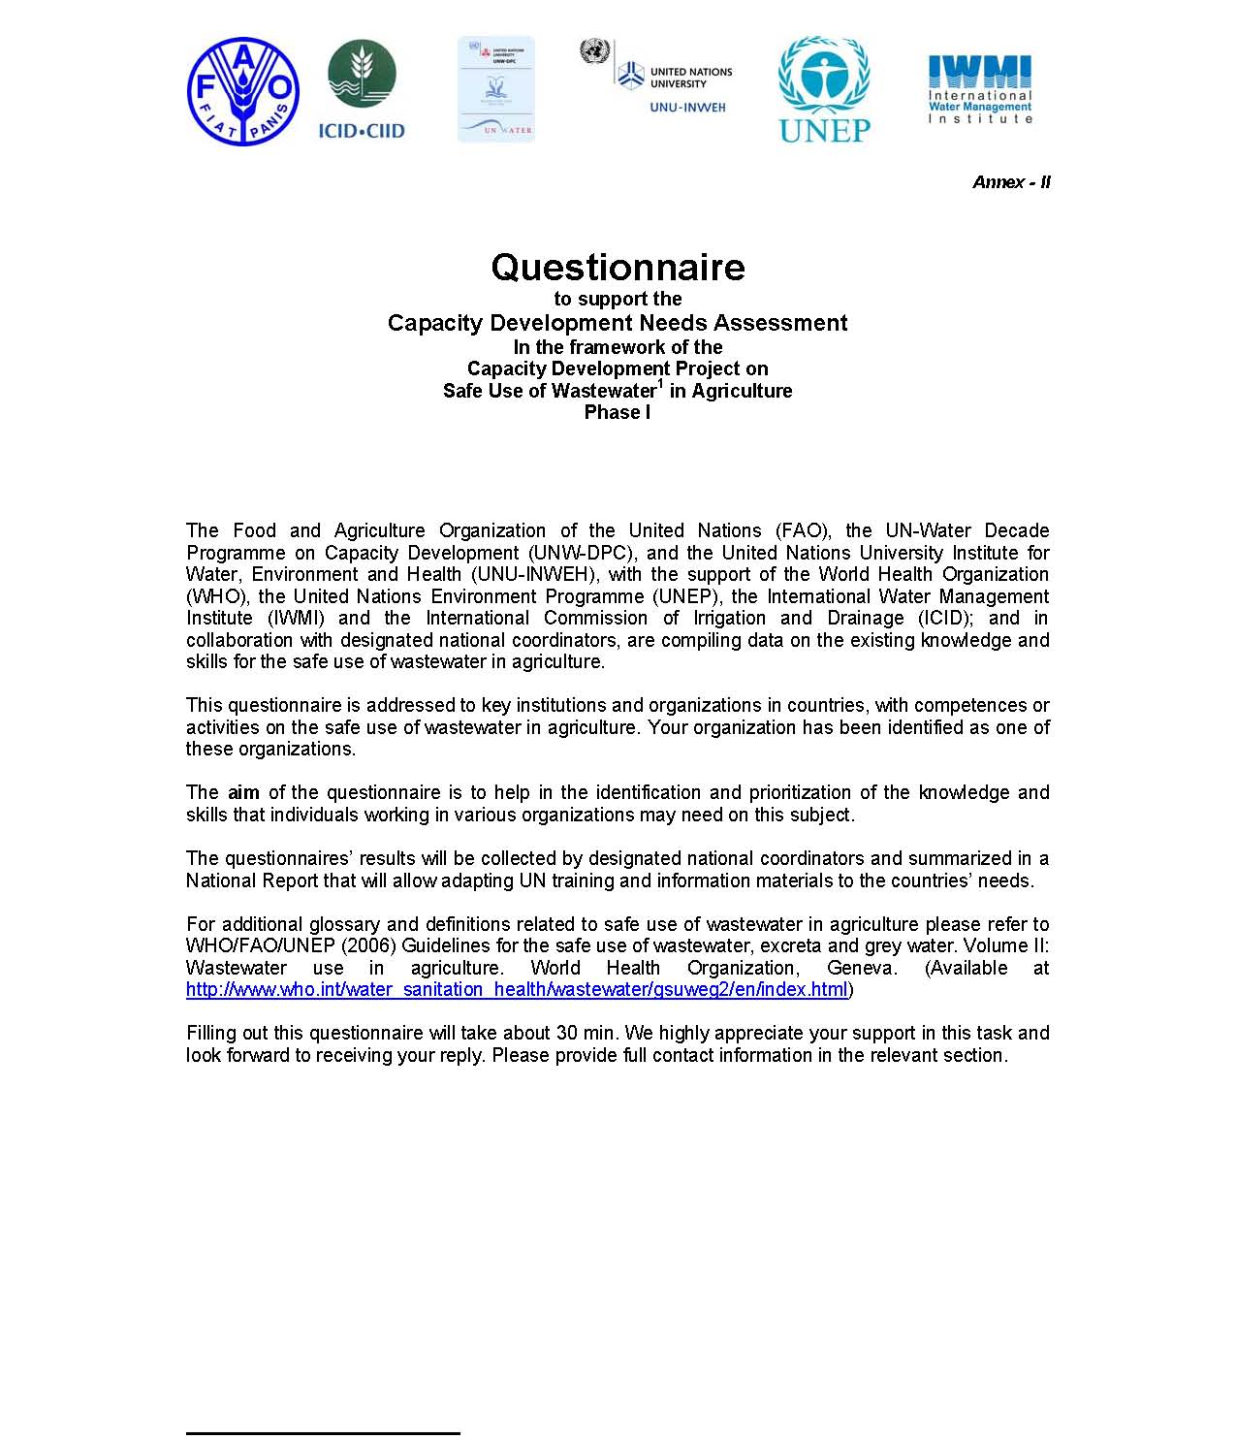
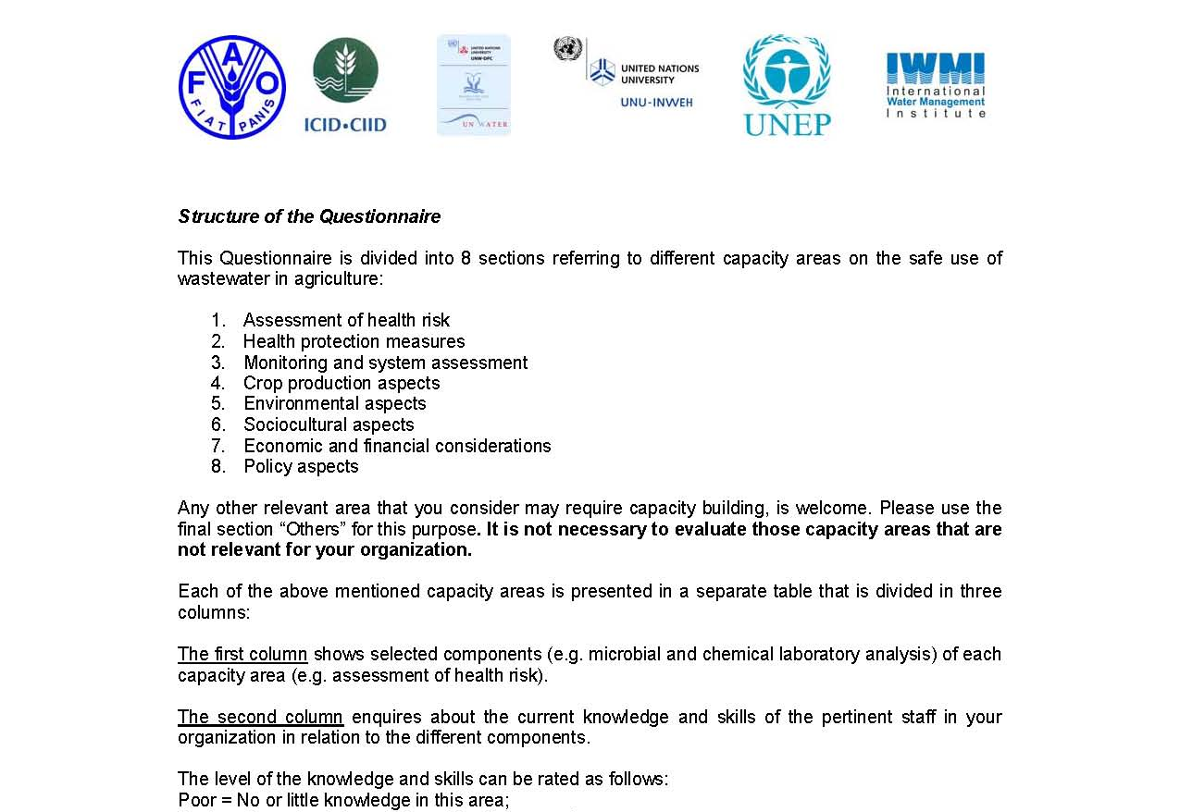
Capacity Needs Assessment
Assessment of health risk
Health protection measures
Monitoring and system assessment
Crop production aspects
Environmental aspects
Socio-cultural aspects
Economic & financial considerations
Policy aspects

Slide 12
Capacity needs
Francophone & Northern Africa
South, West, and Central Asia
Health risk assessment
Health protection monitoring
Resource efficiency
Monitoring & System assessment
Economic & financial considerations
Health risk assessment/Health protection monitoring
Anglophone Africa
Latin America & the Caribbean
Economic & financial considerations
Health risk assessment
Monitoring & System assessment
Economic & financial considerations
Environmental aspects
Health risk assessment
After workshop
Economic & financial considerations
Policy Aspects
Monitoring & System assessment
After workshop
Health risk assessment
Policy Aspects
Socio-cultural aspects

Slide 13
Organized by:
UN-Water Project on
Safe Use of Wastewater in Agriculture
Safe Use of Wastewater
In Agriculture
5th Regional Workshop
1st Regional Workshop for Francophone Africa
Cambodia ∙ China ∙ Indonesia ∙ Lao PDR ∙ Malaysia ∙ Mongolia ∙ Philippines ∙ Thailand ∙ Timor-Leste ∙ Vietnam
18-19 February 2012
Palais de Congr‘es, Room „Fez“

Slide 14
Background of the participants of this workshop
Organizational background
Your daily activities

Slide 15
Background of the participants of this workshop
Your disciplines

Slide 16
Capacity needs
Southeast and Eastern Asia
Based on 10 countries, 17 participants

Slide 17
The situation in your countries
“LEARNING CURVE”:
1. Awareness
2. Understanding
3. Commitment
4. Action
5. Reflection
1. 2. 3. 4. 5.

Slide 18
What you want to learn
“Experiences shared by participants and related policies on use of wastewater in agriculture”
“The best practices and strategies in making safe use of wastewater in agriculture a priority in my country”
“Knowledge and experiences from the experts and other countries about the wastewater use in agriculture”
„The approaches to manage safe sanitation and wastewater use "
“The good and bad experiences from other countries about safe use of wastewater in agriculture and how they deal with those challenges”

Slide 19
What you want to share
“I want to share our initiatives and efforts, existing regulations and how we were able to implement these”
“The research of wastewater treatment in my country.”
“I would like to share my real condition in my country with other countries for safe use wastewater in agriculture.”
“Current situation of wastewater and its potential use in agriculture in my country”

Slide 20
What you want to take home
“Guidance on proper use of wastewater in agriculture”
“New contacts and possible networks for continuous exchange of information and knowledge with regard to broader and wider safe use of wastewater”
“Technologies/experiences/skills of safe use of wastewater in agriculture”
“Recommendations on the safe use of wastewater in terms of technical, management as well as governance.”

Slide 21


Thank you!
UN-Water Decade Programme on Capacity Development
(UNW-DPC)
UNITED NATIONS UNIVERSITY
UN Campus
Hermann-Ehlers-Str. 10
D-53113 Bonn, Germany
Phone: + 49 (0) 228 815-0652
Fax: + 49 (0) 228 815-0655
E-Mail: info@unwater.unu.edu
www.unwater.unu.edu

