Slide 1
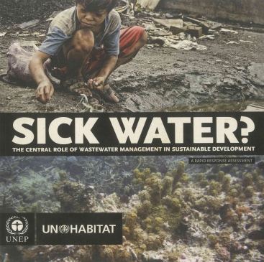
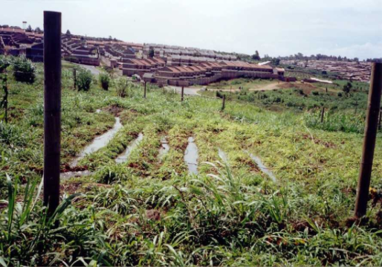
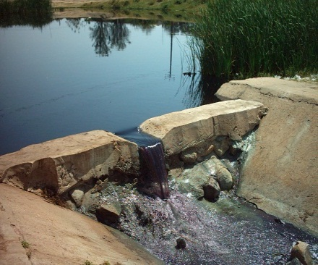

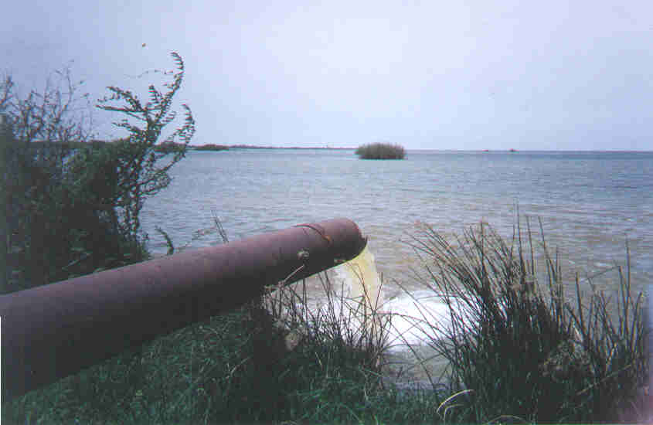
Inter-Agency Collaboration in Wastewater Management
The Case of UN-HABITAT and UNEP under
the UN-Water Task Force on Wastewater Management
The
Presented at the UN-Water Seminar on “Safe Use of Wastewater in Agriculture” at IFAT 2012
By
Bert Diphoorn
Vice Chair, UN-Water
1

Slide 2
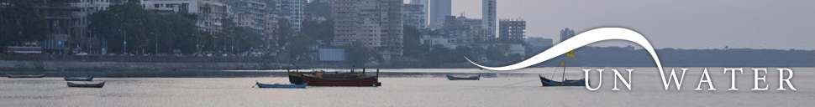
What is
UN-Water is the United Nations coordination mechanism for all freshwater related issues
  E.g. water supply, water resources management, sanitation, wastewater, water related climate change adaptation, ecosystems, water related disasters
UN-Water is not an agency or organization
Activities are implemented by Members, Partners and Programmes

Slide 3
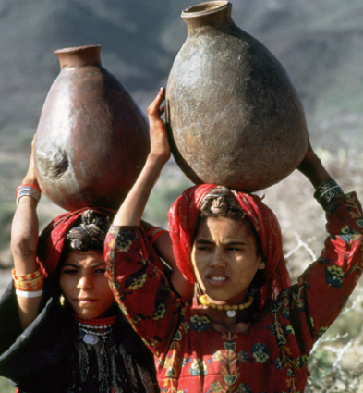
UN-Water strategic directions
Bring further coherence amongst its Members and Partners
Play a major role in ensuring that water is included in global policy debates
Support its Members and Partners at all levels, but with a particular focus on the country level

Slide 4























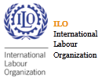




28 UN-Water Members

Slide 5
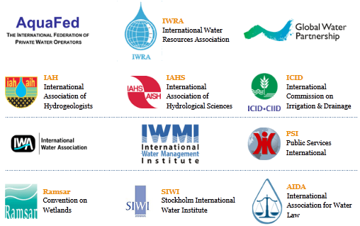
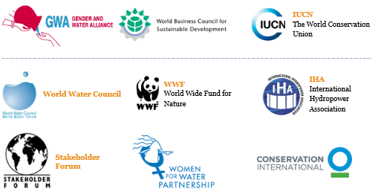


25 UN-Water Partners
Partners with Special Status

Slide 6
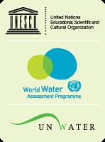

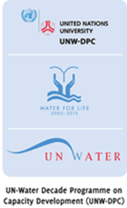

3+1 UN-Water Programmes
World Water Assessment Programme (WWAP)
  UNESCO, Perugia
UN-Water Decade Programme on Advocacy and Communications (UNW-DPAC)
  UNDESA, Zaragoza
UN-Water Decade Programme on Capacity Development (UNW-DPC)
  UNU, Bonn
WHO/UNICEF Joint Monitoring Programme for Water Supply and Sanitation (JMP)*
  WHO and UNICEF, Geneva and New York
* Affiliated to UN-Water

Slide 7
Thematic Priority Areas and Task Forces
Thematic Priority Areas
  Water and Climate Change (WMO)
  Transboundary Waters (UNECE, UNESCO)
  Water Quality (UNEP)
  Drinking Water and Sanitation (UNICEF)
Task Forces
  Wastewater Management (UNEP, UN HABITAT)
  Regional Level Coordination (UN ESCAP, UN ESCWA)
  Country Level Coordination (UNDP, UNW-DPC)
  Water Resources Management (UNEP)

Slide 8
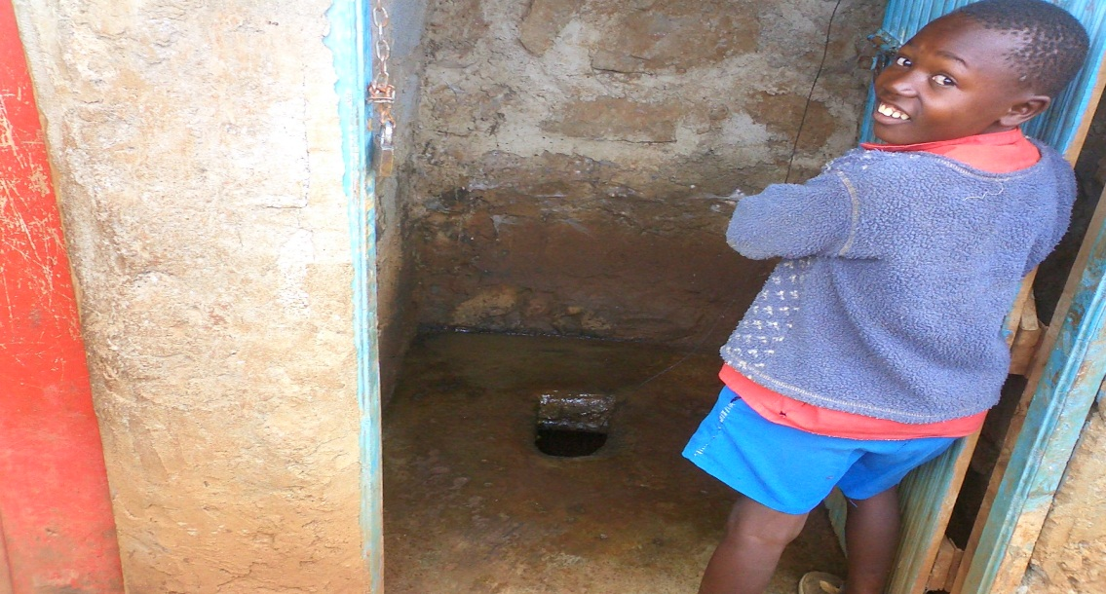
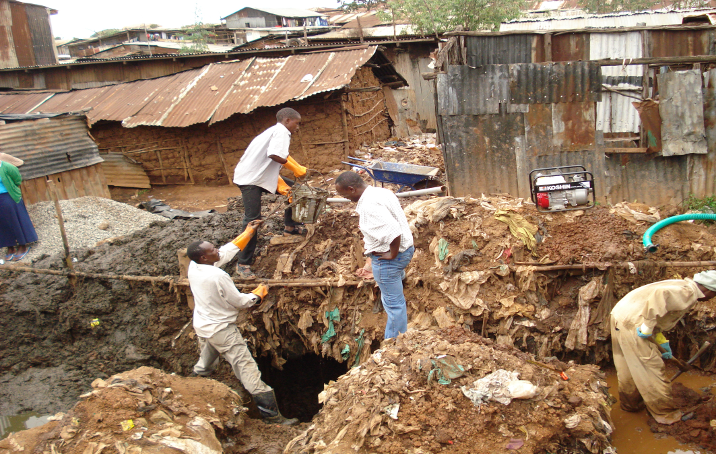
The global sanitation challenge
2.6 billion people, including almost one billion children, in the developing world, don’t have access to sanitation facilities
1 out of 4 city residents worldwide, 794 million in total, lives without access to improved sanitation facilities
8

Slide 9
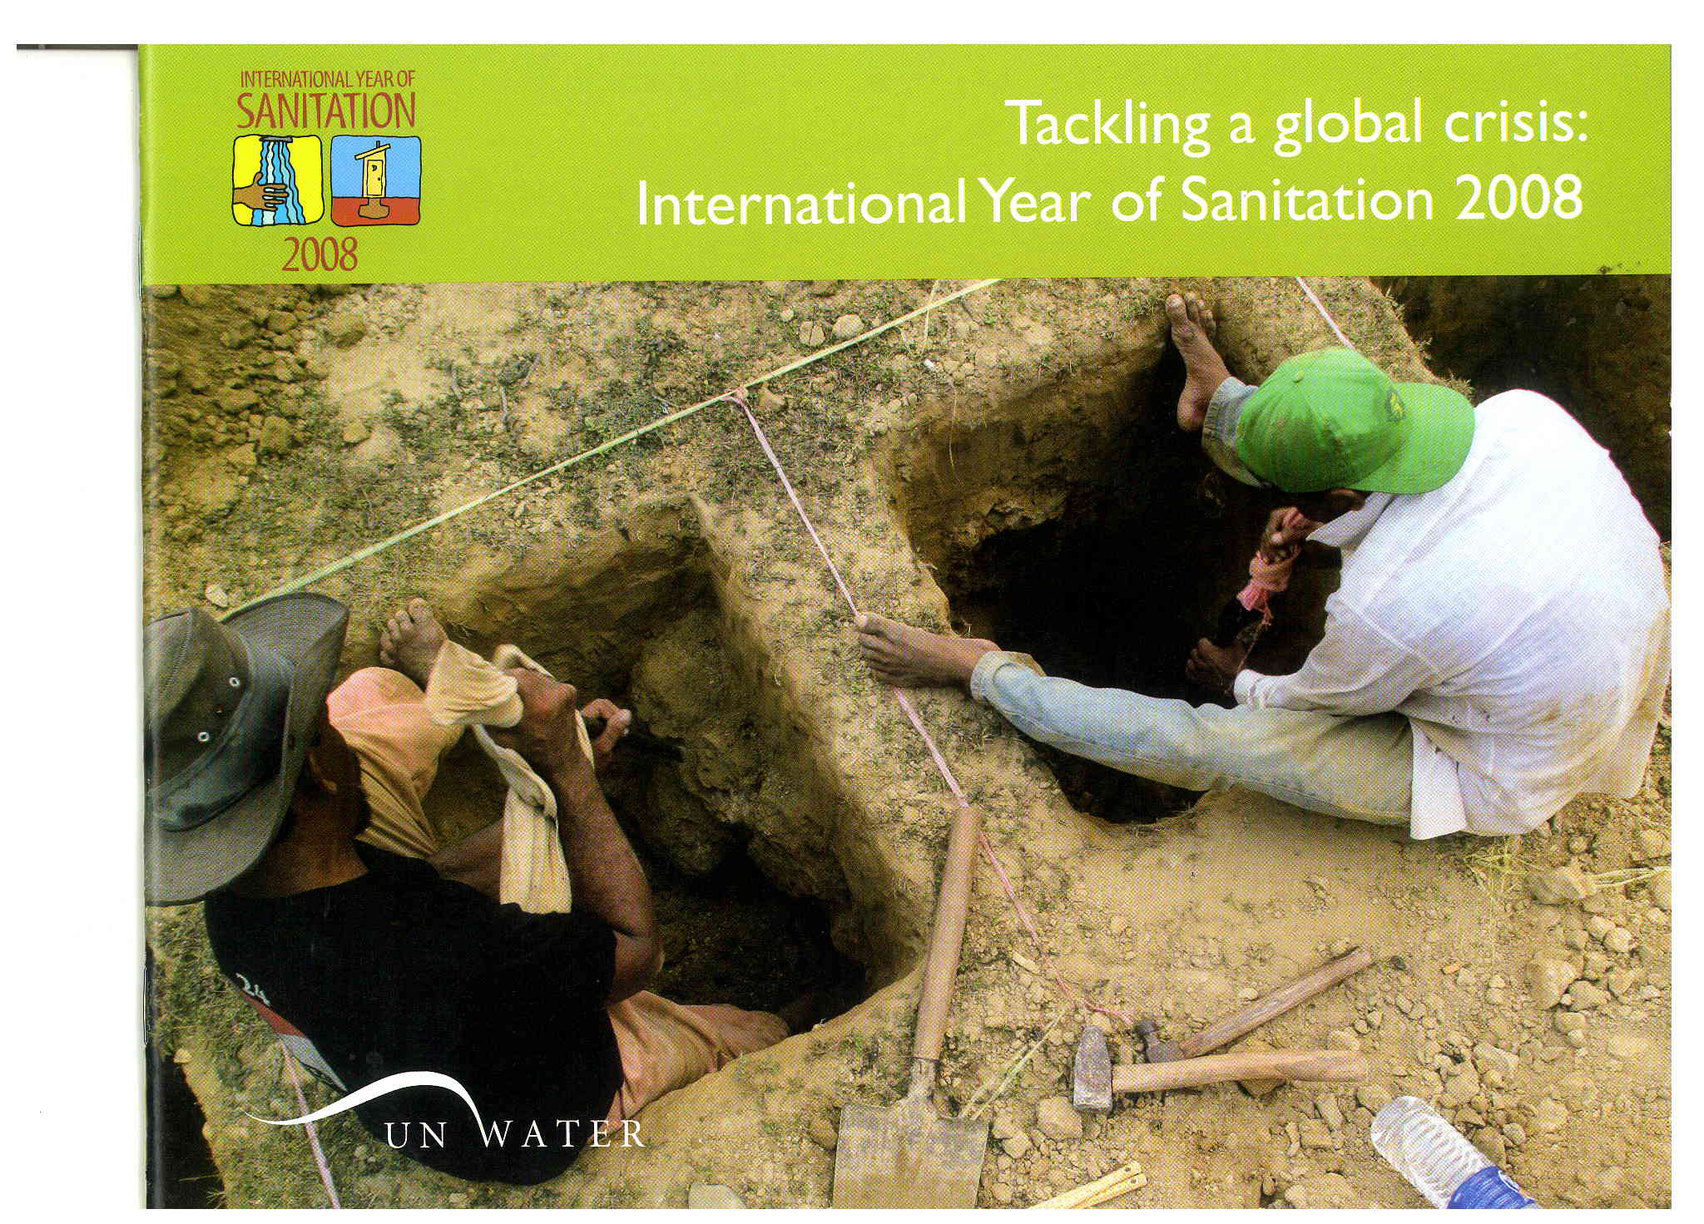
Raising the profile of sanitation
The international community is determined to make a difference
The continuing high level advocacy by the United Nations and development partners has contributed significantly to raising the profile of sanitation issues on the international development agenda
However, little effort has been put in wastewater management – also called “the other side of sanitation”
9
Notes:
The international community is determined to make a difference
The continuing high level advocacy by UN-HABITAT and its partners has contributed significantly to raising the profile of urban sanitation issues on the international development agenda.
In the lead up to the World Summit on Sustainable Development held in Johannesburg in February 2002, UN-HABITAT worked closely with partners such as the Water Supply and Sanitation Collaborative Council (WSSCC) to jointly develop a strategy to bring sanitation to the top of the political agenda at the Summit.
One of the concrete outcomes of the Summit was the setting of the sanitation target, viz. to halve the proportion of people without sustainable access to basic sanitation by 2015.
Since then, a number of international meetings have been organized to review the status of implementation of the Millennium Development Goals and the Johannesburg Plan of Action.
One of the most difficult challenges facing us today is to translate these international commitments into concrete actions by involving policy makers, the public, the private sector and the media to create the demand for sanitation and to prioritize sanitation in national budgetary allocations.

Slide 10

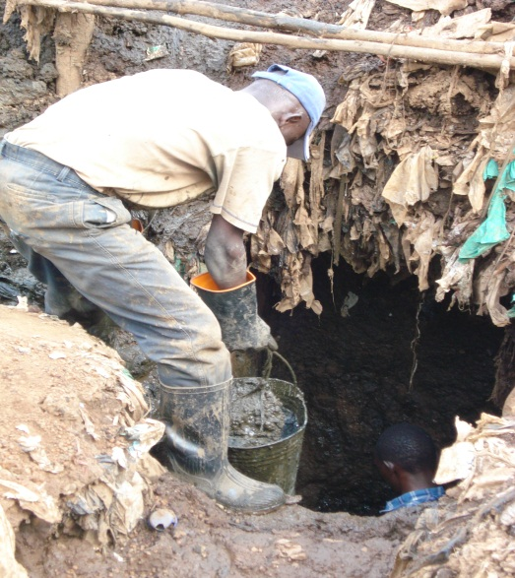
The statistics are stark!
Globally, 2 million tons of sewage, industrial and agricultural waste is discharged into the world’s water ways everyday
Up to 90 % of all wastewater in developing countries is discharged untreated directly into rivers, lakes or the oceans
An estimated 245,000 km2 of marine ecosystems are affected with impacts on fisheries, livelihoods and the food chain
At least 1.8 million children under five years-old die every year from water-related disease (1 in every 20 seconds)
10
Notes:
Water bodies around some cities are polluted with high nutrient levels mainly from peri-urban farming activities as well as from domestic and industrial effluent discharges.
Untreated sewage effluent is one of the most common types of pollution found around urban rivers and in groundwater sources.
The discharge of sewage into city water bodies is often compounded by spillages of raw sewage due to power failures, pump or pipe failures.

Slide 11

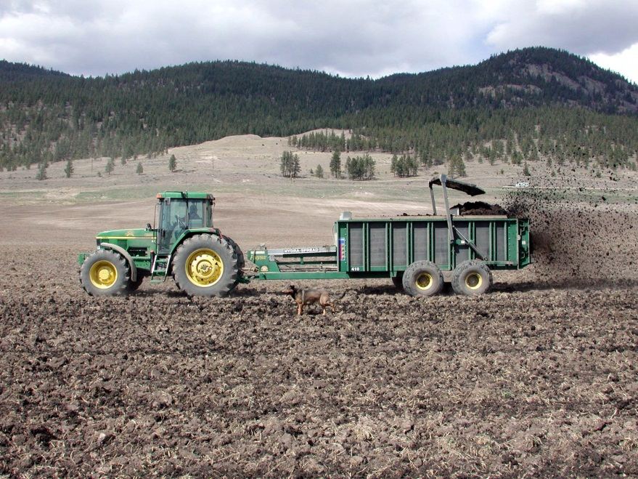
Strategy - Moving from waste to resource
Moving beyond the question of how to remove waste from homes and workplaces to issues revolving around what to do with it –
wastewater treatment and conversion of waste into useful products such as fertilizers, briquettes or building materials
11

Slide 12
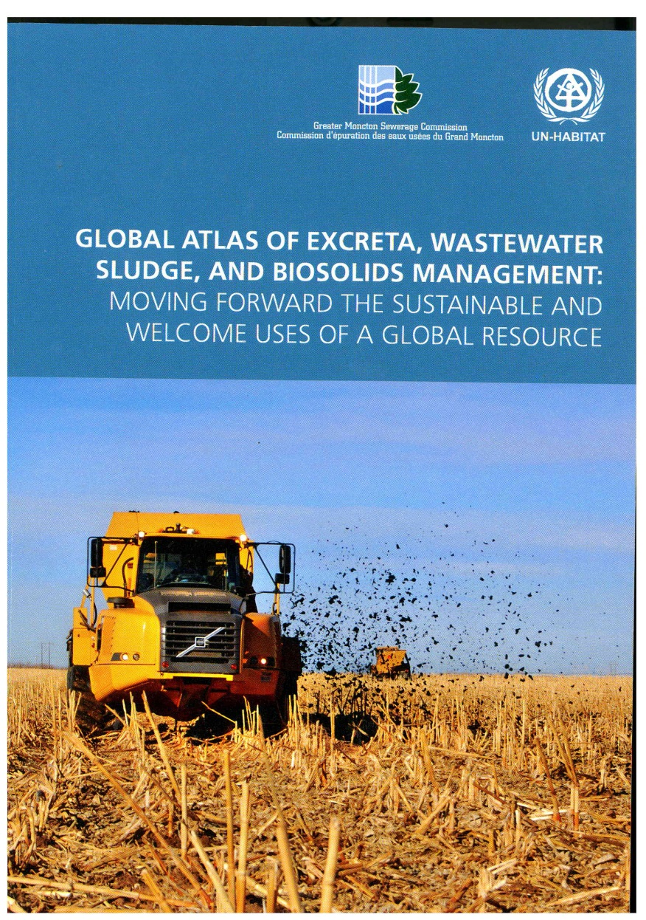
Global picture of the current status
The Global Atlas (2008) was UN-HABITAT’s first effort to catalogue this problem on a worldwide scale
The Atlas provides a global picture of the current status of information and opportunities for wastewater biosolids/sludge disposal and reuse, including trends and regional comparisons
12

Slide 13
Wastewater management challenges
low prestige and recognition
weak policies and institutional frameworks
lack of adequate funding and political will
low public awareness
inadequate or lack of wastewater treatment facilities
Direct discharge of wastewater into surface and groundwater systems with little or no treatment is one of the most serious threats to water resources
13

Slide 14
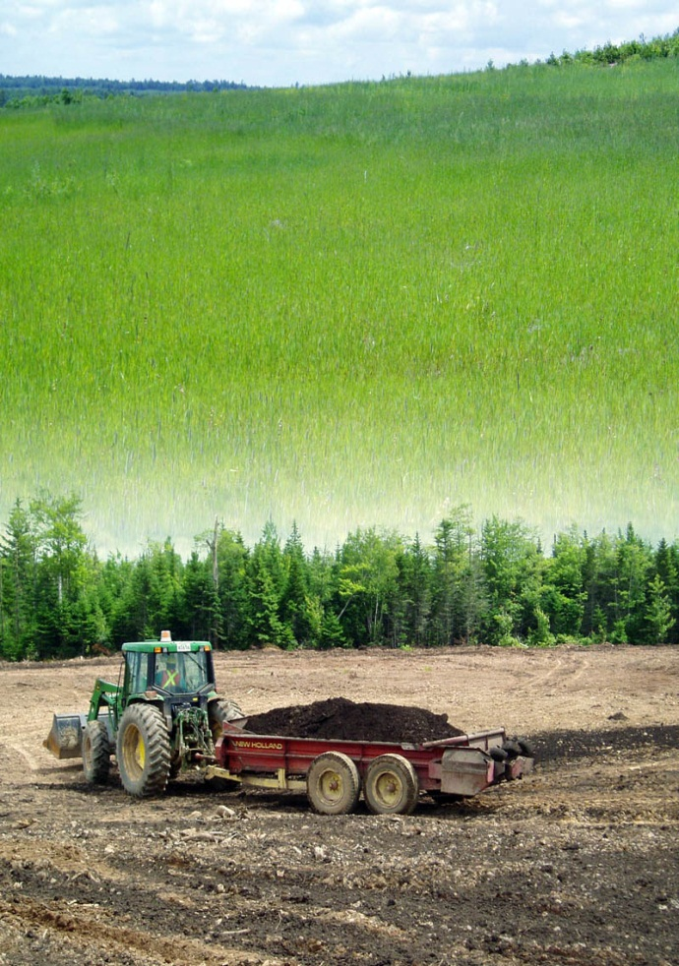
What is needed?
A revolution in wastewater management – in light of urbanization, climate change, food-energy nexus
Better understanding of wastewater – a framework for classification and review of sources and treatment of wastewater
Promoting multi-sectoral approaches– include other sectors in wastewater management
Increasing political support and understanding of the value of wastewater management
Supportive policies – legal and regulatory structures that promote wastewater management – both technical and institutional
Continued research and demonstrations – discover new management solutions
Appropriate technology for cost-efficient excreta, wastewater sludge, and biosolids management.
Innovative and sustained financing – main focus should be mobilizing national /local resources to compliment external support.
Planning against future scenarios – the scale of what we are up against in terms of future urban growth is not factored into planning.
14

Slide 15
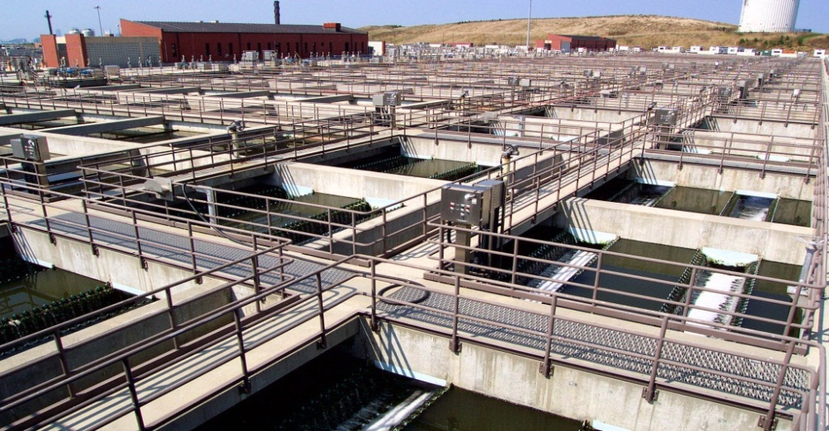
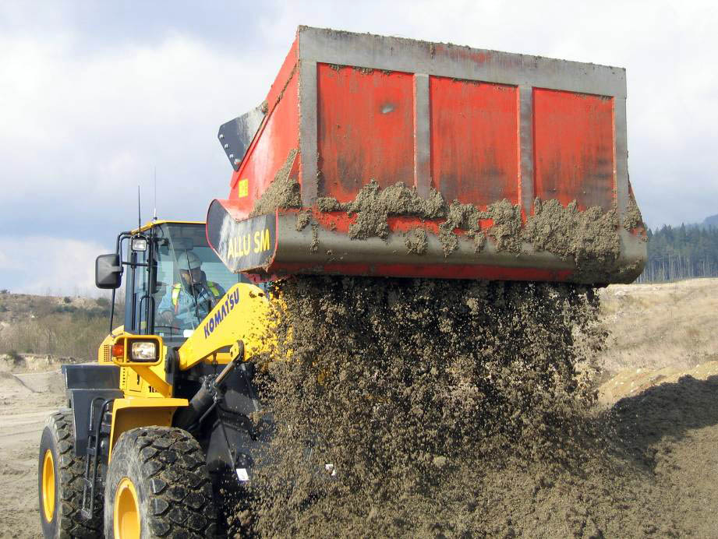
The UN Water Task Force on Wastewater management
Creates synergies from independent work on wastewater by the respective agencies
Link with other contemporary issues, such as climate change, food security and the reduction of poverty
Proactive and constructive role in the formulation and implementation of wastewater management policies
15

Slide 16
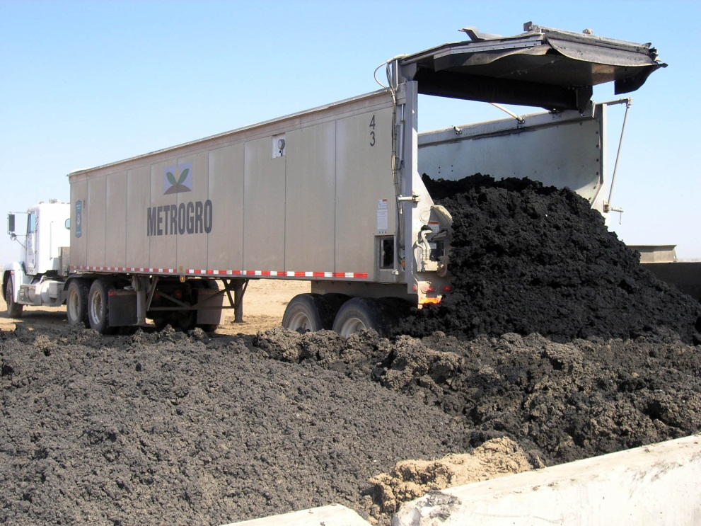
Task Force objectives
Highlight issues surrounding wastewater management
Increase awareness by governments
Strengthen UN-System collaboration on activities related to wastewater management
16

Slide 17


Achievements to date
Launch of the Rapid Assessment Report on Wastewater Management (Sick Water) during the 2010 World Water Day celebrations in Nairobi, Kenya
Launch of the Rapid Assessment Report on Green Hills, Blue Cities during the 2011 World Water Day Celebrations in Cape Town, South Africa
Co-convening of the 2010 and 2011 World Water Days
17

Slide 18
Way Forward – A Collaborative Agenda on Sustainable Wastewater Management
A deliberate and targeted effort by UN-Water and its partners to revolutionize wastewater management over the decade 2010 – 2020
It embodies both immediate and longer-term initiatives that directly address the policy recommendations outlined in the 2010 “Sick Water?” report.
It aims to position sustainable wastewater management on the political and development agenda at a global level.
It elaborates how the UN System, in partnership with governments, industry, NGOs and International Financial Institutions, can:
Communicate the important and central role of sustainable wastewater management in public health, environmental protection and economic development;
Expand the knowledge base on sustainable wastewater management;
Accelerate the formulation and implementation of sustainable wastewater management policies; and
Improve the construction, maintenance and efficiency of site-appropriate wastewater infrastructure.
18

Slide 19
Thank you
www.unwater.org

