Slide 1









Safe Use of Wastewater
In Agriculture
UN-Water Project on
Safe Use of Wastewater
in Agriculture
1st Regional Workshop for Francophone Africa
18-19 February 2012
Palais de Congr‘es, Room „Fez“
Africa ∙ Asia ∙ Latin America
Reza Ardakanian, Director, UNW-DPC

Slide 2
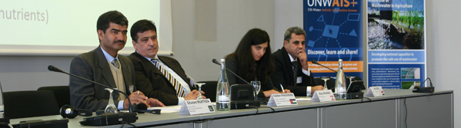
Goal
Qualified people in key organizations to formulate the right policies and
put into practice the safe use of wastewater in agriculture.
Materials and methods
Dissemination strategy
Capacity building action plan
Systems
Organizations
Individuals

Slide 3
Phases of capacity building at the individual/organization level
Phase I:
Individual Capacity Needs Assessment (CNA)
National Reports
Phase II:
International workshop
November 2011
Gap Assessment
Phase III:
Regional workshops
February to March 2013
Capacity building action plan at the individual/organization level
Phase IV:
Wrap-up workshop
May 2013
Implementation of Recommended Actions
New CNA at the intitution/system level

Slide 4
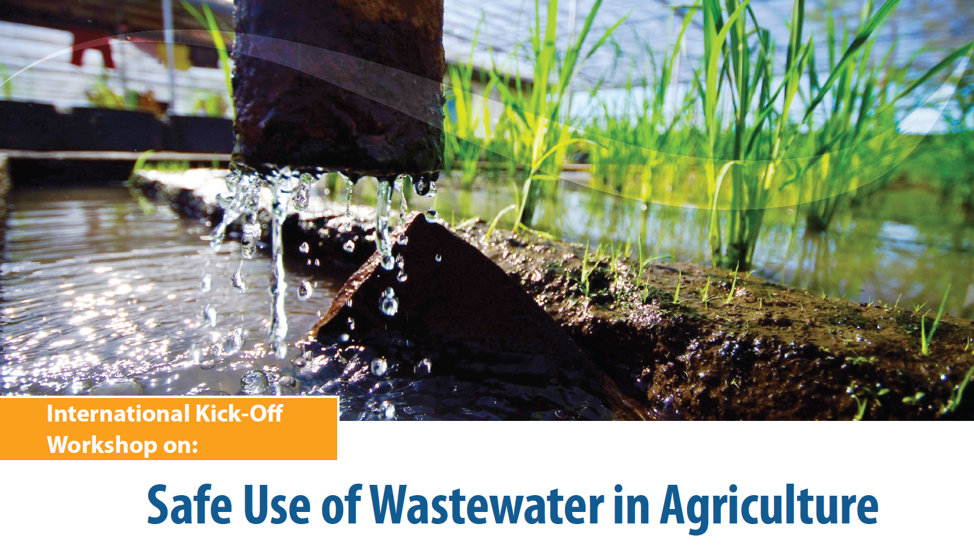







Slide 5
Knowledge & capacity needs: Africa Group
high
medium
low
none

Slide 6
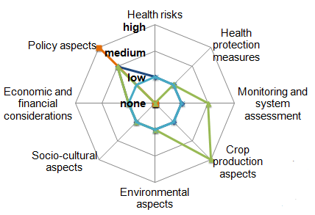
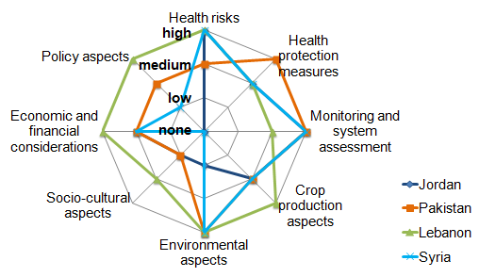
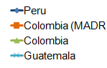
Knowledge & capacity needs:
Asia Group
Latin America Group

Slide 7

Timeline
International Kick-off Workshop | November 2011
Regional Workshops
Francophone & Northern Africa | February 2012
West & Central Asia | May 2012
East & Southern Africa | September 2012
Latin America | December 2012
East Asia | March 2013
International Wrap-up workshop | May 2013

