Slide 1

The role of the
UN-Water Activity Information System
for capacity development and knowledge
dissemination
Jens Liebe, UNW-DPC

Slide 2
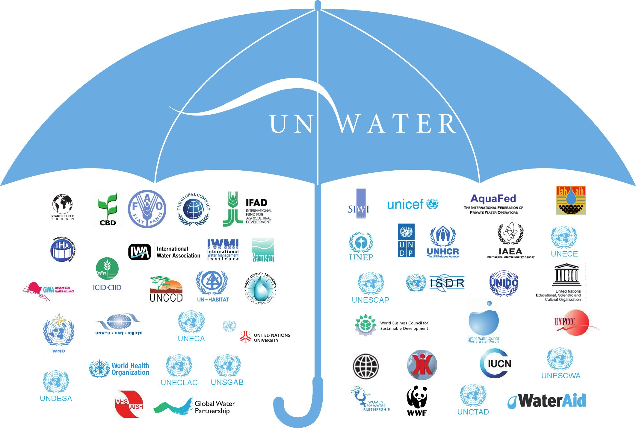
WWAP
UNW-DPC
UNW-DPAC
28 UN-Water Members
25 UN-Water Partners

Slide 3

UNW-DPC’s Mission
“to enhance the coherence,
credibility and
integrated effectiveness
of UN-Water
by strengthening its capacity development programmes, particularly in developing countries and economies in transition.”

Slide 4
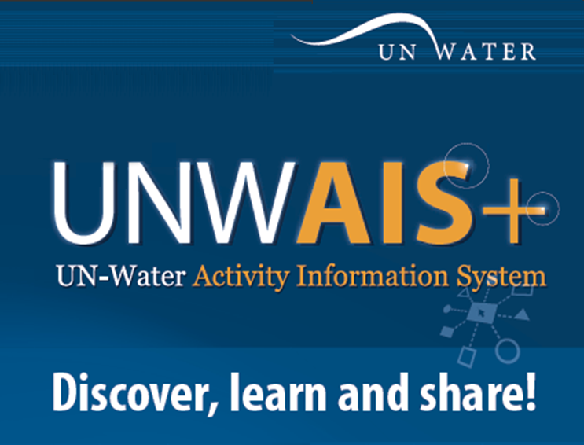
4

Slide 5
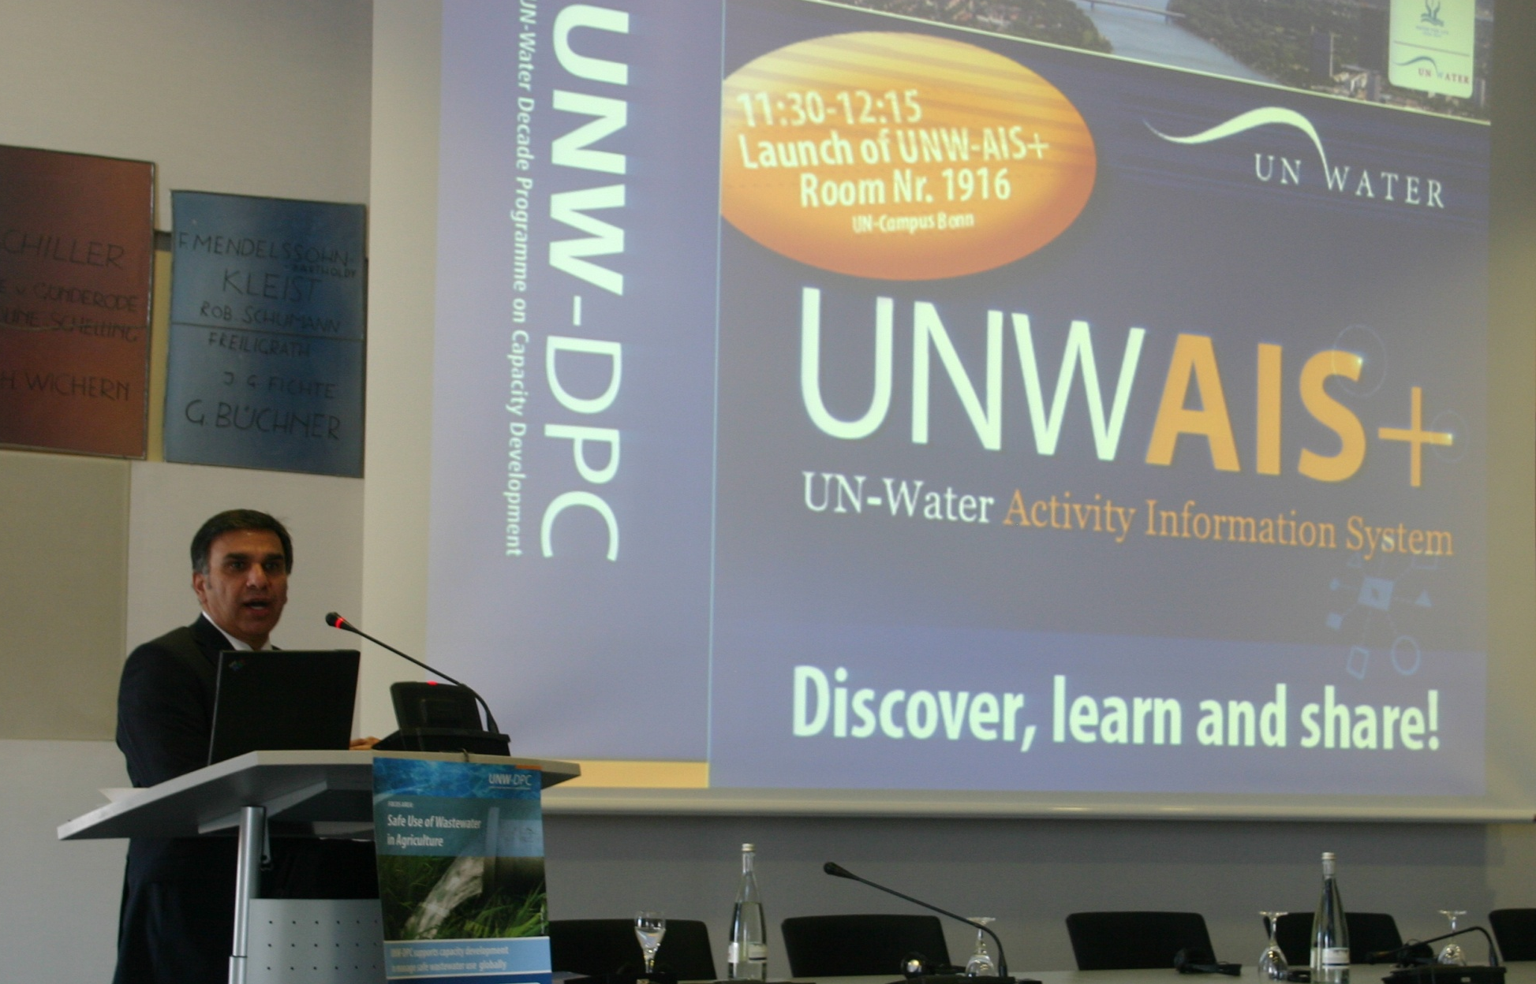
UNWAIS+
Discover, learn, and share!
Launched by
Dr. Zafar Adeel
Former Chair of UN-Water,
Director of UNU-INWEH
November 14, 2011

Slide 6
UNW-AIS+: Scope and Capabilities
http://www.ais.unwater.org/
+ Single entry point of access to information
for UN-Water.
+ Store, update, and share information.
+ Handle metadata, web-based content, documents
or multimedia.
+ Comprehensive search and geographic search.
+ Facilitates the organization of events and interaction with
participants.
+ e-learning and discussion forums.

Slide 7
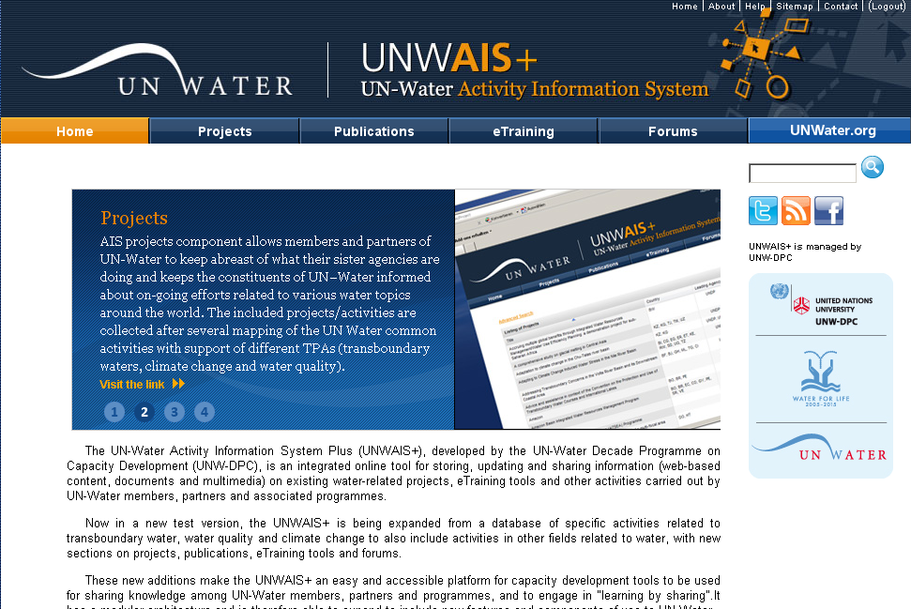
UNW-AIS+ Components
http://www.ais.unwater.org/
http://www.ais.unwater.org/

Slide 8
Role of UNW-AIS for capacity development and knowledge dissemination
Single point of access to knowledge and material available from UN-Water Members & Partners
Knowledge hub for project participants
Helps participants to promote the issue with national partners, to develop national strategies

Slide 9
UNW-AIS+ Future Endeavors
http://www.ais.unwater.org/
Integrating additional databases
Providing e-learning courses including assessment tools
Integrated search of project information,
related documents & e-learning modules

Slide 10
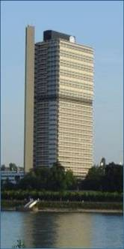


Thank you
UN-Water Decade Programme on Capacity Development
(UNW-DPC)
UNITED NATIONS UNIVERSITY
UN Campus
Hermann-Ehlers-Str. 10
D-53113 Bonn, Germany
Phone: + 49 (0) 228 815-0652
Fax: + 49 (0) 228 815-0655
E-Mail: info@unwater.unu.edu
www.unwater.unu.edu
http://www.ais.unwater.org/

