Slide 1
Safe Use of Wastewater in Agriculture
UN-Water at IFAT 2012
Water reuse in Agriculture in the Arab region Situation, needs and challenges
Eng. Khaldon Khashman
Secretary General
Munich, Germany
09 May 2012

Slide 2
Background
Limited water availability
Increasing demands on water resources for (household, commercial, industrial, and agricultural purposes) due to population and economic growth
Poor water policies and management frameworks
Contamination of ground and surface water by industrial effluents, and agricultural chemicals
Over abstraction of conventional water resources
Therefore → Need for non-conventional water resources

Slide 3
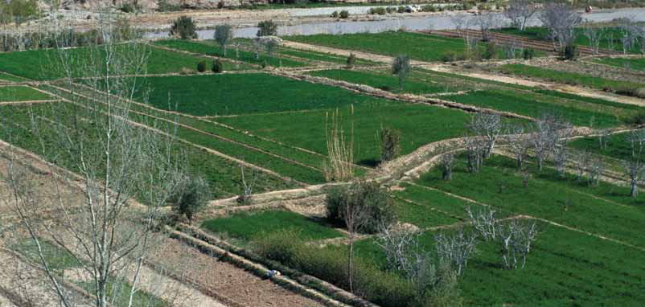
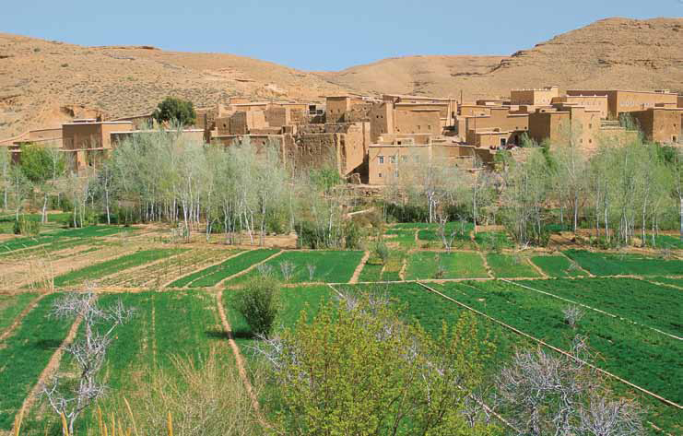
Benefits of Reuse in Agriculture
Reduction of surface water pollution
Maintain water security
Savings “high-quality” fresh water
Providing alternative water resources → Reallocation of water budget
Nutrients in treated wastewater can
reduce the need for applying
chemical fertilizers

Slide 4
Water Reuse Situation
Arab countries currently produce around 10.8 x10⁹ m³/year of wastewater, of which:
  55% reused in agriculture, landscape irrigation
  15% treated in industrial cooling and environmental protection.
In some countries, reclaimed wastewater is used for groundwater recharge to protect freshwater resources
Agriculture is considered to be the top consumer of water resources, with a share of about 85% of available water resources in Arab countries.

Slide 5
Water Reuse Situation
and Ground water recharge
Standards exist in most countries – focus on effluent quality and not irrigation water quality – most WWTP do not meet the set requirements
Safety control and risk management system is only available in Jordan (Crop Monitoring System)

Slide 6
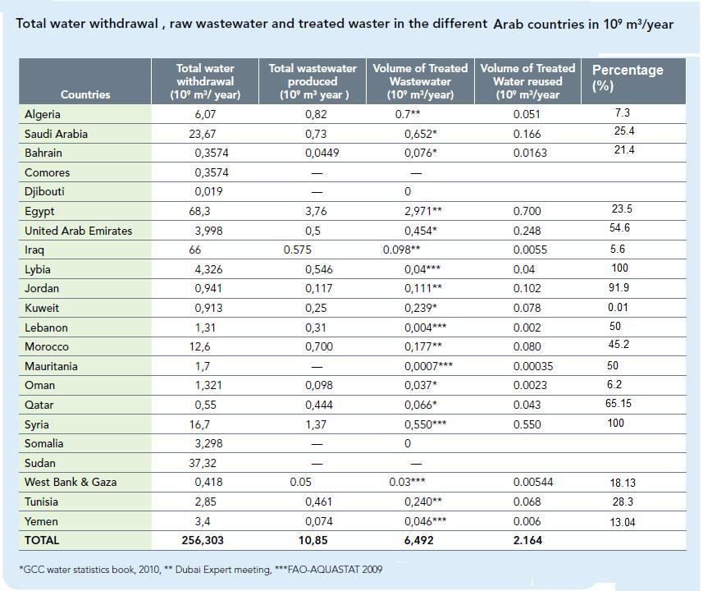

Slide 7
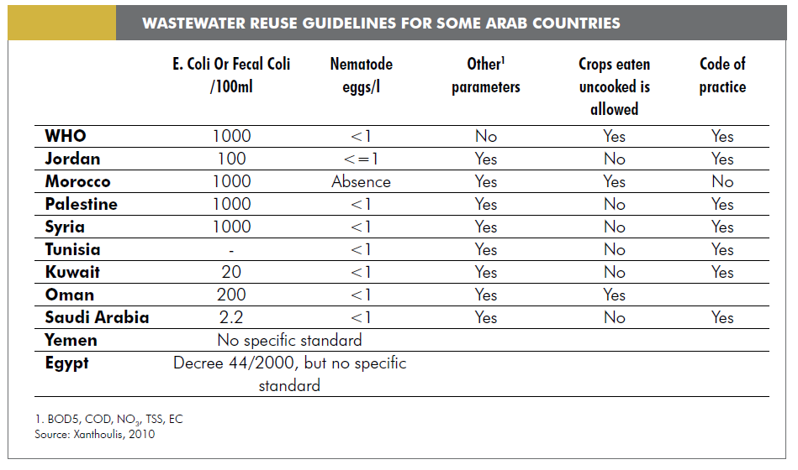
Wastewater Reuse Guidelines

Slide 8
Water Reuse Challenges
In some countries, willingness to pay for reclaimed wastewater is an issue
High cost of wastewater treatment projects
Lack of institutional and policy frameworks
Enable local end-users to feel confident with reclaimed water for irrigation and other uses
Low of tariff of water dis-encourage end users to use reclaimed water
Difficulty in creating financial incentives allowing safe and efficient reuse
Reclaimed water produced is far from the point of use

Slide 9
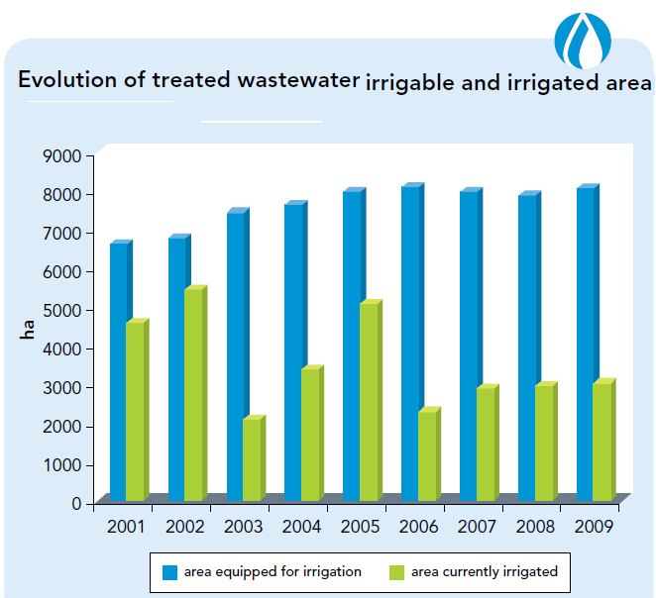
Tunisia: Water reuse for Agriculture
47% of the total area equipped for irrigation is irrigated with reclaimed wastewater
Best levels of reclaimed water
reuse are recorded on fruit orchards
and in the arid zones of the centre
and the south of the country
In year 2014 It is projected to have18 new irrigated schemes on 7010 ha

Slide 10
Jordan: Water reuse in the Jordan Valley
The Government of Jordan has been implementing several agricultural projects in Jordan Valley which is considered as food basket for Jordan
Objective is to demonstrate that water reuse can be reliable, commercially viable, socially acceptable, environmentally sustainable and safe
The productivity of the treated wastewater irrigated lands is significant with the direct beneficiaries being farmers whose income, standards of living and economic status were elevated
→ reducing unemployment and poverty.

Slide 11
Jordan: Water reuse in the Jordan Valley
Jordan has developed National Master Plan aims to produce 250 million m³ of treated water to be used in agriculture.
Investment plan for constructing new 25 wastewater treatment plant all over the country.
Also, upgrading and rehabilitation of wastewater treatment plants to serve more citizens.
Involvement of private sector to build new WWTPs like SAMRA WWTP

Slide 12
Water Reuse Needs in Arab Region
Enhance public awareness, participation and dissemination of best practices in safe use of treated wastewater
Encourage demand-driven planning of water reuse
Mobilize financial resources for wastewater treatment and reuse and encourage PPP/DPP in wastewater treatment and reuse.
The need for building capacity, develop standards and operational manuals for different users
Support research and innovation in wastewater treatment and reuse.

Slide 13
ACWUA’s role
As regional center of excellence, ACWUA plays a vital role in disseminating information and best practices about wastewater reuse (ACWUA Report Wastewater Reuse in Arab Countries -Comparative Compilation of Information and Reference List)
Partner in Safe Use of Wastewater in Agriculture project with UN-Water (Regional Workshops)
Water and Health Technical Working Group (provide case studies and best practices manuals)
  Domestic Water Supply
  Waste Water Treatment and Re-use

Slide 14
Thank You!
Arab Countries Water Utilities Association (ACWUA)
P.O.Box: 962449, Amman 11196 Jordan
E-mail: acwua_secretariat@acwua.org
Phone: +962-6-5161-700
Fax: +962-6-5161-800

