Slide 1

1

Slide 2
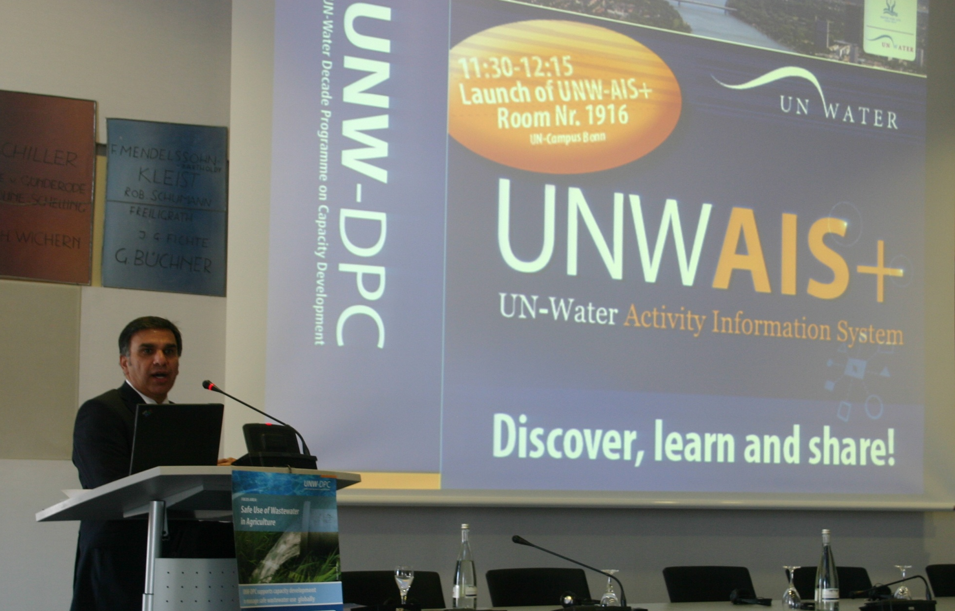
UNWAIS+
Discover, learn, and share!
Launched by
Dr. Zafar Adeel
Chair of UN-Water,
Director of UNU-INWEH
November 14, 2011

Slide 3
UNW-AIS+: Scope and Capabilities
http://www.ais.unwater.org/
+ Single entry point of access to information for UN-Water.
+ Store, update, and share information.
+ Handle metadata, web-based content, documents or multimedia.
+ Project data selection, geographic search, document search.
+ Facilitates the organization of events and interaction with participants.
+ e-learning and discussion forums.

Slide 4
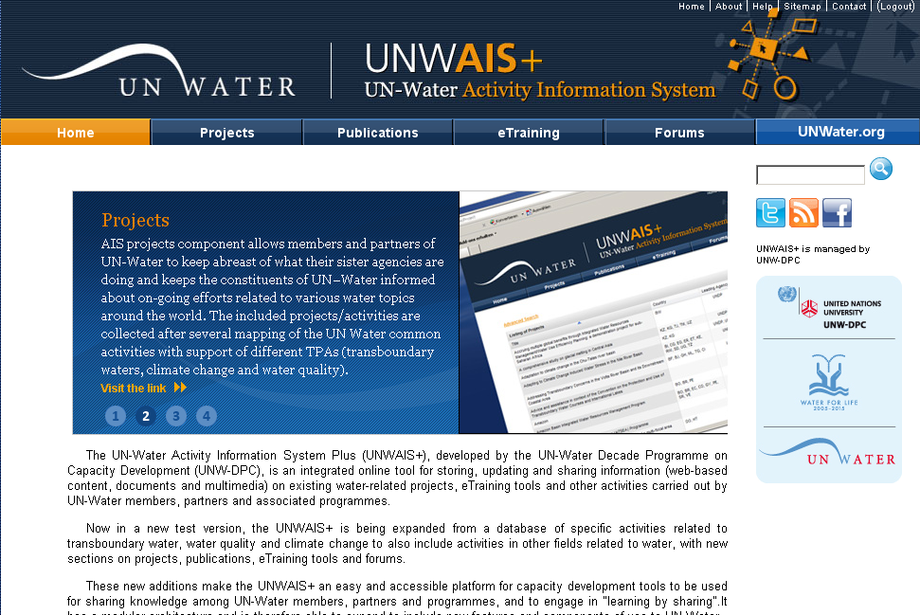
UNW-AIS+ Components
http://www.ais.unwater.org/
http://www.ais.unwater.org/

Slide 5
UNW-AIS+ Components
http://www.ais.unwater.org/
http://www.ais.unwater.org/

Slide 6
UNW-AIS+ Future Endeavors
http://www.ais.unwater.org/
Integrating additional databases
Providing e-learning courses including assessment tools
Integrated search of project information,
related documents & e-learning modules

Slide 7
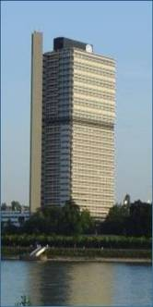

Thank you
UN-Water Decade Programme on Capacity Development (UNW-DPC)
UNITED NATIONS UNIVERSITY
UN Campus
Hermann-Ehlers-Str. 10
D-53113 Bonn, Germany
Phone: + 49 (0) 228 815-0652
Fax: + 49 (0) 228 815-0655
E-Mail: info@unwater.unu.edu
www.unwater.unu.edu
http://www.ais.unwater.org/

