Slide 1

Trade-offs of Wastewater Irrigation in Developing Countries
Manzoor Qadir
UNU-INWEH
16th African Water Association Congress, 20-23 February 2012, Marrakesh, Morocco

Slide 2
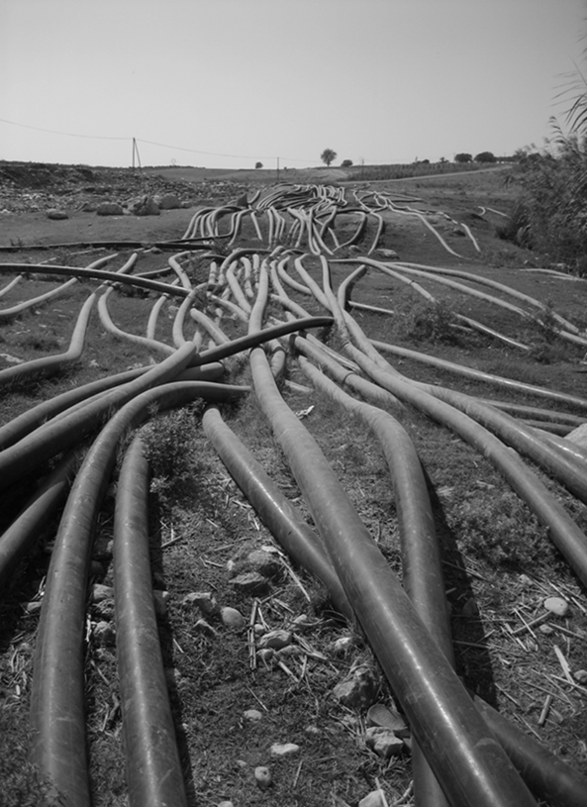
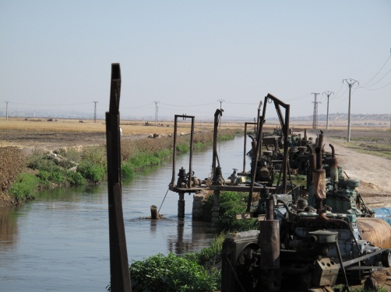
Key Issues and Challenges
Most developing countries and countries in transition have yet to reach full-capacity wastewater treatment
Policies and regulatory measures that encourage wastewater treatment and reuse of treated wastewater are lacking
Wastewater is available to the farmers in untreated, inadequately treated, or diluted forms

Slide 3
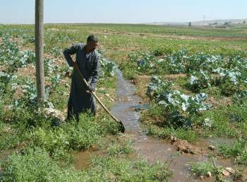
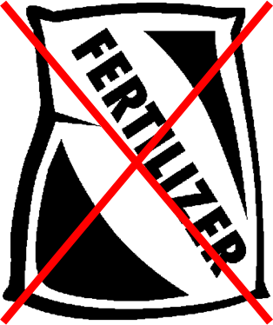
Incentives for the Farmers
Reliable availability of a water resource amid water scarcity
Savings on fertilizer use (wastewater contains nutrients)
Less pumping cost if alternate water source is groundwater
Additional benefits: high-value crops; increased cropping intensities

Slide 4
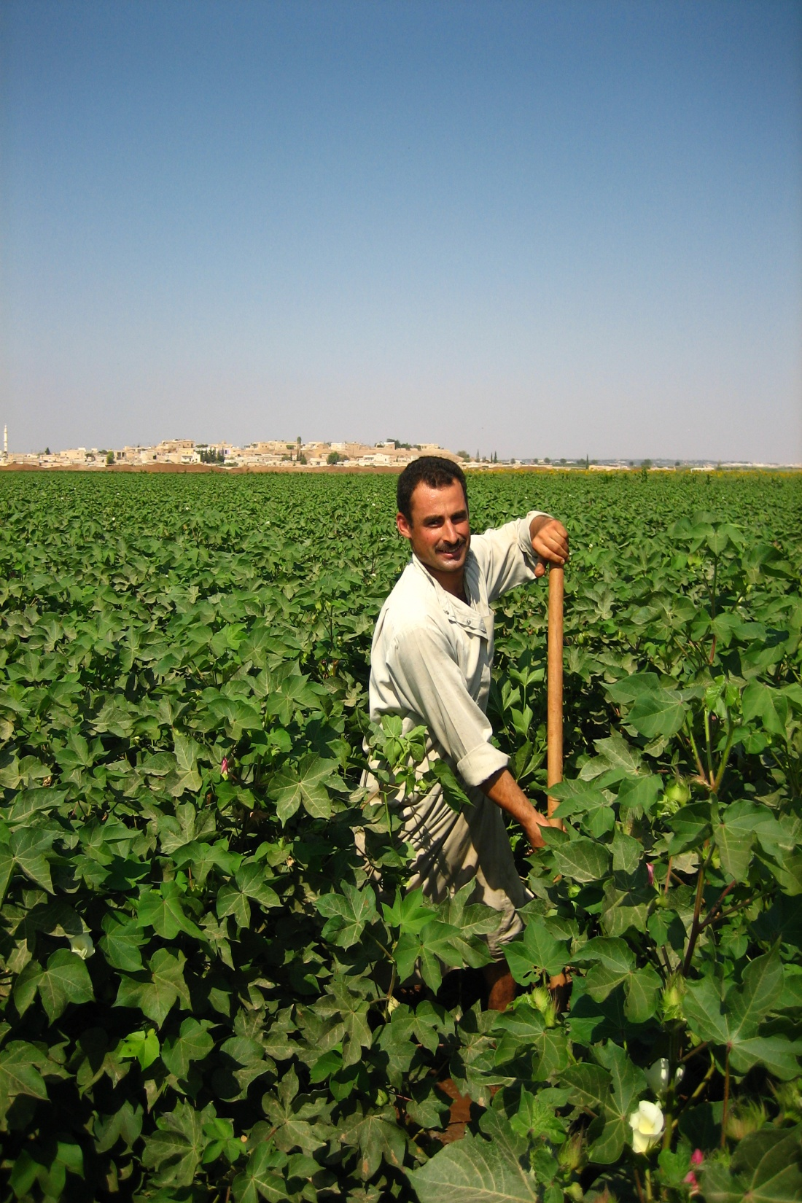
Tradeoffs of Wastewater Irrigation
Economic incentives and other benefits for the wastewater irrigating farmers
Health Implications
Environmental Implications
Climate change – untreated wastewater irrigation nexus

Slide 5
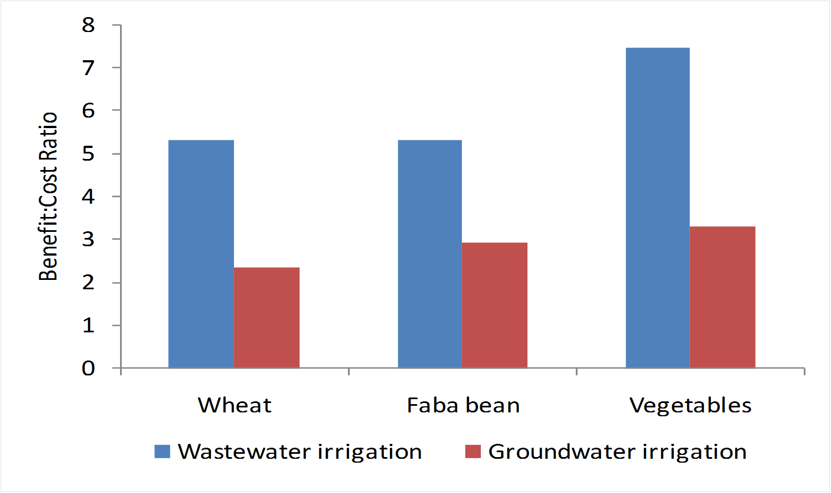
Economic Incentives

Slide 6
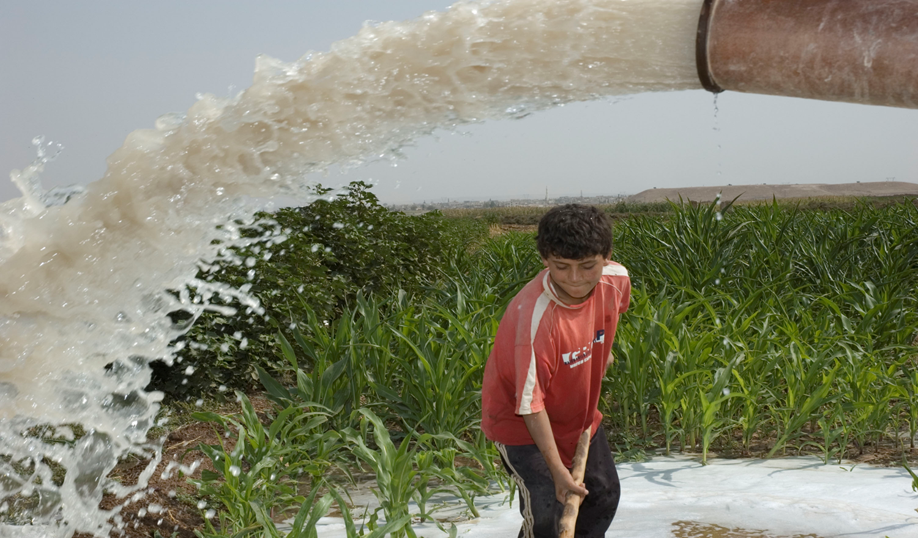
Health Implications
Target Group: Children within 8-12 years
Wastewater versus groundwater irrigated area
Waterborne and non-waterborne diseases

Slide 7
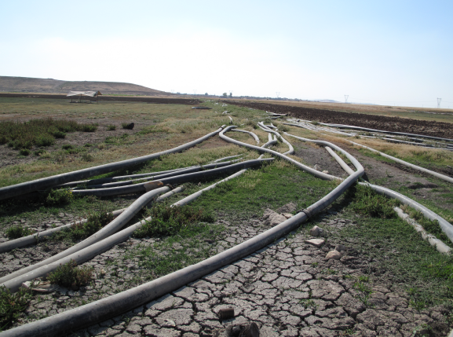
Environmental Implications: Natural Resource and Environmental Degradation

Slide 8
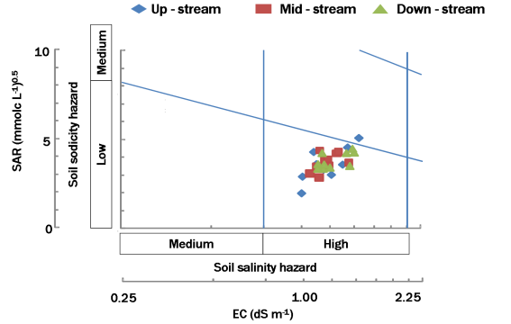
Salinity and Sodicity Interaction

Slide 9
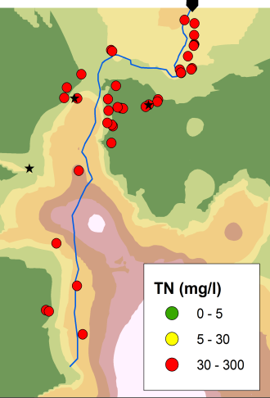
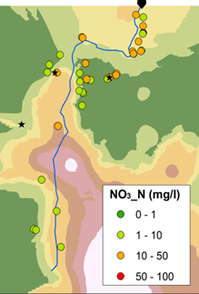
Nitrogen in Groundwater

Slide 10
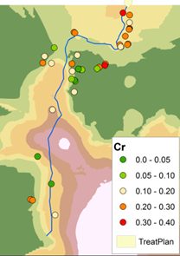
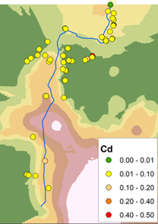
Heavy Metals in Groundwater

Slide 11
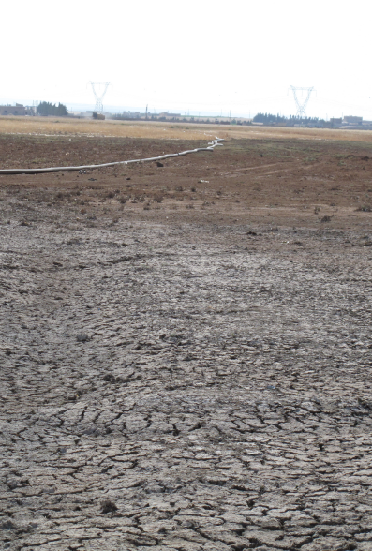
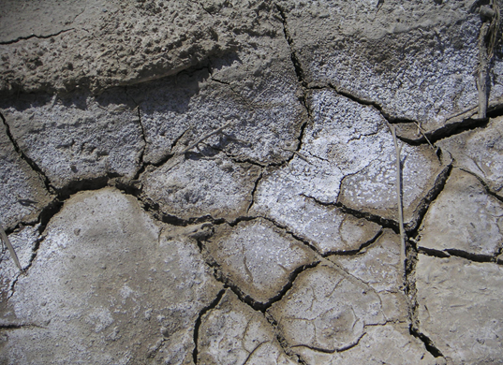
Climate Change – Wastewater Irrigation Nexus
High-intensity rainfall events leading to surface runoff and transport of salts and contaminants from soils irrigated with untreated or inadequately treated wastewater to nearby good soils irrigated with freshwater or rain-fed

Slide 12
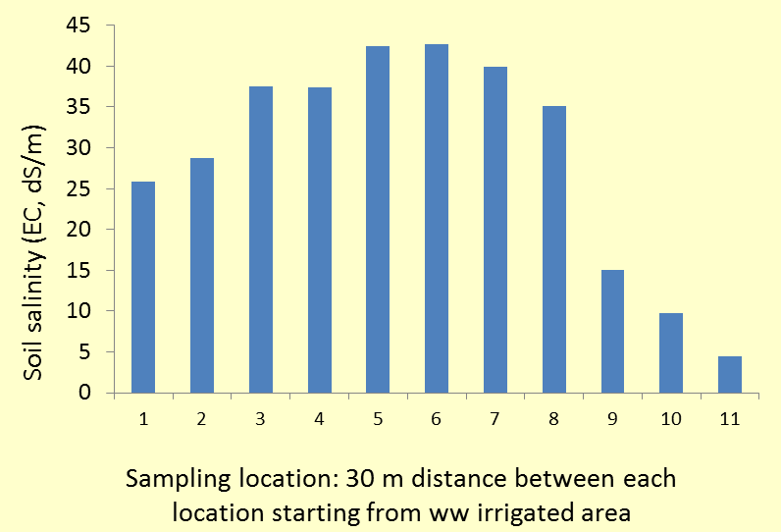
Salinity Build-up in Adjacent Areas

Slide 13
Conclusions
Urban wastewater in water scarce developing countries is a valuable resource that needs:
Implementation of adequate wastewater treatment and its regulated reuse
Monitoring systems and implementation of standards and guidelines
Skilled human resources and supportive institutions
Pertinent and flexible policy frameworks
Regulated use of treated wastewater in developing countries offers great promise for environment and health protection as well as livelihoods resilience

Slide 14
Thank you
16th African Water Association Congress, 20-23 February 2012, Marrakesh, Morocco

