Slide 1
UN-Water Seminar on the Safe use of Wastewater in Agriculture
Dr. Reza Ardakanian
Director
UN-Water Decade Programme on Capacity Development
UN-Campus Bonn, Germany
1

Slide 2
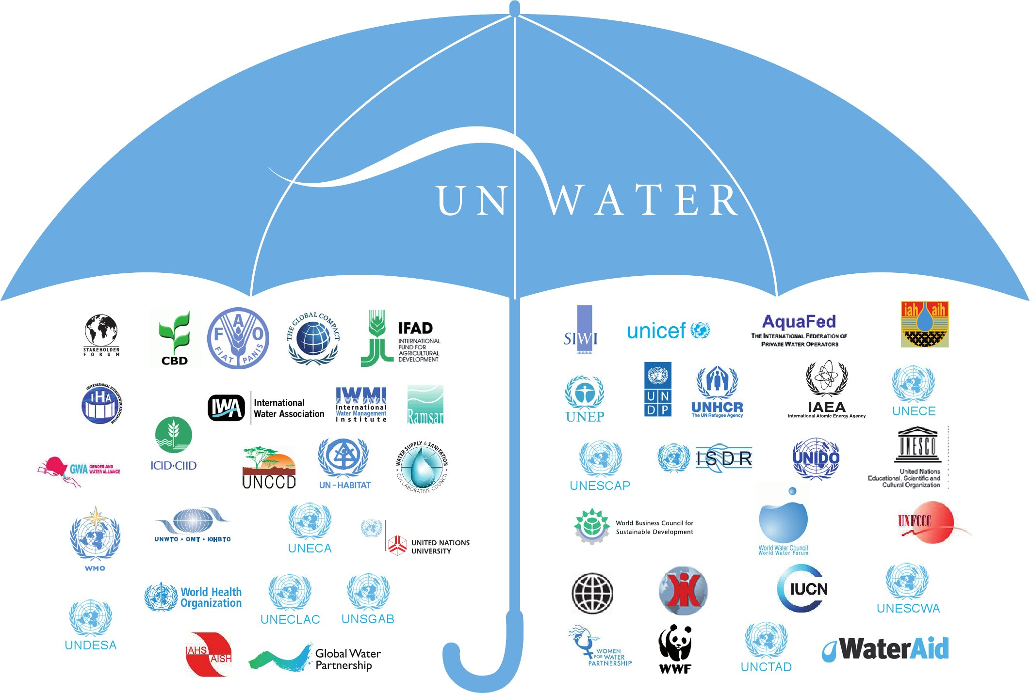
WWAP
UNW-DPC
UNW-DPAC
UN-Water Members
UN-Water Partners

Slide 3

UNW-DPC’s Mission
“to enhance the coherence, credibility and integrated effectiveness
of UN-Water
by strengthening its capacity development programmes, particularly in developing countries and economies in transition.”

Slide 4






Safe use of Wastewater in Agriculture
Organized by:

Slide 5
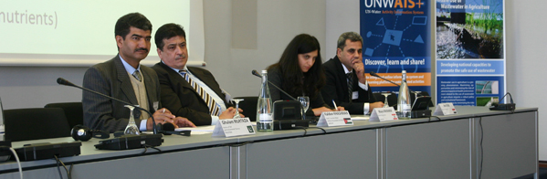
Safe use of Wastewater in Agriculture
Qualified people in key organizations to formulate the right policies and
put into practice the safe use of wastewater in agriculture.
Materials and methods
Identified experts
Dissemination strategy
Capacity building action plan
Systems
Organizations
Individuals

Slide 6
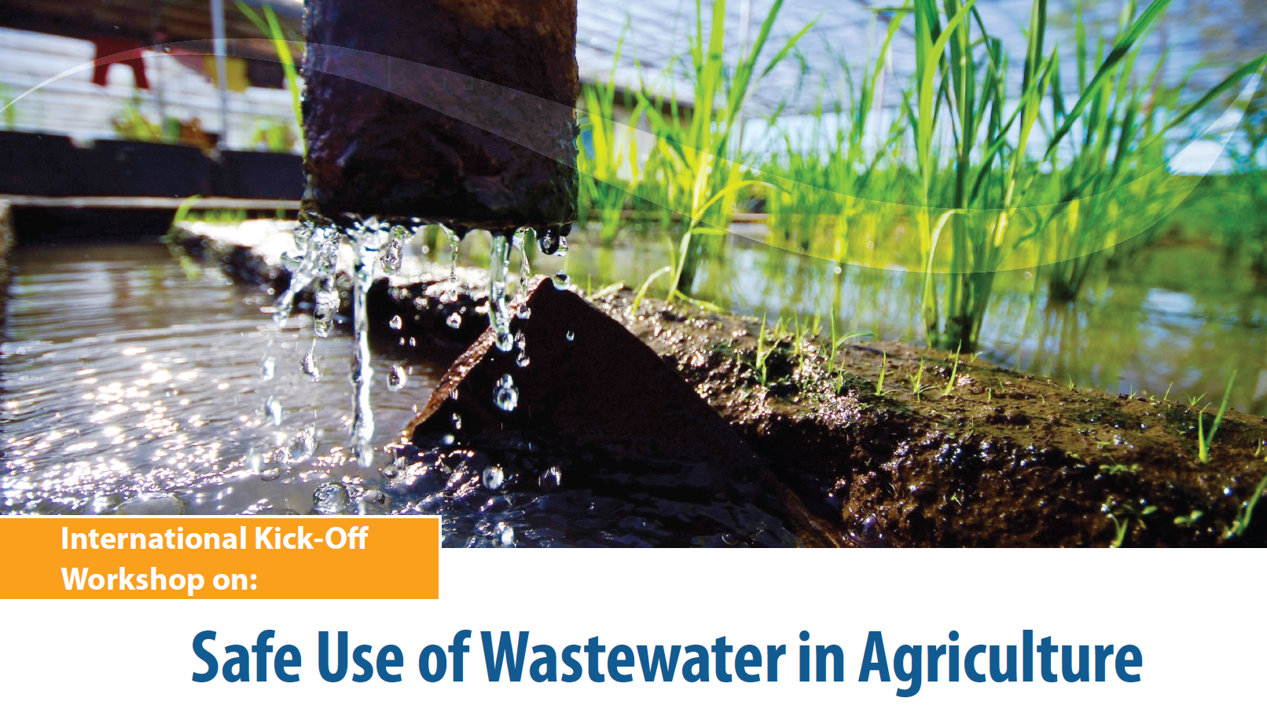





Slide 7






Organized by:
Local Partner:
Safe Use of Wastewater
in Agriculture
Safe Use of Wastewater
In Agriculture
>> 1st Regional Workshop for Africa
1st Regional Workshop for Francophone Africa
Algeria, Benin, Burkina Faso, Cameroun, Central African Republic, Côte d’Ivoire, Democratic Republic of Congo, Egypt, Gabon,
Guinea, Guinea-Bissau, Mauritania, Morocco, Niger, Nigeria, Senegal, Togo, Tunisia.
18-19 February 2012
Palais de Congr‘es, Room „Fez“

Slide 8
Capacity Needs for Regional Workshop

Slide 9

Timeline
Results and milestones | Deadline
International Workshop | November 2011
Regional Workshops 2 in Africa, 2 in Asia and Middle East, 1 in Latin America | February 2012- February 2013
International Wrap-up workshop | ~ May 2013

Slide 10
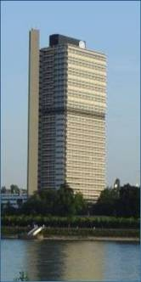

Thank you!
UN-Water Decade Programme on Capacity Development (UNW-DPC)
UNITED NATIONS UNIVERSITY
UN Campus
Hermann-Ehlers-Str. 10
D-53113 Bonn, Germany
Phone: + 49 (0) 228 815-0652
Fax: + 49 (0) 228 815-0655
E-Mail: info@unwater.unu.edu
www.unwater.unu.edu

