Slide 1

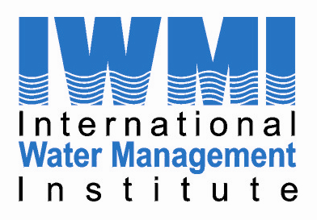
Health Risk Assessment and Mitigation where Wastewater Treatment does not Work
Manzoor Qadir and Pay Drechsel
FAO/UNEP/UNU-INWEH/UNW-DPC/IWMI/ICID First Regional Workshop of the Capacity Development Project on Safe Use of Wastewater, 18-19 February 2012, Marrakesh, Morocco

Slide 2
Major Aspects of Presentation
What are the situations where wastewater treatment work?
What are the situations where wastewater treatment does not work?
What are the health risk assessment approaches?
What are the health risk management/mitigation measures?
Some short videos on related aspects

Slide 3
Situations where wastewater treatment work
Appropriate wastewater collection, conveyance, treatment, and use systems exist
Skilled human resources are available
Supporting institutions exist and enabling policies are present and followed
Government priority and support exist
Water reclamation and reuse is common in developed countries

Slide 4
Situations where treatment does not work
Wastewater collection and treatment systems don’t exist
Wastewater collection system partly available, but treatment system unavailable, or broken/non-functional
Wastewater collection system available, but wastewater treatment system broken/non-functional
Overcapacity centralized wastewater treatment system
Government priority and support limited
Common in developing countries

Slide 5
Situations where treatment does not work
Availability of wastewater to the farmers in urban and peri-urban areas in untreated, inadequately treated, and diluted forms
Farmers use wastewater in unregulated ways to produce a range of crops
Health implications for the farmers and their families, traders of wastewater produce, kitchen staff, and consumers

Slide 6
Health risk assessment
Disability adjusted life years (DALYs) lost due to diseases of possible relevance to wastewater use in agriculture
DALYs describe the health of a population or burden of disease due to a specific disease or risk factor
DALYs reflect the time lost due to disability or death from a disease, compared with a long life free of disability in the absence of the disease
Details on health risk assessment to be covered later in another session

Slide 7
Health risk reduction/management/mitigation
Shall we wait for the day when all wastewater produced in the developing countries is adequately collected and treated to eliminate the health risk?
Or
Shall we look for interim solutions and measures that minimize/manage/mitigate risk?

Slide 8
Safety concept
Wastewater treatment is the key barrier for risk reduction (WHO 1989) …
Wastewater generation
Consumer
Wastewater treatment
Safe produce
…
… but is not available or has little coverage in many regions

Slide 9
1989 WHO Guidelines
WHO-FAO-UNEP (2006)
Irrigation water quality thresholds
Health-based targets
Wastewater generation
Farm worker
Traders
Kitchen staff
Consumer
Wastewater generation
Farm worker
Traders
Kitchen staff
Consumer
Wastewater treatment
Safe Irrigation Practices
Hygienic Handling Practices
Safe food washing and preparation
Wastewater treatment
Awareness creation to create demand for safe produce
Multi-barrier approach for health risk reduction
Notes:
Hazard analysis and critical control points Single barrier as risk management tool → multi barriers

Slide 10
Health risk mitigation measures
Farm based
Market based
Kitchen based
Policy based – WHO Guidelines, National Policies
Some examples . . . . . . . . .

Slide 11
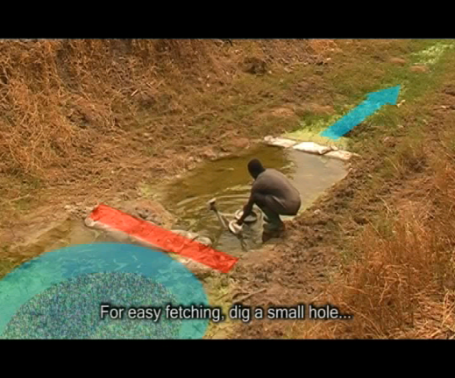
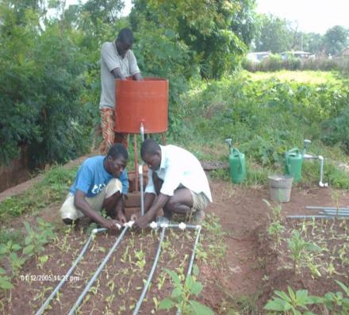
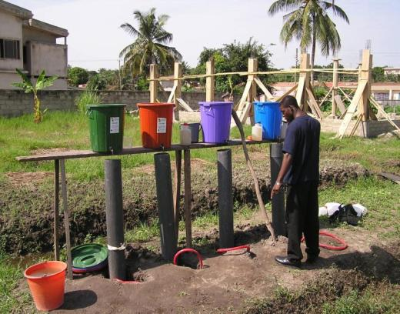
Drip and furrow irrigation
Sedimentation ponds
Cessation of irrigation
Filter
Limited soil splash
Improved water fetching
Increased retention time
On-farm treatment ponds
FARM

Slide 13
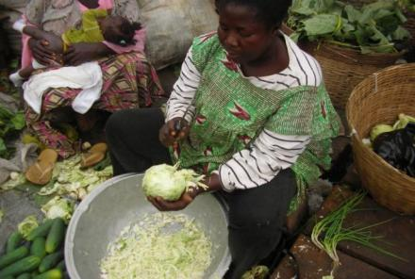
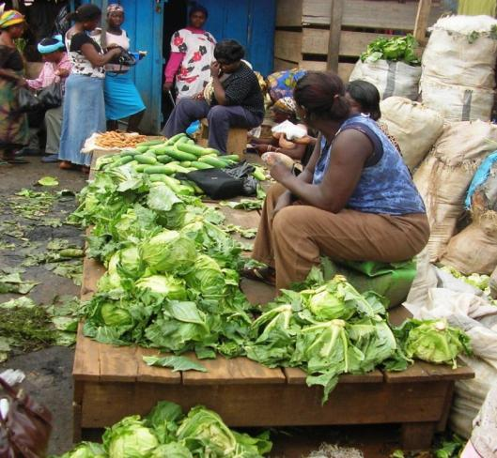
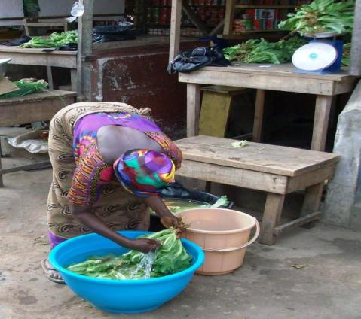
Supporting die-off
Display w/o recontamination
Safe washing & refreshing
Safe cutting practices, etc.
MARKET

Slide 14
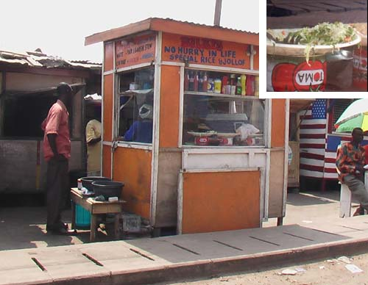
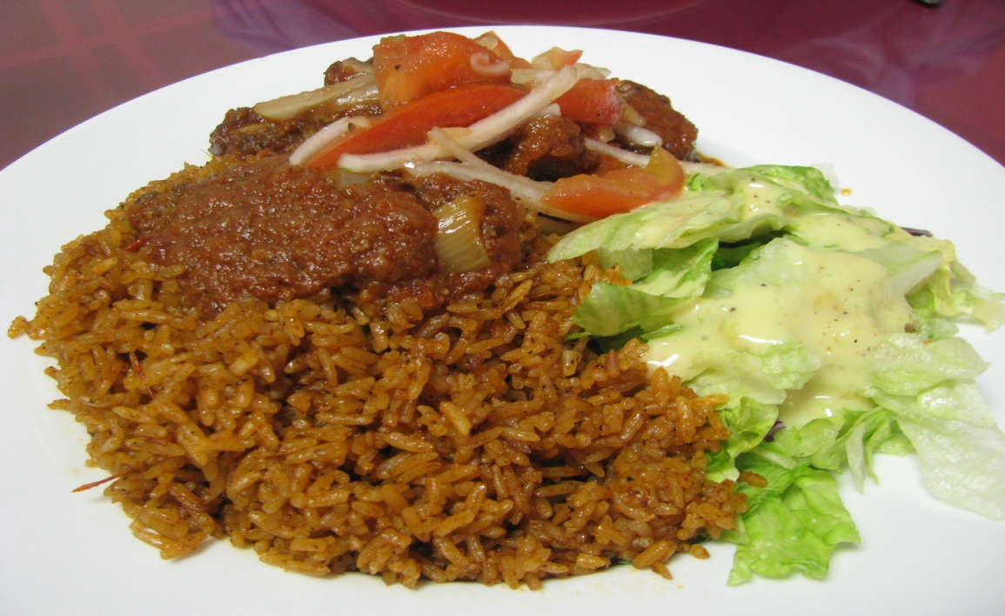
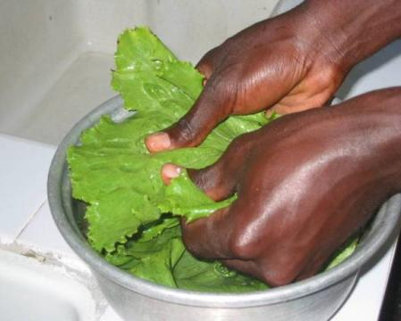
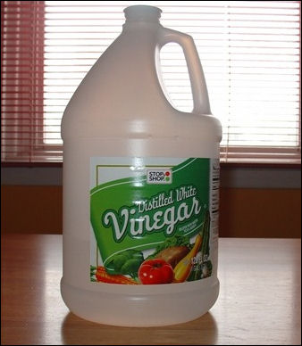

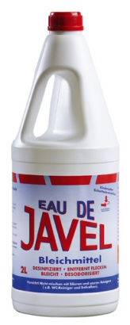
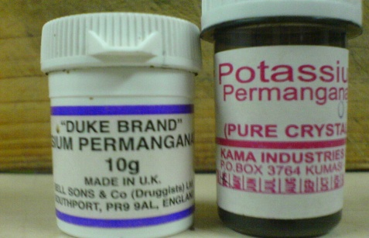
Kitchen
Effective & safe vegetable washing

Slide 16
All results ARE translated into various extension and training materials

Slide 17
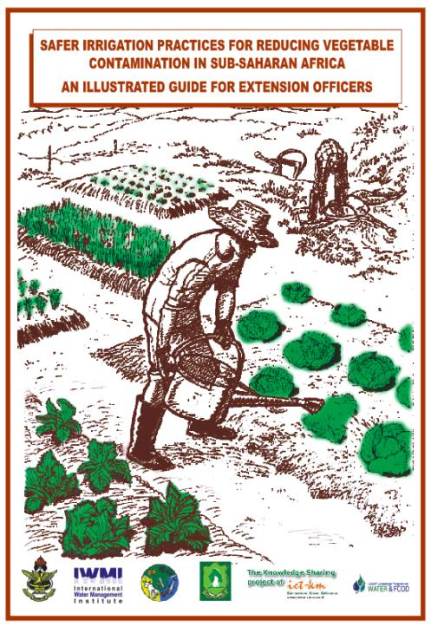
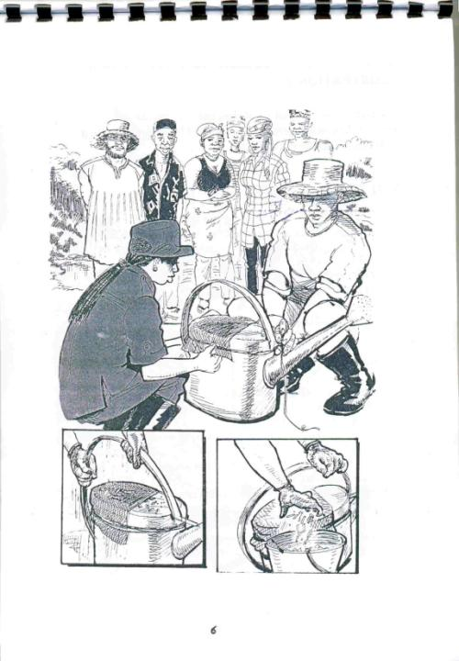
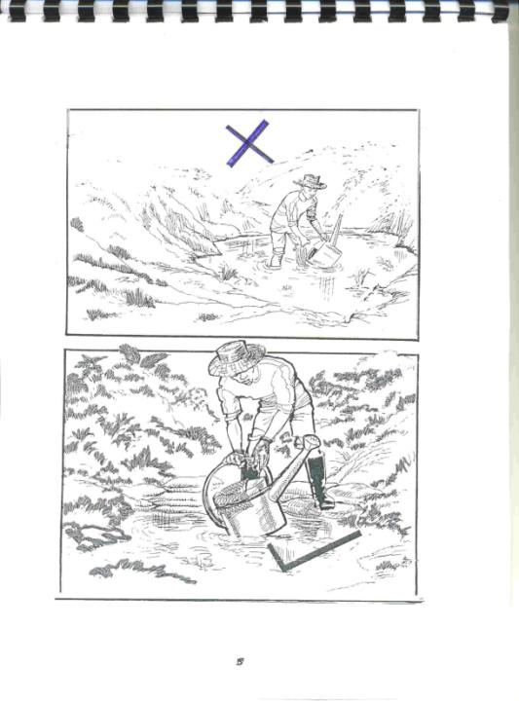
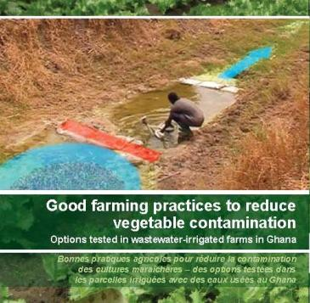
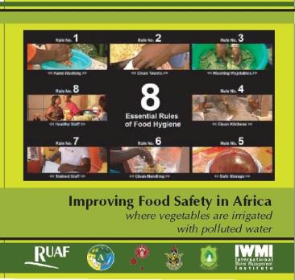
Multi-media Extension Material
Free online at video.google.com
Supporting FAO Farmer Field School modules

Slide 18
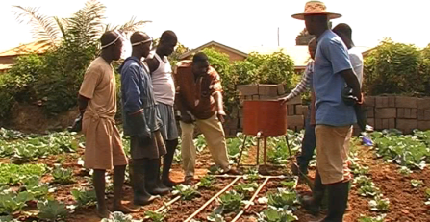
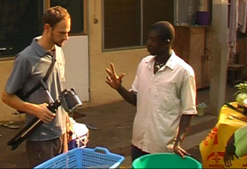
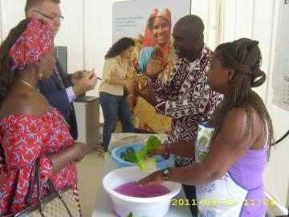
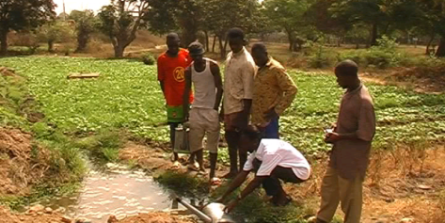
Training of trainers, farmers, fast food sellers

Slide 19
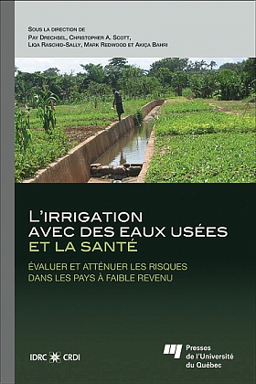
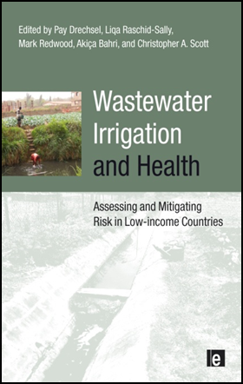
Free online references for further reading
www.iwmi.org www.idrc.ca

Slide 20
Conclusions
Risk management is possible at low cost also where wastewater treatment is only emerging (> 90% of disease burden down)
Combination of treatment and non-treatment options would be ideal, but also on-farm and/or off-farm interventions alone can be very effective
Impact and cost-effectiveness of these interventions depend on their adoption rate: this requires education, incentives and social marketing (similar to hand wash campaigns)

Slide 21
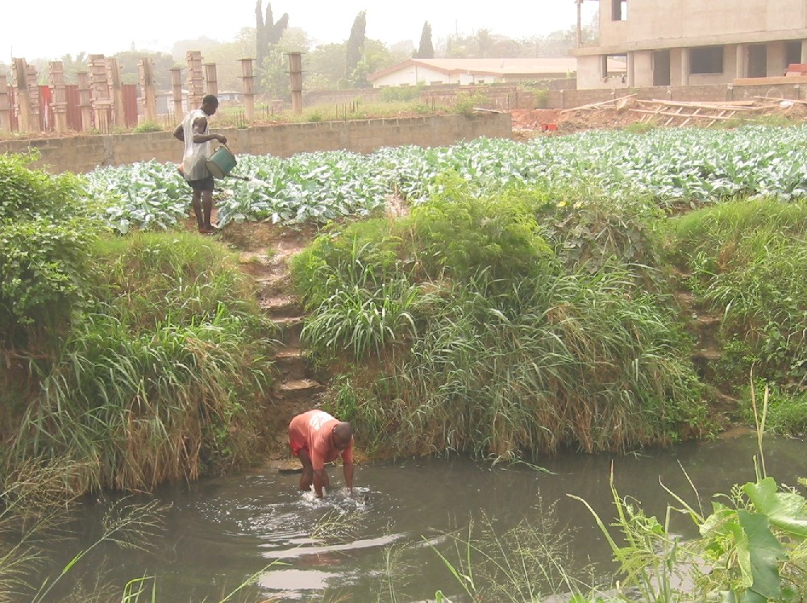
Thank you

