Slide 1

Bonding & Bridging in Capacity Development Networks
Mariëlle van der Zouwen & Miranda Pieron
In cooperation with

Slide 2
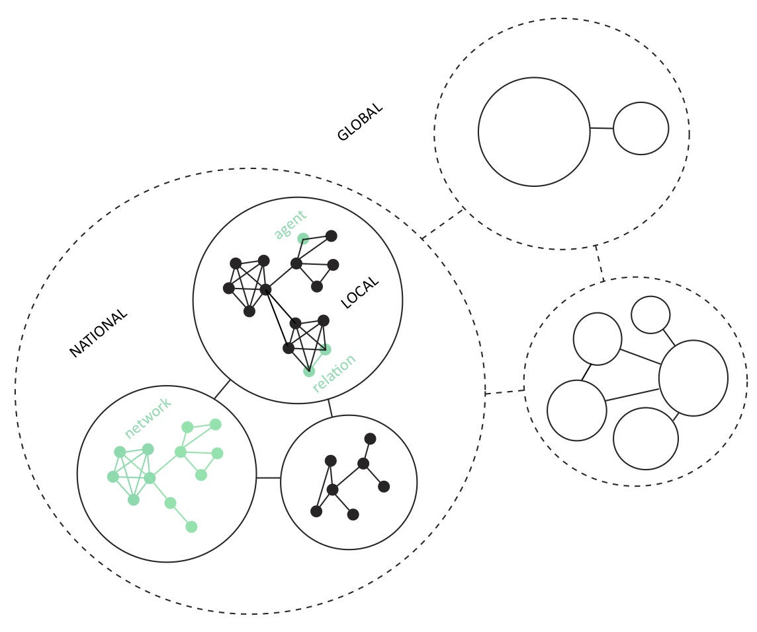
Research on Capacity Development
Safe Use of Wastewater in Agriculture:
many stakeholders on multiple levels;
many thematic areas with interrelated problems;
uncertainties regarding future developments.
Requirement:
A stable and coherent
social network for
capacity development

Slide 3
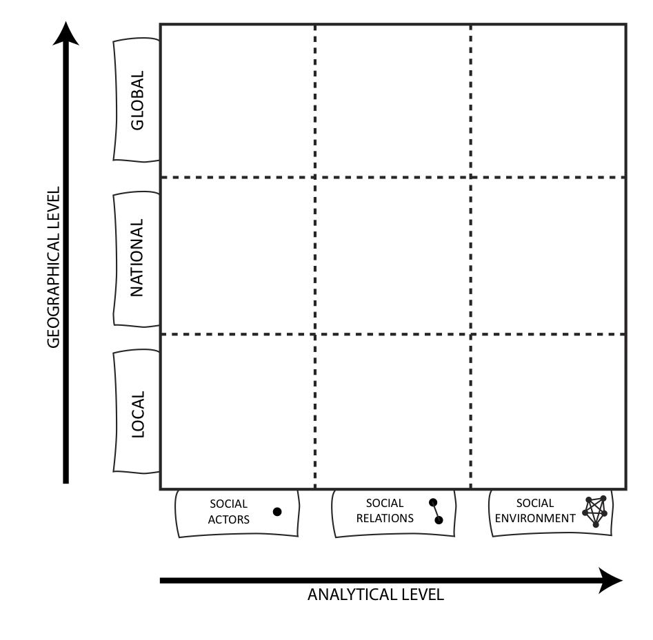
Expected Outcomes
3 STEP APPROACH:
Mapping the social network content and structure;
Identifying capacity needs
and gaps & coherency;
Formulating recommendations as regards a stable C.D. network.
Social-cognitive network map
List of enabling/constraining factors
Recommendations document

Slide 4



Participation
Input from network participants (YOU!) essential.
EXPLORATION
MAPPING
VALIDATION
With whom do you share information?
Which skills and information do you
have/need for/from whom?
What do you need from the social network
to develop capacity effectively and efficiently?
Which challenges do you perceive?
March ’12
June ‘12

Slide 5
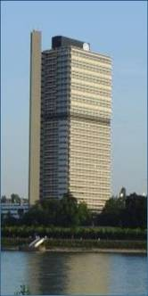

Thank you!
UN-Water Decade Programme on Capacity Development
(UNW-DPC)
UNITED NATIONS UNIVERSITY
UN Campus
Hermann-Ehlers-Str. 10
D-53113 Bonn, Germany
Phone: + 49 (0) 228 815-0652
Fax: + 49 (0) 228 815-0655
E-Mail: info@unwater.unu.edu
www.unwater.unu.edu

