Slide 1
Awareness raising and national strategies for dissemination
>> Interactive session
Dr. Jens Liebe
Miranda Pieron
1st Regional Workshop on Safe use of Wastewater in Agriculture
19 February 2012
Marrakech, Morocco
1

Slide 2
Program
Awareness raising
  Public awareness and acceptance (requested during kick-off workshop)
National strategies for dissemination
  >> 2 Tasks
  >> Discussion
Example of a National Strategy, Morocco
UN-Water Activity Information System

Slide 3
Background
… from the concept note:
An important output from these regional workshops would be a capacity development action plan.
It should describe how the training material and learning methods should be disseminated at country level in the relevant organizations.

Slide 4
Public awareness and acceptance
Raising awareness at different levels
  Awareness at national policy domain
  (supply and waste management, resources management and planning, health sector)
  Users and handlers
  Public awareness of consumers & acceptance

Slide 5
Key elements for acceptance
Critical: Involvement of the public from early on (planning, implementation, use).
Requirements
Identification of users and consumers
Exchange of information between authorities and public representatives to ensure that WW use addresses a real community need (incl. reduction of competition for other water sources)
Addressing peoples health concerns and confidence in food safety

Slide 6
Key elements for acceptance
Public acceptance is commonly higher
when the community is aware of water scarcity, and the need to preserve high-quality water for domestic use.
Use of WW in Agriculture is then seen as a solution to a real problem, instead of a problem in itself.
Bear in mind: Public acceptance is different for different uses (influences success, failure)

Slide 7
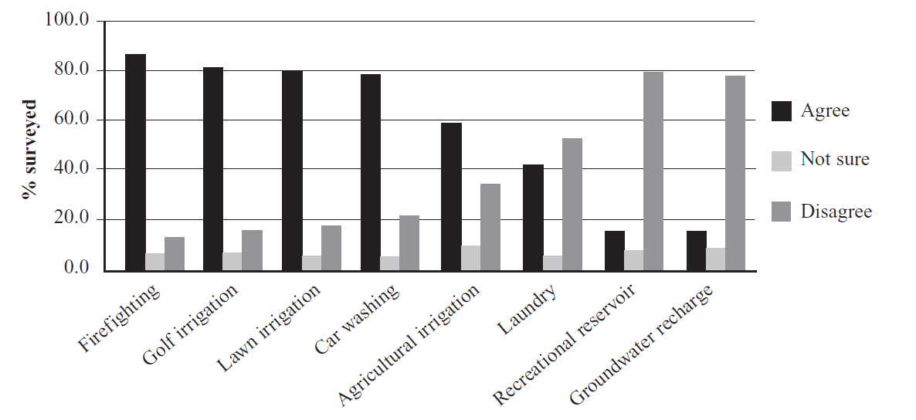
Attitudes towards wastewater use options
Less contact - greater acceptance
(WHO Guidelines 2006)

Slide 8
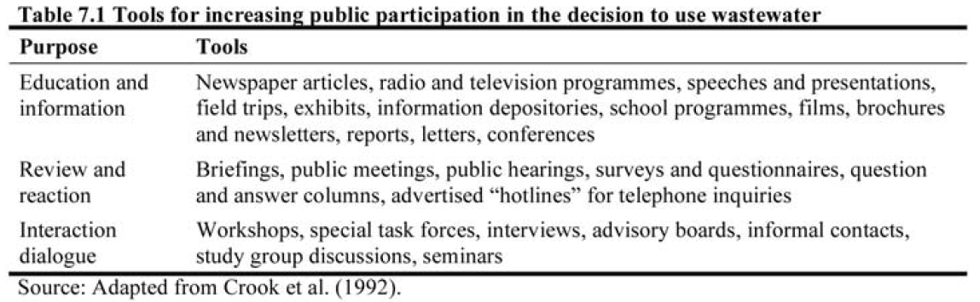
Tools to increase public participation
(WHO Guidelines 2006)

Slide 9
Survey: Sensibilisation du public/
Public Awareness
« Sensibilisation du public » est une partie importante de toute stratégie nationale. Quels sont vos groupes cibles les plus importantes et les défis pour atteindre chacun d'entre eux?
"Public Awareness" is an important part of any national strategy. What are your most important target groups and the challenges to reach each of them?

Slide 10
Responses
“ ... the most important target groups are women and youth. In Burkina Faso, women and young people are prominent in terms of irrigated agriculture, and their enthusiasm about the acceptance of innovations such as the use of wastewater in agriculture is low.
The challenge to reach these target groups is mainly and issue of sensitization and training on the use of wastewater in agriculture.“

Slide 11
Responses
“The user awareness is critical for the acceptance of this water. [...] we target irrigation farmers by showing them the benefits of using this water, which is available year round and of its fertilizer value, and trying to support them to equip irrigation systems appropriately.“
“Targets: Water User Associations for agriculture, tourism promoters, industrial and agricultural. Challenges: establishing a framework of incentives at the institutional, regulatory and financial level.”

Slide 12
Awareness raising
>> Discussion
Add discussion points

Slide 13
National strategies for dissemination
Different types of national strategies:
    Resources management
    Capacity development, dissemination
  → Capacity Development Action Plan

Slide 14
Capacity Development
What is “Capacity building” ?
The process of developing and strengthening the skills, abilities, and resources that organizations and communities need to survive, adapt, and thrive in the fast-changing world."
(after Philbin 1996)
A fundamental goal is to enhance the ability to evaluate and address the crucial questions related to policy choices and modes of implementation among development options, based on an understanding of environment potentials and limits and of needs perceived by the people of the country concerned".
(UNCED, 1992.)

Slide 15
Capacity Development
3 pillars of capacity development
Human capital
Institutional capacity
Infrastructure & technological capacity
“Enabling environment”

Slide 16
Levels and dimensions of capacity with respect to safe wastewater use in agriculture
Trade and market environment
System level:
Context in which organisations, individuals and groups involved in wastewater use for agriculture operate
Dimensions: Policies, strategies, laws and regulations related to safe wastewater use in agriculture.
Relationships, interdependencies and interactions among concerned stakeholders
Socio-economic and political environemnt
Organization level:
Government Agencies and Institutions such as Ministries of Agriculture, Water, Environment, Health or Irrigation; Water control laboratories, Research Centers, Consumer groups
Dimensions: Resources (human, financial, information) procedures, structures, culture, decision-making, infrastructure, etc.
Individual Level:
Public health, agricultural and environmental scientists, agriculture professionals, educators, researchers,engineers,policy makers and those responsible for developing
standards and regulations
Dimensions: Knowledge, skills, competences, work ethics, etc.
Governance
Education
(Source: UNDP 1998)

Slide 17
What is a dissemination strategy?
An intentionally-developed approach to dissemination of a particular project which includes
identification of targeted potential adopters,
an assessment of the climate of readiness for change,
planning how engagement will be built, and
enabling transfer of project outcomes.
(Hinton, T., Gannaway, D., Berry, B., & Moore, K. (2011). The D-Cubed Guide: Planning for Effective Dissemination. Sydney: Australian Teaching and LearningCouncil.)

Slide 18
Focus on Capacity Development
Capacity development action plan with a dissemination strategy:
  (Scope)
  To whom?
    Who are the actors?
    Who can lead and integrate others?
  Which materials or training at which level?
  In what form of delivery?

Slide 19

Bonding & Bridging in Capacity Development Networks
Mariëlle van der Zouwen & Miranda Pieron
In cooperation with

Slide 20
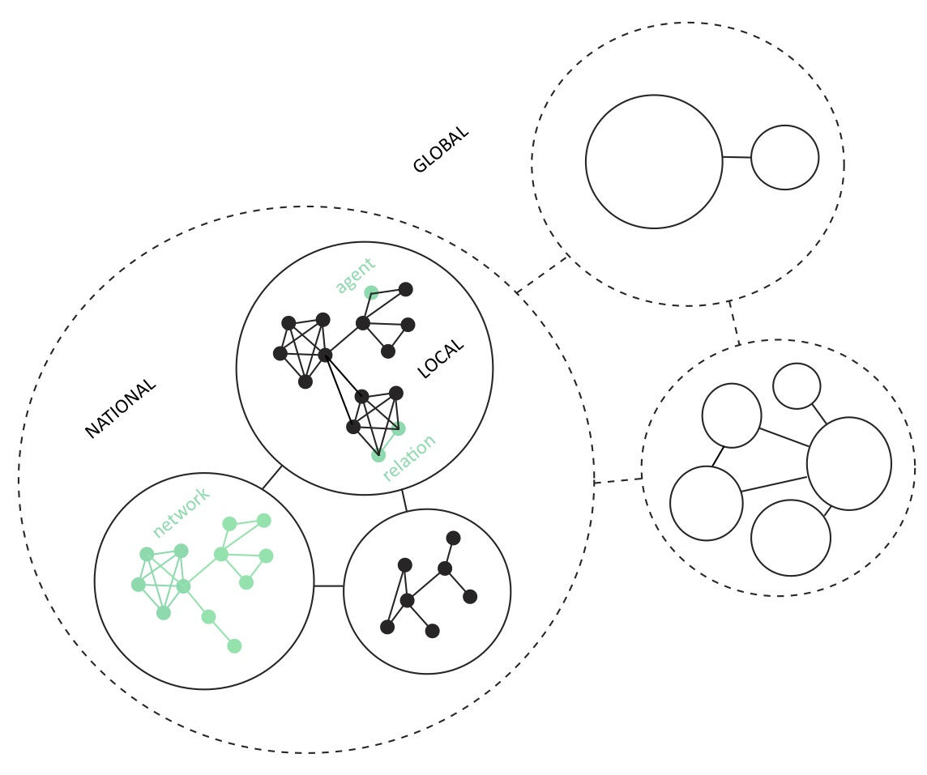
Research on Capacity Development
Safe Use of Wastewater in Agriculture:
many stakeholders on multiple levels;
many thematic areas with interrelated problems;
uncertainties regarding future developments.
Requirement:
A stable and coherent
social network for
capacity development

Slide 21
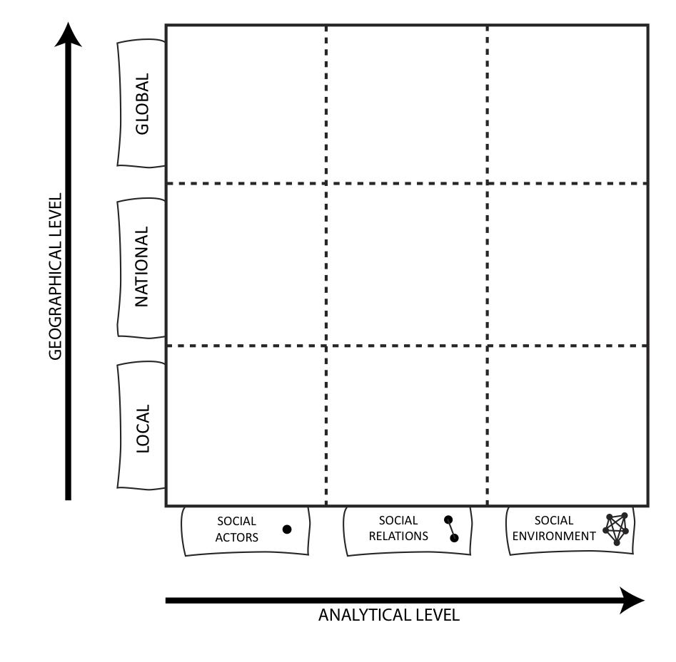
Expected Outcomes
3 STEP APPROACH:
Mapping the social network content and structure;
Identifying capacity needs
and gaps & coherency;
Formulating recommendations as regards a stable C.D. network.
Social-cognitive network map
List of enabling/constraining factors
Recommendations document

Slide 22



Participation
Input from network participants (YOU!) essential.
EXPLORATION
MAPPING
VALIDATION
With whom do you share information?
Which skills and information do you
have/need for/from whom?
What do you need from the social network
to develop capacity effectively and efficiently?
Which challenges do you perceive?
March ’12
June ‘12

Slide 23
Task 1 - National strategy
(~10 minutes)
>> Please fill out the fields 1 and 2.
Please compile 1 document per country
1. Who are the actors in your country?
2. Who is in a position to take the lead on this initiative and bring these actors together in your country?

Slide 24
Focus on Capacity Development
Capacity development action plan with a dissemination strategy:
  (Scope)
  To whom?
    Who are the actors?
    Who can lead and integrate others?
  Which materials or training at which level?
  In what form of delivery?

Slide 25
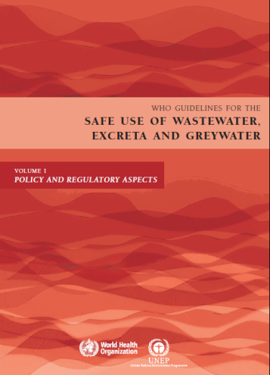
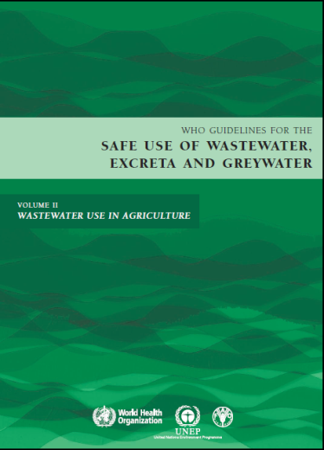
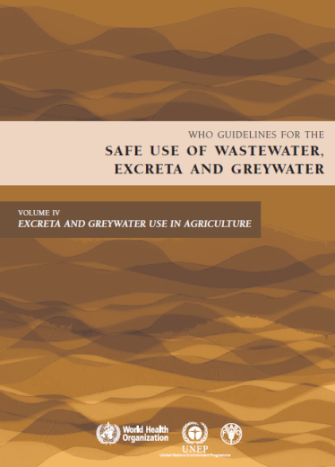
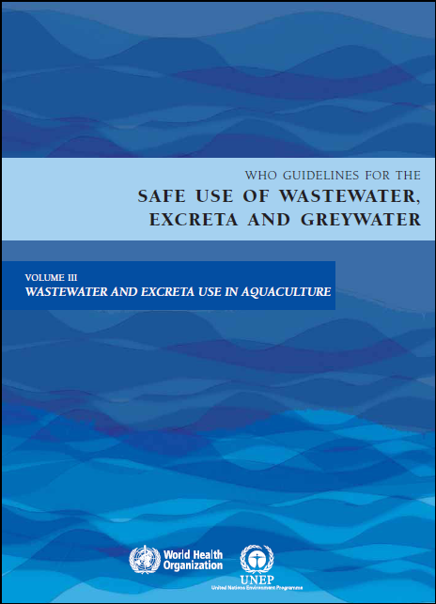
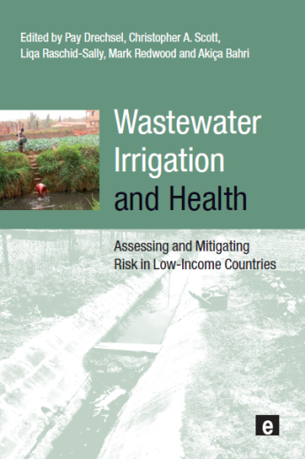

Which materials?
Materials presented yesterday and today, e.g.
WHO Guidelines
Wealth of Waste and Posters (FAO)
Sick water report (UNEP)
Wastewater Irrigation and Health
+ your own material

Slide 26
In what form of delivery?
Training of trainers
Distribution of materials and guidelines (international and national)
Identify and work with early adopters (showcasing, incentives)
Workshops
…
What worked well in your experience?

Slide 27
Task 2 - National strategy
(20 minutes)
Scope
Which materials?
What form of delivery?
>> Please fill out the matrix 3.
Please compile 1 document per country

Slide 28
Survey: Ce qui est nécessaire dans votre pays pour élaborer une stratégie nationale pour l'utilisation sécuritaire des eaux usées dans l'agriculture? (What is needed in your country to develop a national strategy for the safe use of wastewater in agriculture?)
“ strategy is already in place regarding the regulation, standards .... what is necessary to take good care of it is good practice to use the treated wastewater.”
“ Establishment of an urgent consultative committee between state authorities and stakeholders for a better understanding and awareness of the importance of safe use of wastewater.”

Slide 29
Survey: Ce qui est nécessaire dans votre pays pour élaborer une stratégie nationale pour l'utilisation sécuritaire des eaux usées dans l'agriculture? (What is needed in your country to develop a national strategy for the safe use of wastewater in agriculture?)
“…financial means to build modern treatment stations and reinforcement of capacities of technicians, …”
“A strong political will and a collective awareness of the importance of wastewater use in agriculture and the creation of a permanent group of experts in this field.”

Slide 30
Survey: Ce qui est nécessaire dans votre pays pour élaborer une stratégie nationale pour l'utilisation sécuritaire des eaux usées dans l'agriculture? (What is needed in your country to develop a national strategy for the safe use of wastewater in agriculture?)
“…revision of standards for reuse. Strengthening support
measures is necessary and certain actions must be
strengthened including:
Improving the quality of treated wastewater complementary treatments (tertiary if necessary) upstream.
Adaptation of uses for produced water qualities (different classes of water for different uses).
The proposed solutions to improve water quality and access to water in except during the irrigation season (long-term storage and inter-seasonal).
Strengthening of enforcement to prevent the fraudulent use of water for irrigation of other crops
The adoption of marketing patterns of treated wastewater more attractive.
The implementation of awareness campaigns for farmers.
The creation of irrigated areas near water production”

Slide 31
National Strategies
>> Discussion
What is needed in your country to develop a national strategy for the safe use of wastewater in agriculture?
What goals do you want to achieve in 1 year, 5 years, 10 years?

Slide 32
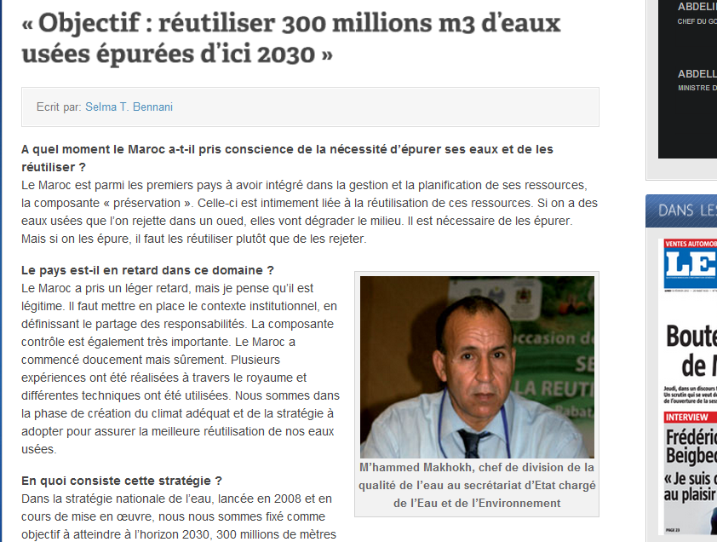
National Strategy,
Example Morocco
(http://www.lesoir-echos.com/)

Slide 33
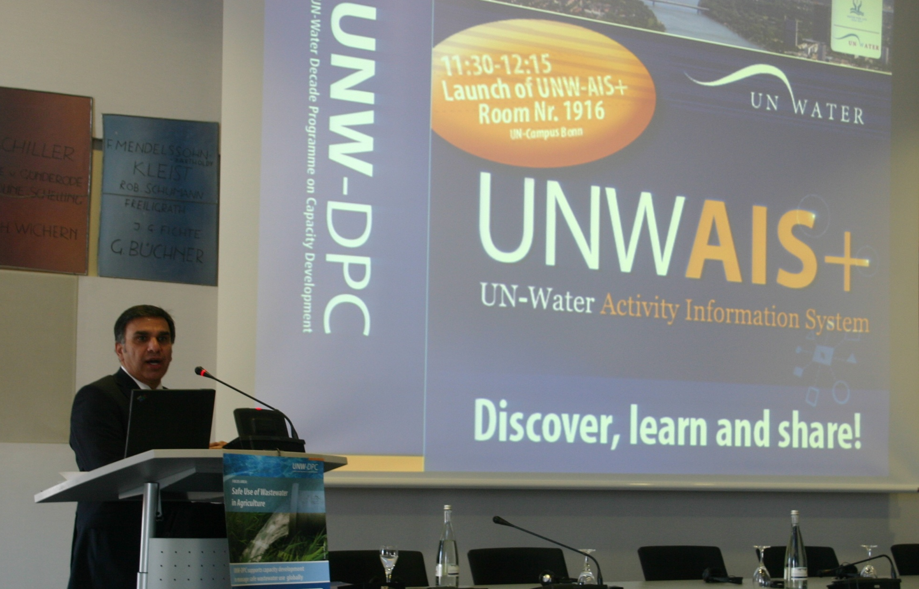
UNWAIS+
Discover, learn, and share!
Launched by
Dr. Zafar Adeel
Chair of UN-Water,
Director of UNU-INWEH
November 14, 2011

Slide 34
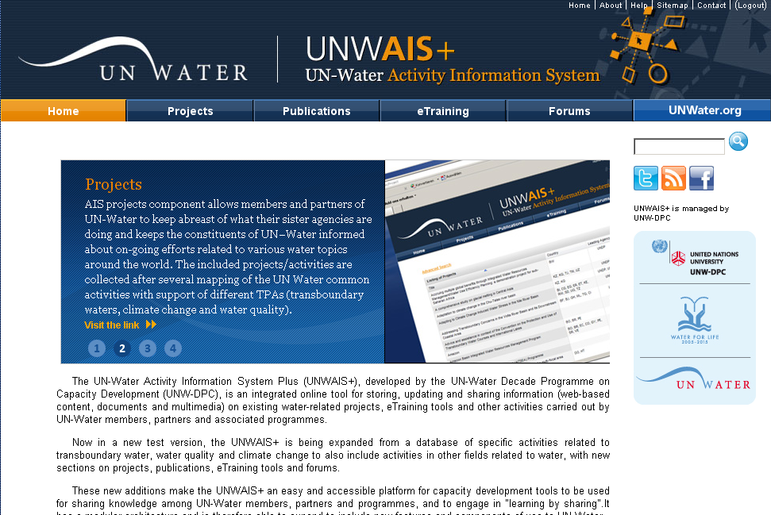
http://www.ais.unwater.org/
Discover, learn, and share!

Slide 35
UNW-AIS+: Scope and Capabilities
+ Single entry point of access to information.
+ Storing, updating, sharing and analysis of information.
+ Handling metadata, web-based content, documents
or multimedia.
+ Project data selection, geographic search, document search.
+ Facilitates organization of events and interaction with
participants.
+ Social networking, groups, discussion forums and e-learning.

Slide 36


Thank you!
UN-Water Decade Programme on Capacity Development
(UNW-DPC)
UNITED NATIONS UNIVERSITY
UN Campus
Hermann-Ehlers-Str. 10
D-53113 Bonn, Germany
Phone: + 49 (0) 228 815-0652
Fax: + 49 (0) 228 815-0655
E-Mail: info@unwater.unu.edu
www.unwater.unu.edu

