Slide 1






Institutional Arrangements and Collaboration for Safe Use of Wastewater in Agriculture in Latin America and the Caribbean
Manzoor Qadir
UNU-INWEH
Fourth Regional Workshop ‘Safe and Productive Use of Wastewater in Agriculture’, 11-13 December 2012, Lima, Peru

Slide 2
Presentation based on Questionnaire Response
  Chile
  Colombia
  Dominican Republic
  El Salvador
  Guyana
  Honduras
  Paraguay
  St Kitts and Nevis
  Uruguay
Questionnaire is available in English and Spanish
Remaining countries can submit their feedback at Javier.MateoSagasta@fao.orgManzoor.Qadir@unu.edu

Slide 3
Institutional Levels/Categories
National level across different ministries
District level across related institutions
Academic level across educational institutions
Farmers level across individual and associations
Policy level addressing the use of WHO/national guidelines
Regional level across countries in the region

Slide 4
National Level – Responsible Ministry
Great diversity at the national level ministries among countries for wastewater management
  Ministry of Environment
  Ministry of Environment and Sustainable Development
  Ministry of Natural Resources and Environment
  Ministry of Housing, Planning, and Environment
  Ministry of Housing and Water
  Ministry of Public Works
  Ministry of Health

Slide 5
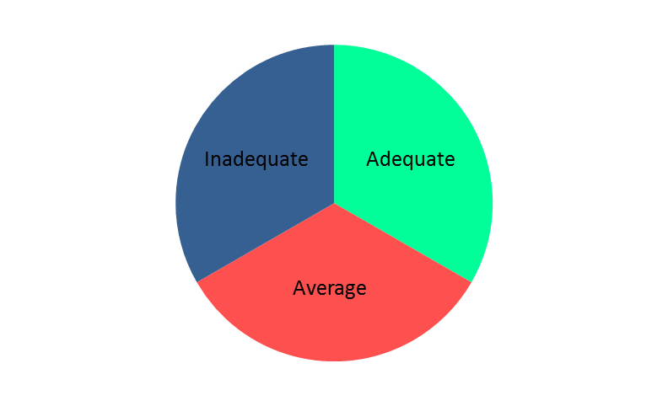
Inter-ministerial Collaboration
Categories included excellent, adequate, average, inadequate, and none

Slide 6
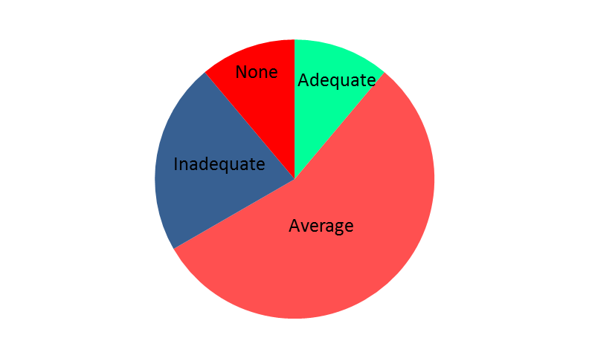
Government’s Commitment and Budget Allocation
Categories included excellent, adequate, average, inadequate, and none

Slide 7
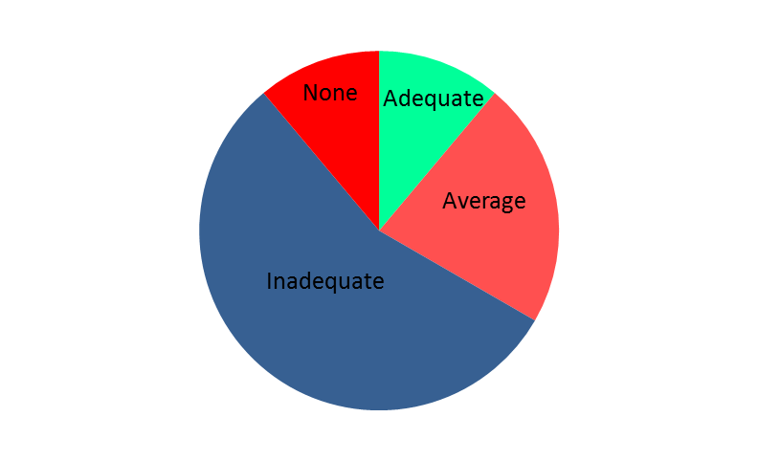
Institutional Collaboration at District Level
Categories included excellent, adequate, average, inadequate, and none

Slide 8
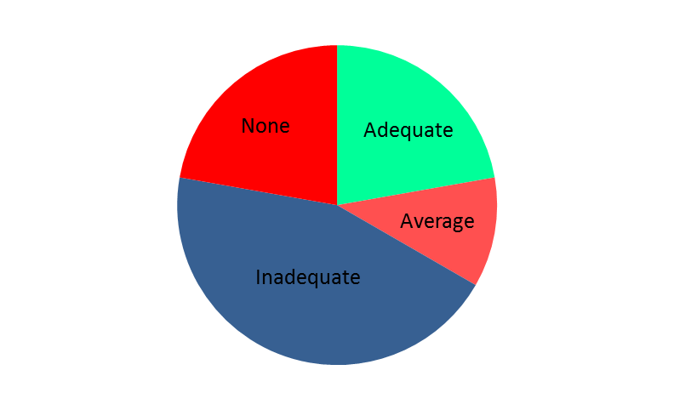
Institutional Commitment and Budget Allocation
Categories included excellent, adequate, average, inadequate, and none

Slide 9
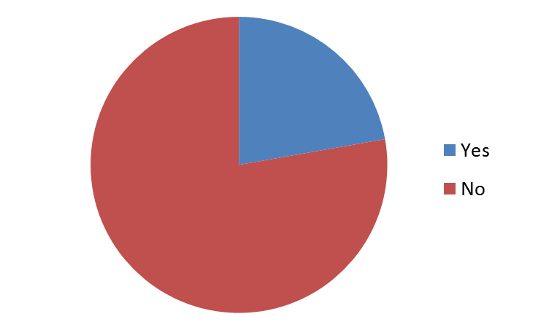
Academic Level: Wastewater in Schools’ Curricula
Topic of wastewater management in any form as a part of the curricula in schools

Slide 10
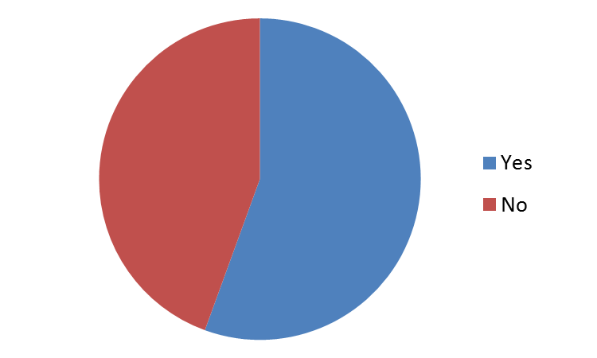
Academic Level: Wastewater in Universities’ Curricula
Topic of wastewater management in any form as a part of the curricula in universities

Slide 11
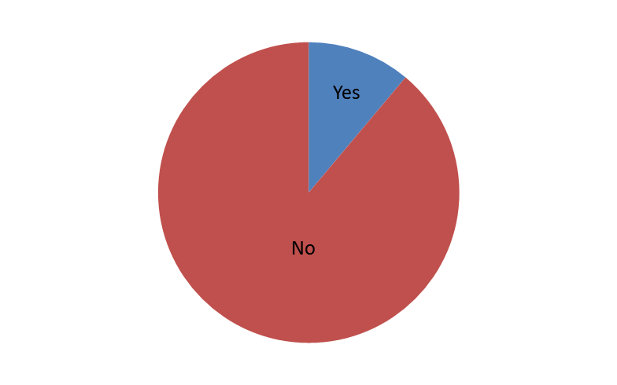
Farmers/Water Users Associations
Farmers/water users associations dealing with local institutions for wastewater delivery

Slide 12
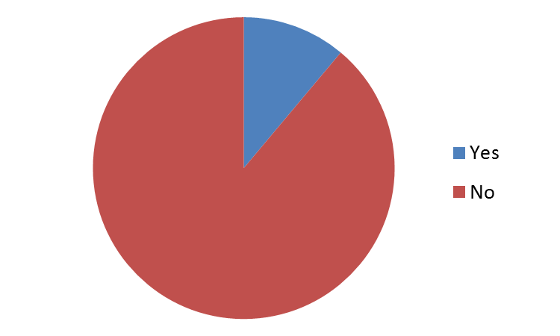
Farmers pay to Local Institutions for Wastewater

Slide 13
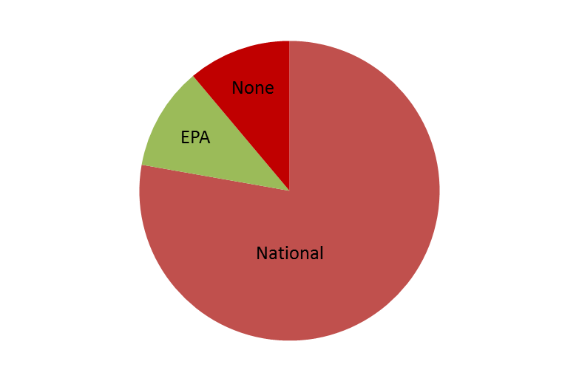
Policy Level: Guidelines for Wastewater Use
Categories included WHO guidelines, EPA, national guidelines, and none

Slide 14
Regional Level: Collaboration across Countries
In case of yes, collaboration through joint projects and participation in regional workshops

Slide 15
Key Questions for Discussion
What status do we have in regard to institutional arrangements at different levels for wastewater management?
What success stories do we have in terms of institutional collaboration addressing safe and productive use of wastewater?
How can we improve institutional collaboration addressing safe and productive use of wastewater?

