Slide 1


Maximizing Productivity from Wastewater: Irrigation, Soil, and Crop Management Strategies
Manzoor Qadir (UNU-INWEH)
Javier Mateo-Sagasta (FAO)
Fourth Regional Workshop ‘Safe and Productive Use of Wastewater in Agriculture’, 11-13 December 2012, Lima, Peru

Slide 2
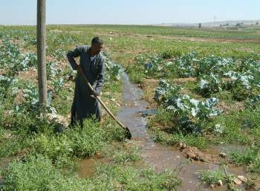
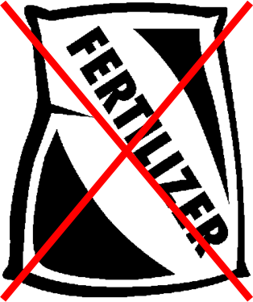
Wastewater: Opportunities for Crop Production
  Stable source of water with reliable availability of water for irrigation amid water scarcity
  Savings on fertilizer use (wastewater contains nutrients), i.e. cheap source of nutrients with no or little amount of fertilizer needed

Slide 3
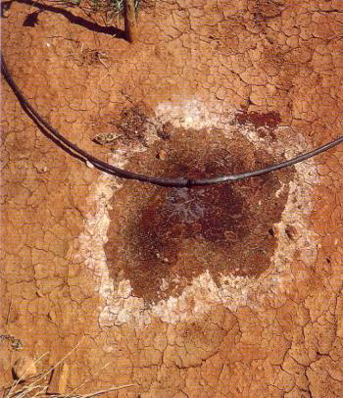
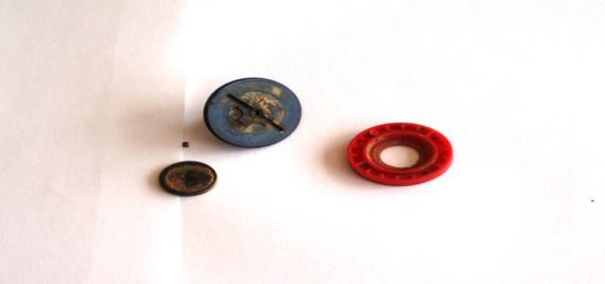
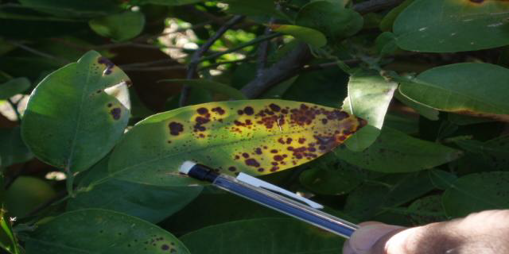
Wastewater: Risks for Crop Production
  Salinity/sodicity
  Specific-ion toxicity
  Suspend solids
Salinity/sodicity
Clogged drippers
Boron toxicity

Slide 4
How can we maximize agricultural productivity and benefits from wastewater?
Some on-farm wastewater management strategies to maximize productivity and minimize risks

Slide 5
Crop selection based on
Market value
Irrigation requirement
Diversification
Stress tolerance
Irrigation, soil, and crop management strategies for wastewater use in agriculture
Irrigation management for
Water quality
Irrigation method
Irrigation scheduling
Irrigation rate
Soil management based on
Soil characteristics
Pollutant control
Amendment needs, if any
Nutrient management
Other related aspects
Harvesting measures
Human health protection
Farmers’ awareness about best practices
Qadir, Drechsel, Raschid-Sally (2008) Wastewater use in agriculture: Agronomic considerations. Encyclopedia of Water Science: 1296-1299
FAO (2003) Users manual for irrigation with treated wastewater. FAO Regional Office for the Near East, Cairo, Egypt.

Slide 6
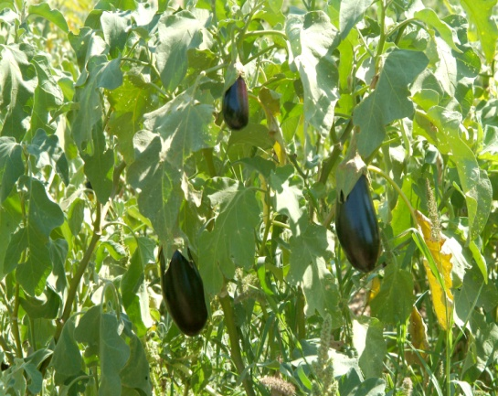
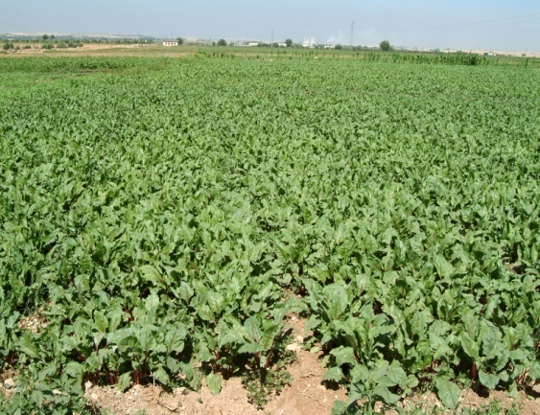
Crop Selection based on
  Market value/demand
  Crop/crop rotation irrigation requirement inline with water availability
  Crop diversification/restriction where untreated wastewater is used for irrigation
  Stress tolerance for salts, heavy metals, boron, etc.

Slide 7
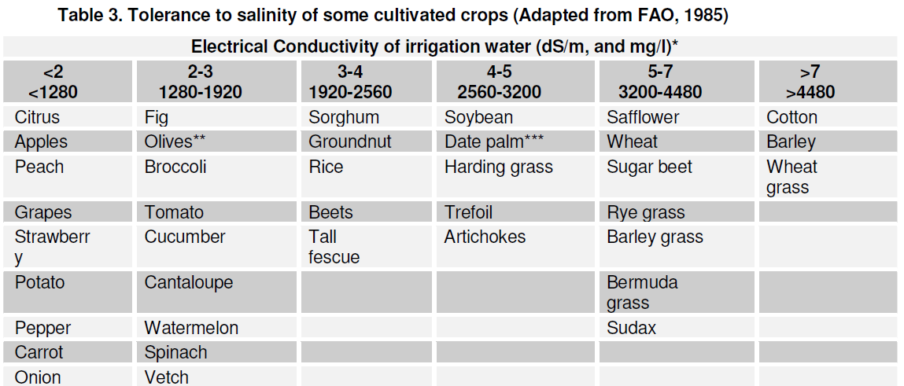
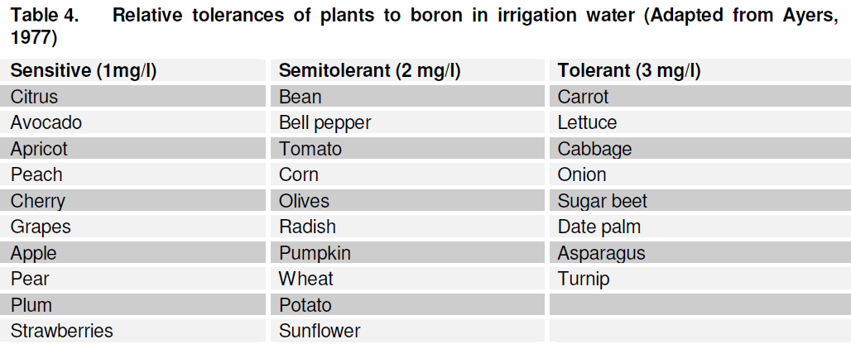

Crop Selection based on Stress Tolerance

Slide 8
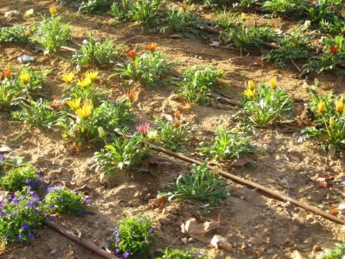
Irrigation Management for
  Water quality: Level of wastewater treatment – no treatment to tertiary treatment
  Irrigation method: flood irrigation (low cost and low WUE), manual irrigation with watering cans, furrow irrigation, sprinkler irrigation, and drip irrigation (high cost and high WUE)
  Leaching and drainage

Slide 9
Irrigation Management for
  Irrigation scheduling/frequency
  Irrigation rate
  Conjunctive use such as cyclic or blended application with good-quality water

Slide 10
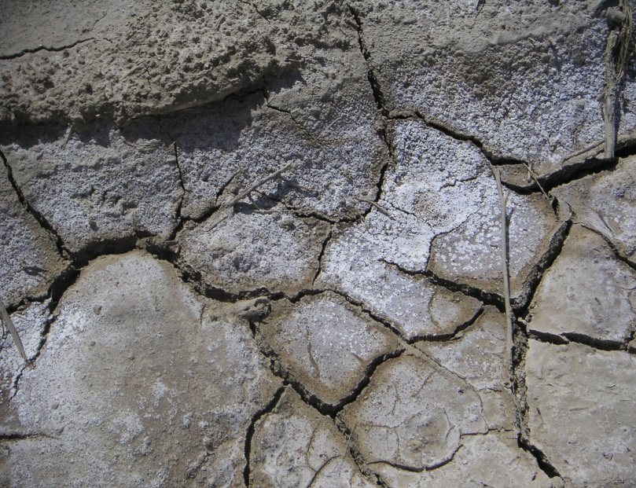
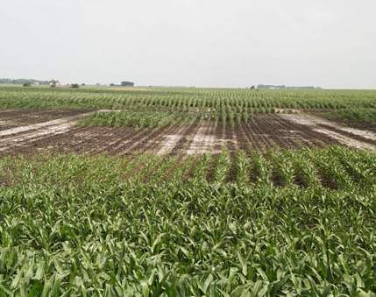
Soil management based on
  Soil characteristics such as texture and structure
  Soil contamination/pollution level and its control
  Soil amendment needs, such as use of gypsum in case of using highly sodic wastewater
  Fertilizer management considering nutrient content of wastewater and soil nutrient availability status

Slide 11
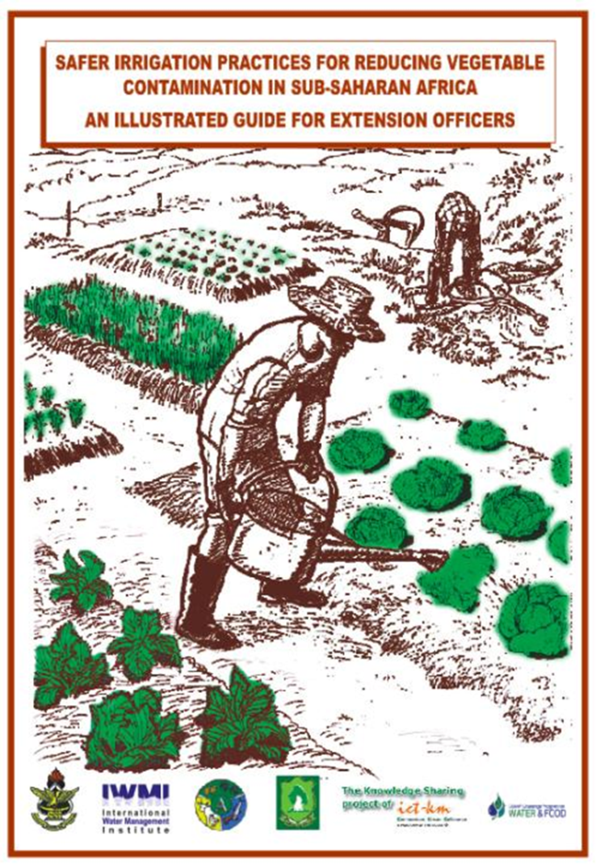
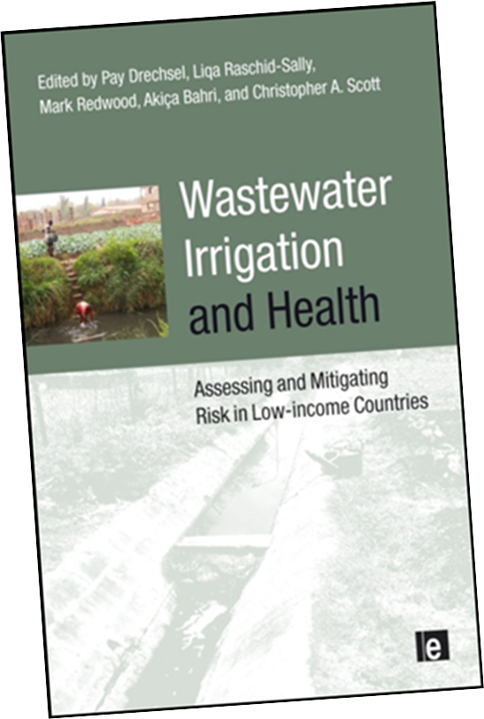
Some Selected Publications on the Subject

Slide 12
Conclusions
Recovery of water and nutrients from wastewater offers multiple opportunities for crop production.
These opportunities can translate into increased productivity and income for farmers if appropriate irrigation, crop, and soil management strategies are implemented.

