Slide 1
UN-Water Project on
Safe Use of Wastewater in Agriculture
Safe Use of Wastewater
In Agriculture
Africa ∙ Asia ∙ Latin America
Recap of the International Kick-off, previous Regional Workshops; Scope of the 4th Regional Workshop
1st Regional Workshop for Francophone Africa
18-19 February 2012
Palais de Congr‘es, Room „Fez“
Dr. Jens Liebe, UNW-DPC

Slide 2
“Wastewater” is a resource
Wastewater use can …
…reduce pressure on freshwater resources
…improve food production, nutritional status
…save fertilizers and energy
How can member states be supported in addressing Safe Use of Wastewater in Agriculture?

Slide 3
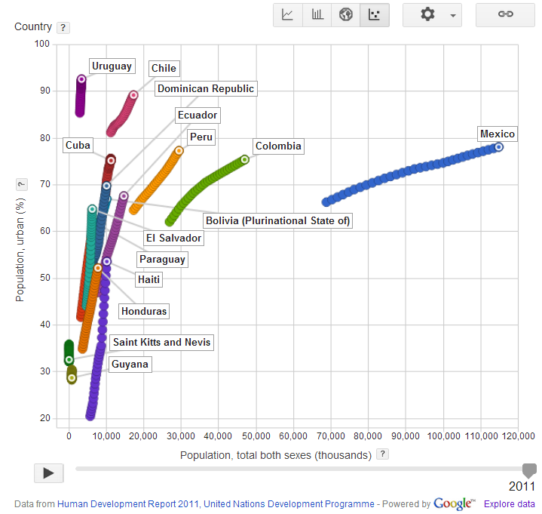
Population growth and urbanization
(1980-2011)

Slide 4
Goal
Qualified people in key organizations to formulate the right policies and
put into practice the safe use of wastewater in agriculture.
Materials and methods
Dissemination strategy
Capacity building action plan
Systems
Organizations
Individuals

Slide 5
Phases of capacity building at the individual/organization level
Phase I:
Individual Capacity Needs Assessment (CNA)
National Reports
Phase II:
International workshop
November 2011
Gap Assessment
Phase III:
Regional workshops
February 2012 to March 2013
Capacity building action plan at the individual/organization level
Phase IV:
Wrap-up workshop
May 2013
Implementation of Recommended Actions
New CNA at the intitution/system level

Slide 6
November 2011, Bonn, Germany

Slide 7
Knowledge & capacity needs: Latin America Group
high
medium
low
none

Slide 8
UN-Water Project on
Safe Use of Wastewater in Agriculture
Safe Use of Wastewater
In Agriculture
Regional Workshops
1st Regional Workshop for Francophone Africa
Francophone & Northern Africa
South, West & Central Asia
Anglophone Africa
Latin America & the Caribbean
Pacific & South-East Asia
18-19 February 2012
Palais de Congr‘es, Room „Fez“

Slide 9
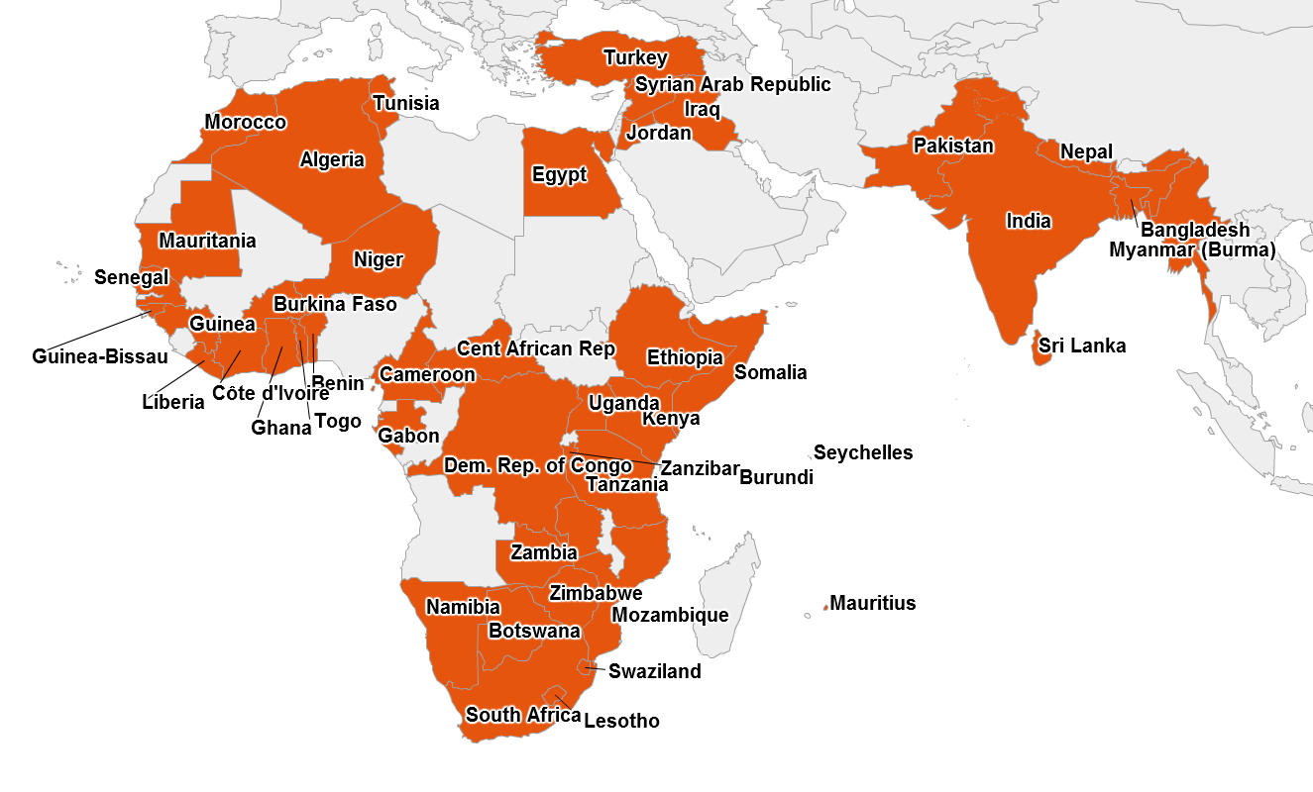
2nd Regional Workshop
South, West & Central Asia
1st Regional Workshop
Francophone & Northern Africa
So far:
Participants from 50 countries
3rd Regional Workshop
Anglophone Africa

Slide 10
Capacity needs Francophone & Northern Africa
Based on 18 countries, 29 participants

Slide 11
Capacity needs South, West, and Central Asia
Based on 11 countries, 18 participants

Slide 12
Capacity needs Anglophone Africa (before workshop)
Based on 21 countries, 31 participants

Slide 13
Capacity needs Anglophone Africa (after workshop)
Based on 21 countries, 31 participants

Slide 14
Organized by:
Partners:
UN-Water Project on
Safe Use of Wastewater in Agriculture
Safe Use of Wastewater
In Agriculture
4th Regional Workshop
1st Regional Workshop for Francophone Africa
Argentina ∙ Bolivia ∙ Chile ∙ Colombia ∙ Cuba ∙ Ecuador ∙ El Salvador ∙ Guatemala ∙ Guyana ∙ Haiti ∙ Honduras ∙ México ∙ Paraguay ∙ Perú ∙ Republica Dominicana ∙ St Kitts and Nevis ∙ Uruguay
18-19 February 2012
Palais de Congr‘es, Room „Fez“

Slide 15
Capacity needs Latin America & the Caribbean
Based on 18 countries, 29 participants

Slide 16
Background of the participants of this workshop
Organizational background
Your daily activities

Slide 17
Background of the participants of this workshop
Your disciplines

Slide 18
The situation in your countries
“LEARNING CURVE”:
1. Awareness
2. Understanding
3. Commitment
4. Action
5. Reflection
1. 2. 3. 4. 5.

Slide 19
What you want to learn
“I would like to learn new tools to implement the responsible use of waste waters in agriculture”
“The challenges faced in other countries and how they over came these challenges”
“Specific experiences regarding the treatment of waste water for agriculture and the implementation of safe use”
“Issues regarding public health and environment”
"The composition of Wastewater and state of application for particular plants"
“About the conditions of implementation”
“Economic challenges of treatment of waste water for agriculture”

Slide 20
What you want to share
“My knowledge concerning policy and legislation related to the environment and agriculture”
“My experiences concerning the effects on the environment of using wastewaters for irrigation”
“Share the experiences and the context of our countries and how everyone is dealing with the issue of wastewaters and the creation of regulations and policy”
“My country’s achievements “
"Policy formulation and implementation"

Slide 21
What you want to take home
“Greater knowledge base to further a possible development in the subject area”
“Establish contact with relevant organizations and experts on the issue”
“Understanding of the use of wastewater in Agriculture”
“A network of experts in the issue and information on the experiences in other countries”
“Learn the experience of other countries and develop the capacity for proposing a future project in my country”

Slide 22
Timeline
International Kick-off Workshop | November 2011
Regional Workshops
Francophone & Northern Africa | February 2012
South, West & Central Asia | May 2012
Anglophone Africa | September 2012
Latin America & the Caribbean | December 2012
Pacific & South-East Asia | March 2013
International Wrap-up workshop | May 2013
Additional events:
16th AfWA International Congress & Exhibition, Marrakech, Morocco
Seminar at IFAT 2012, Munich, Germany
Side event at the World Water Week 2012, Stockholm, Sweden

Slide 23
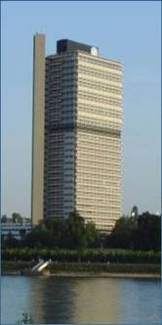
Thank you!
UN-Water Decade Programme on Capacity Development (UNW-DPC)
UNITED NATIONS UNIVERSITY
UN Campus
Hermann-Ehlers-Str. 10
D-53113 Bonn, Germany
Phone: + 49 (0) 228 815-0652
Fax: + 49 (0) 228 815-0655
E-Mail: info@unwater.unu.edu
www.unwater.unu.edu

