Slide 1









UN-Water Project on
Safe Use of Wastewater in Agriculture
Safe Use of Wastewater
In Agriculture
Wrap‐up and Concluding Session:
Expectations
1st Regional Workshop for Francophone Africa
18-19 February 2012
Palais de Congr‘es, Room „Fez“
Dr. Jens Liebe, UNW-DPC

Slide 2
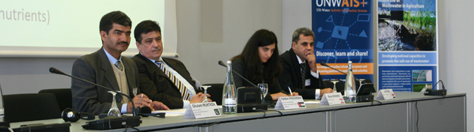
Goal
Qualified people in key organizations to formulate the right policies and
put into practice the safe use of wastewater in agriculture.
    Materials and methods
    Dissemination strategy
    Capacity building action plan
Systems
Organizations
Individuals

Slide 3
Expectations of the Organizers
Action
Foster interdisciplinary approach, formation of a platform to promote the issue
Contribute to awareness raising and public acceptance (resource, not waste; part of a solution to water shortage, food security; …)

Slide 4
Expectations of the Organizers
Revisit the challenges and possible solutions you described – anything you can implement?
Formulate goals which lead to actions/Future action plan (i.e. 3 most important interventions)
Promote formulation of guidelines, policies

Slide 5
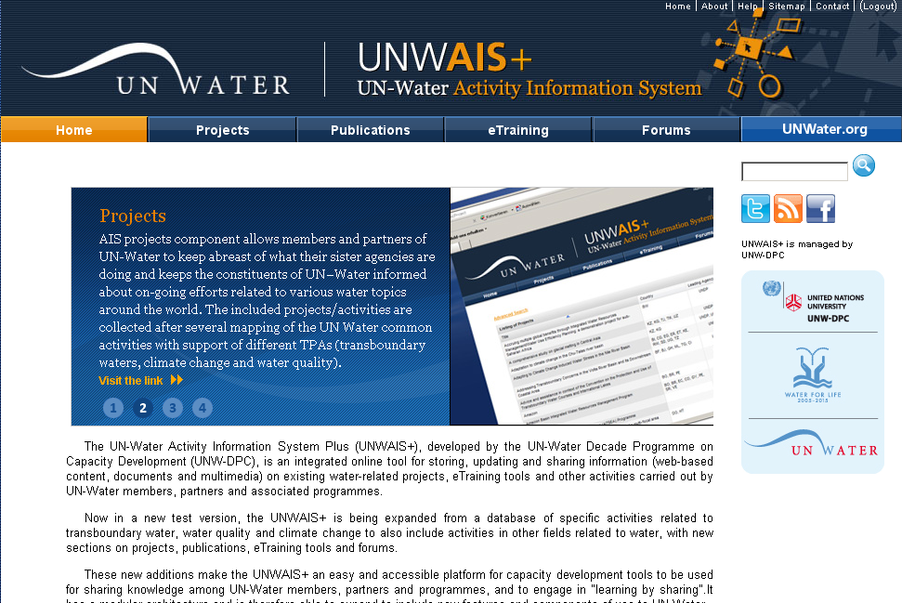
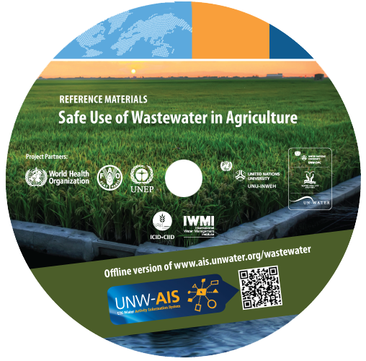
UN-Water Activity Information System
UNW-AIS
Discover, learn, and share!
http://www.ais.unwater.org/wastewater/

Slide 6
International Wrap-up Conference
Synopsis, inviting workshop participants with success stories
Complete institutional mapping and revised national report
Let us know of your activities (reportable post-workshop activities, achievements, challenges, needs assessment, etc.)

Slide 7
We’ll stay in touch
Let us know of your activities
We will contact you regarding…
Revised country report
National meetings
Activities reportable at the international wrap-up conference in May 2013

Slide 8
Your expectations and comments
What have you learned which motivates you to promote safe use of wastewater in your country?
What are your needs from UN-Water members and partners?
What do you want to achieve?

Slide 9
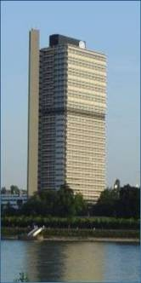

Thank you!
UN-Water Decade Programme on Capacity Development
(UNW-DPC)
UNITED NATIONS UNIVERSITY
UN Campus
Hermann-Ehlers-Str. 10
D-53113 Bonn, Germany
Phone: + 49 (0) 228 815-0652
Fax: + 49 (0) 228 815-0655
E-Mail: info@unwater.unu.edu
www.unwater.unu.edu

