Slide 1

Safe Use of Wastewater in Agriculture
Capacity needs
and
national strategies
Dr. Jens Liebe, UNW-DPC
1

Slide 2
Background
… from the concept note:
An important output from these regional workshops would be a capacity development action plan.
It should describe how the training material and learning methods should be disseminated at country level in the relevant organizations.

Slide 3
Capacity Development
What is “Capacity development” ?
The process of developing and strengthening the skills, abilities, and resources that organizations and communities need to survive, adapt, and thrive in the fast-changing world."
(after Philbin 1996)
A fundamental goal is to enhance the ability to evaluate and address the crucial questions related to policy choices and modes of implementation among development options, based on an understanding of environment potentials and limits and of needs perceived by the people of the country concerned".
(UNCED, 1992.)

Slide 4
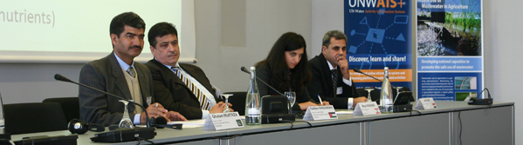
Goal
Qualified people in key organizations to formulate the right policies and
put into practice the safe use of wastewater in agriculture.
    Materials and methods
    Dissemination strategy
    Capacity building action plan
Systems
Organizations
Individuals

Slide 5
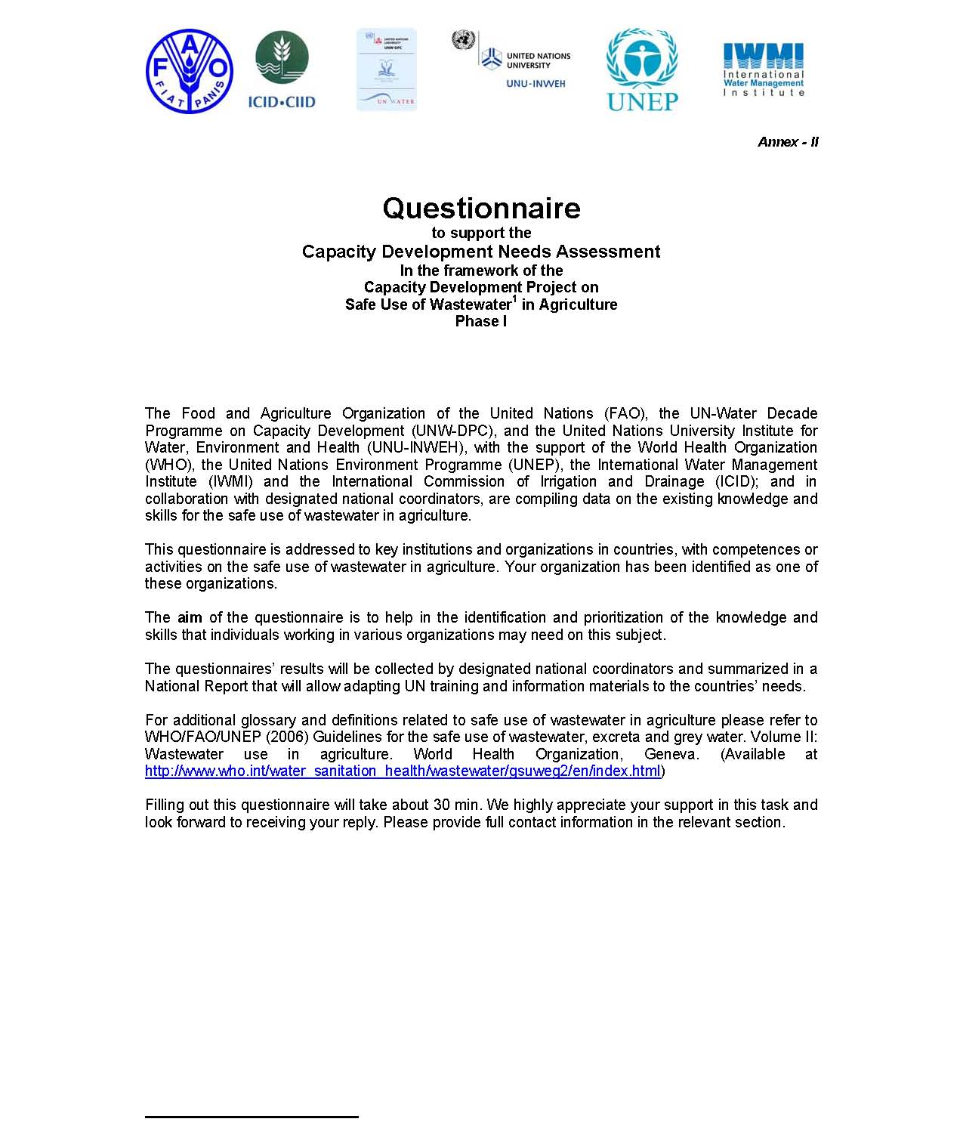
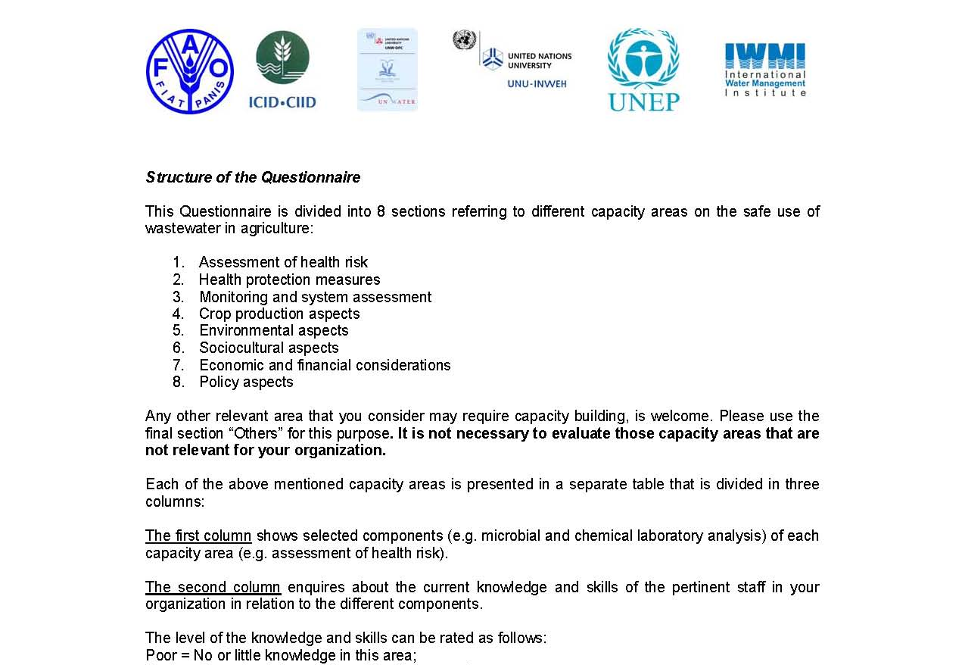
Capacity Needs Assessment
Assessment of health risk
Health protection measures
Monitoring and system assessment
Crop production aspects
Environmental aspects
Socio-cultural aspects
Economic and financial considerations
Policy aspects

Slide 6
Survey results: Your capacity needs
Based on 33 of 41 participants

Slide 7
What is a dissemination strategy?
An intentionally-developed approach to dissemination includes
identification of targeted potential adopters,
an assessment of the climate of readiness for change,
planning how engagement will be built, and
enabling transfer of knowledge and materials.
Goal: Utilization
(Hinton, T., Gannaway, D., Berry, B., & Moore, K. (2011). The D-Cubed Guide: Planning for Effective Dissemination. Sydney: Australian Teaching and Learning Council.)

Slide 8
Needs to develop national strategy
"To create awareness to the stakeholders on the importance of safe use of wastewater in agriculture”
"Provide successful case studies to political leaders to show is has worked elsewhere."
"Public education and incentives"
"Formulation of Multi-sectoral Wastewater (Think tank) management Team"
"Public awareness followed by actions demonstrating the advantages and benefits of wastewater use (environmental, socio-economical, and others)”
"Institutional set up and personnel capacity"
"Financial resources"

Slide 9
Hindrances and barriers
"Lack of treatment facilities both advanced and local"
"Knowledge (locally available), no regulation, no enforcement, no laboratories to test water quality, no food safety standard in place."
"No Wastewater collection networks; No Wastewater management system "
"Insufficient involvement and information of civil society on benefits of treatment and reuse"
"Lack of human and financial resources for implementing policy"

Slide 10
Questions for dissemination planning
• What do you want to disseminate?
• Why do you want to disseminate?
• Who is your target audience?
• How are you going to do it?
• How might you involve your target audience
throughout the process?
• Have you allowed time for evaluation,
reflection and re-planning?
• How will you know that your dissemination has
been successful?
(after King, 2003)

Slide 11
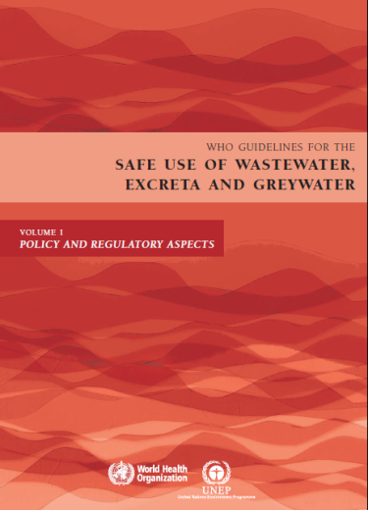
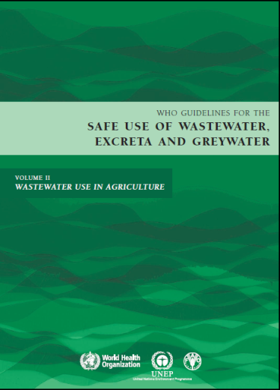
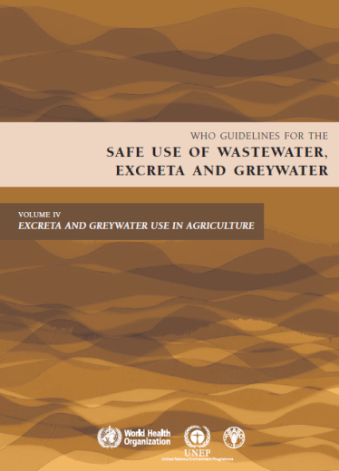
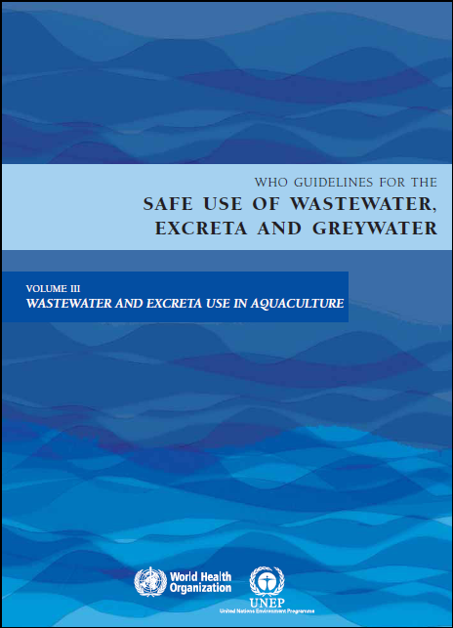
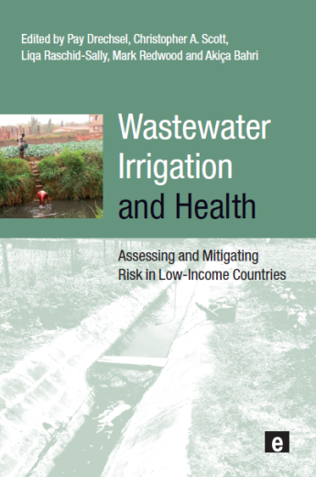

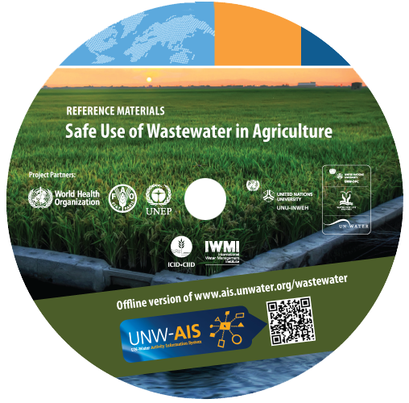
Which materials?
Materials presented yesterday and today, e.g.
WHO Guidelines
Wealth of Waste and Posters (FAO)
Sick water report (UNEP)
Wastewater Irrigation and Health
+ your own material

Slide 12
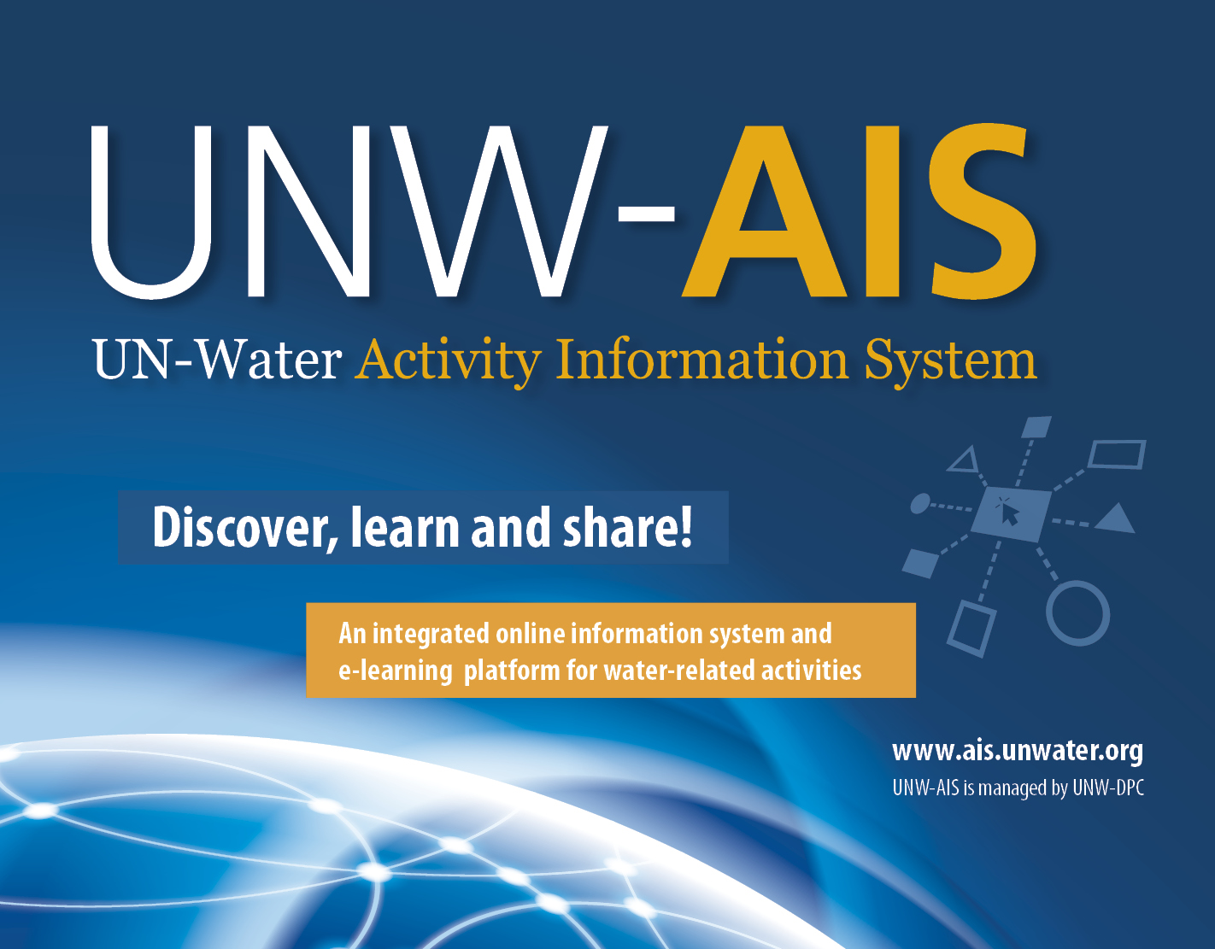
Strategies for dissemination
Possible steps:
    Institutional arrangements/platform
    National wastewater reuse committee
    National meetings and workshops
    Institutional web page
    Linking to existing agriculture/health programmes
    Formulate a dissemination strategy at national level (identifying target audiences and materials/information)

Slide 13
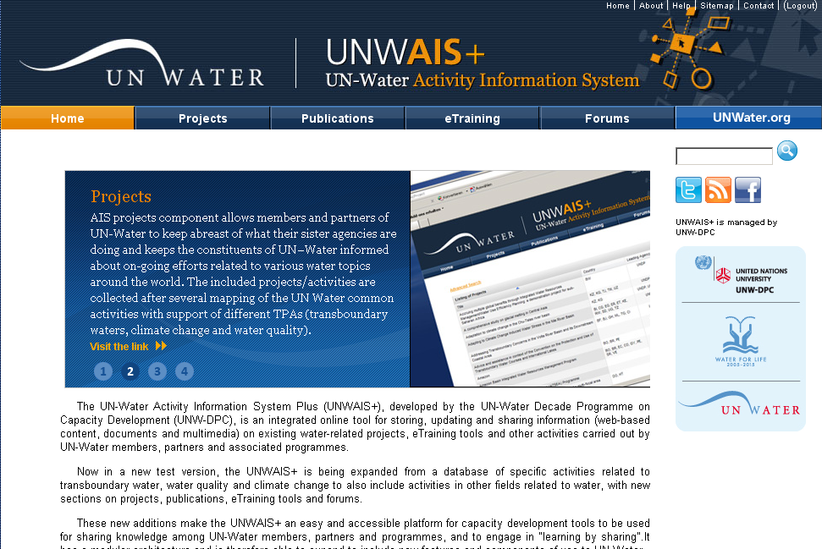
UN-Water Activity Information System
UNW-AIS
Discover, learn, and share!
http://www.ais.unwater.org/wastewater/

Slide 14
UNW-AIS: Scope and Capabilities
+ Single entry point of access to information.
+ Storing, updating, sharing and analysis of information.
+ Handling metadata, web-based content, documents
or multimedia.
+ Project data selection, geographic search, document search.
+ Facilitates organization of events and interaction with
participants.
+ Social networking, groups, discussion forums and e-learning.

Slide 15
Discussion
>> Group 1:
Capacity building requirements
Which experiences/capacities do you have and what is needed?
Which actor/institutional arrangement can facilitate capacity development?
How should materials and methods be adapted to reach the target audiences more effectively?

Slide 16
Discussion
>> Group 2:
National dissemination strategies
How are knowledge and guidelines disseminated in your country? What are your experiences?
Which could be the pertinent national dissemination strategies?
Which institutional arrangements are best suited for the dissemination of information/knowledge and guidelines, and to coordinate policies and action on safe wastewater use (national wastewater reuse committee, …)?

