Slide 1

Institutional Arrangements and Collaboration for Safe Use of Wastewater in Agriculture
Manzoor Qadir
UNU-INWEH
Third Regional Workshop ‘Safe Use of Wastewater in Agriculture’, 26-28 September, Johannesburg, South Africa

Slide 2
Institutional Levels/Categories
National level across different ministries
District level across related institutions
Academic level across educational institutions
Farmers level across individual and associations
Policy level addressing implementation of WHO/national guidelines
Regional level across countries in the region

Slide 3
National Level – Responsible Ministry
Diversity at the national level ministries among countries for wastewater management
  Ministry of Water (and Energy)
  Ministry of Water and Environment
  Ministry of Agriculture (Water and Forestry)
  Ministry of Environment (Wildlife and Tourism)
  Ministry of Natural Resources
  Ministry of Energy and Public Utilities
  Ministry of Local Government and Rural/Urban Development
  Municipalities

Slide 4
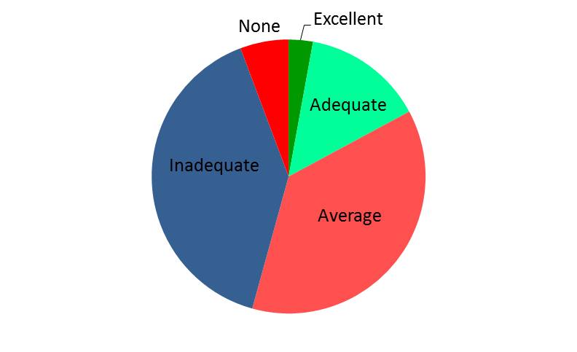
Inter-ministerial Collaboration
Excellent: Swaziland
Adequate: Botswana and Mauritius

Slide 5
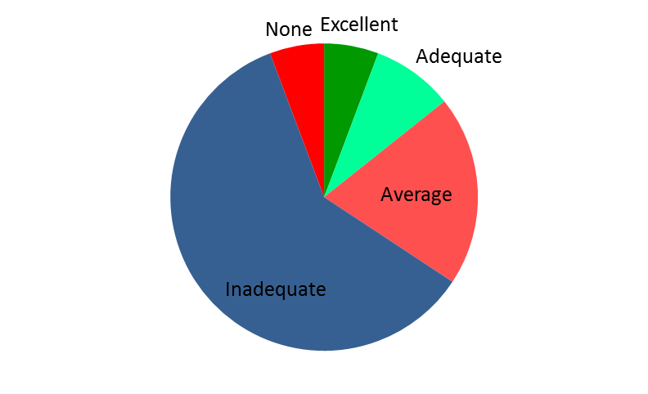
Government’s Commitment and Budget Allocation
Excellent: Botswana
Adequate: Mauritius

Slide 6
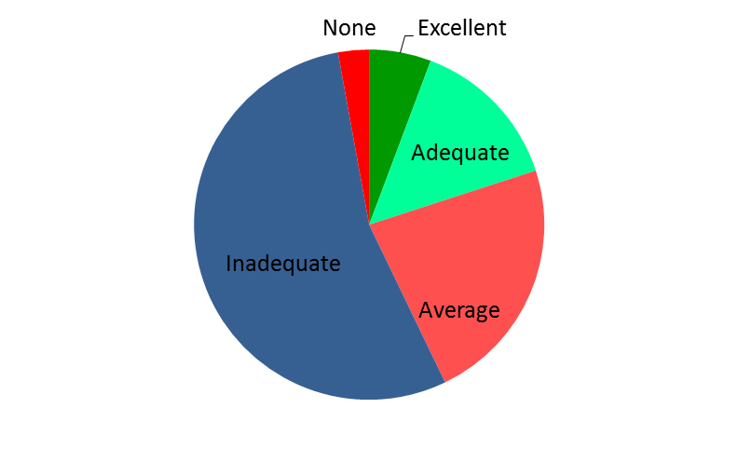
Institutional Collaboration at District Level
Excellent: Swaziland and Namibia
Adequate: Botswana and Seychelles

Slide 7
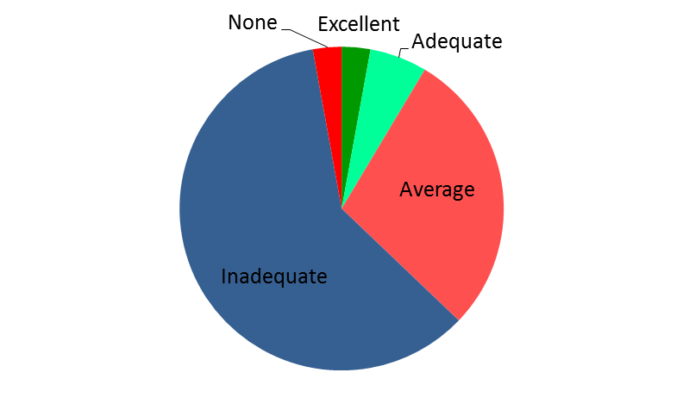
Institutional Commitment and Budget Allocation
Excellent: Namibia
Adequate: Botswana and Swaziland
Variable: Adequate in large cities, inadequate in small towns (South Africa)

Slide 8
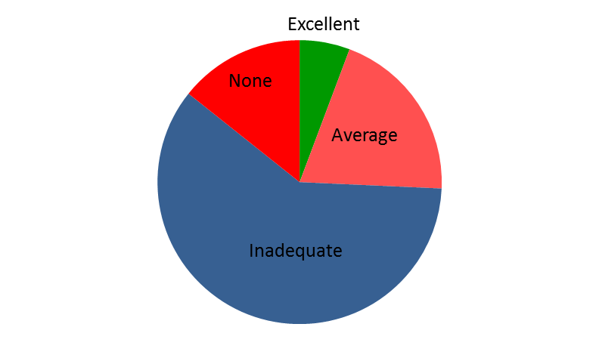
Multi-institutional Collaboration (PPP)
Excellent: Swaziland and Namibia

Slide 9
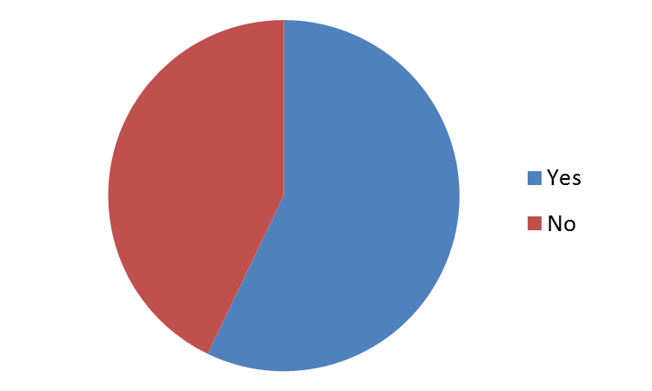
Academic Level: Wastewater in Schools’ Curricula
Topic of wastewater management in any form as a part of the curricula in schools

Slide 10
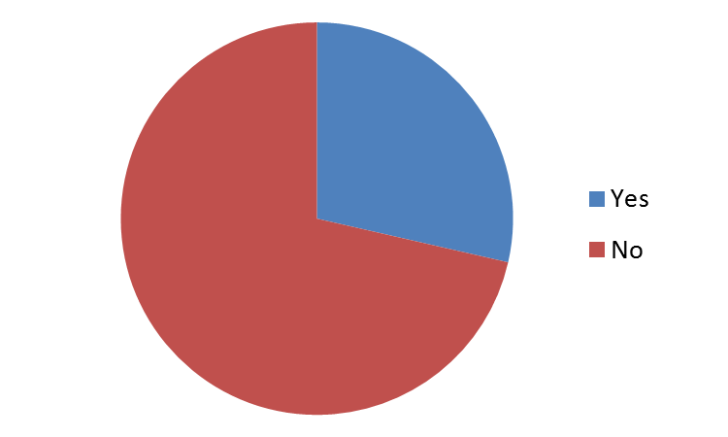
Academic Level: Wastewater in Universities’ Curricula
Topic of wastewater management as a part of the curricula in universities

Slide 11
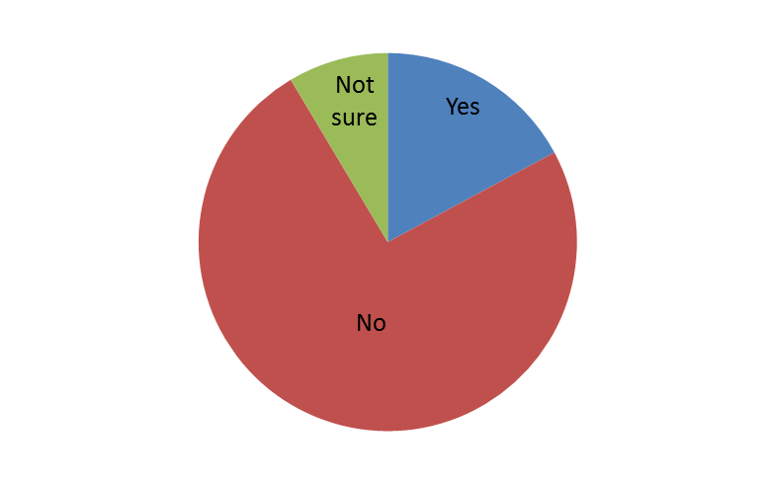
Farmers/Water Users Associations
Farmers/water users associations dealing with local institutions for wastewater delivery

Slide 12
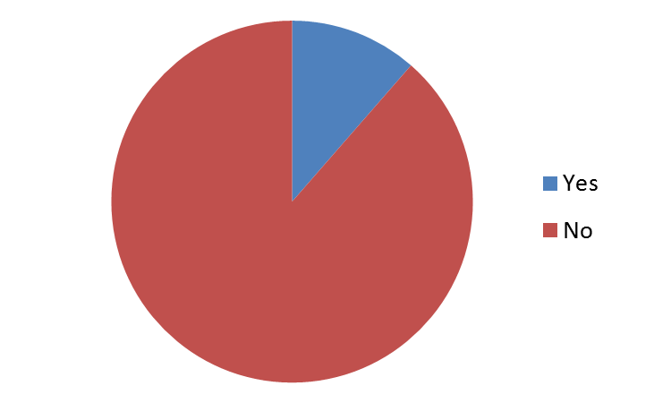
Farmers pay to Local Institutions for Wastewater
Yes: Botswana and South Africa (Cape Town)

Slide 13
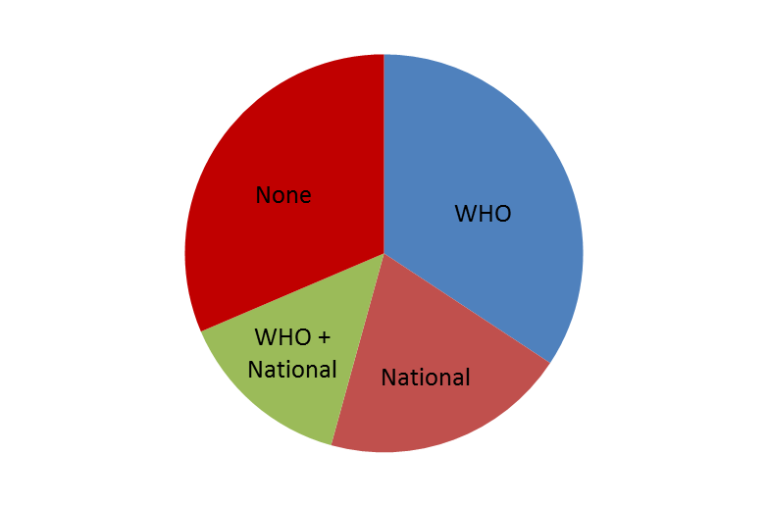
Policy Level: Guidelines for Wastewater Use
Major Challenge: Implementation
Categories included WHO guidelines, national guidelines, and none

Slide 14
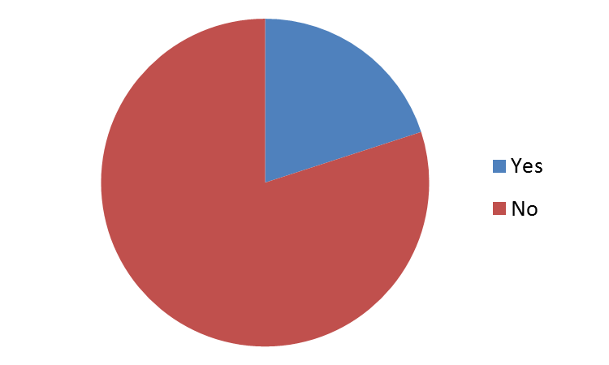
Regional Level: Collaboration across Countries
In case of yes, collaboration through joint projects and participation in workshops
Lake Victoria Environment Management Program (LVEMP)

Slide 15
Key Questions for Roundtable Discussions
What status do we have in regard to institutional arrangements at different levels for wastewater management?
What success stories do we have in terms of institutional collaboration addressing safe use of wastewater?
How can we improve institutional collaboration for safe use of wastewater?

