Slide 1
Wastewater Production, Treatment, and Use in Gaborone, Botswana
H M Masundire, B T Ketshogile, D D Shushu & H Okatch
University of Botswana
Gaborone, Capital City of Botswana

Slide 2
Botswana brief
Total population approximately 2 million
rainfall ranging from a high of 550 and low of 200 mm per year
estimated annual average evaporation rate of 1400 mm
Botswana is a water stressed country
contribution by agriculture to the national GDP (currently standing at 2%)

Slide 3
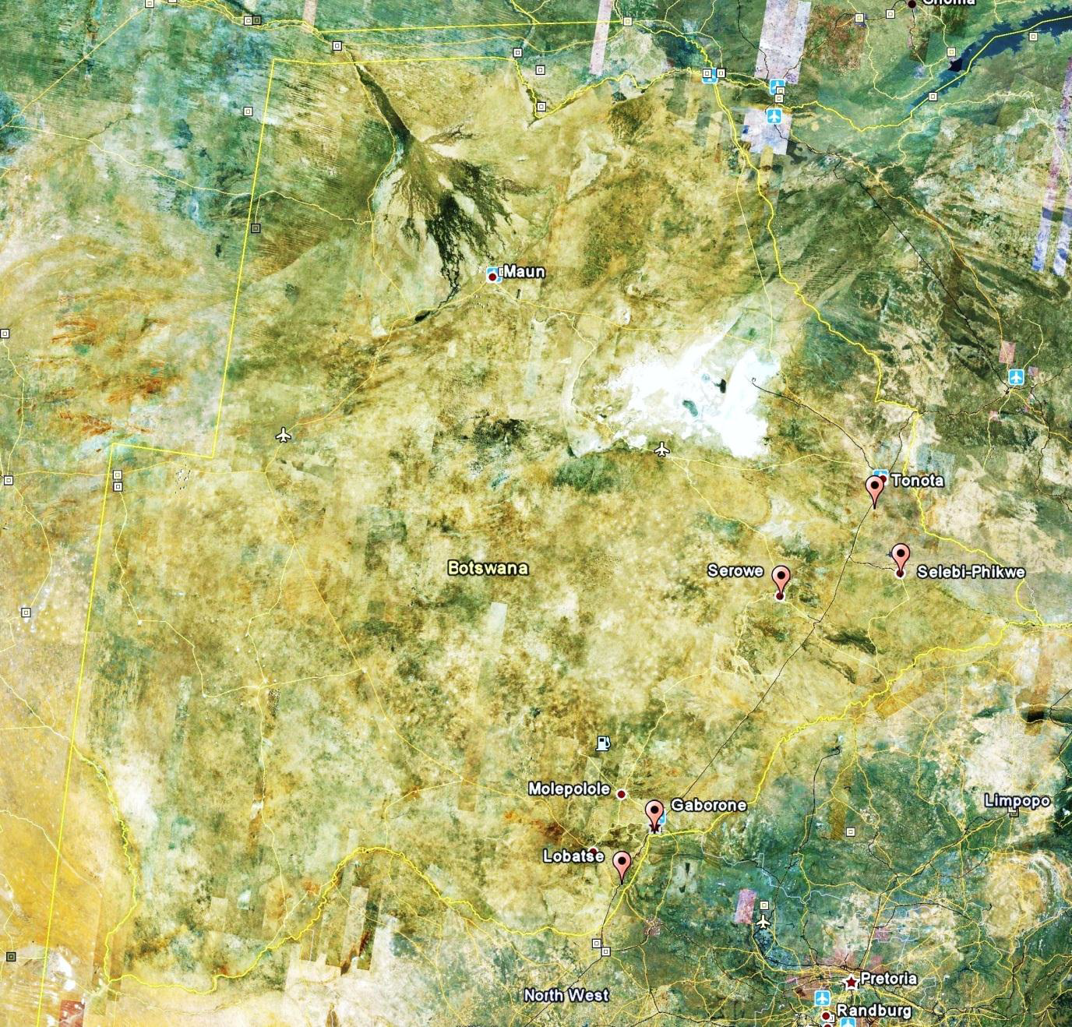

Slide 4
Wastewater production and treatment
Gaborone, the capital city of Botswana, has a population of about 300 000
Per capita water demand about 0.2 m³ per day
total water consumption was about 50ML/day (2008)
Sewage treatment plant has a capacity of 65ML per day
Current inflow average 57ML per day
Outflow estimated to be about 50ML per day
Uses Activated Sludge treatment process
Treated (digested) sludge is disposed of after dewatering and drying – used for fertilizing lawns
Wastewater is treated twice
Activated sludge
Stabilization ponds

Slide 5
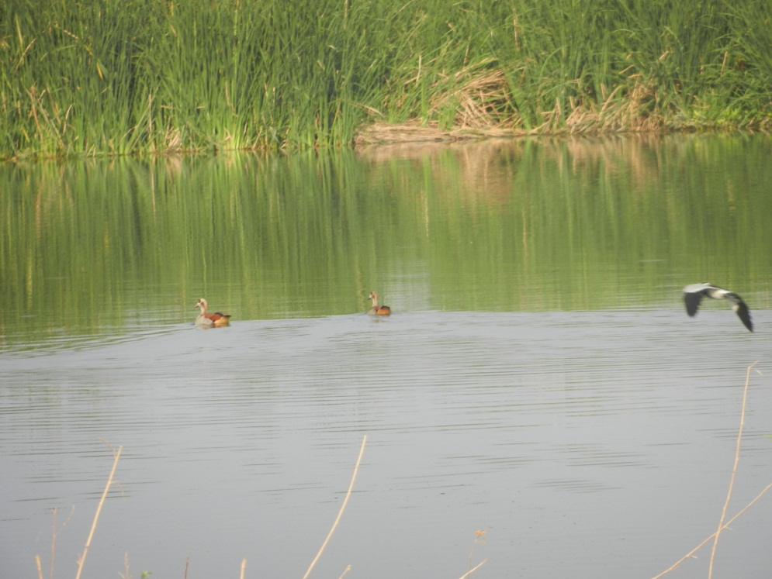
Wastewater use and/or disposal
Effluent is held in stabilization ponds – the former treatment process
From the 3 pond series most effluent goes into another set of lagoons
Some effluent flows into a wetland in Gaborone Game Reserve and into Notwane River
Ponds have become an IBA as well as an important watering site for livestock
From 2nd lagoon effluent is pumped to feed an irrigation scheme
Crops include: cabbage, tomatoes, spinach, butternut, green pepper, maize, beet root, carrot, rape, olives, roses
Effluent priced at P0.67 (R0.72 m⁻³ )
Vegetables sold to traders including supermarkets

Slide 6
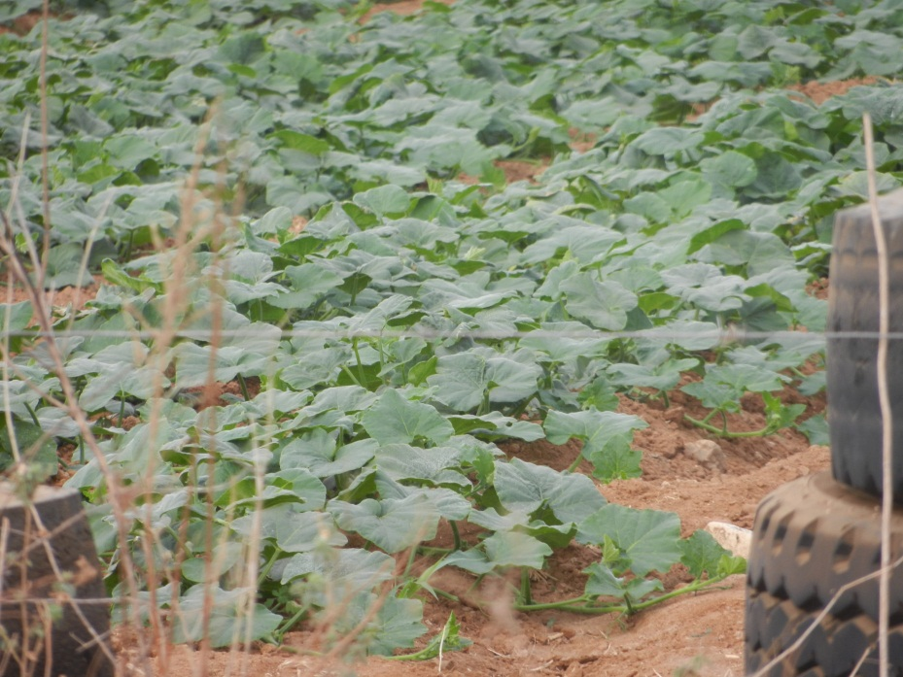
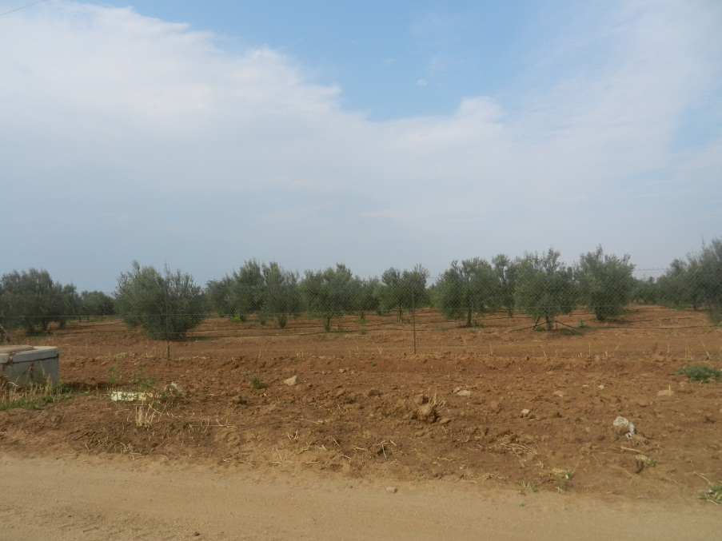
Wastewater use and/or disposal

Slide 7
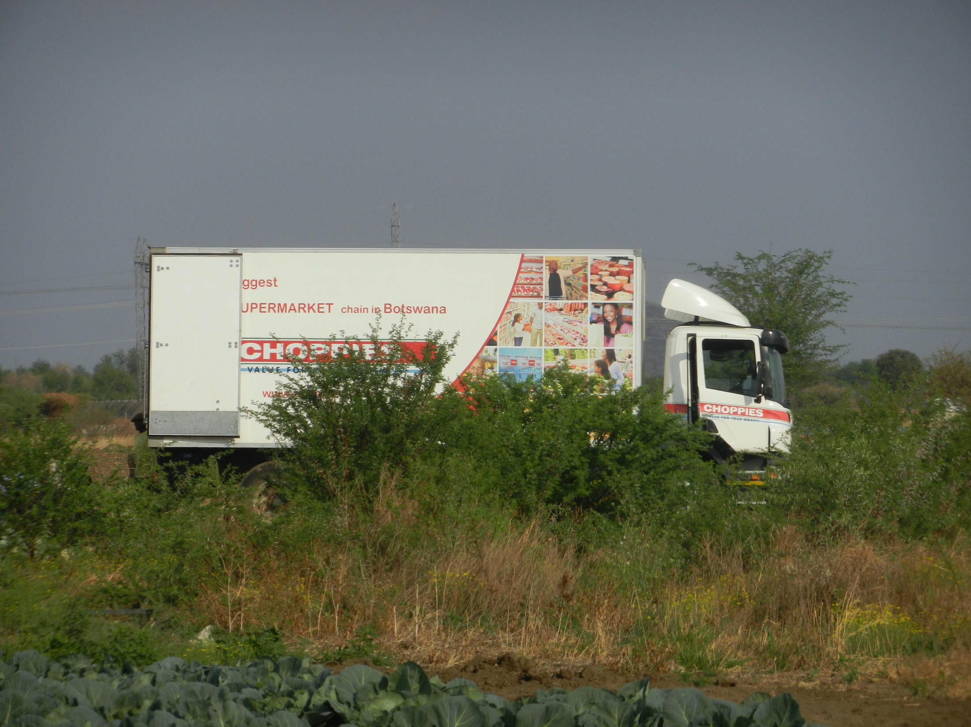

Slide 8
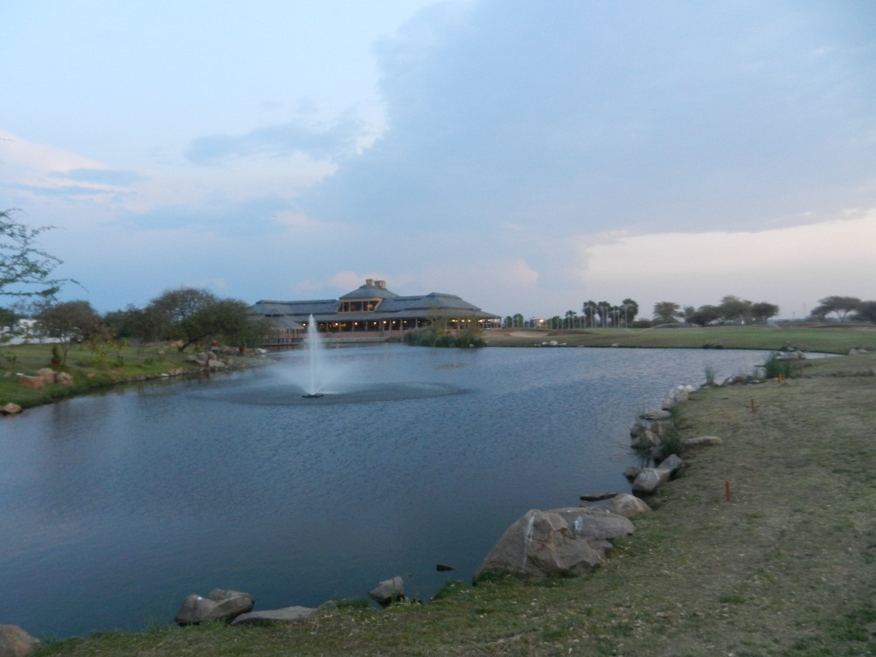
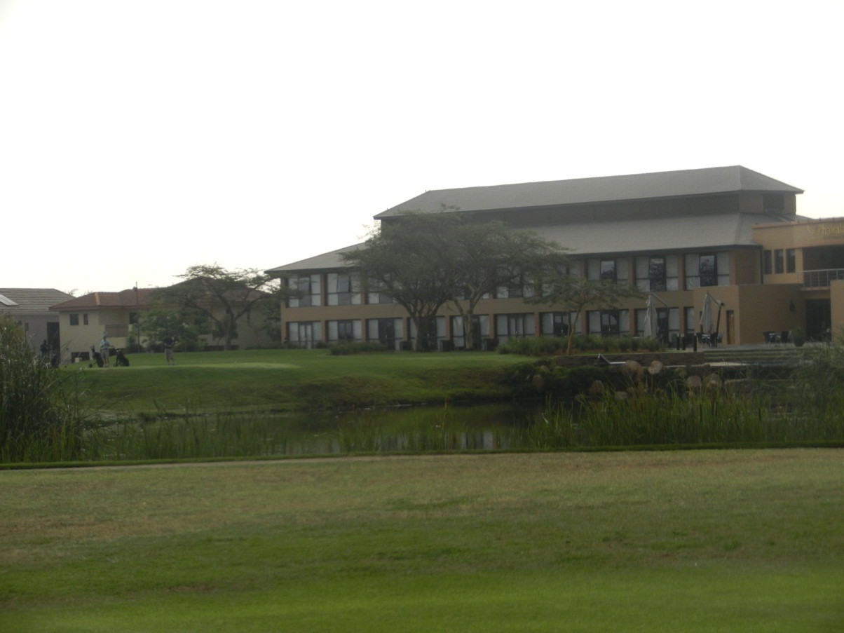
Wastewater use and/or disposal
Some effluent is used to water 2 golf courses, a golf driving range
City and residents also use some effluent for watering gardens

Slide 9
Two types of irrigation
Drip irrigation – used on all vegetables, e.g. butternut above
Spray irrigation used on golf courses

Slide 10
Regulations and implementation of guidelines
See Excell file.
Most of the parameters of major concern are within “acceptable limits”
N & P in effluent could benefit agriculture in requiring less use of artificial fertilizers
Excess nitrates may lead to succulence in vegetables – spinach, rape, cabbage
BUT N & P concentrations are high enough to cause algal blooms especially in hot season

Slide 11
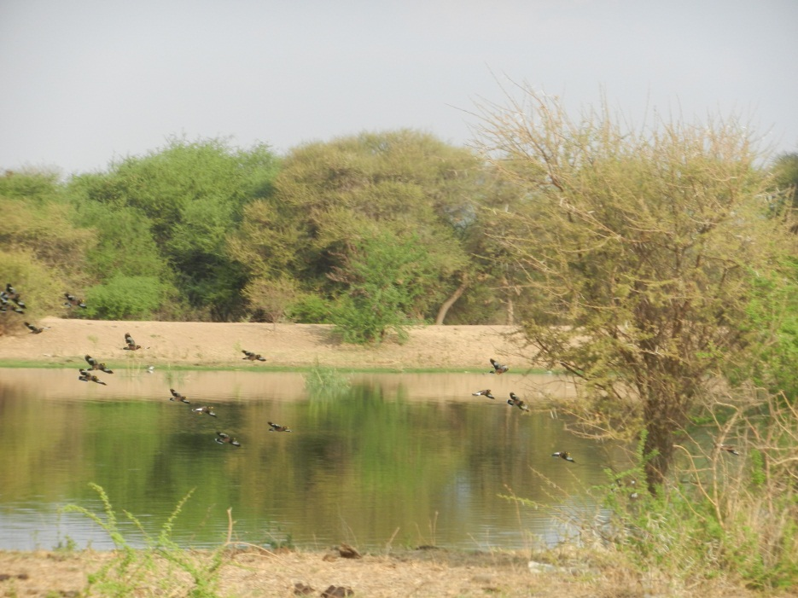
Challenges
Attitudes & perceptions
Demand vs supply
Water quality
Eutrophication
Algal blooms
Harmful algal blooms
Blooms of Microcystis sp.
Produce algal toxins called microcystins (hepatotoxins) known to be lethal to animals
Microcystins also seem to affect plant growth & development

Slide 12
Government’s approach to wastewater management
Improvement in reticulation of households to the municipal sewer system in all cities, towns and major villages
Improved treatment process for reuse and even recycling
There are over 60 wastewater treatment works country-wide
2006 estimates:
total inflow = 24.5Mm³
total outflow = 12.3Mm³
20% reused for irrigation
Inclusion of wastewater into national water accounts
estimated that if adequately treated, wastewater could contribute about 16% of the country’s available water resources.

