Slide 1









UN-Water Project on
Safe Use of Wastewater in Agriculture
Safe Use of Wastewater
In Agriculture
Wrap‐up and Concluding Session:
Expectations
1st Regional Workshop for Francophone Africa
18-19 February 2012
Palais de Congr‘es, Room „Fez“
Dr. Jens Liebe, UNW-DPC

Slide 2
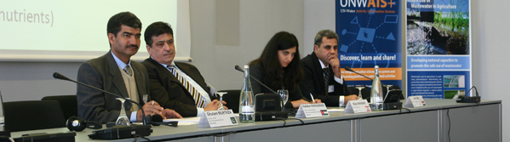
Goal
Qualified people in key organizations to formulate the right policies and
put into practice the safe use of wastewater in agriculture.
    Materials and methods
    Dissemination strategy
    Capacity building action plan
Systems
Organizations
Individuals

Slide 3
Expectations of the Organizers
Share your knowledge and materials with your colleagues
(www.ais.unwater.org/wastewater)
Foster interdisciplinary approach, formation of a platform to promote the issue
Contribute to awareness raising and public acceptance (resource, not waste; part of a solution to water shortage; …)

Slide 4
Expectations of the Organizers
Formulate goals which lead to actions/Future action plan (i.e. 3 most important interventions
Promote formulation of guidelines, policies
Revisit the challenges and possible solutions you described – anything you can implement?

Slide 5
We’ll stay in touch
Let us know of your activities
We will contact you regarding…
Revised country report
National meetings
Activities reportable at the international wrap-up conference in May 2013

Slide 6
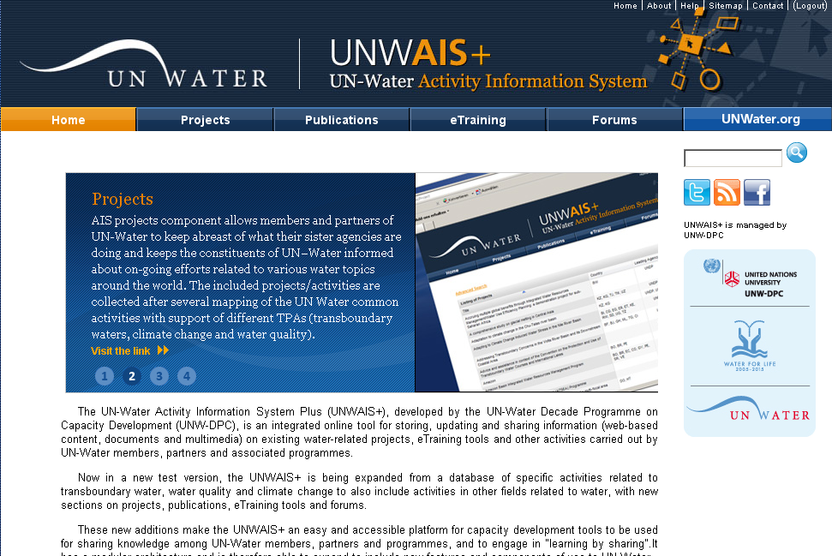
UN-Water Activity Information System
UNW-AIS+
Discover, learn, and share!
http://www.ais.unwater.org/

Slide 7
Your comments
What have you learned which motivates you to promote safe use of wastewater in your country?
What are your needs from UN-Water members and partners?

Slide 8
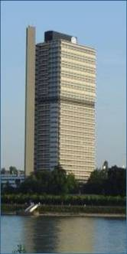

Thank you!
UN-Water Decade Programme on Capacity Development
(UNW-DPC)
UNITED NATIONS UNIVERSITY
UN Campus
Hermann-Ehlers-Str. 10
D-53113 Bonn, Germany
Phone: + 49 (0) 228 815-0652
Fax: + 49 (0) 228 815-0655
E-Mail: info@unwater.unu.edu
www.unwater.unu.edu

