Slide 1
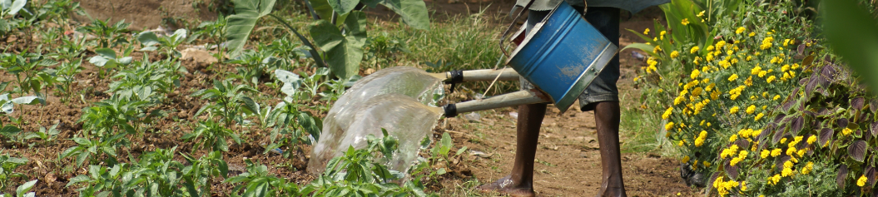
WHO Guidelines
Safe Use of Wastewater Greywater and Excreta

Slide 2
Background
Wastewater use is extensive worldwide, and increasing
10% of the world’s population is thought to consume wastewater irrigated foods.
20 million hectares in 50 countries are irrigated with raw or partially treated wastewater.
The use of excreta (faeces, urine) is important worldwide, but the extent has not been quantified.
The use of greywater is growing in both developed and less-developed countries – it is culturally more acceptable in some societies
Wastewater can be an excellent resource….
if it is managed safely.

Slide 3
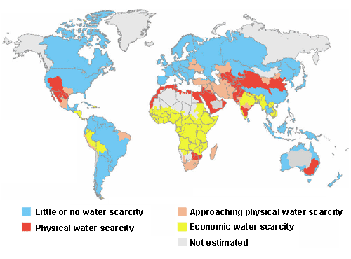
Where is it most needed?
Notes:
Economic water scarcity is a type of water scarcity caused by a lack of investment in water or insufficient human capacity to satisfy the demand of water. Symptoms of economic water scarcity include a lack of infrastructure, with people often having to fetch water from rivers or lakes for domestic and agricultural uses. Physical water scarcity is the situation where there is not enough water to meet all demands, including that needed for ecosystems to function effectively. Arid regions frequently suffer from physical water scarcity. It also occurs where water seems abundant but where resources are over-committed. This can happen where there is overdevelopment of hydraulic infrastructure, often for irrigation. Symptoms of physical water scarcity include environmental degradation and declining groundwater.Large parts of Africa suffer from economic water scarcity; developing water infrastructure there could therefore help to reduce poverty.

Slide 4


Health concerns
Direct Health Effects
Disease outbreaks (in developing and developed countries)
Non-communicable diseases (waste water mixed with industrial waste containing heavy metals)
Persistent diseases (e.g. intestinal helminth infections, diarrhoeal infections)
3 GROUPS TO CONSIDER:
workers
community
consumers
Indirect Health Effects
Adverse impacts on the safety of drinking water, food and recreational water.
Positive impacts on household food security and nutrition (with safe use)

Slide 5
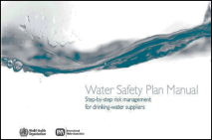
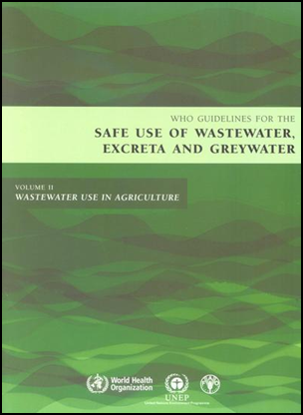
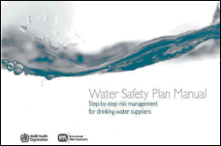
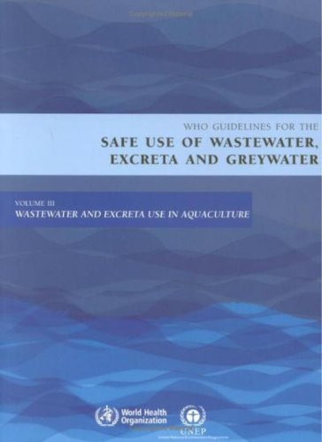
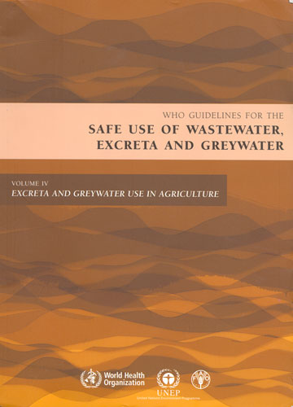
Various WHO Guidelines on Water Quality
UNDER DEVELOPMENT 2012/13
Sanitation Safety Plan
Manual

Slide 6
Some lessons so far
Overly strict standards borrowed from other countries often fail
Guidelines are not just numbers; they are made up of good practice + microbial water quality standards
Low-cost effective treatment technologies needed
Risk reduction strategies necessary (and possible) where wastes receive no or inadequate treatment

Slide 7
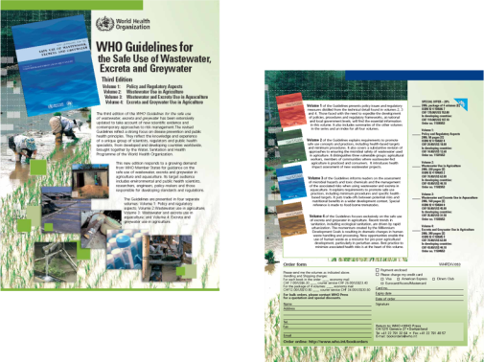
Four volumes to better reach different target audiences
    Volume 1: Policy and regulatory aspects
    Volume 2: Wastewater use in agriculture
    Volume 3: Wastewater and excreta use in aquaculture
    Volume 4: Excreta and greywater use in agriculture

Slide 8
WHO Guidelines (3rd Edition)
    Objective:
    Maximize the protection of human health and the beneficial use of important resources
    Target Audience:
    Policy makers
    People who develop and enforce standards and regulations
    Environmental and public health scientists
    Educators
    Researchers and engineers

Slide 9
What's new in the 3rd edition?
Guidelines provide an integrated preventive management framework for maximizing public health and environmental benefits of waste/wastewater use.
Health components:
Define a level of health protection as health-based targets.
Identify health protection measures to achieve the health-based target.
Implementation components:
Establish monitoring and system assessment procedures.
Define institutional and oversight responsibilities.
Requires:
System documentation; and confirmation by independent surveillance.
Notes:
Guidelines provide an integrated preventive management framework for maximizing public health and environmental benefits of waste use.
Health components:
Define a level of health protection that is expressed as a health-based target for each hazard.
Identify health protection measures which used collectively can achieve the specified health-based target.
Implementation components:
Establish monitoring and system assessment procedures.
Define institutional and oversight responsibilities.
Require:
System documentation; and
Confirmation by independent surveillance.

Slide 10
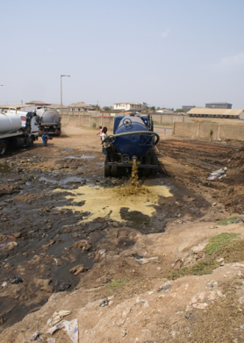
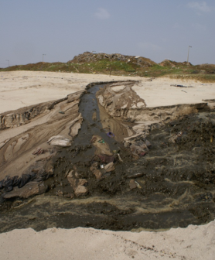
Scope
    The Guidelines cover:
    Intentional use. But they may also be relevant to some unintentional uses
    (e.g. irrigation or aquaculture with sewage contaminated surface waters)
    Municipal or domestic wastes without substantial industrial inputs
    Faecal sludge derived from on-site sanitation facilities but not sludge produced from the treatment of wastewater
    Detailed information only on matters related to health protection
Notes:
The Guidelines cover:
intentional use……but they may also be relevant to some unintentional uses
(e.g., irrigation or aquaculture with sewage contaminated surface waters);
municipal or domestic wastes without substantial industrial inputs;
faecal sludges derived from on-site sanitation facilities but not sludge produced from the treatment of wastewater;
detailed information only on matters related to health protection – only cursory reference to technical issues on good agriculture or aquaculture practices in text or annexes.

Slide 11
Vol I: Policy and Regulatory Aspects
International Policy framework:
National Policy aspects:
MDG Goal 1
Eradicate extreme poverty and hunger
MDG Goal 7
Ensure environmental sustainability
poverty reduction
food security
protection of public health
protection of the environment
consumer protection
integrated water resources management
energy reliance
Notes:
The third edition of WHO’s Guidelines for the Safe Use of Wastewater, Excreta and Greywater in Agriculture and Aquaculture is launched at the IWA World Water Congress in Beijing September 2006. The four volumes can be ordered as of now from the WHO.

Slide 12
Vol I: How to start?
Harmonization:
Institutional Arrangements:
Situation analysis and needs assessment
Establish a mechanism for policy dialogue
Obtain political endorsement
Engage in an adequately resourced policy dialogue
Ensure policy changes are legitimized through Parliament and/or decreed by the Prime Minister’s Office
Agreed mechanisms for coordination and resource sharing between sectors
Identification of roles and responsibilities
Incentive: partial inputs lead to credit for 100% outcome
through specific Memoranda of Understanding between sectors
through existing intersectoral mechanisms
by operating at lower levels of governance
Notes:
The third edition of WHO’s Guidelines for the Safe Use of Wastewater, Excreta and Greywater in Agriculture and Aquaculture is launched at the IWA World Water Congress in Beijing September 2006. The four volumes can be ordered as of now from the WHO.

Slide 13
Vol 1: Regulation
Assemble the team
Describe the system
Hazard assessment
Assess the existing system
Identify control measures
Define monitoring of
control measures - limits
Prepare Risk Management Plans
Procedure to verify
that RMP is working
Develop support
programmes
Develop management
procedures
Documentation and
communication

Slide 14
Assessment of Health Risk
A health risk exists if:
an infective dose of a pathogen reaches a crop or a pathogen that reaches a crop multiplies to an infective dose, and
the infective dose reaches a human host (directly or indirectly through a vector)
What is a tolerable health risk?
Based on local public health conditions
Health priorities (hazards, types of diseases and relative importance)
Capabilities (institutional, economic, social)
Can be expressed in DALY's

Slide 15
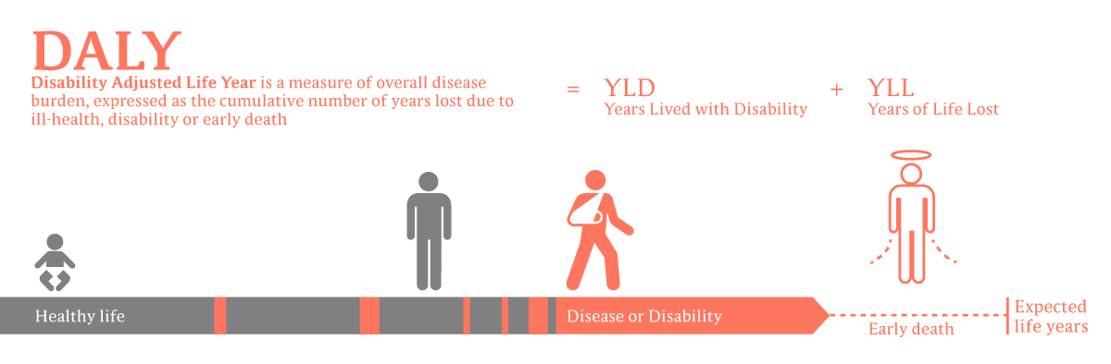

Slide 16
Health protection measures
The level of protection to achieve the target can be reached through a combination of management options such as:
  Wastewater treatment
  Crop restriction
  The method of irrigation
  Food preparation
    Washing
    Disinfection
    Peeling
    Cooking
  Hygiene practices at the marketplace
  Vaccines and other health sector preventive measures
"Control Measures"
that may be identified in the
Risk Management Plan

Slide 17
Control measure | Pathogen reduction (log units) |  | Notes
A. Wastewater treatment | up to 6−7 |  | Pathogen reduction depends on type and degree of treatment selected
B. On-farm options
Crop restriction (i.e., no food crops eaten uncooked) | 6−7 |  | Depends on (a) effectiveness of local enforcement of crop restriction, and (b) comparative profit margin of the alternative crop(s)
On-farm treatment:
(a) Three-tank system | 1−2 |  | Very effective for helminth egg sedimentation.
(b) Simple sedimentation | 0.5−1 |  | If ca. 18 hours; more effective for helminth eggs
(c) Simple filtration | 1−3 |  | Value depends on filtration system used
Safer wastewater application:
(a) Furrow irrigation |  | 1−2 | Crop density and yield may be reduced
(b) Low-cost drip irrigation |  | 2−4 | 2-log unit reduction for low-growing crops, and 4-log unit reduction for high-growing crops
(c) Reduction of splashing |  | 1−2 | Farmers trained to reduce splashing when watering cans used (splashing adds contaminated soil particles on to crop surfaces which can be minimized)
Pathogen die-off (cessation) |  | 0.5−2 per day | Die-off between last irrigation and harvest (value depends on climate, crop type, etc.)
PHILIP AMOAH

Slide 18
Control measure | Pathogen reduction (log units) |  |  |  |  | Notes
C. Post-harvest options at local markets
Overnight storage in baskets |  |  | 0.5−1 | Selling produce after overnight storage in baskets (rather than overnight storage in sacks or selling fresh produce without overnight storage)
Produce preparation prior to sale |  |  | 1−2 | (a) Washing salad crops, vegetables and fruit with clean water
 |  |  | 2−3 | (b) Washing salad crops, vegetables and fruit with running tap water
 |  |  | 1−3 | (c) Removing the outer leaves on cabbages, lettuces, etc.
D. In-kitchen produce-preparation options
Produce disinfection/washing |  | 2−3 |  |  | Washing salad crops, vegetables and fruit with an appropriate disinfectant solution and rinsing with clean water.
Produce peeling |  | 2 |  |  | Fruits, root crops
Produce cooking |  | 5−6 |  |  | Option depends on local diet and preference for cooked food.

Slide 19
2006 WHO Guidelines
1989 WHO Guidelines
Irrigation water
quality thresholds
Health-based targets
Wastewater
generation
Wastewater
generation
Farmer/
Producer
Farmer/
Producer
Traders/
Retailers
Traders/
Retailers
Kitchens
Kitchen staff
Consumer
Consumer
Wastewater
treatment
Safe
Irrigation
Practices
Hygienic
Handling
Practices
Safe food
washing and
preparation
Wastewater
treatment
Awareness
creation
to create
demand for
safe produce
Facilitating behaviour change via education,
financial & non-financial incentives, and
regular inspections
Notes:
Hazard analysis and critical control points Single barrier as risk management tool → multi barriers

Slide 20
Conclusions:
Health risks can be managed
Risk management is possible at low cost, also where wastewater treatment is only emerging. (Senegal, Jordan and Ghana (2007-2010) (>90% of disease burden down; CER < 100$/DALY).
Combination of treatment & non-treatment options would be ideal, but on-farm and/or off-farm interventions alone can be very effective.
Impact & cost-effectiveness of these interventions depend on their adoption rate: this requires education, incentives & social marketing (similar to hand wash campaigns).
Notes:
20
The average cost-effectiveness ratios (CER); US$ per DALY (ie the cost incurred for each DALY averted by the intervention)

Slide 21
Questions / Discussion
All publications can be found at:
www.who.int

