Slide 1






Institutional Arrangements and Collaboration for Safe Use of Wastewater in Agriculture
Manzoor Qadir
UNU-INWEH
Second Regional Workshop ‘Safe Use of Wastewater in Agriculture’ , 16-18 May 2012, New Delhi, India

Slide 2
Institutional Levels/Categories
National level across different ministries
District level across related institutions
Academic level across educational institutions
Farmers level across individual and associations
Policy level addressing the use of WHO/national guidelines
Regional level across countries in the region

Slide 3
National Level – Responsible Ministry
Great diversity at the national level ministries among countries for wastewater management
  Ministry of Environment (and Forest)
  Ministry of Energy
  Ministry of Agriculture
  Ministry of Water and Irrigation
  Ministry of Physical Planning and Works
  Ministry of Housing and Construction
  Ministry of Forestry and Water Affairs

Slide 4
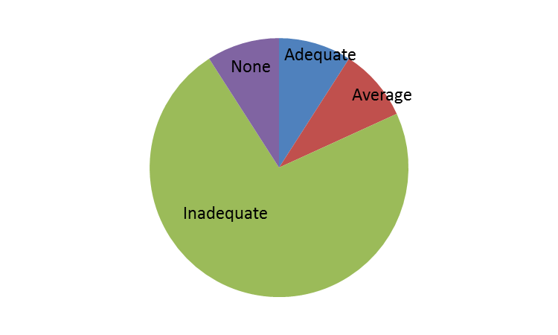
Inter-ministerial Collaboration
Categories included excellent, adequate, average, inadequate, and none

Slide 5
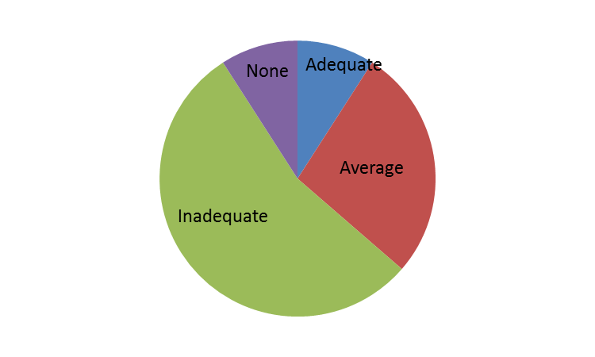
Government’s Commitment and Budget Allocation
Categories included excellent, adequate, average, inadequate, and none

Slide 6
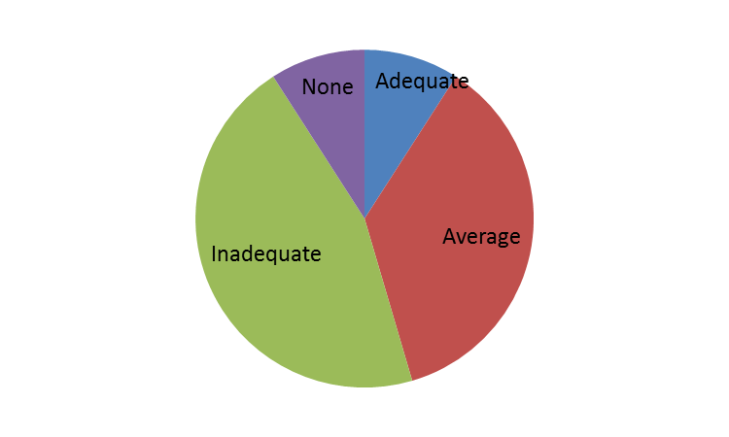
Institutional Collaboration at District Level
Categories included excellent, adequate, average, inadequate, and none

Slide 7
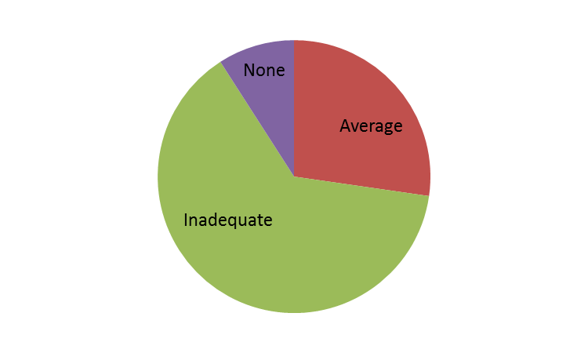
Institutional Commitment and Budget Allocation
Categories included excellent, adequate, average, inadequate, and none

Slide 8
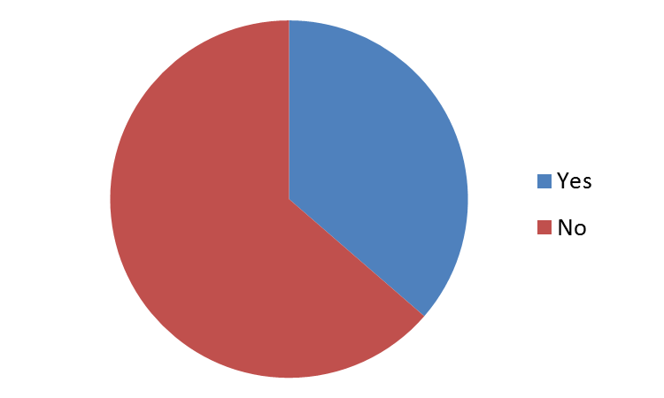
Academic Level: Wastewater in Schools’ Curricula
Topic of wastewater management in any form as a part of the curricula in schools

Slide 9
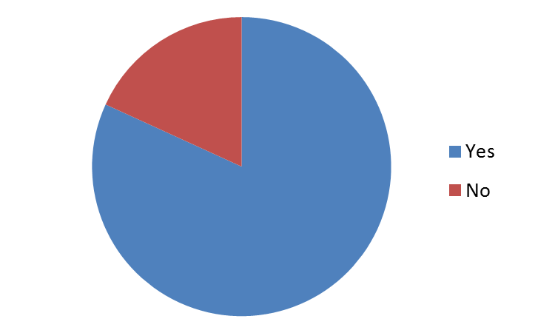
Academic Level: Wastewater in Universities’ Curricula
Topic of wastewater management in any form as a part of the curricula in universities

Slide 10
Farmers/Water Users Associations
Farmers/water users associations dealing with local institutions for wastewater delivery

Slide 11
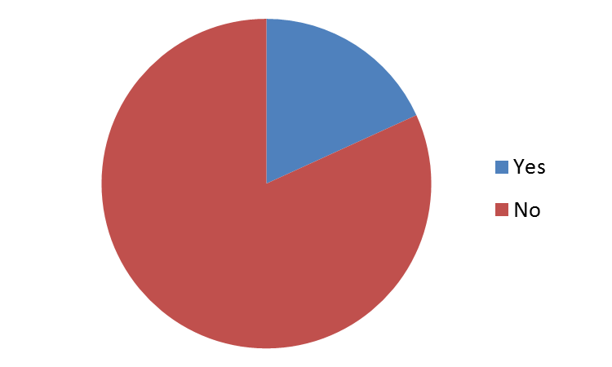
Farmers pay to Local Institutions for Wastewater

Slide 12
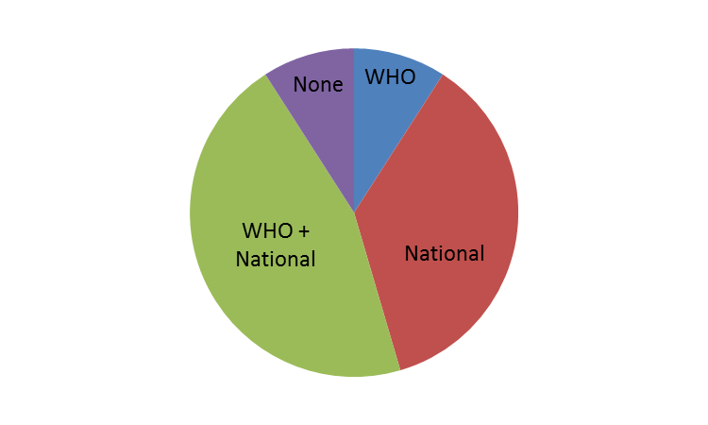
Policy Level: Guidelines for Wastewater Use
Major Challenge: Implementation
Categories included WHO guidelines, national guidelines, and none

Slide 13
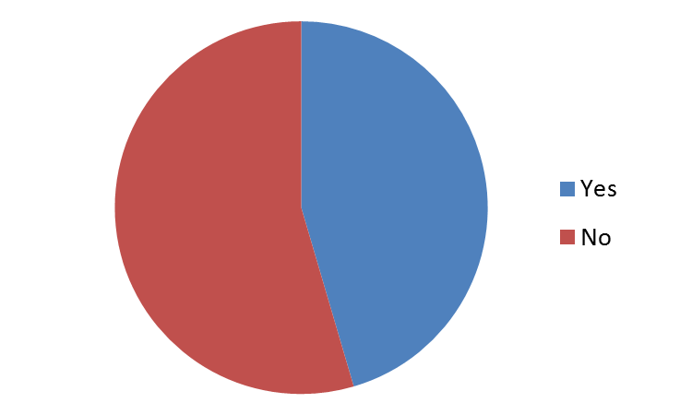
Regional Level: Collaboration across Countries
In case of yes, collaboration through joint projects and participation in regional workshops

Slide 14
Key Questions
What status do we have in regard to institutional arrangements at different levels for wastewater management?
What success stories do we have in terms of institutional collaboration addressing safe and productive use of wastewater?
How can we improve institutional collaboration addressing safe and productive use of wastewater?

