Slide 1









UN-Water Project on
Safe Use of Wastewater in Agriculture
Safe Use of Wastewater
In Agriculture
Africa ∙ Asia ∙ Latin America
Recap of the International Kick-off and 1st Regional Workshop; Scope of the 2nd Regional Workshop
1st Regional Workshop for Francophone Africa
18-19 February 2012
Palais de Congr‘es, Room „Fez“
Dr. Jens Liebe, UNW-DPC

Slide 2
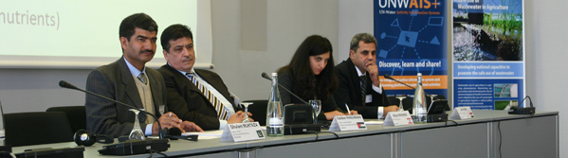
Goal
Qualified people in key organizations to formulate the right policies and
put into practice the safe use of wastewater in agriculture.
Materials and methods
Dissemination strategy
Capacity building action plan
Systems
Organizations
Individuals

Slide 3
Scope: capacity building at the individual/organization level
Trade and market environment
System level: Context in which organisations, individuals and groups involved in wastewater use for agriculture operate
Dimensions: Policies, strategies, laws and regulations related to safe wastewater use in agriculture.
Relationships, interdependencies and interactions among concerned stakeholders
Socio-economic and political environemnt
Organization level: Government Agencies and Institutions such as Ministries of Agriculture, Water, Environment, Health or Irrigation; Water control laboratories, Research Centers, Consumer groups
Dimensions: Resources (human, financial, information) procedures, structures, culture, decision-making, infrastructure, etc.
Individual Level: Public health, agricultural and environmental scientists, agriculture professionals, educators, researchers,engineers,policy makers and those responsible for developing
standards and regulations
Dimensions: Knowledge, skills, competences, work ethics, etc.
Governance
Education
(Source: UNDP 1998)

Slide 4
Phases of capacity building at the individual/organization level
Phase I:
Individual Capacity Needs Assessment (CNA)
National Reports
Phase II:
International workshop
November 2011
Gap Assessment
Phase III:
Regional workshops
February to March 2013
Capacity building action plan at the individual/organization level
Phase IV:
Wrap-up workshop
May 2013
Implementation of Recommended Actions
New CNA at the intitution/system level

Slide 5
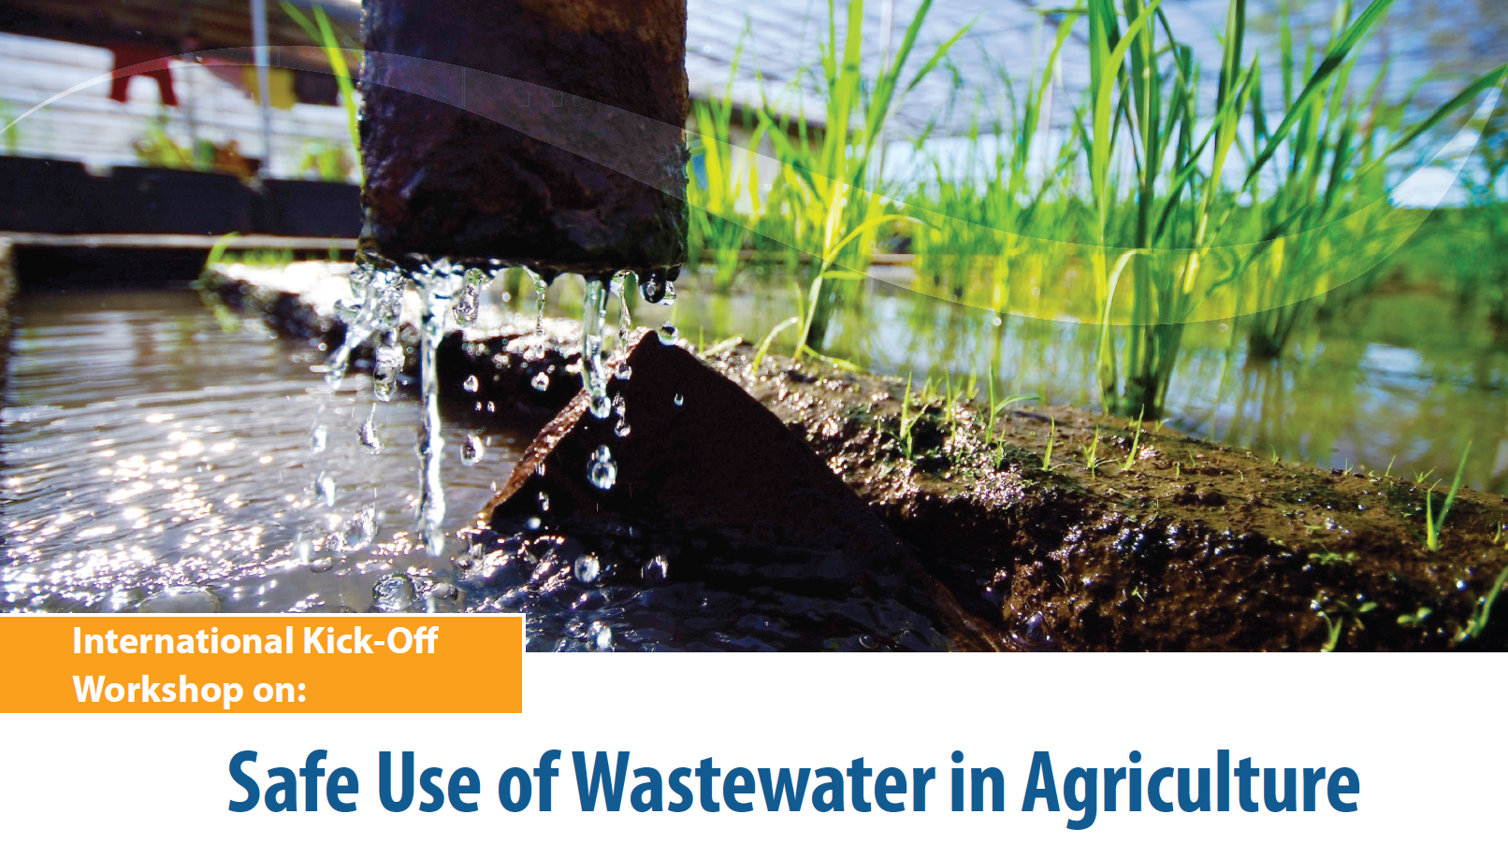






November 2011, Bonn, Germany

Slide 6
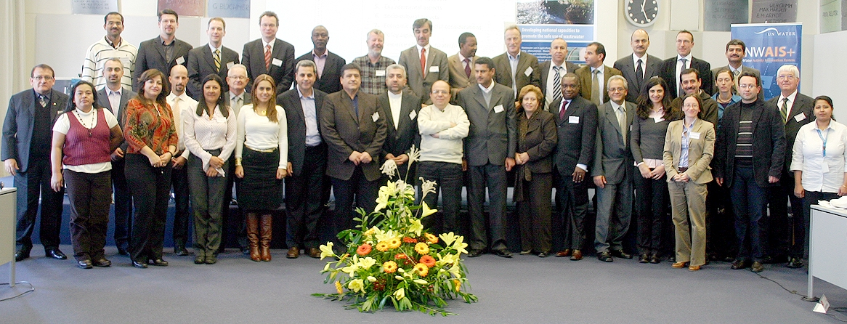
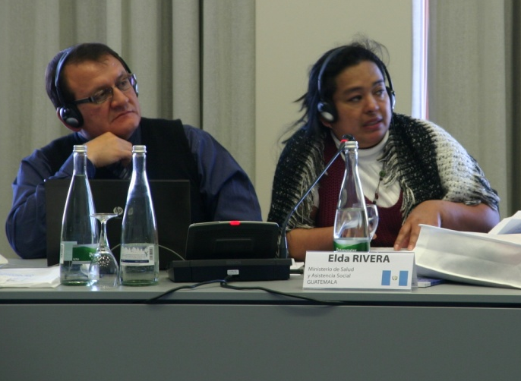
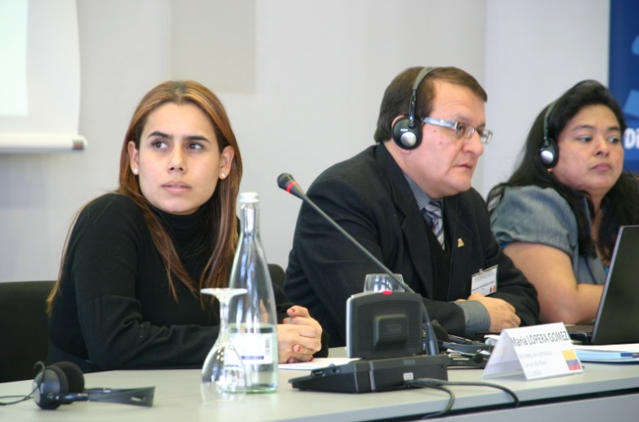
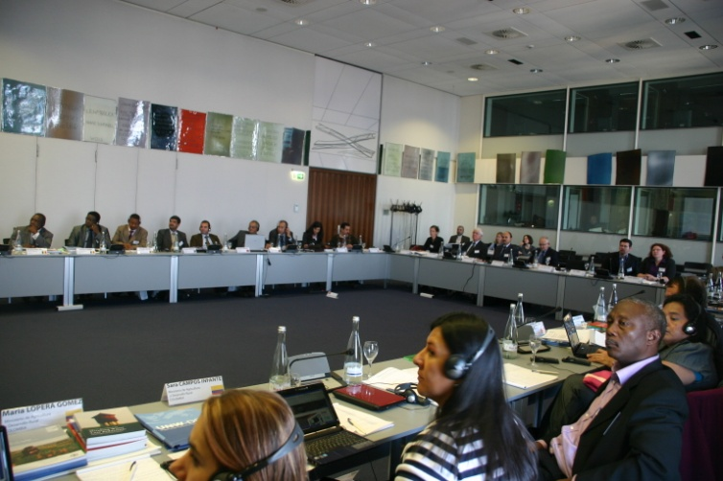
International Kick-off Workshop

Slide 7
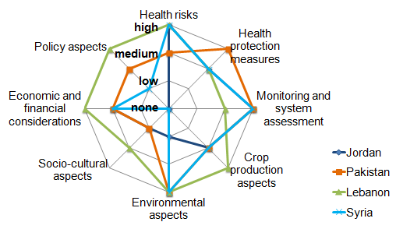
Knowledge & capacity needs:
Asia Group

Slide 8

Organized by:
Local Partner:
February 2012, Marrakech, Morocco
Safe Use of Wastewater
in Agriculture
Safe Use of Wastewater
In Agriculture
>> 1st Regional Workshop for Africa
1st Regional Workshop for Francophone Africa
Algeria ∙ Benin ∙ Burkina Faso ∙ Cameroun Central African Republic ∙ Côte d’Ivoire Democratic Republic of Congo ∙ Egypt ∙ Gabon
Guinea ∙ Guinea-Bissau ∙ Mauritania ∙ Morocco Niger ∙ Nigeria ∙ Senegal ∙ Togo ∙ Tunisia
18-19 February 2012
Palais de Congr‘es, Room „Fez“

Slide 9
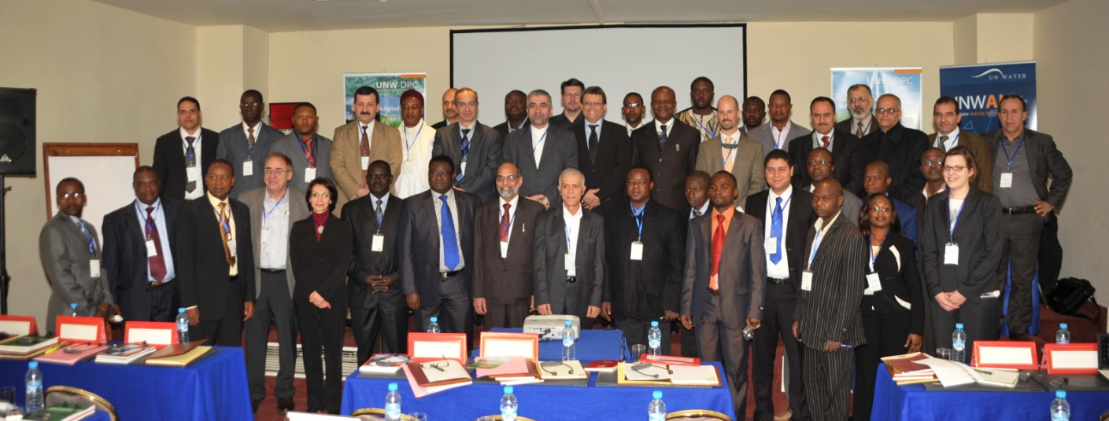
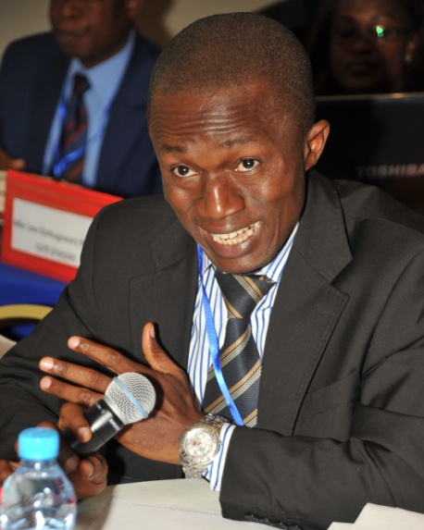
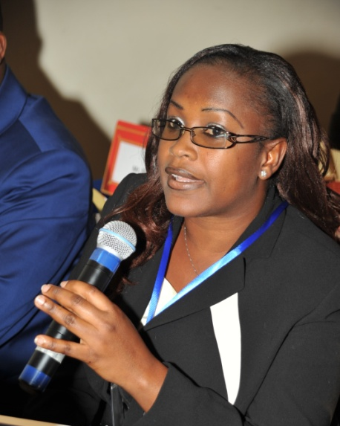
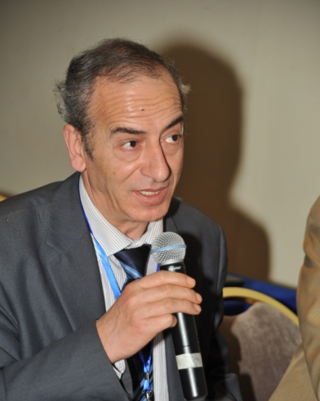
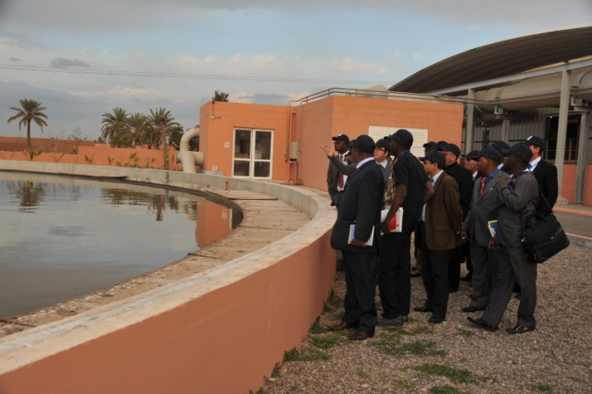
1st Regional Workshop for Africa February 2012, Marrakech, Morocco

Slide 10
Capacity Needs, 1st Regional Workshop

Slide 11
UN-Water Project on
Safe Use of Wastewater in Agriculture
Safe Use of Wastewater
In Agriculture
2nd Regional Workshop
1st Regional Workshop for Francophone Africa
Bangladesh ∙ India ∙ Iran ∙ Iraq
Jordan ∙ Myanmar ∙ Nepal ∙ Pakistan Sri Lanka ∙ Syria ∙ Turkey
18-19 February 2012
Palais de Congr‘es, Room „Fez“
Dr. Jens Liebe, UNW-DPC

Slide 12
Survey results: Your capacity needs

Slide 13
Background of the participants of this workshop

Slide 14
Background of the participants of this workshop

Slide 15
The situation in your countries
LEARNING CURVE:
1. Awareness
2. Understanding
3. Commitment
4. Action
5. Reflection
1. 2. 3. 4. 5.

Slide 16
What you want to learn
"Learn about experiences in other countries"
"About the new challenges, problems, and solutions in this area"
"I would like to know how far the developments reach in developed countries."
"Which irrigation system to use when using treated wastewater?"
"New and safe technologies for wastewater reuse."
"Learn about recent innovations, research and information on this topic."
"What are the health risks when using wastewater?"
"Learn from the work that the colleagues from other countries are engaged with."
"Regional best practices for assessing and reducing health risks.”
"About existing policies and techniques to promote safe use of wastewater."

Slide 17
What you want to share
"Our national situation, problems, approaches, barriers, policy weaknesses, etc."
“Interact and share the work that I have been doing”
"My country's experience and attitude regarding this topic"
"The initiatives related to this subject that we are implementing in my country"
"I want to share information and research about this topic"
"Practical avoidance of the challenges and risks of using wastewater in
irrigation fields; the obligations and instructions"
"How wastewater management and use in agriculture is
embedded with traditions and livelihood systems in my country"

Slide 18
What you want to take home
"New knowledge partners, likemindedness,
an extended network and joint collaborations"
"Insights to create a strategic plan to promote safe use of wastewater in agriculture."
"General information about wastewater use in agriculture and
the accompanying challenges, applications and results, for use in my country"
"Recent innovations, research and latest knowledge."
"Knowledge about the experiences in other countries
and practical issues they deal with."
"Scientific update on safety standards and national policy formulation.”
"Information about new technologies related to this topic"
"Knowledge about health and safety concerns for wastewater users.”

Slide 19
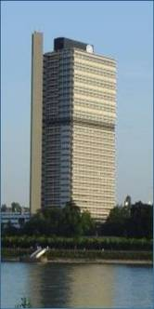

Thank you!
UN-Water Decade Programme on Capacity Development (UNW-DPC)
UNITED NATIONS UNIVERSITY
UN Campus
Hermann-Ehlers-Str. 10
D-53113 Bonn, Germany
Phone: + 49 (0) 228 815-0652
Fax: + 49 (0) 228 815-0655
E-Mail: info@unwater.unu.edu
www.unwater.unu.edu

