Slide 1
Safe Use of Wastewater in Agriculture
Capacity needs and national strategies
Dr. Jens Liebe, UNW-DPC
1

Slide 2
Capacity needs Southeast and Eastern Asia
Based on 10 countries, 17 participants

Slide 3
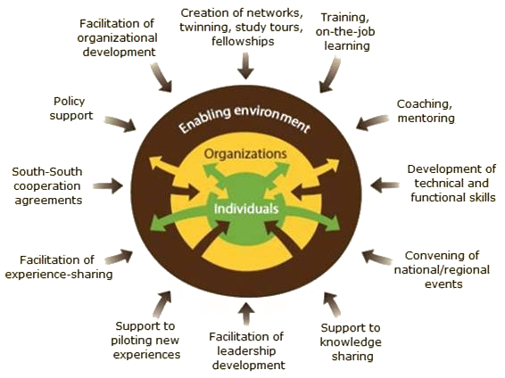
Levels of Capacity Development
(Source: FAO)

Slide 4
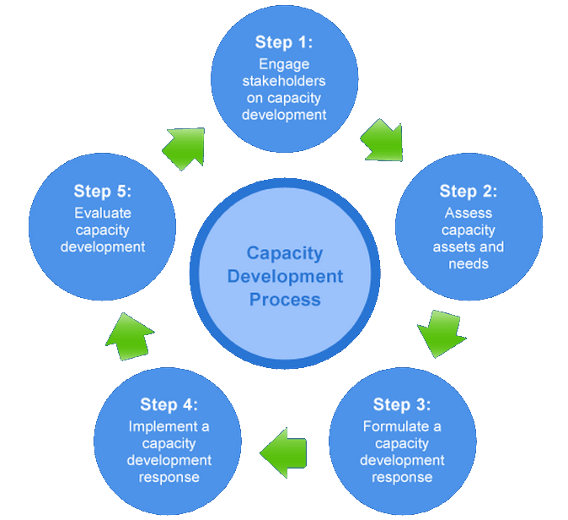
Capacity Development Process
(Source: UNDP)

Slide 5
Needs to develop national strategy
“Multi-sectoral action plan”
“Prepare capacity to all level both of Government and non-government organization”
“To encourage local government units to develop and adopt their own regulations "
“Awareness, research and development, capacity building, policy”
“Implementing functional treatment systems and inexpensive management”

Slide 6
Hindrances and barriers
“Limited knowledge on the advantages or beneficial effects of wastewater reuse ”
“The public awareness about water shortage is insufficient”
“Development of wastewater treatment technology and adequate knowledge and skill for wastewater”
“Lack of strict supervision measures”

Slide 7
What is a dissemination strategy?
An intentionally-developed approach to dissemination includes
identification of targeted potential adopters,
an assessment of the climate of readiness for change,
planning how engagement will be built, and
enabling transfer of knowledge and materials.
Goal: Utilization
(Hinton, T., Gannaway, D., Berry, B., & Moore, K. (2011). The D-Cubed Guide: Planning for Effective Dissemination. Sydney: Australian Teaching and Learning Council.)

Slide 8
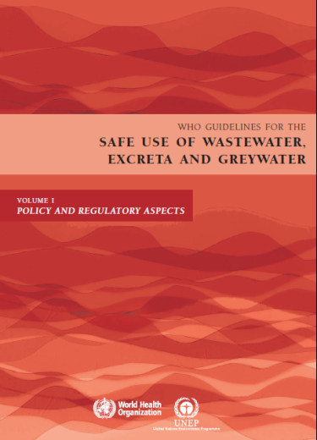
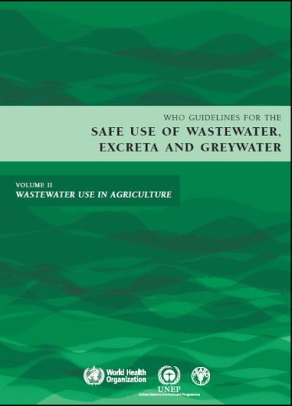
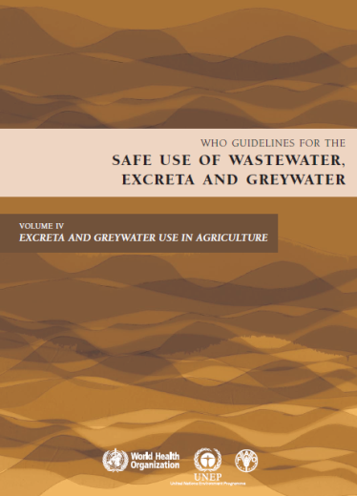
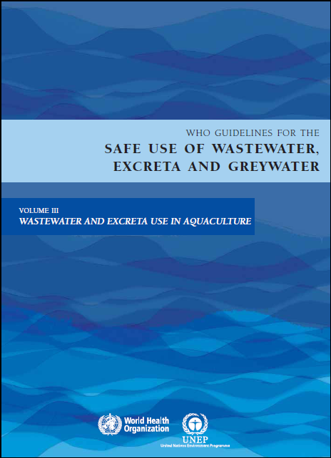
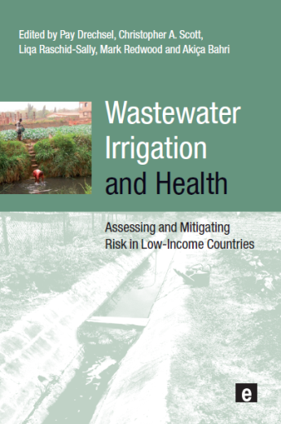
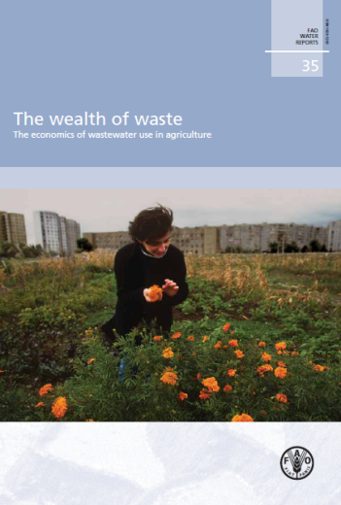
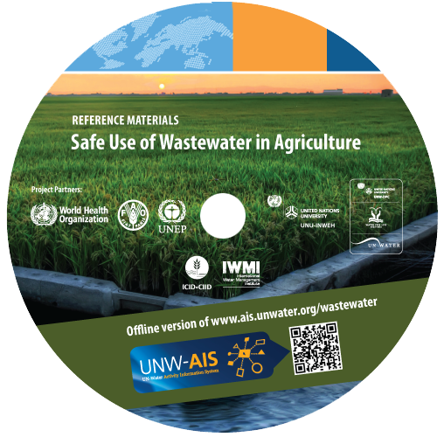
Which materials?
Materials presented during the workshop, e.g.
WHO Guidelines
Wealth of Waste and Posters (FAO)
Sick water report (UNEP)
Wastewater Irrigation and Health
+ your own material

Slide 9
Strategies for dissemination
Possible steps:
Institutional arrangements/platform
National wastewater reuse committee
National meetings and workshops
Institutional web page
Linking to existing agriculture/health programmes
Formulate a dissemination strategy at national level (identifying target audiences and materials/information)
www.ais.unwater.org/wastewater/

Slide 10
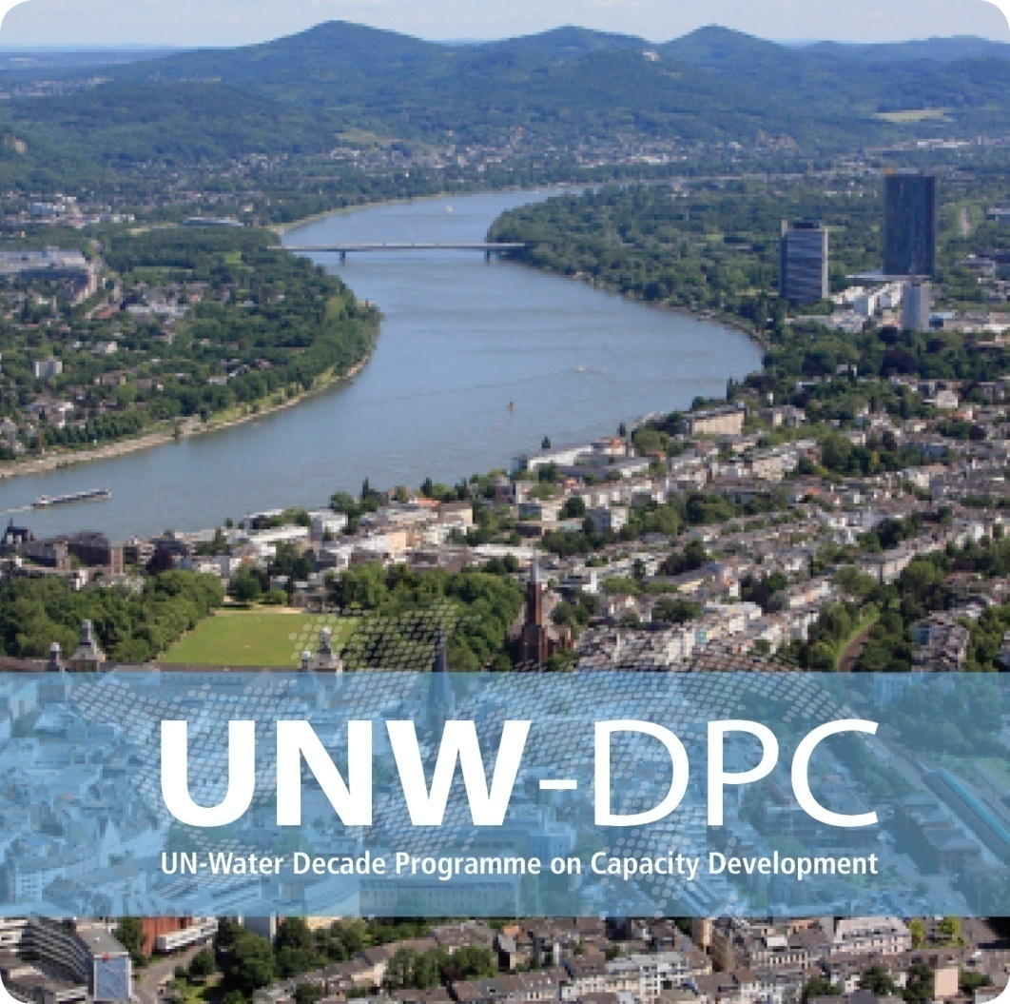
Thank you!
UN-Water Decade Programme on Capacity Development (UNW-DPC)
UNITED NATIONS UNIVERSITY
UN Campus
Hermann-Ehlers-Str. 10
D-53113 Bonn, Germany
Phone: + 49 (0) 228 815-0652
Fax: + 49 (0) 228 815-0655
E-Mail: info@unwater.unu.edu
www.unwater.unu.edu

