Slide 1
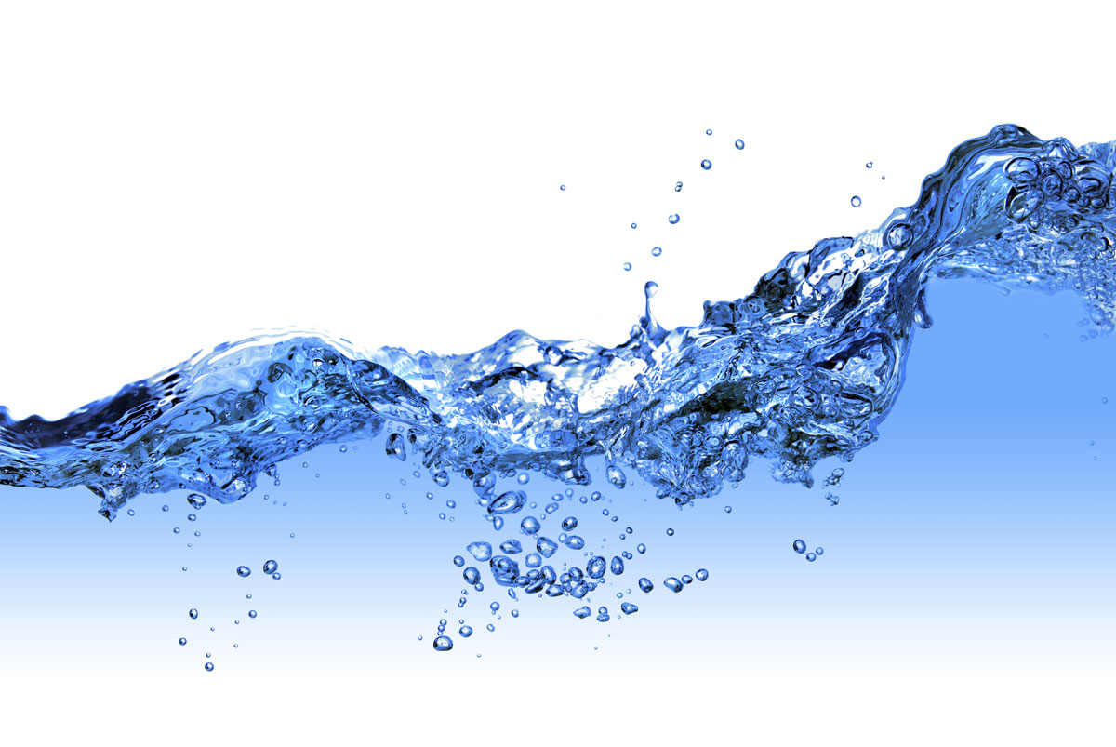
Safe and Productive Use of Wastewater
Manzoor Qadir
FAO/UNEP/UNU-INWEH/UNW-DPC/IWMI/ICID First Regional Workshop of the Capacity Development Project on Safe Use of Wastewater, 18-19 February 2012, Marrakesh, Morocco

Slide 2
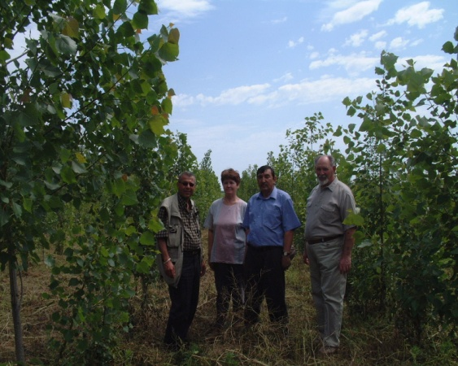
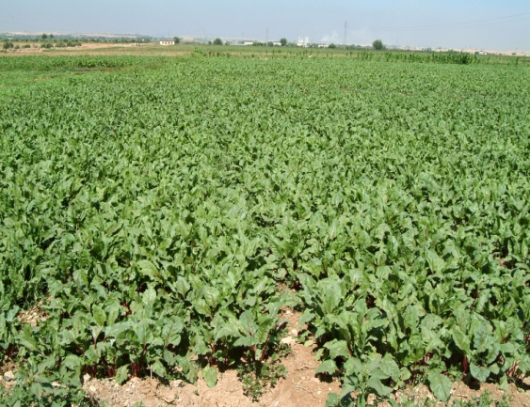
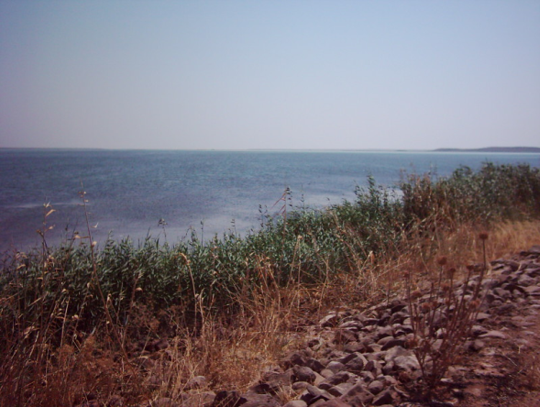
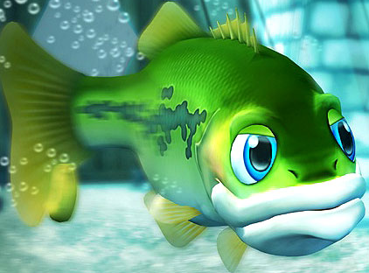
Wastewater Use in AAAA
Agriculture
Agroforestry
Aquaculture
Aquifer recharge

Slide 3
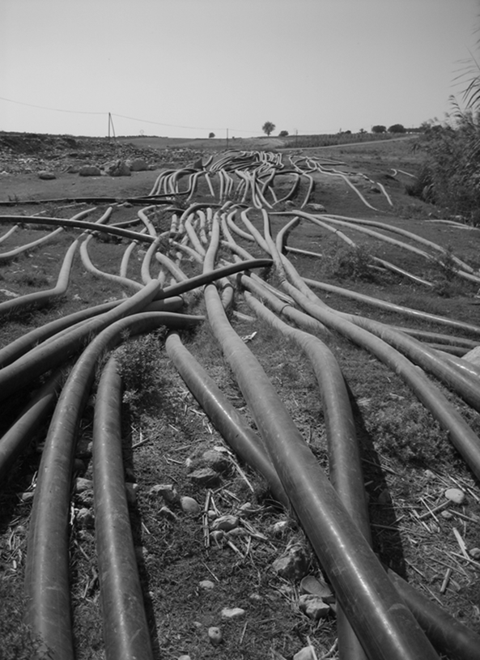
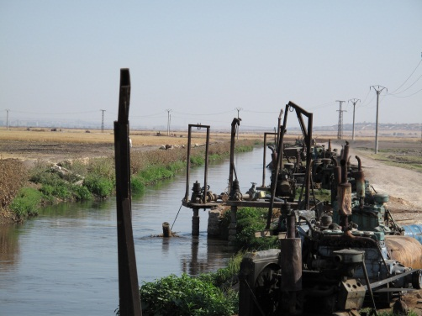
Key Issues and Challenges
Most developing countries and countries in transition have yet to reach full-capacity wastewater treatment
Policies and regulatory measures that encourage wastewater treatment and reuse of treated wastewater are lacking
Wastewater is available to the farmers in untreated, inadequately treated, or diluted forms

Slide 4
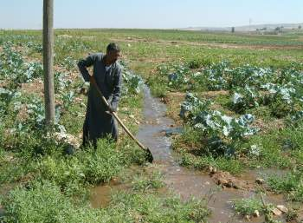
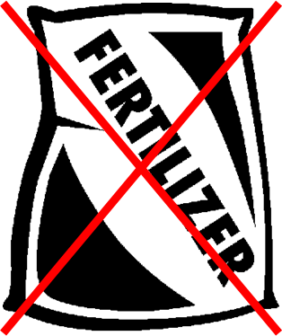
Incentives for the Farmers
Reliable availability of a water resource amid water scarcity
Savings on fertilizer use (wastewater contains nutrients)
Less pumping cost if alternate water source is groundwater
Additional benefits: high-value crops; increased cropping intensities

Slide 5
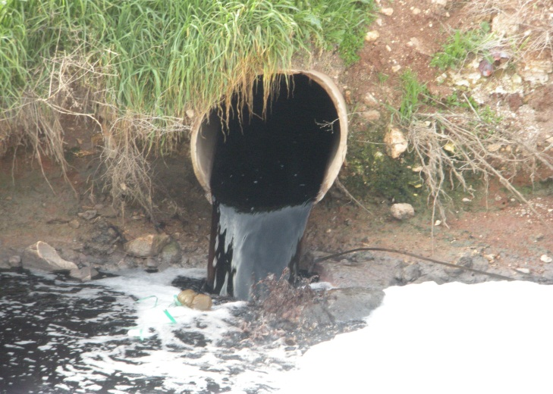
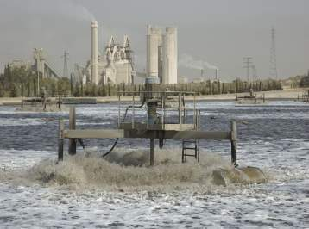
Categories of Wastewater Use
Direct use of untreated wastewater occurs from a sewage outlet when it is directly disposed of on a land for irrigation
Direct use of treated wastewater occurs when wastewater has undergone treatment before it is used for irrigation or recycling purposes

Slide 6
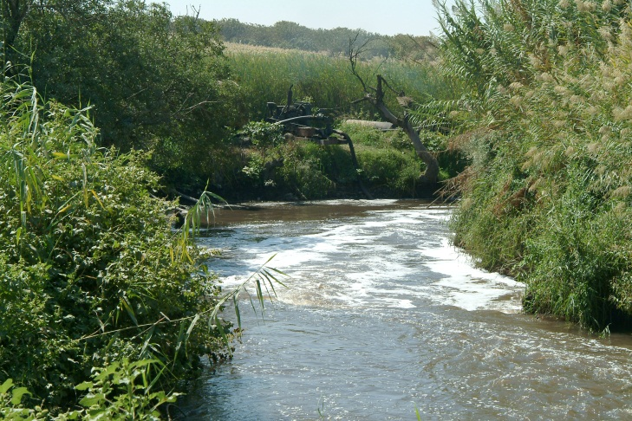
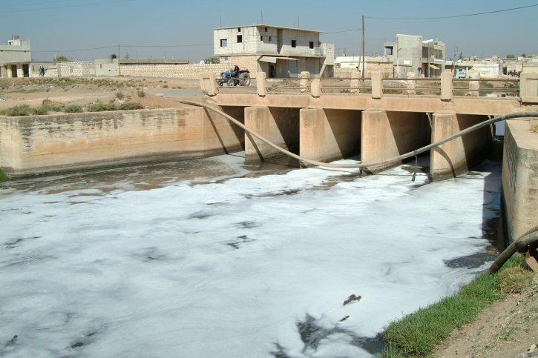
Categories of Wastewater Use
Indirect use of untreated wastewater occurs when water from a river receiving untreated wastewater is abstracted by farmers downstream for agriculture.
This happens when cities do not have comprehensive sewage collection network and wastewater is discharged into rivers.

Slide 7
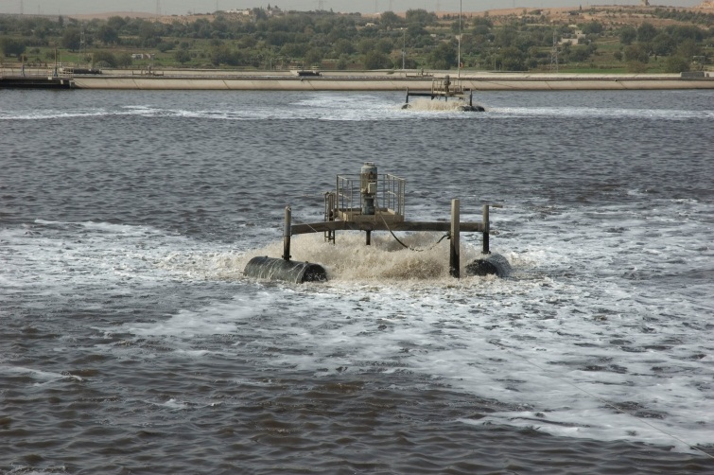
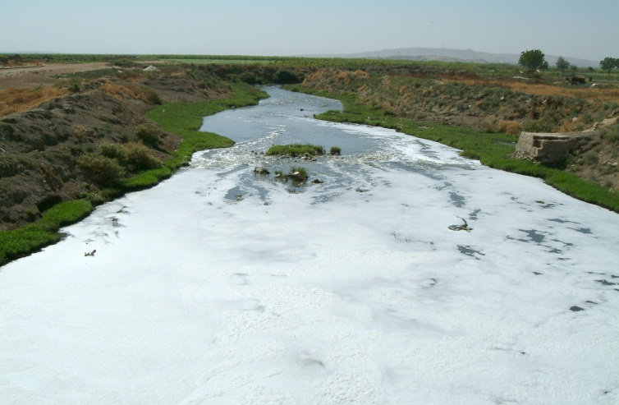
Categories of Wastewater Use
Indirect use of inadequately treated wastewater occurs when water from a river receiving such wastewater is abstracted by farmers downstream for agriculture.
This happens when cities have sewage collection network, but wastewater treatment is inadequate.

Slide 8
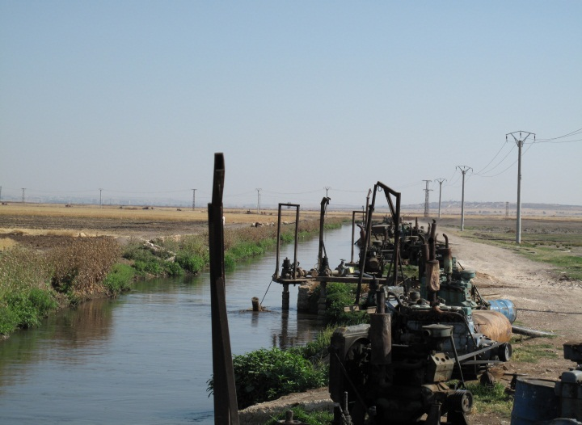
Categories of Wastewater Use
Planned use of wastewater refers to the conscious and controlled use of wastewater either in raw (direct) or diluted (indirect) forms.
Unplanned use of wastewater refers to unregulated use of wastewater either in raw (direct) or diluted (indirect) forms; common in developing countries

Slide 9
Wastewater Program at UNU-INWEH
Recent initiative in partnership with:
ICARDA – Wastewater and greywater reuse in dry areas, environmental impact assessment of wastewater reuse
IWMI – Regional wastewater assessment; resource recovery from wastewater and greywater
ACWUA – Wastewater and greywater reuse in the Arab region
FAO/UNEP/UNW-DPC – Capacity Development Project on safe use of wastewater in agriculture

Slide 10
Some Examples . . . . . . .

Slide 11
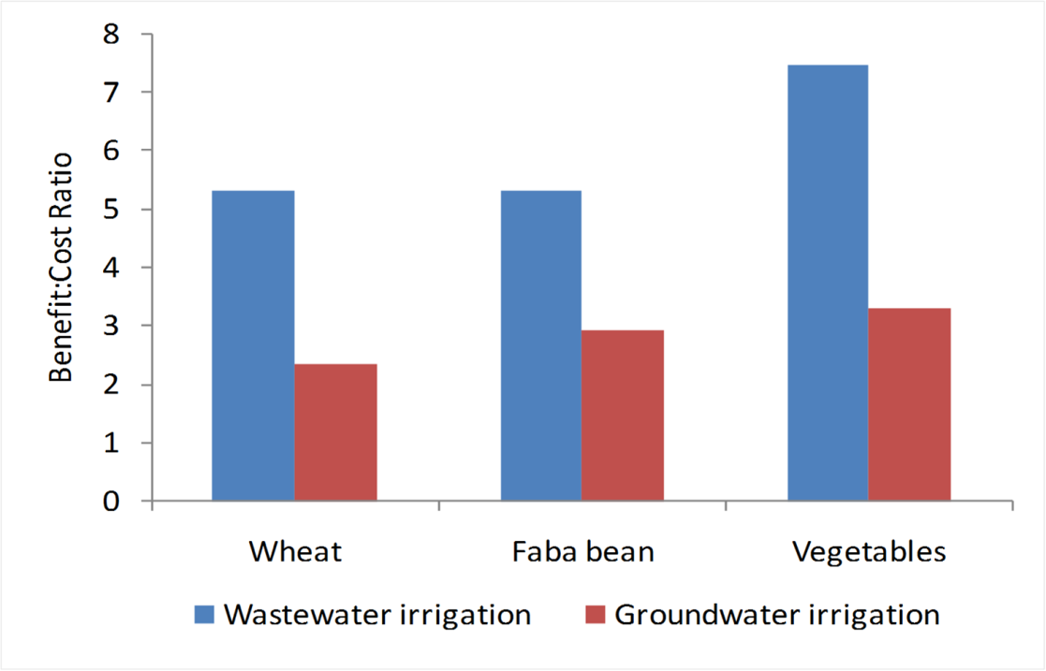
Economics of Wastewater Use
Based on crop cultivation, fertilizer use, farm labor, and irrigation costs
Some costs such as environmental and health costs were not included
Benefit:cost ratio was almost double from wastewater-irrigated area

Slide 12
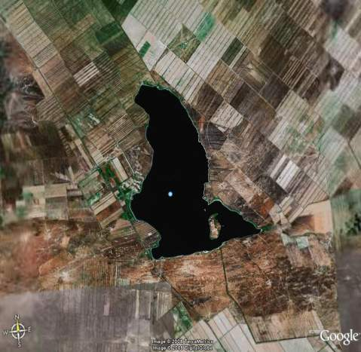
Use of Wastewater for Agroforestry
Almaty, Kazakhstan
Treated wastewater stored in Sorbulak lake
Four agroforestry species
Silver-leaf poplar (Populus alba L.)
Ash (Fraxinus excelsior L.)
White mulberry (Morus alba L.)
Dog rose (Rosa canina L.)

Slide 13
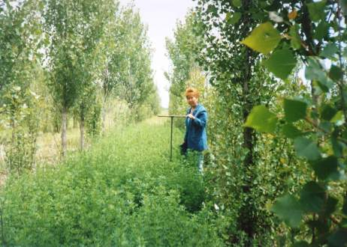
Use of Wastewater for Agroforestry
5-year irrigation with wastewater didn’t increase metal ion concentration in soil above the respective permissible levels
Increase in nutrient availability status of the soil because of nutrients added with wastewater irrigation

Slide 14
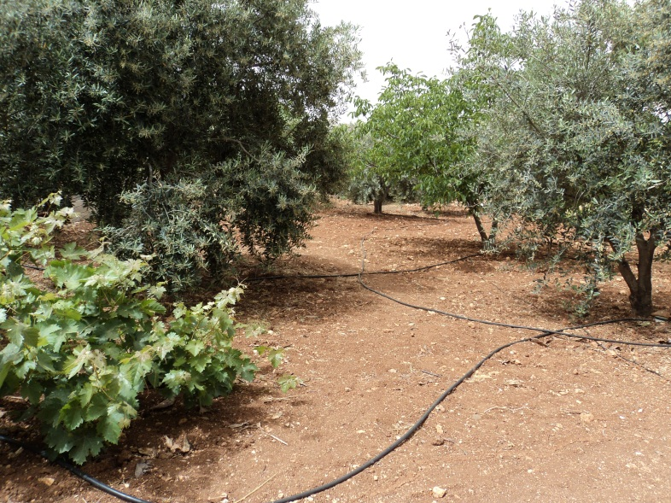
Use of Greywater for Olive Irrigation
Amman, Jordan
Part of domestic effluent consisting of kitchen and bathroom wastewater (50-80% of residential wastewater)
Separated from domestic wastewater, treated, and reused
Greywater use for home farming to irrigate high-value olives contribute to income generation at household level in dry areas

Slide 15
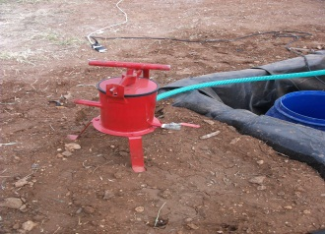
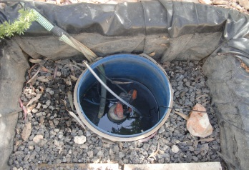
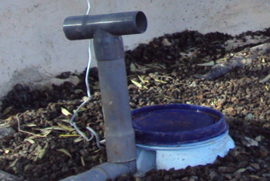
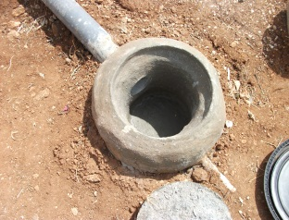
Greywater Treatment System
Green removal panel
Manhole- steel cover
Screen Filter
To the irrigation system
Stone
Vales

Slide 16
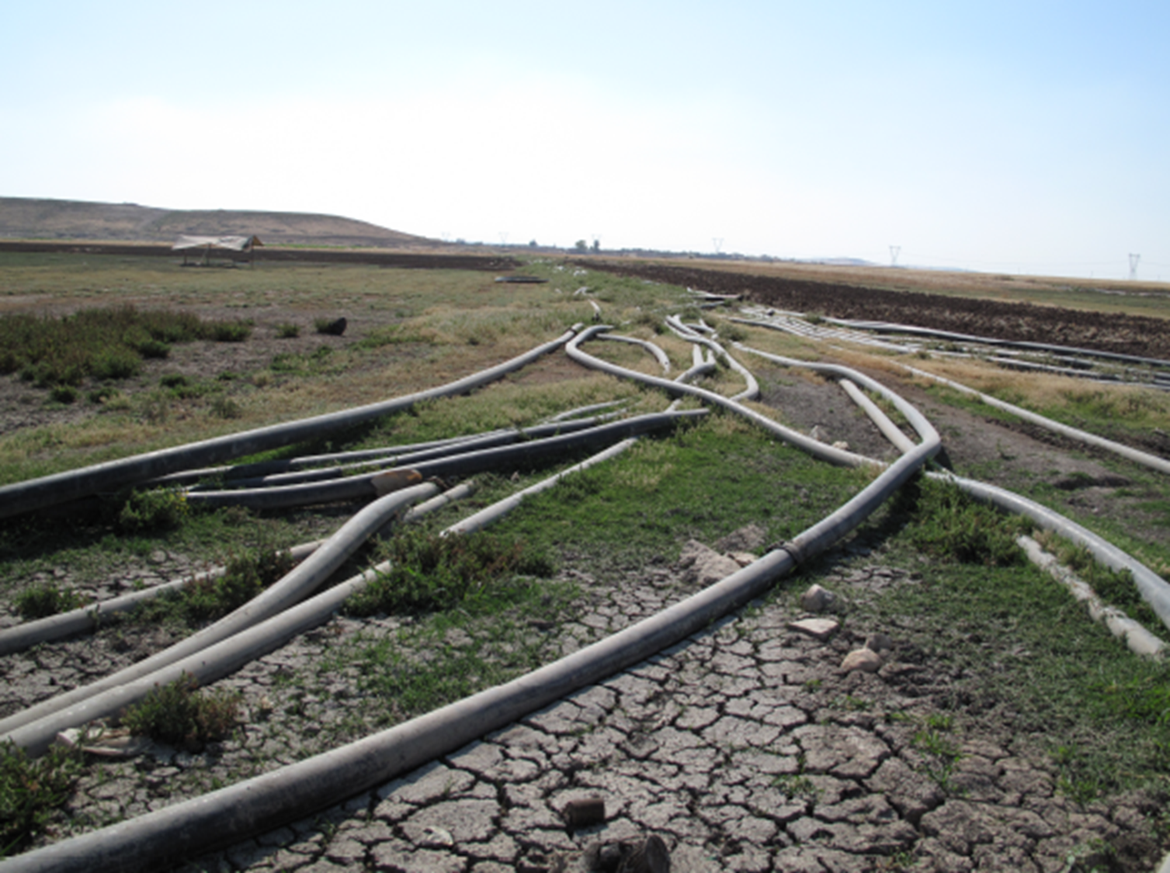
Environmental Impact Assessment of Irrigation with Untreated or Inadequately Treated Wastewater

Slide 17
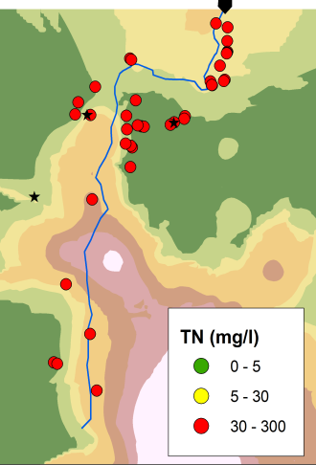
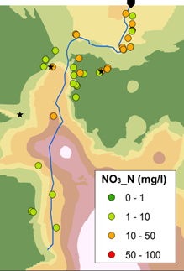
Nitrogen in Groundwater

Slide 18
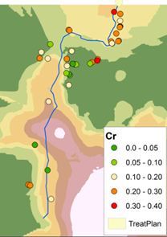
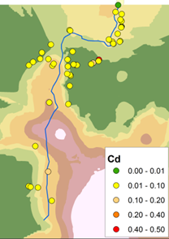
Heavy Metals in Groundwater

Slide 19
Conclusions
Urban wastewater and greywater in water scarce countries is a valuable resource that needs:
Implementation of treatment and regulated use of wastewater
Monitoring systems and implementation of WHO guidelines
Skilled human resources and institutional capacity
Pertinent and flexible policy frameworks
Regulated use of treated wastewater offers great promise for environment and health protection as well as livelihoods resilience

