Slide 1
Wastewater use in Irrigation: needs for policy integration Avinash C Tyagi Secretary General, ICID
First Regional Workshop
Safe use of Wastewater in Agriculture,
18-19 February 2012, Marrakech, Morocco
Under the Auspices of UN-Water
Partners: UNW-DPC, FAO, UNEP, WHO, ICID and ONEP

Slide 2
Mission
Dedicated to enhancing the worldwide supply of food and fibre for all people by improving water and land management and the productivity of irrigated and drained lands through appropriate management of water, environment...

Slide 3
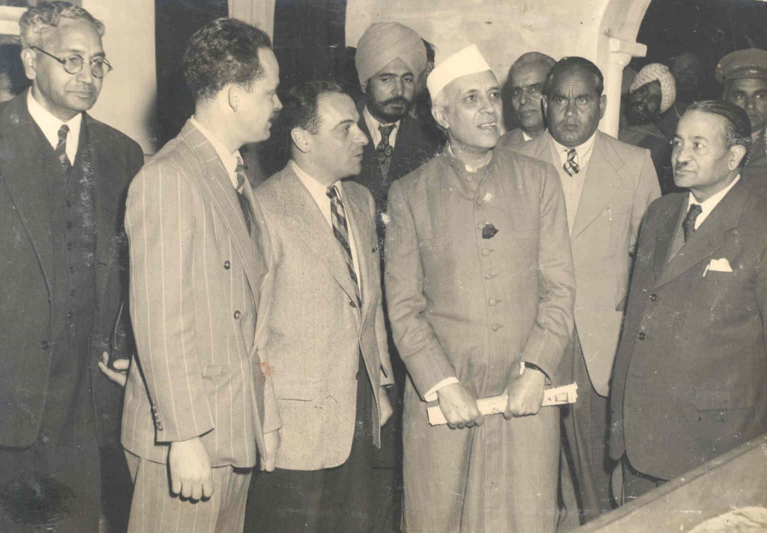
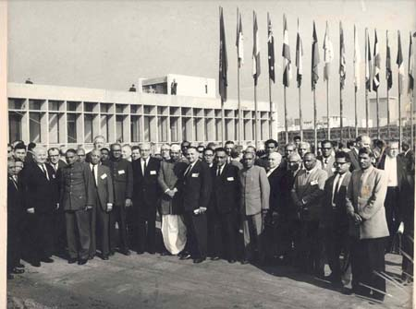
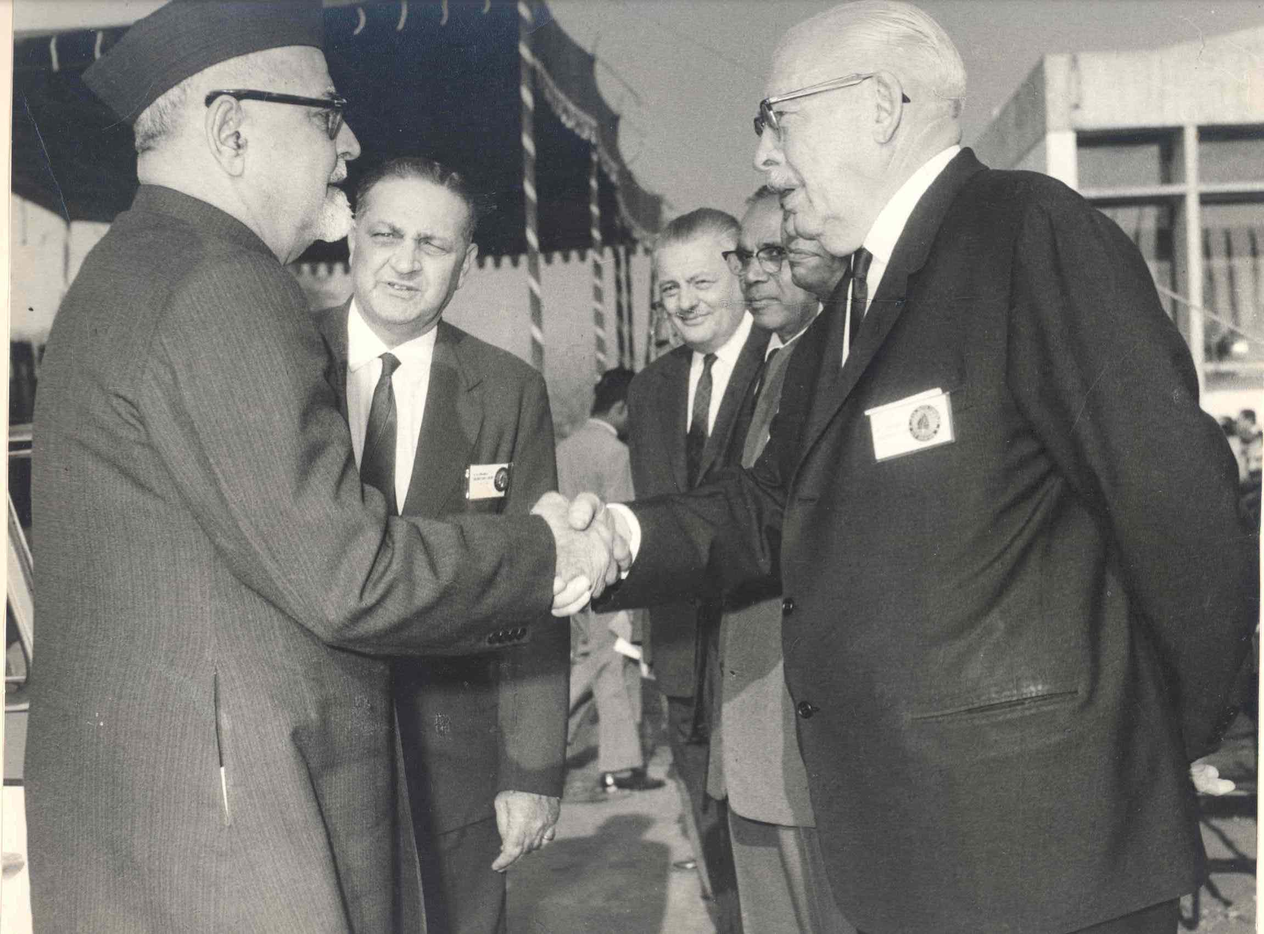
ICID was established on 24 June 1950
The Central Office building was inaugurated by the then
Vice President Dr. Zakir Hussain
on 10 January 1966
Prime Minister Shri Jawahar Lal Nehru and the then President Dr. A.N. Khosla at the French National Committee Pavilion (1951)
Dr. Framji introducing Pres.Hon. Tipton to
Hon’ble Vice President of India Dr. Zakir Hussain

Slide 4
ICID Membership network spreads over 100 countries
covering about 96% of the world’s irrigated area

Slide 5
ICID Structure and Governance
International Executive Council
Management Board
International
Organizations
Central Office,
New Delhi
UN Organizations
Technical
Working Groups/
Task Forces
Member Countries

Slide 6
ICID Technical Working Groups
Modernization of irrigation services
Water saving in agriculture
On-farm irrigation systems,
Use of poor quality water for irrigation.
Environmental impacts of irrigation & drainage
GCC and agriculture water management,
Agricultural drainage,
Water and crop,
Floods and drought mitigation,
Sustainable development of tidal areas,
Technology and research uptake,
Role of irrigation in poverty alleviation,
Financing water for agriculture,
Bio-energy and food

Slide 7
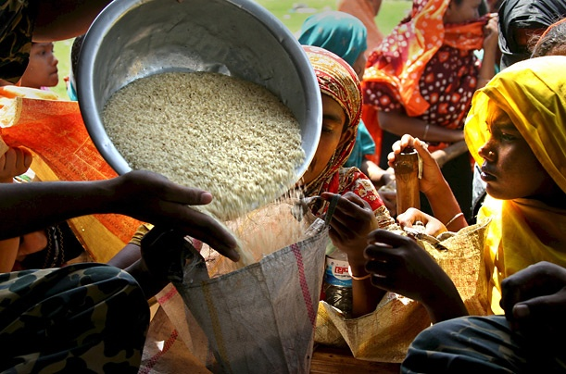
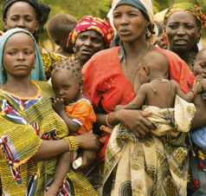
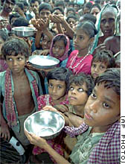
World agriculture faces an enormous challenge over the next
40 years to produce almost 50% more food up to 2030 and
double the food production by 2050
Key drivers
Increasing population and urbanization
Changing diets
Rapidly growing water demand from industrial/ energy and domestic sectors
Increasing area under bio-energy crops
Climate change impacts
Increasing fresh water scarcity

Slide 8
Why bother about wastewater?
Wastewater (raw, diluted or treated) is a resource of increasing global importance, particularly in urban and peri-urban areas due to growing wastewater volumes
Without proper management, wastewater use poses serious risks to human health and the environment
With proper management, wastewater use can contribute significantly to sustaining livelihoods, food security and the quality of the environment
Wastewater already irrigates approximately 49 million acres of cropland, and
10 percent of the world's population would starve if they didn't have access to food grown that way

Slide 9
Why bother about wastewater?
In majority of the urban areas, the activities in the wastewater sector are focused mostly on wastewater disposal than recycle and reuse recycle
benefits of wastewater farming far outweigh the drawbacks
reuse of wastewater has not received much attention by the policy-decision makers perhaps because of the lack of viable models with necessary research and technology support,
strong policies and legal framework at the national and state levels and sufficient trained manpower in the urban local bodies are required.

Slide 10
Benefits of wastewater use?
Direct benefits
Recycles and thereby conserve water,
Recycles nutrients, thereby reducing the need for farmers to invest in chemical fertilizer, and
Provides a reliable water supply to farmers particularly in low-income dry areas;
Indirect benefits
Prevents of pollution of rivers, canals and other surface water that would otherwise be used for the disposal of the wastewater, and
Disposes municipal wastewater in a low cost and hygienic way.

Slide 11
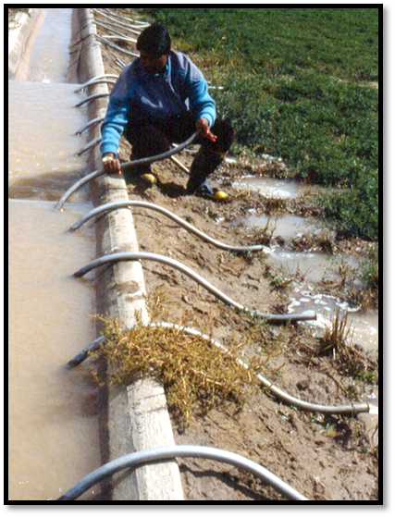
Is there need for a policy?
Wastewater as a new resource
Treated, partially treated, diluted or raw wastewater uses
Health risks management issues
Nutrient and land management
Economic considerations
Socio-cultural acceptability

Slide 12
THANKS
For more visit
www.icid.org

