Slide 1
Introduction to UNW-DPC
Dr. Jens Liebe
1st Regional workshop for Africa on Safe use of Wastewater in Agriculture
18 February 2012
Marrakech, Morocco
1

Slide 2
UNW-DPC’s Mission
“to enhance the coherence, credibility and integrated effectiveness
of UN-Water
by strengthening its capacity development programmes, particularly in developing countries and economies in transition.”

Slide 3
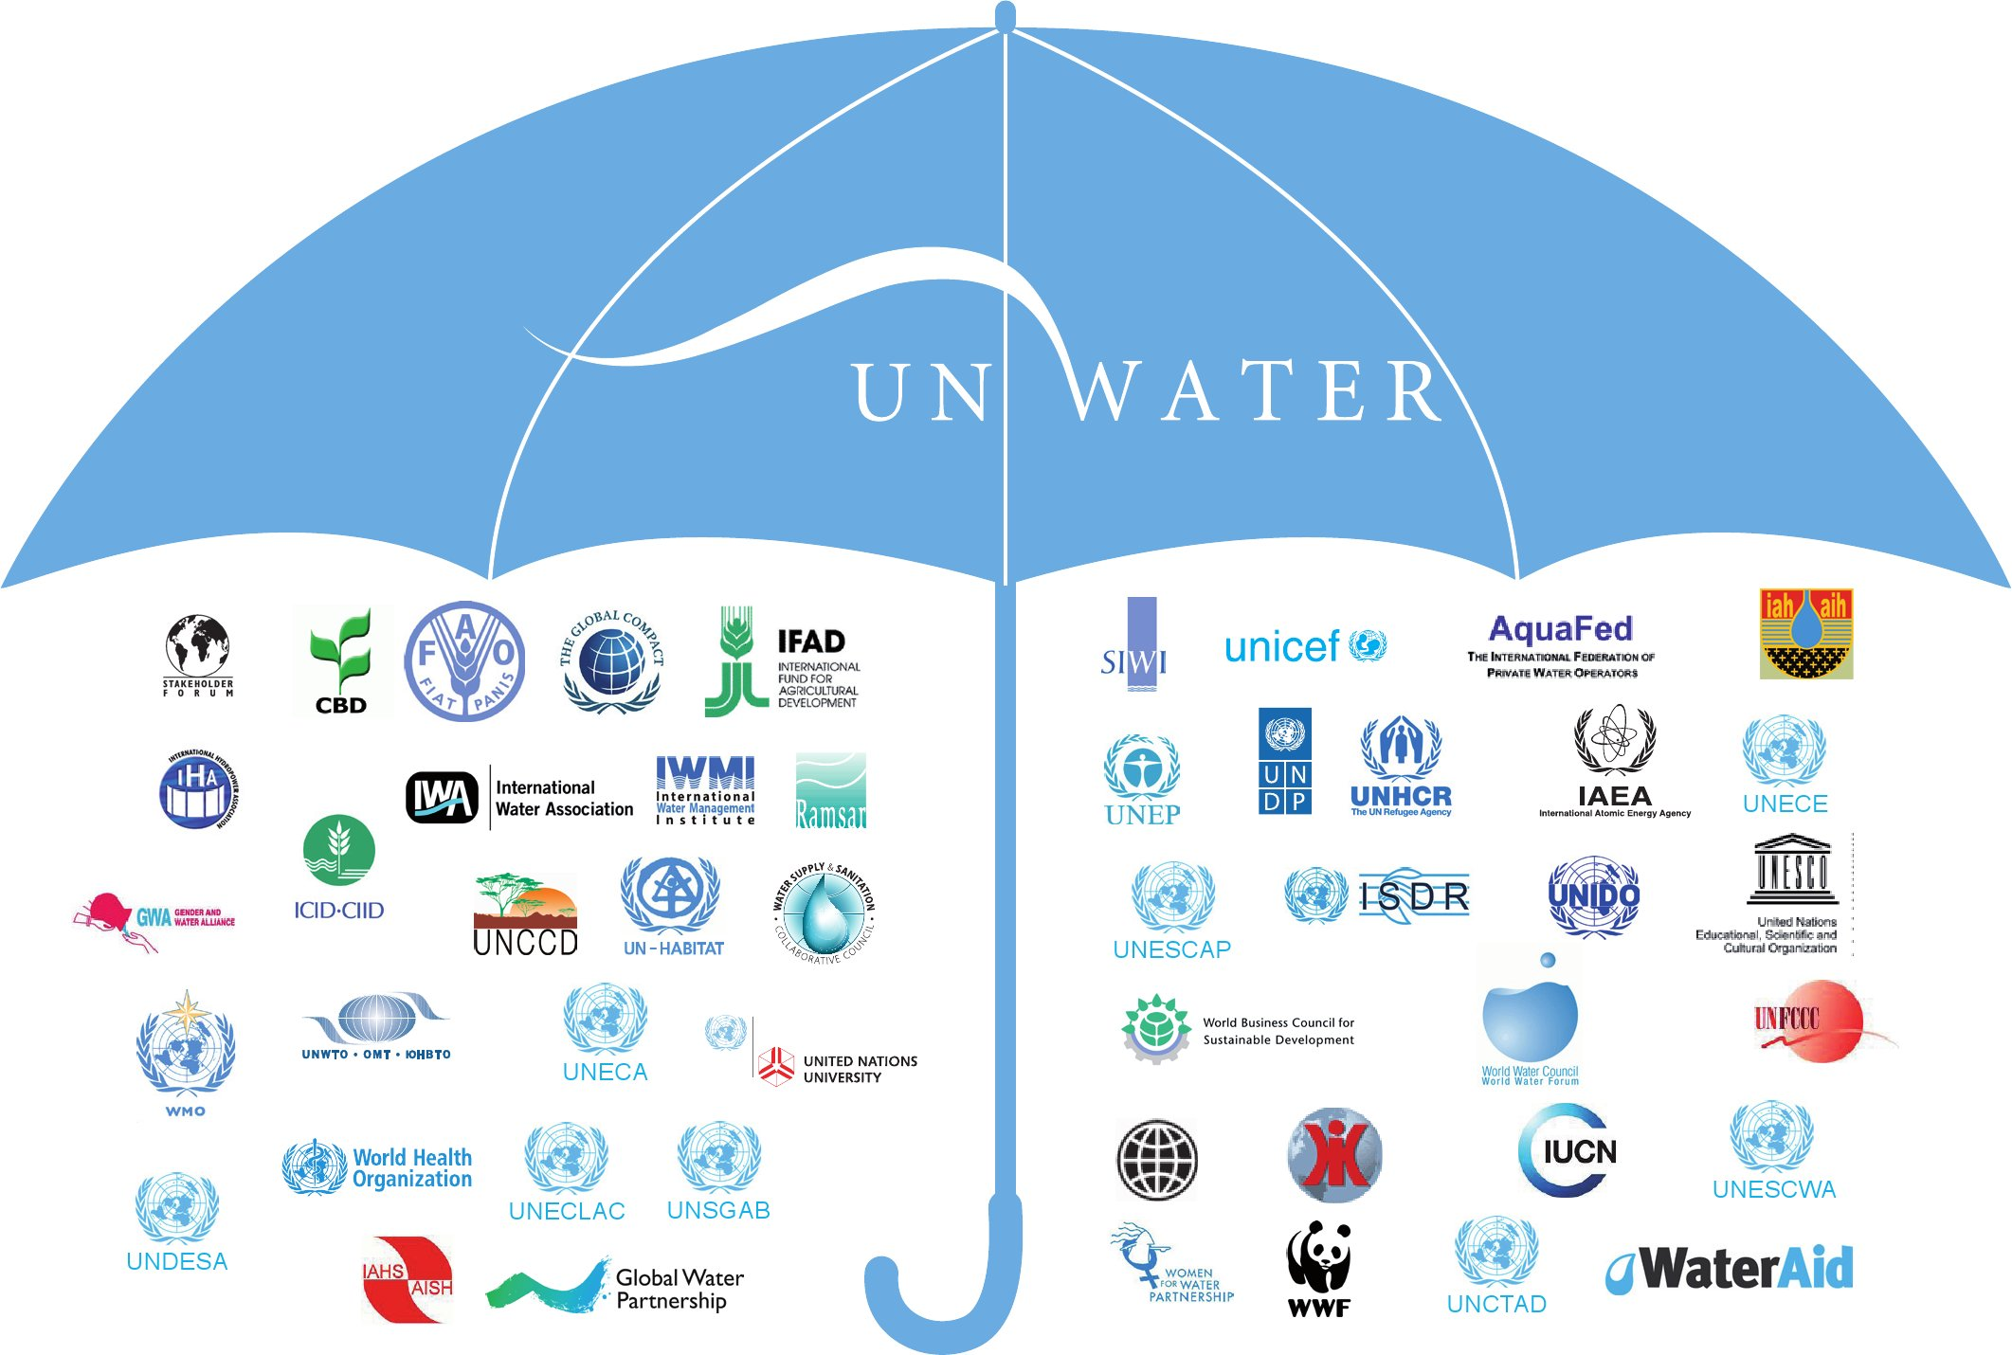
WWAP
UNW-DPC
UNW-DPAC
UN-Water Members
UN-Water Partners

Slide 4
UNW-DPC work plan
Improve synergy, and strategic and operational coherence of UN-Water
Strengthen technical and policy guidance of UN-Water and contribute to the “professionalization” of water governance and management
Cooperate with other UN-Water programmes
Support UN-Water and its member in general, in particular its Task Forces, Thematic Priority Areas (TPAs) and other coordinated activities of UN-Water members

Slide 5
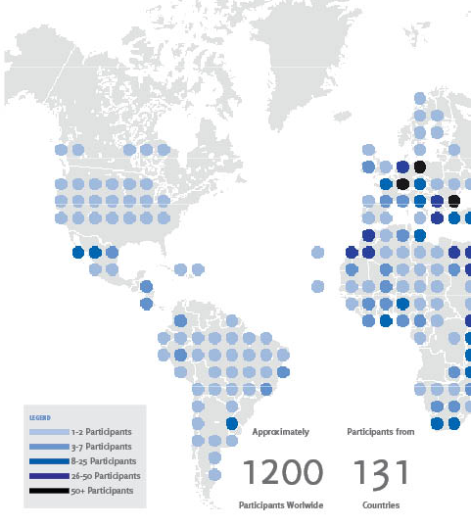
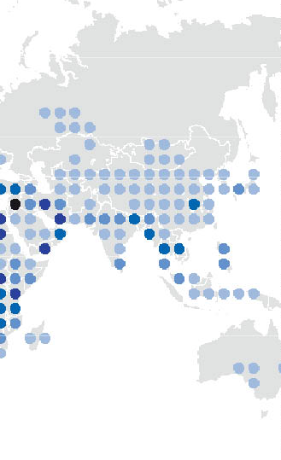
UNW-DPC Capacity Development Effort

Slide 6
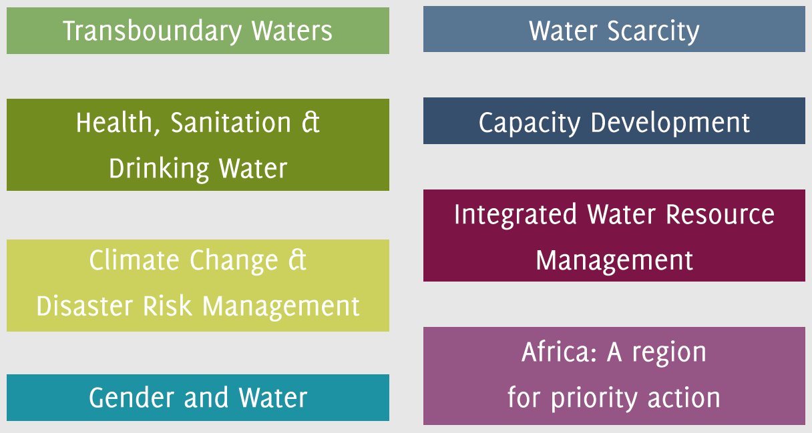
UNW-DPC Areas of Activity
all areas of priority to UN-Water:

Slide 7
Example: UNW-DPC support sequence on Drinking Water Loss Reduction
1. International workshop
Raise awareness
Determine level of stakeholder interest
Identify stakeholders’ experience, assess key issues and action-oriented tasks
Publish report as baseline for regional meetings

Slide 8
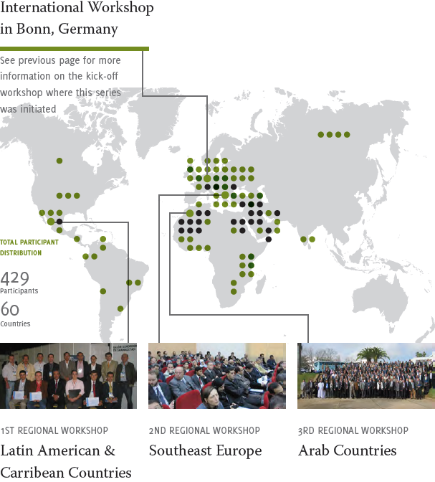
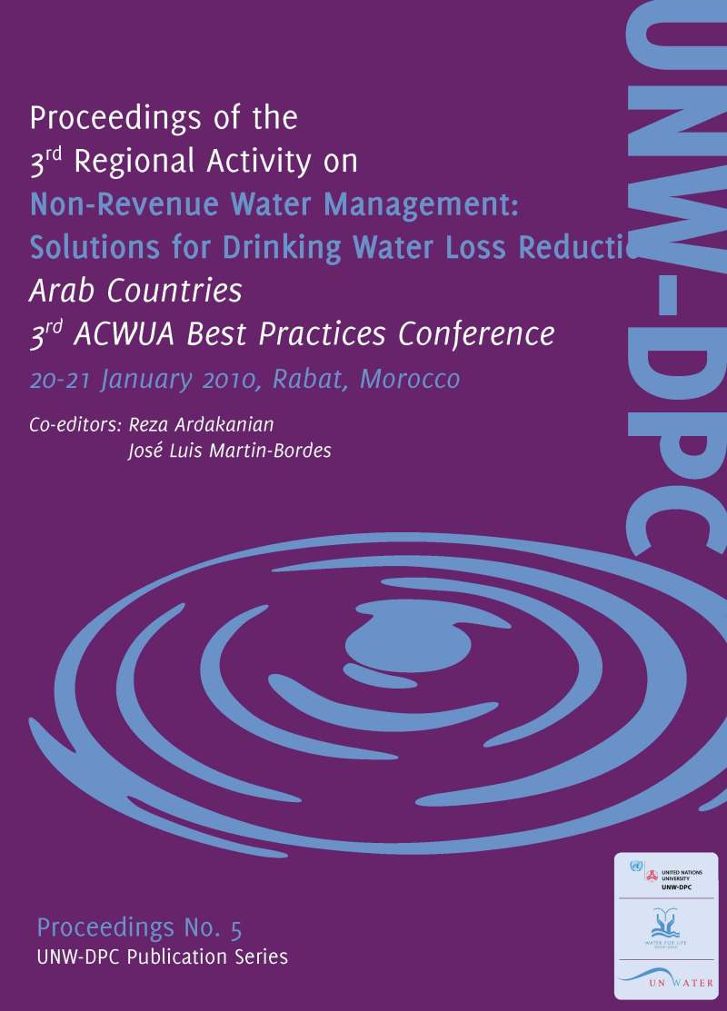
2. Series of Regional Drinking Water Loss Reduction Workshops (with UN-Habitat, local partners)

Slide 9
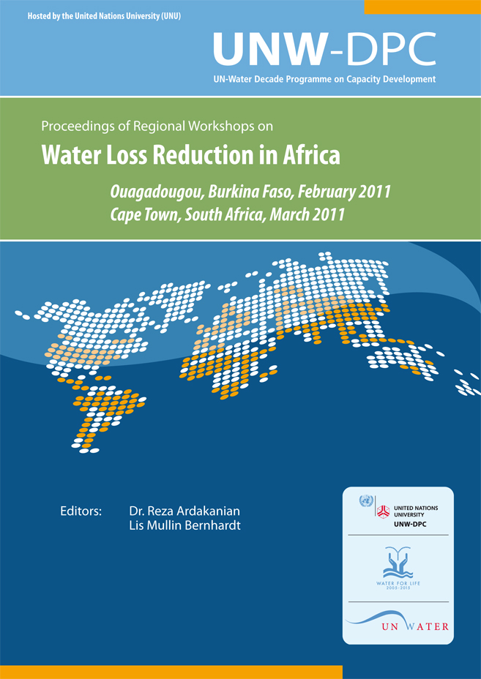
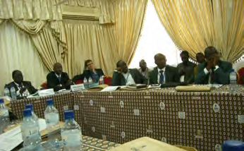
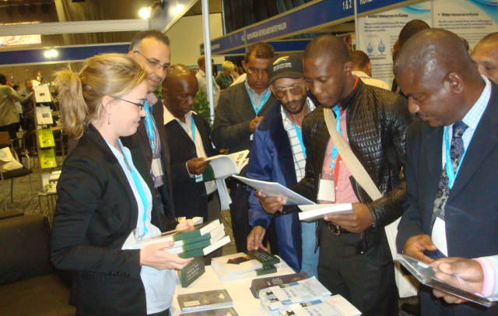
3. Further awareness raising
Workshop in Burkina Faso
Seminar
South Africa
Seminar on "Capacity Building for Non Revenue Water Loss Reduction: an Africa Perspective"

Slide 10
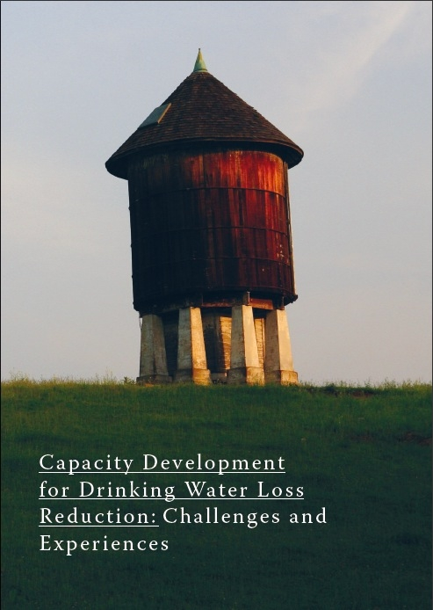
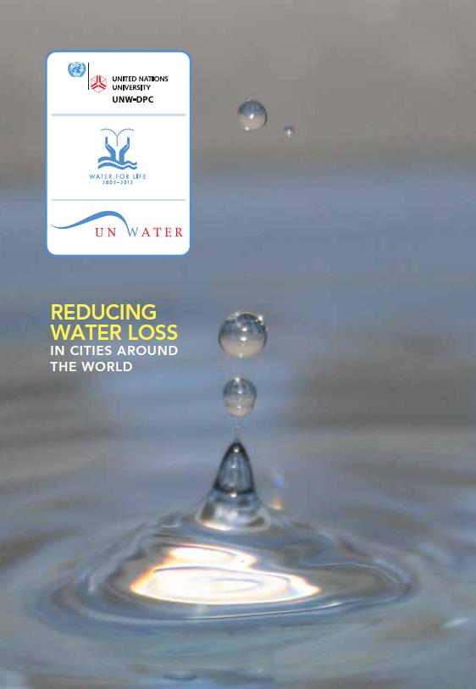
Book and Video launch
Launched at the World Water Day 2011 in Cape Town

Slide 11
UNWAIS+
Discover, learn, and share!
Launched by
Dr. Zafar Adeel
Chair of UN-Water,
Director of UNU-INWEH
November 14, 2011

Slide 12
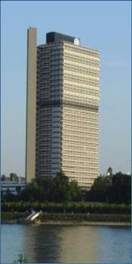
Thank you!
UN-Water Decade Programme on Capacity Development (UNW-DPC)
UNITED NATIONS UNIVERSITY
UN Campus
Hermann-Ehlers-Str. 10
D-53113 Bonn, Germany
Phone: + 49 (0) 228 815-0652
Fax: + 49 (0) 228 815-0655
E-Mail: info@unwater.unu.edu
www.unwater.unu.edu

