Slide 1
UN-Water Project on
Safe Use of Wastewater in Agriculture
Safe Use of Wastewater
In Agriculture
Africa ∙ Asia ∙ Latin America
Recap of the International Kick-off, 1st and 2nd Regional Workshops; Scope of the 3rd Regional Workshop
1st Regional Workshop for Francophone Africa
18-19 February 2012
Palais de Congr‘es, Room „Fez“
Dr. Jens Liebe, UNW-DPC

Slide 2
“Wastewater” is a resource
Wastewater use can …
…reduce pressure on freshwater resources
…improve food production, nutritional status
…save fertilizers and energy
How can member states be supported in addressing Safe Use of Wastewater in Agriculture?

Slide 3
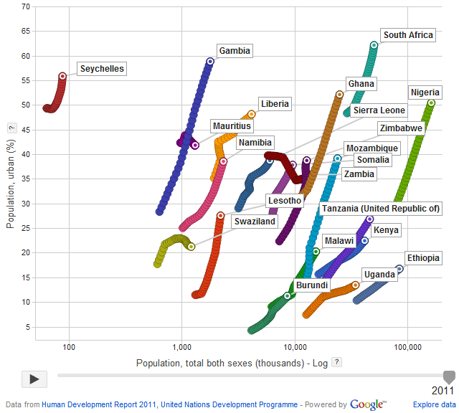
Population growth and urbanization

Slide 4
Goal
Qualified people in key organizations to formulate the right policies and
put into practice the safe use of wastewater in agriculture.
Materials and methods
Dissemination strategy
Capacity building action plan
Systems
Organizations
Individuals

Slide 5
Phases of capacity building at the individual/organization level
Phase I:
Individual Capacity Needs Assessment (CNA)
National Reports
Phase II:
International workshop
November 2011
Gap Assessment
Phase III:
Regional workshops
February to March 2013
Capacity building action plan at the individual/organization level
Phase IV:
Wrap-up workshop
May 2013
Implementation of Recommended Actions
New CNA at the intitution/system level

Slide 6
November 2011, Bonn, Germany

Slide 7
Knowledge & capacity needs: Africa Group
high
medium
low
none

Slide 8
Organized by:
Local Partner:
February 2012, Marrakech, Morocco
Safe Use of Wastewater
in Agriculture
Safe Use of Wastewater
In Agriculture
>> 1st Regional Workshop for Africa
1st Regional Workshop for Francophone Africa
Algeria ∙ Benin ∙ Burkina Faso ∙ Cameroun Central African Republic ∙ Côte d’Ivoire Democratic Republic of Congo ∙ Egypt ∙ Gabon
Guinea ∙ Guinea-Bissau ∙ Mauritania ∙ Morocco Niger ∙ Nigeria ∙ Senegal ∙ Togo ∙ Tunisia
18-19 February 2012
Palais de Congr‘es, Room „Fez“

Slide 9
Capacity Needs, 1st Regional Workshop

Slide 10
UN-Water Project on
Safe Use of Wastewater in Agriculture
Safe Use of Wastewater
In Agriculture
2nd Regional Workshop
1st Regional Workshop for Francophone Africa
Bangladesh ∙ India ∙ Iran ∙ Iraq
Jordan ∙ Myanmar ∙ Nepal ∙ Pakistan Sri Lanka ∙ Syria ∙ Turkey
18-19 February 2012
Palais de Congr‘es, Room „Fez“
May 16-18, 2012, New Delhi, India

Slide 11
Capacity needs West, Central and South Asia

Slide 12
UN-Water Project on
Safe Use of Wastewater in Agriculture
Safe Use of Wastewater
In Agriculture
3rd Regional Workshop
1st Regional Workshop for Francophone Africa
Burundi ∙ Ethiopia ∙ Gambia ∙ Ghana ∙ Kenya ∙ Lesotho ∙ Liberia ∙ Malawi ∙ Mauritius ∙ Mozambique ∙ Namibia ∙ Nigeria ∙ Seychelles ∙ Sierra Leone ∙ Somalia ∙ South Africa ∙ Swaziland ∙ Tanzania ∙ Uganda ∙ Zambia ∙ Zimbabwe
18-19 February 2012
Palais de Congr‘es, Room „Fez“

Slide 13
Survey results: Your capacity needs
Based on 33 of 41 participants

Slide 14
Background of the participants of this workshop
Organizational background
Your daily activities
Notes:
Mostly delegates from governments;
With daily activities in management & strategy and research & development;
→ Maybe it would be nice to refer back to this slide at the end of the workshop: in the needs they describe that they need to engage stakeholders in all of these categories and activities (also public, NGO’s, policy makers, industrialists, farmers, operators and technicians on the local level). Those people are not here and are not the ones that they normaly engage with → outreach strategies required!

Slide 15
Background of the participants of this workshop
Your disciplines
Notes:
Mostly from Water resources management, wastewater treatment/management and irrigation. Although there is a lot of diversity from this perspective. This is good! See on the next slide how much knowledge you bring together!!

Slide 16
The situation in your countries
“LEARNING CURVE”:
1. Awareness
2. Understanding
3. Commitment
4. Action
5. Reflection
1. 2. 3. 4. 5.
Notes:
This is very interesting!
As I expected we see a clear learning curve here.
We see that most people agree on that there are great challenges; they are AWARE of challenges related top Safe Use of Wastewater in Agriculture.
A little bit smaller percentage of the respondents indicates that they have knowledge about approaches and strategies; they have UNDERSTANDING on what the causes of the challenges are and how they could be solved.
Still a smaller percentage indicates that their country is actually COMMITTED to addressing their challenges; most of the times commitment only happens when at least approaches are known and the problems are understood.
Only when committed one takes ACTION, and as we see there are even less countries that actually take action.
Actions can be improved through REFLECTION on earlier actions; this can only happen when there are earlier action and when they are systematically evaluated: only a small percentage indicates that their country does this.
Decide where your country is in the learning curve; which steps to take?

Slide 17
What you want to learn
"How the practice is being implemented in other countries and possible challenges they are facing."
"To be better-equipped to lead and participate in efforts to ensure the safe use of wastewater in Zimbabwean agriculture"
"I intend to learn from others on the use of low-cost methods available to treat wastewaters for agriculture"
"Best practices elsewhere"
"Safe handling of Wastewater and application in farm land"
"The composition of Wastewater and state of application for particular plants"
"Results on monitoring and evaluation of use of treated water"
"Price of treated water sold to farmers and capacity to pay"
Notes:
The more orange, fat and big, the more people have indicated this.
The blue texts are quotes from single people.
→ Note how everybody has their own questions and things they want to share. Probably these learning and sharing wishes connect at some point; let’s do our best to find the right people to exchange our knowledge with!

Slide 18
What you want to share
"Status of wastewater irrigation in […], challenges in wastewater irrigation, findings from on-going studies"
"Policy acceptance and implementation"
"the problems we faced by using untreated water for agriculture"
"my experiences on the needs of irrigators, their fears as well as their expectations from water supply authorities"
"Management and governance of Wastewater use in farms"
"Policy formulation and implementation"
Notes:
The more orange, fat and big, the more people have indicated this.
The blue texts are quotes from single people.
→ Note how everybody has their own questions and things they want to share. Probably these learning and sharing wishes connect at some point; let’s do our best to find the right people to exchange our knowledge with!

Slide 19
What you want to take home
"Knowledge and network"
"Experiences from other countries on safe use of wastewater"
"Reading Material on success stories of Wastewater use"
"Develop communication with experts/participants in relation to policies, technologies and R&D projects"
"Steps in developing a national strategy in safe use of Waste Water"
"New interesting technologies to treat waste-water and use it productively"
Notes:
The more orange, fat and big, the more people have indicated this.
The blue texts are quotes from single people.
→ Note how everybody has their own questions and things they want to share. Probably these learning and sharing wishes connect at some point; let’s do our best to find the right people to exchange our knowledge with!

Slide 20
Timeline
International Kick-off Workshop | November 2011
Regional Workshops
Francophone & Northern Africa | February 2012
West & Central Asia | May 2012
East & Southern Africa | September 2012
Latin America | December 2012
East Asia | March 2013
International Wrap-up workshop | May 2013
Additional events:
16th AfWA International Congress & Exhibition, Marrakech, Morocco
Seminar at IFAT 2012, Munich, Germany
Side event at the World Water Week 2012, Stockholm, Sweden

Slide 21
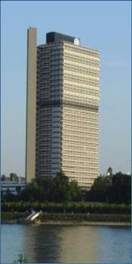
Thank you!
UN-Water Decade Programme on Capacity Development (UNW-DPC)
UNITED NATIONS UNIVERSITY
UN Campus
Hermann-Ehlers-Str. 10
D-53113 Bonn, Germany
Phone: + 49 (0) 228 815-0652
Fax: + 49 (0) 228 815-0655
E-Mail: info@unwater.unu.edu
www.unwater.unu.edu

