Slide 1
National Strategies for the use of poor quality Water Resources in agriculture By AVINASH CHAND TYAGI Secretary General, International Commission on Irrigation and Drainage
2nd Regional Workshop on
Safe Use of Wastewater in Agriculture
May 16-18, 2012, NASC Complex, New Delhi

Slide 2
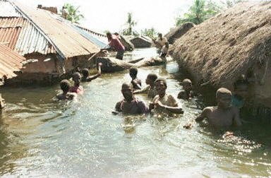
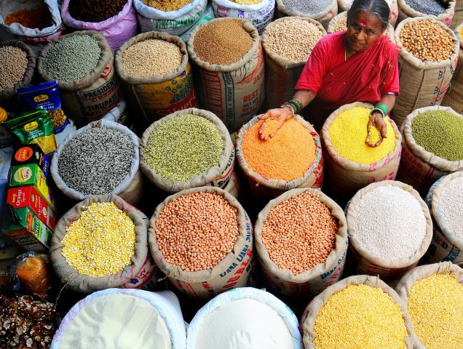
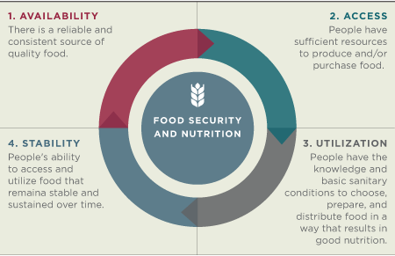
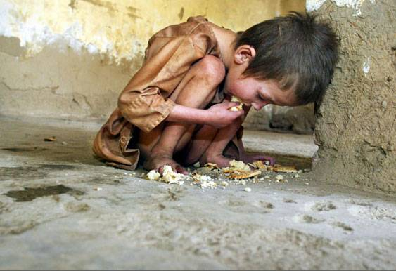
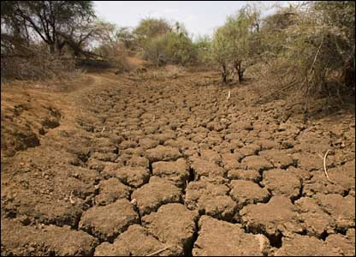
Food Security
Floods: 2006
Courtesy: Middle-East Online

Slide 3
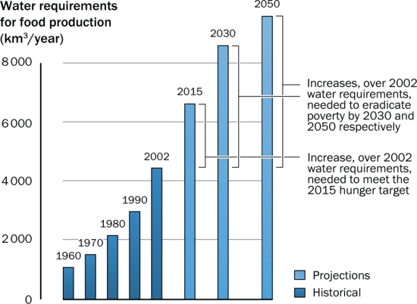
Water and food production

Slide 4
Global warming is here to stay……

Slide 5
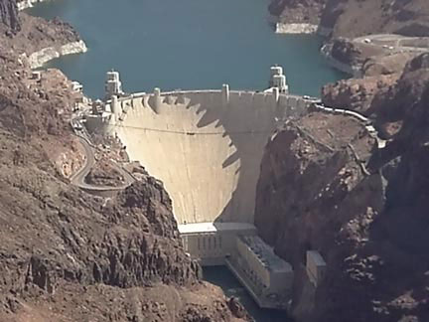
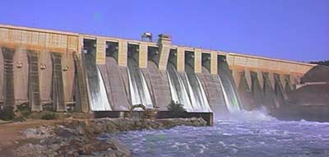
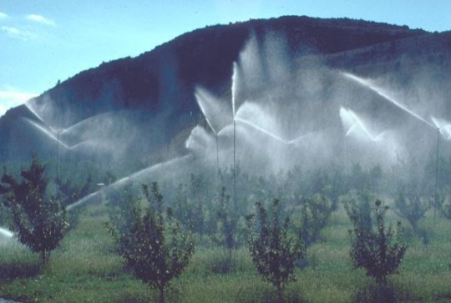
Water Security sustainable strategies for resilient agriculture
Planning new infrastructure;
Improving maintenance, major rehabilitation and re-engineering of existing systems;
Modifying processes in existing systems and demands of water users;
Introducing new efficient technologies.
Recycle and reuse of water,
Notes:
(for example in reservoirs, irrigation systems, capacity expansions, levees, water supply systems, wastewater treatment plants, ecosystem restoration
Adjusting monitoring, operation and regulation practices of existing systems to accommodate new uses or conditions (for example, pollution, climate change, population growth etc. using pricing, regulation, legislation, early warning and seasonal predictions).
Improving maintenance, major rehabilitation and re-engineering of existing systems (through vulnerability assessment and life-cycle management of aging infrastructure through increased inspections, oversight and regulation of infrastructure during operation and maintenance);
Modifying processes in existing systems and demands of water users (for example through rainwater harvesting, basin planning, ecosystem services, stakeholder participation, water conservation and consumer education and awareness); and
Introducing new efficient technologies (for example desalination, biotechnology, drip irrigation, wastewater reuse, recycling etc.).

Slide 6
Poor quality water: and its use in agriculture
Saline water
Drainage water
Wastewater
Domestic
Industrial
Biological
Possible –ve impacts
Health implications
Soil degradation
Salinization
Water pollution
Potential +ve impacts
Nutrient source
Releases freshwater for drinking water
Ecological services
ECONOMIC DEVELOPMEN

Slide 7
Why a strategy
Sustainability of Development
Governance is more complex
Democratic
Informed society
Public policy
Multi-disciplinary
Water engineers, hydrologist
Soil scientists
Water chemists
Agriculturists
Social scientists
Legal experts

Slide 8
Elements of a National Strategy
Situational Analysis
Define the Goal, Objectives and Target
Identifying actions

Slide 9
Situational analysis
Water availability situation: plenty or scarce?
How is wastewater collected?
Availability of waste water: quantity and quality
Wastewater treatment facility
Market opportunities
Economic situation
Legal framework
Environmental sensitivities

Slide 10
Setting goals
Wastewater as a resource: How much? And where?
What quality of wastewater should be used: Fully or partially treated
Typology of wastewater use: Types of crops to be raised, mixing with fresh water
What kind of health risks can be taken?
What type of uses wastewater can be put to?
Other related policies: health, agriculture, water management, sanitation and sewage, and environmental protection

Slide 11
Identifying actions
Division of responsibilities: various disciplines- national, regional and local level
Allocation of resources (funds)
Establishing collaborative mechanism between ministries and agencies
Setting standards and guidelines
Capacity development needs
Putting in place a legal and a regulatory framework
Awareness raising programme

Slide 12
Pre-requisites
Perception of farmers
Wastewater monitoring and
Assessment of present and future wastewater treated and untreated
Institutional cooperation
Legal framework: codes of practice
Enforcement mechanism
Informed decision making: based on scientific assessment

Slide 13
Capacity Development
What capacity development is required?

Slide 14
So the questions for you to ponder and discuss are…..
Which experience do we have?
Which success stories do we know?
How could we help each other?

Slide 15
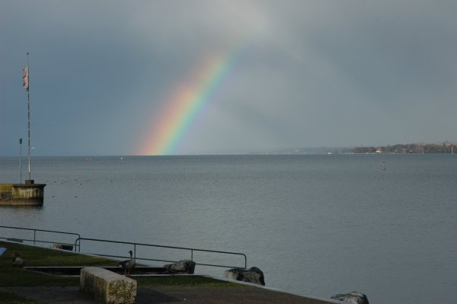
Thanks for your attention…..

